Slide 1
Failing Forward: A reflection on the PSET CLOUD systems and design thinking in South Africa
Panelists: Dr. Rooksana Rajab, Dr. More Manda, Ms. Barbara Dale-Jones, and Mr. Tumelo Ngwako Moderator: Ms. Carla Pereira
Groningen Declaration Network - 11th annual meeting - 12-14 October 2022, Forum, Groningen, NL

Slide 2
Deep inequality, extreme unemployment of youth in South Africa
There is a big disconnect between South Africa’s post-school worlds of learning and work (supply and demand mismatch).
Fluidity in skills recognition creates an opportunity through an evolving credentialing ecosystem characterised by the coexistence of formal, micro, and digital credentials
But siloed approach is still very prevalent, esp. when it comes to data and technology.
Education disruptions - aligned to existing qualifications and standards - being sought after to close the gap
Interoperability allows interrelated, well-synchronised, data sets to be effectively used for decision making
Without deep meaningful engagements and addressing unmet needs, success in innovation is almost impossible.
INTEROPERABILITY, LIFE-LONG LEARNING & LEARNER CENTRICITY

Slide 3
“Once we start working together as equal partners, we start creating a solid skills-based economy”

Slide 4
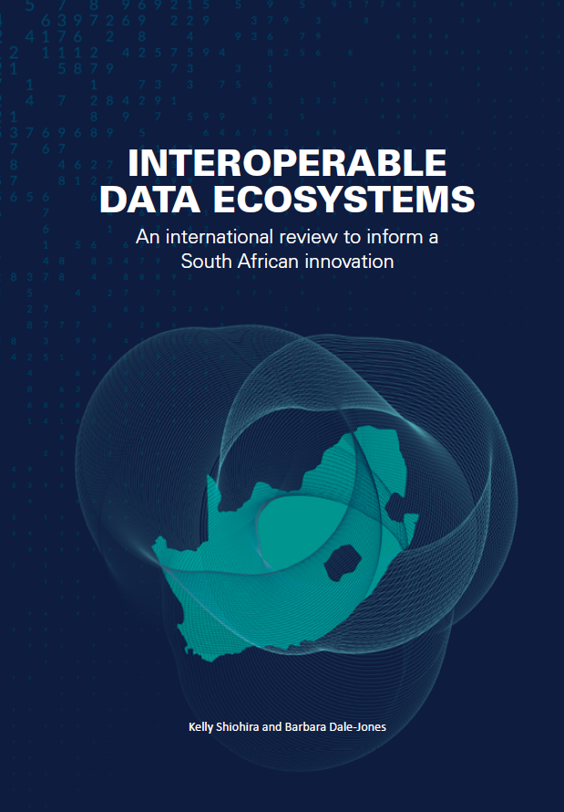
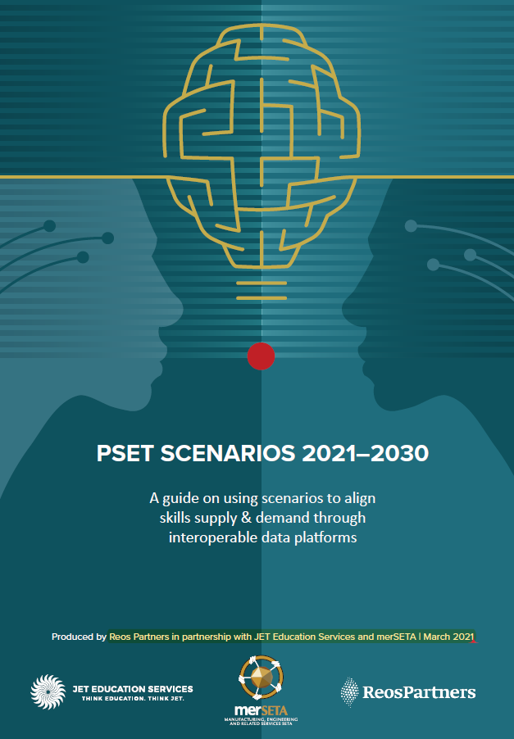
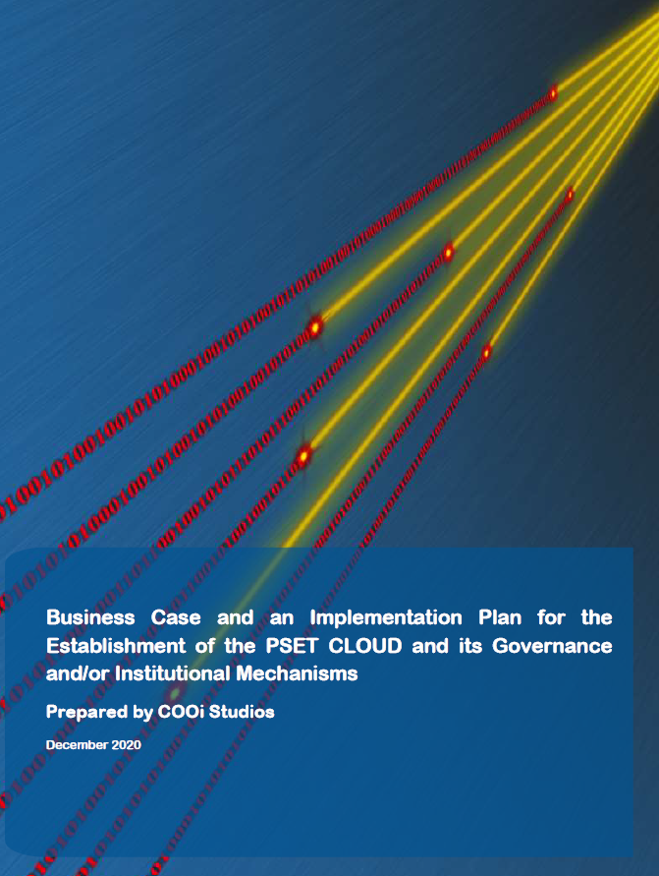
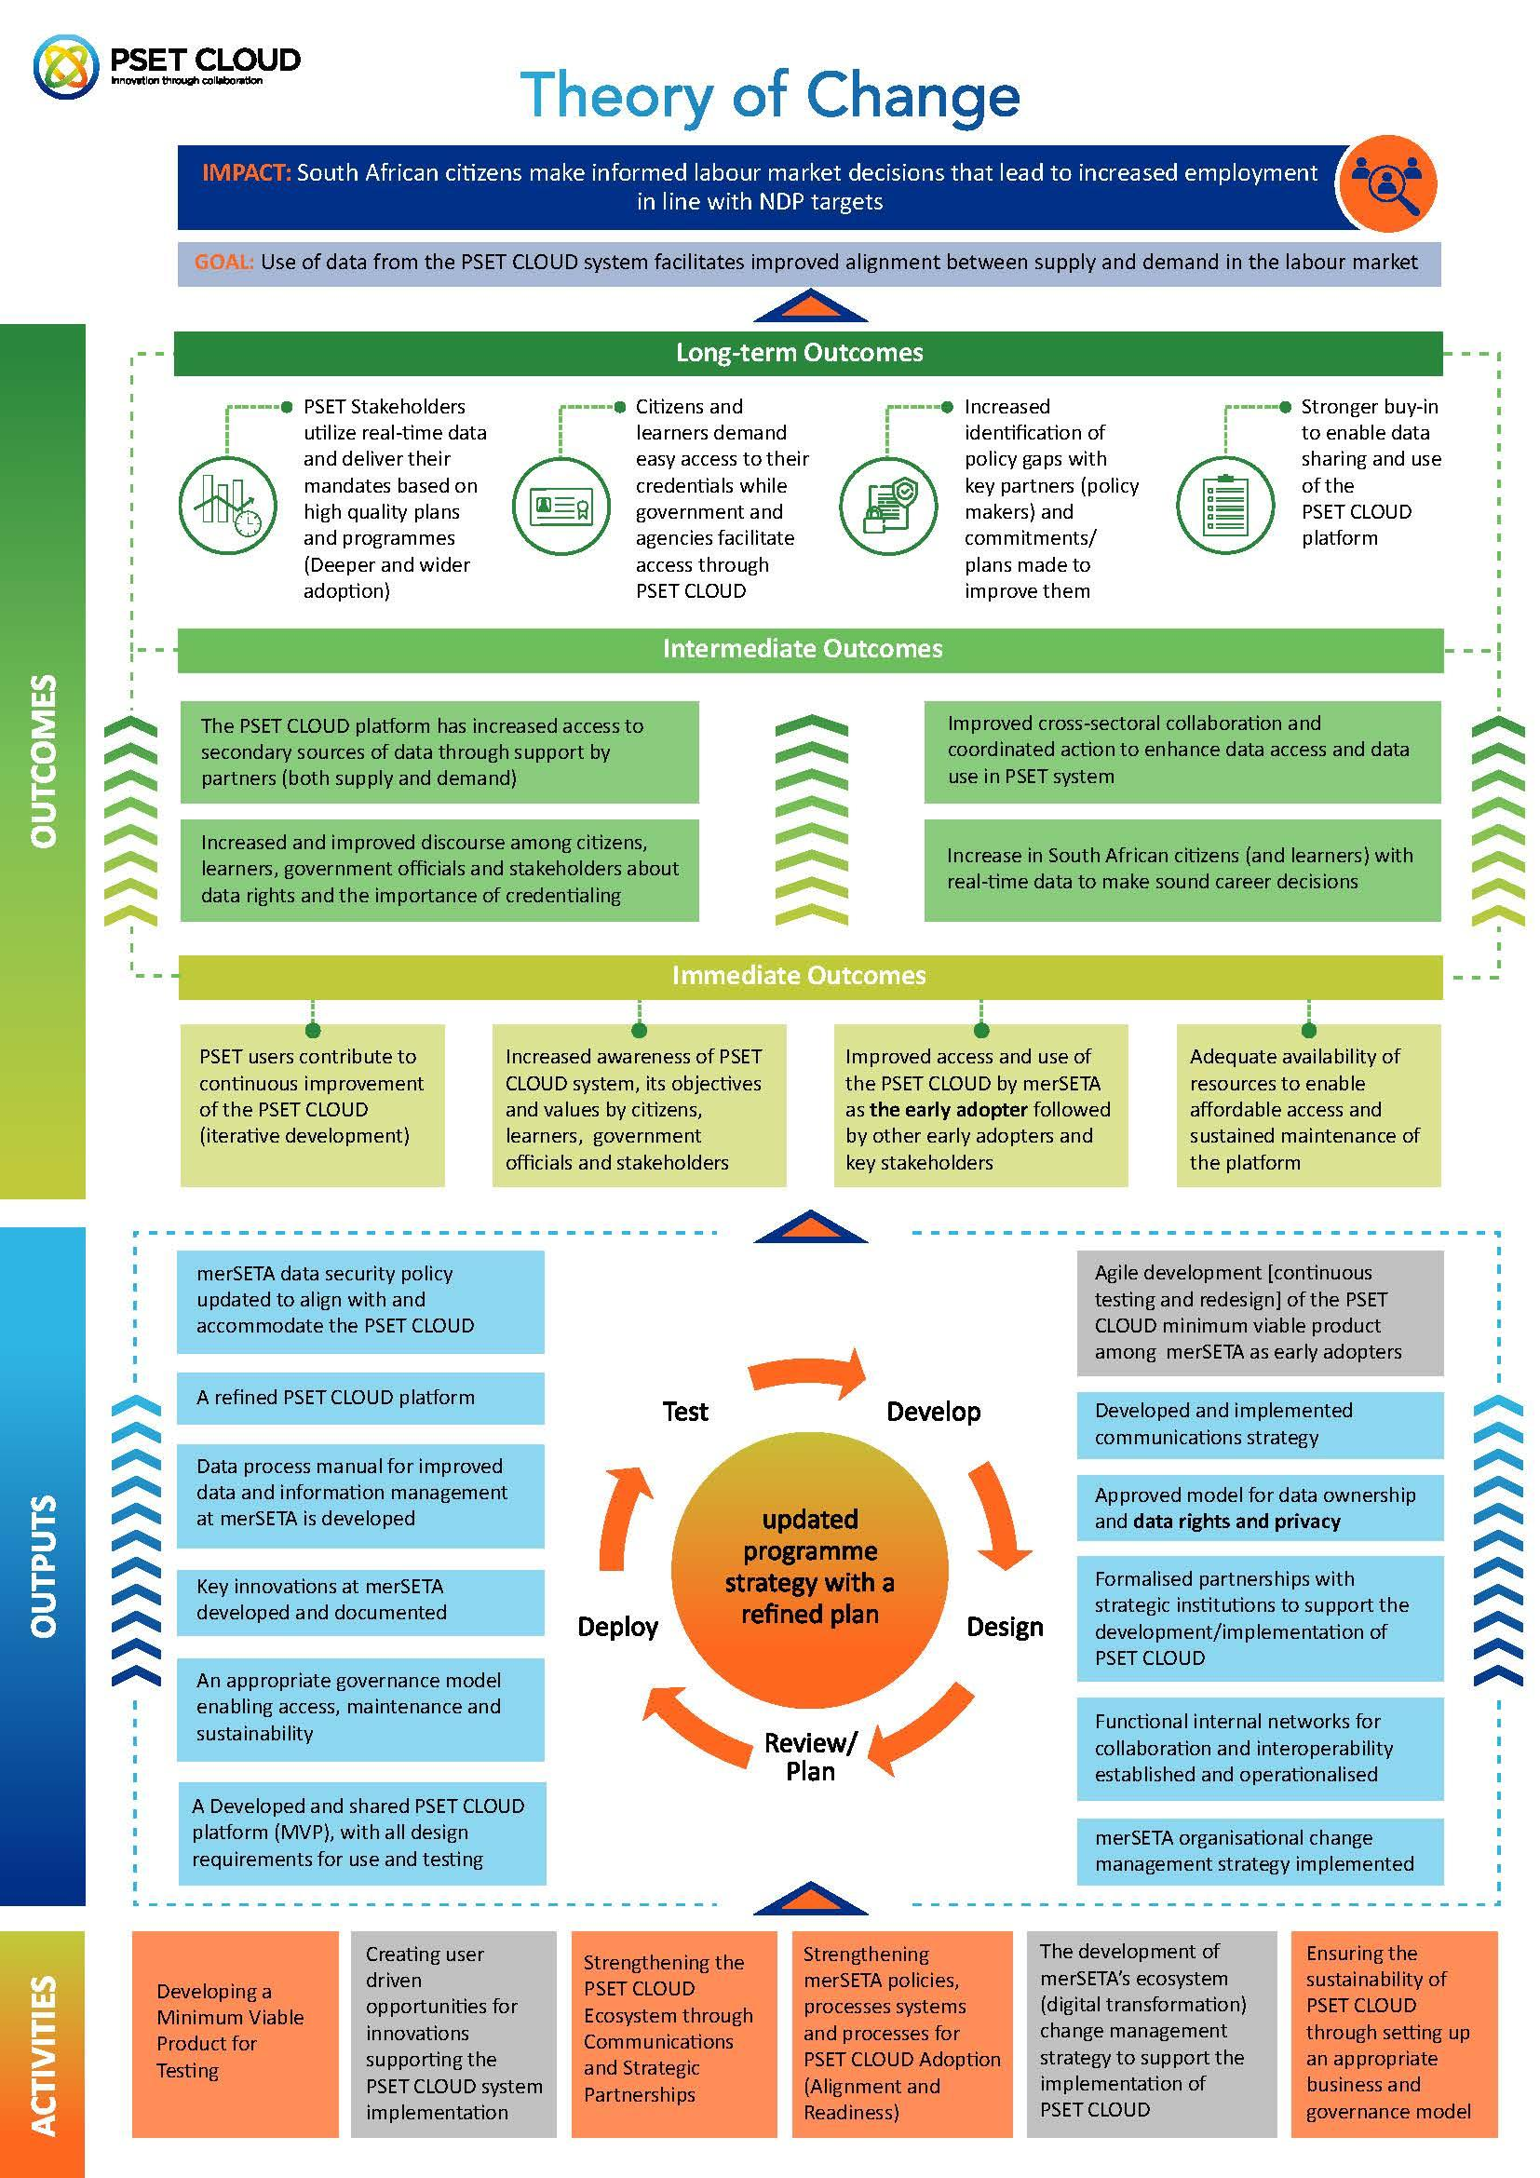
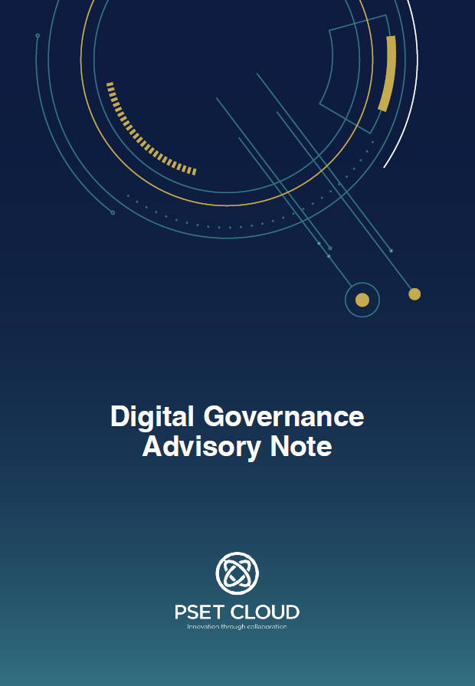
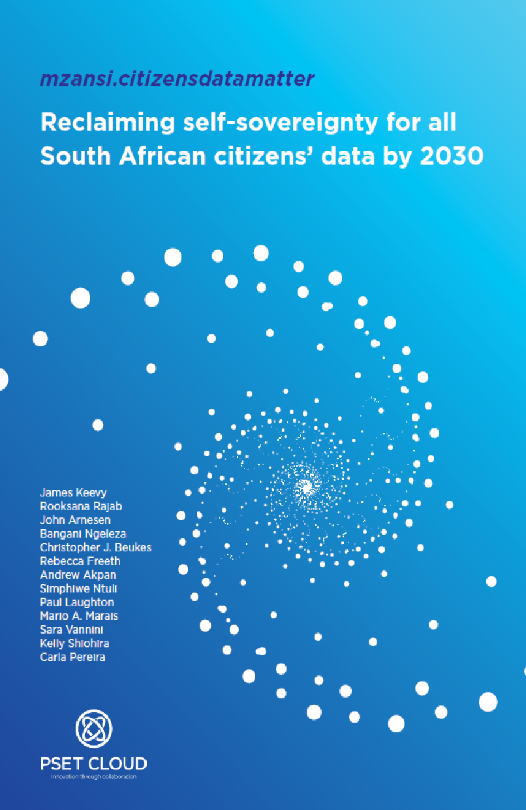
South African citizens have access to data and information to make informed learning and career decisions that lead to increased employment

Slide 6
“When looking to innovate—fail forward. Innovation can be a chaotic process, embrace it and learn from your failures.“
Luke Wester @ Miva

