Slide 1
Country update – United Kingdom Michael Hilton, Hedd October 2022
Notes:
Good morning. My name is Michael Hilton, senior relationship manager at Hedd. It is a pleasure to be able to provide this country update from the UK. My colleagues Guy Chester and Carlos Howarth are in the audience and we are happy to take your questions at the end of this session and throughout GDN. We were totting up the number of times Hedd has been represented at GDN – we think it’s the fifth or sixth – and I am delighted to be following in the footsteps first put down by my colleague Jayne Rowley almost a decade ago.
GDN is very important to us. We prize our relationships with BQA, CSCSE, DUO, HEC and SAQA, all of which have been made possible by the wonderful opportunities GDN provides for forging enduring international connections.
We are going to talk about the situation in the UK around degree verification and qualification fraud, beginning with Hedd and its associated qualification fraud reporting service, including some new trends in fraud, before looking at some of the developments that have taken place in the education and legal environments.

Slide 2
Notes:
Hedd, UK higher education’s official degree verification service, celebrated its tenth anniversary last year. Hedd has come a long way since the first degree verification was processed in October 2011.

Slide 3
Hedd is 11 years old
Notes:
Hedd is now 11 years old

Slide 4
Hedd is 11 years old
1 million verifications
Notes:
In September of this year, the millionth verification was made through the system. We expect to reach the 2 million mark within the next three years, which speaks to just how fast Hedd is growing. Fifty-eight universities are now exclusive Hedd partners, meaning that all of their degree verifications are conducted through Hedd, and we provide a service to another 70 plus Universities. Hedd covers over 90% of UK graduates.
But degree verification is still a minority activity for UK employers. Although most employers of graduates will ask for evidence of qualifications, for example to see a copy of degree certificate, only between 25-30% of them actually check the authenticity of the data with the awarding body.

Slide 5
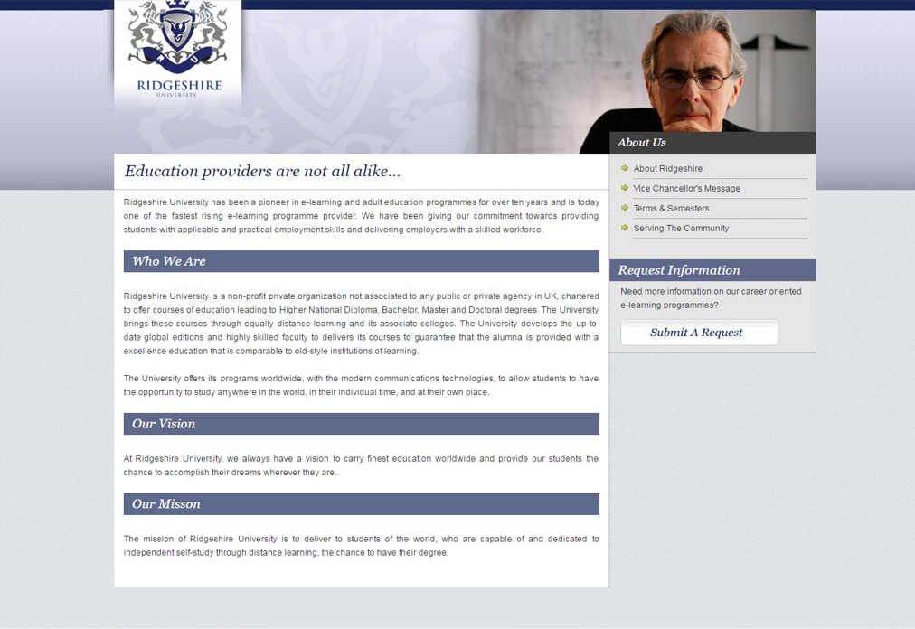
Notes:
This creates an opportunity gap for vendors of fake university experiences and documents. Qualification fraud is an international problem and the UK has been a high-profile target for the fraudsters for many years. Hedd started out as an efficiency service but quickly became a center for reporting degree fraud. This work was formalised in 2015 when we launched a reporting service on behalf of the Department for Education and latterly the Office for Students. It is now free-standing.

Slide 6
85 bogus universities shut down
Notes:
Since 2015, the services has helped shut down 85 bogus institutions

Slide 7
85 bogus universities shut down
300+ investigated
Notes:
and added more than 300 to the Hedd database, where they are flagged as ‘not awarding recognised UK degrees’ which is a polite way of saying ‘bogus’. These include universities that use the name of a real institution but invert the order, such as Manchester University or Surrey University as well as made-up institutions such as Marylebone University or Chelsea University. We have investigated made-up universities based in real English counties such as Rutland University as well as those based in made-up counties such as Ridgeshire University. A few years ago a very topical institution emerged – Brexit University!
One of the challenges we face is the fact that most of the operators of these sham entities claiming UK credentials are based outside of UK jurisdiction and it is sometimes difficult to take action against them.
We have seen many more fake certificates recently. In 2021 as part of our reporting service we received more than 200 certificates, double the previous year.
Examples of dubious certificates that we have received in the last month – doctorates, higher diplomas, professional certificates – include the Oxford Training Academy, the International Professionals Academy, the British Institute of Economics and Political Science – note the deliberate LSE associations. Fake certificates don’t exist on their own terms – they may be bolstered by an accreditation from a non-existent accreditation body or come with a built-in verification loop.
There is a problem with a lack of clarity in the regulation of qualifications outside of the higher education sector. For example, the regulations surrounding degree-awarding powers are very rigorous. Even the use of the word ‘university’ is highly constrained.
But there is much less clarity with diplomas, for example. We are observing a marked uptick in the number of fake or value-less diploma certificates. Despite the efforts of Hedd and many other organisations in higher education and industry, degree fraud has not been eradicated but there is more noise around it and the fraudsters know that they are more likely to be exposed. That’s why fraud outside of degrees is becoming more common.

Slide 8
Accreditation ambiguity
Notes:
Whilst diplomas may be awarded by higher education institutions and professional associations or chartered bodies, they can also be issued by non-regulated providers. This makes it very difficult for students to assess the relative value of the training or course they are undertaking.

Slide 9
Accreditation ambiguity
Notes:
Here's an example of an organisation that provides training leading to the award of a diploma. It claims to be a postgraduate-level institution, which is a clever way of side-stepping the requirement to be an accredited institution of higher education.

Slide 10
Accreditation ambiguity
Notes:
It also claims that it is verified by and registered with the UK’s Department for Education. What is being referred to here is a UK provider reference number, which means that the organisation in question is registered with the UK Register of Learning Providers. This is not a quality assurance or accreditation status and once the UKPRN has been allocated, the training provider is not subject to any ongoing scrutiny.

Slide 11
Accreditation ambiguity
Notes:
This particular company awards diplomas across an extraordinary range of subjects. Fees are expensive too. For example, students can pay as much as £45,000 for, and I quote, ‘a three-month Executive Management Programme, Leading to Postgraduate Diploma in Executive Management’.
This company is not breaking any laws. There is nothing to stop any one of us in this room from setting up an education and training company, securing a UKPRN and entering the diploma market. But it is trading on misleading associations.
The most important point is that it is very difficult for students to assess the relative quality of different providers.
How can they be sure that the £45,000 they will pay for a three-month programme with this provider is better value and leads to better outcomes than the £7,000+ they would typically pay to do a PG diploma in Business at a UK university? (Obviously it isn’t.)
There is definitely a lot of work to be done in bringing greater consistency and clarity to the provision of diplomas and other non-degree qualifications and it’s still early days.

Slide 12
Notes:
I want to say a few words about the work the higher education sector and government have been doing around education fraud. One of the most significant recent developments in the war on fraud has been the Quality Assurance Agency’s Academic Integrity Charter, which was set up to combat all kinds of academic cheating including not only qualification fraud but fraud at application (e.g. forging personal statements), illegitimate funding applications and plagiarism and coursework cheating. Hedd’s own degree fraud charter has been folded into it.

Slide 13
Notes:
An important associated development was the passing of a law in April 2022 in England that outlawed essay mills. It is now a criminal offence to provide or arrange for another person to provide contract cheating services for financial gain to students in colleges and universities. It is also now an offence to advertise such services. The advert doesn’t even have to be seen by the target demographic for it to be breaking the law.
Similarly, it is now an offence for a person to make arrangements for an advertisement in which that person offers, or is described as being available or competent, to provide or arrange for another person to provide a cheating service. Importantly, the offence centres around the act of advertising to students, and for the offence to be committed it does not need to be seen by its target demographic. This importance of this development cannot be overstated. It represents the first time that the government has taken steps to clamp down on a major area of fraud affecting universities and colleges.

Slide 14
Notes:
On the subject of the government, the Professional Qualifications Act 2022 is a new piece of legislation which introduces new measures to ensure that both British workers and foreign nationals can have their regulated qualifications identified when working in either country. The Act requires UK regulators to publish their own entry and qualification requirements for their respective industries, as well as any other data about entitlement to practise any profession, including related qualifications. In practice, this means that UK and foreign workers have a clearer understanding of what qualification routes they will need to take in order to gain entitlement to practise a profession, although it does not provide any guidance about which qualifications may be recognised and how these may be authenticated in the workplace. Whilst a welcome development, it does not actually preclude the possibility of further qualification fraud occurring.

Slide 15
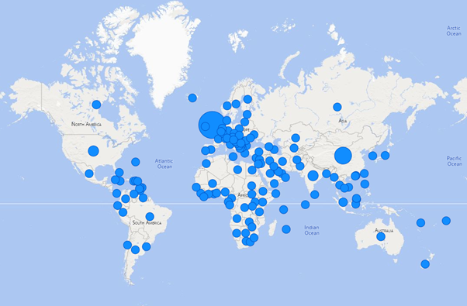
Hedd coverage by country
Notes:
Finally, I want to talk about the international dimension, beginning with UK higher education, which continues to be a destination of choice for international students. In 2020-21, just over 600,000 students in higher education were from outside the UK. Twenty-five per cent of them were from the EU, 75% from outside the EU. Chinese students made up the largest group of international students with 143,820 studying in the UK in 2020-21. India, Nigeria, United States, Hong Kong, Italy, France, Pakistan, Romania and Spain make up the rest of the top ten.
In the year ending December 2021 there were 432,279 sponsored study visas granted. This is the highest annual number of study visas granted on record and represents both a recovery from the lower number of visas granted during the lockdown period but also an increase on pre-lockdown levels.
The number of international students in the UK is, of course, the reason for Hedd’s international profile. More than 40% of verification requests come from outside of the UK.
Our partnership with CSCSE has a profound impact. Hedd has helped CSCSE verify more than 230,000 degrees in the past five years. Embassies and consulates around the world are regular Hedd users and we have verified more than 30,000 degrees via these sources during Hedd’s lifetime. Excluding CSCSE and embassies and consulates, more than a quarter of a million verification requests have come from outside the UK.
In the spirit of GDN, we are slowly establishing system links with our peers. In July 2019 we were delighted to come to an agreement with our colleagues Verifdiploma whereby Hedd users can verify the credentials of French degree-holders. We have also extended Hedd’s service to universities in Ireland.
These are small but significant steps towards the global network of interconnected systems that has been the vision of GDN since its earliest days.

