Slide 1

Australia/New Zealand National Update
Thursday 13th October
GDN Annual Meeting
Groningen
Jay Segeth – My eQuals Program Director

Slide 2

My eQuals was inspired by GDN
Sector trailblazers attend GDN
DSD Working Group (Anthony Manahan, Matt Taylor) undertakes Feasibility Study/EOI, tender process, Business Case
Project Group established (approx. 20 HoSAs, chaired by Neil Robinson (UoM))
DVCC approves Business Case.
Digitary selected
Pilot implementations commence (Auckland, Melbourne, Monash)
My eQuals formally launched at GDN Annual Meeting.
All 47 ANZ universities sign-up
Implementation completes (end ’18) on-time and within budget.
International recognition as the official ANZ credentials platform
Canberra Institute of Technology joins as the first non-university
2.8M documents issued & 800k learners..
Roll-out to TAFEs and Independent HE providers.
Digital Badges launched
Graduate Verification Service project initiated
Collaboration with Aust Govt towards “National Credentials Platform” (NCP).
2015-2016
2017 - 2018
2019
2020-2022
Digital Student Data
Launch and roll-out
Fully Operational
Current

Slide 3






71 Providers
Across Australia & New Zealand
135 Countries
Accepting verified records
100% Trusted
By the Higher Education sector
2.0 Million
Learner accounts created
5 Million
Learner records shared
7 Million
Academic records issued

Slide 4




My eQuals has delivered the Business Case (2016) objectives
Target (Qualitative) | Actual
Reduce academic credential document fraud and maintain credential integrity | Zero reported instances of document fraud. Widely used and accepted for assurance of trust of credentials in ANZ and worldwide.
Enhance student mobility | 5 million records shared in more than 135 countries. 13.6% annual growth in demand for digital documents (vs student growth 2.3% per annum).
Close academic record digitisation gap (with UK, US, Europe, China) | ANZ establish the first whole-of-sector digital platform and serves as best-practice example for Canada (MyCreds), Japan.
Digital and accessible platform. Private, secure and ease of use. | More than 2 million registered learner accounts. 85% user satisfaction rating. Growth in demand for digital records.
Fraud Prevention
Student Mobility
Digitisation Gap
Student Experience
Sector savings exceeding Business Case projections 10-fold

Slide 5
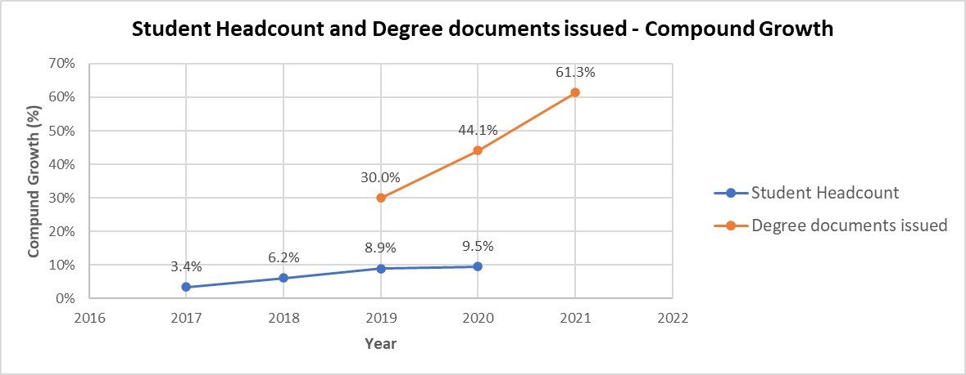
Demand for Digital records is significant

Slide 6
Impacts of COVID
Digital credentials Desirable => Essential
Boost in interest from other Education Providers to join My eQuals
Other university priorities and resource constraints => less engagement with My eQuals roadmap

Slide 7
National Credentials Platform
Commonwealth Government funded initiative, in recognition for the need of a Lifelong learning account for all citizens
HES/My eQuals and UAC to deliver “NCP BETA” (proof of concept)
BETA involves testing desirability, feasibility, and viability of various features and functionality, including:
  Skills profile
  Course progress
  Learner profile curation
Post BETA steps uncertain but should include:
  Building on My eQuals (ensuring sector support)
  Utilising sector-wide capacities (My eQuals, Tertiary Admission Centres)

