Slide 1


The Recognition of Qualifications of Refugees & Asylum Seekers: Implementation of a Collaborative Pilot Initiative
GDN, Groningen 2022
Navin Vasudev, Manager, Business Development & Stakeholders
SAQA

Slide 2
THE FACTS

Slide 3
Africa – Continent on the Move
Labour Migration
Refugee Flows
Internal Displacement
United Nations, 2022

Slide 4

Africa: Refugee Flows
6M refugees & Asylum Seekers
2.4 M refugees hosted in Uganda & Sudan
UNHCR
New conflicts in the Sahel region, Ethiopia & Northern Mozambique

Slide 5
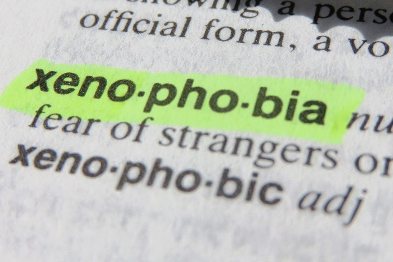

South Africa: Refugee Flows
250,259 Refugees & Asylum Seekers (2022)
Burundi, DRC, Rwanda, South Sudan, Somalia & Zimbabwe
Scarce Skills
One of the major challenges facing South African refugees & asylum seekers

Slide 6
The SAQA EXPERIENCE

Slide 7
Challenges faced by Refugees & Asylum Seekers in the Recognition of Qualifications
Incomplete Documentation
Security challenges in Verification
Misrepresentation

Slide 8
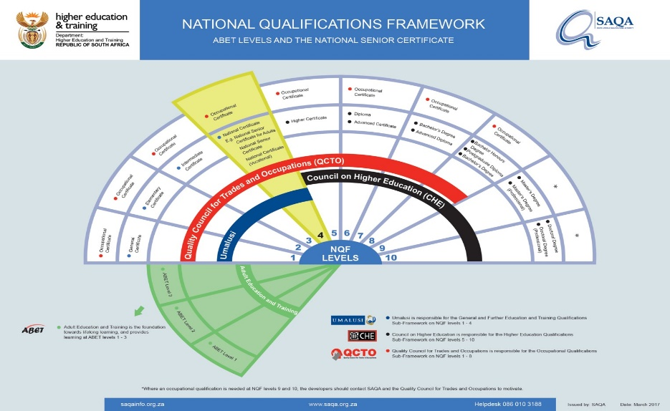

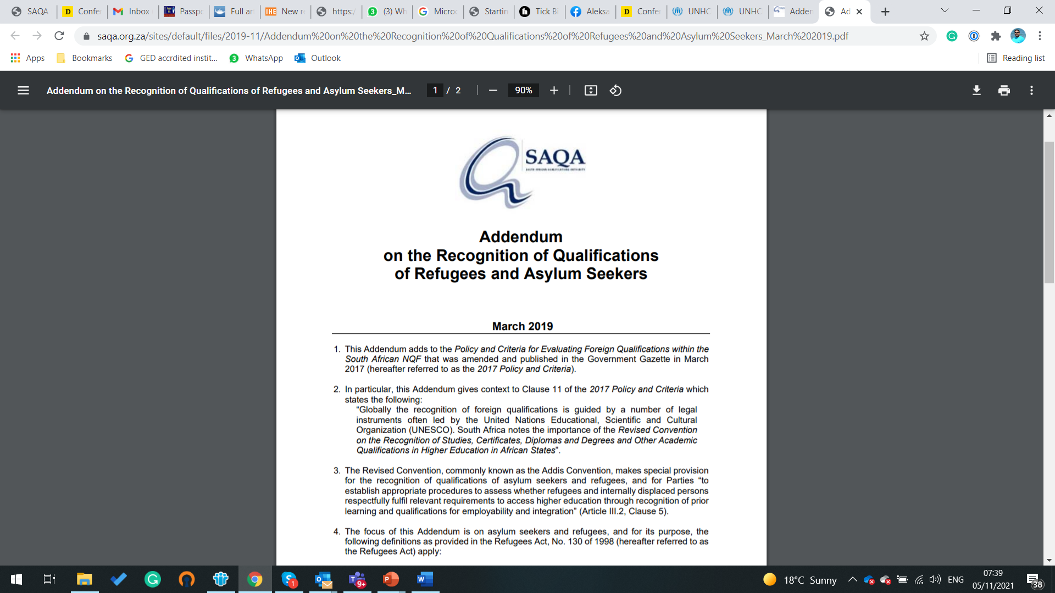
Drivers for Change

Slide 9
The Pilot Project

Slide 10
Why this Pilot?
Provide provisions of the Addis Convention
Create a credible qualifications recognition mechanism for registered refugees and asylum seekers who are unable to submit the required documentation
Create opportunities for access to further education, employment opportunities and sustainable livelihoods in South Africa and beyond, for refugees and other displaced persons.
Provide much needed scarce skills for the South African economy, and beyond
Explore ways for the project to be scaled up into various parts of the African Continent
50 Applicants in 3 Provinces

Slide 11
Criteria for the Selection
Application from refugees & asylum seekers only
Application from citizens from countries from the African continent
Minimum completed school leaving qualification
Unable to meet the standard SAQA document requirements
Has at least one piece of credible/verifiable evidence of academic study.

Slide 12
Process(1st Phase)
Identifying Applicants
Information sharing
Vetting
Face to face Interview
Review & selection
Continuation with SAQA Evaluation

Slide 13
Process(2nd Phase)
Links to the world of work
Links to the world of study

Slide 14
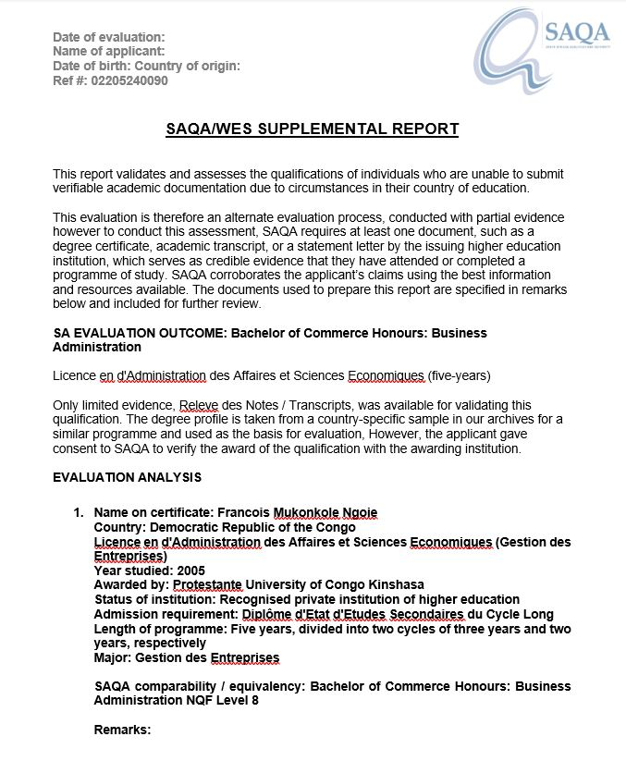
Products
SAQA e Certificate

Slide 15
Key Learning
Long immigration status wait affects asylum seekers
Concerns on risk to safety and fear of being “outed” and their families being punished
Poor access to information on employment and further study
Lack of awareness on refugee and asylum seeker issues amongst professional bodies in particular
Increasing xenophobia within SA
Several asylum seekers & refugees possess skills that have been published by government in SA, for example doctors, nurses, lawyers, teachers, geologists and IT professionals
Multi-country recognition will offer more access and opportunity for mobility in Africa and internationally

Slide 16
Key Learning
Collaboration key to project success – roles of different entities in the value chain (WES, Scalabrini, SAQA, Departments, Other entities)
Interest by IGAD(East Africa) to collaborate with the project

Slide 17
Next Steps

Slide 18
Next Steps
Focus on 2nd Phase – Work with Professional Bodies & HEIs
Costing of the project
Incorporate RPL learning into this initiative
Creation of a good practice guide

Slide 19
