Slide 1
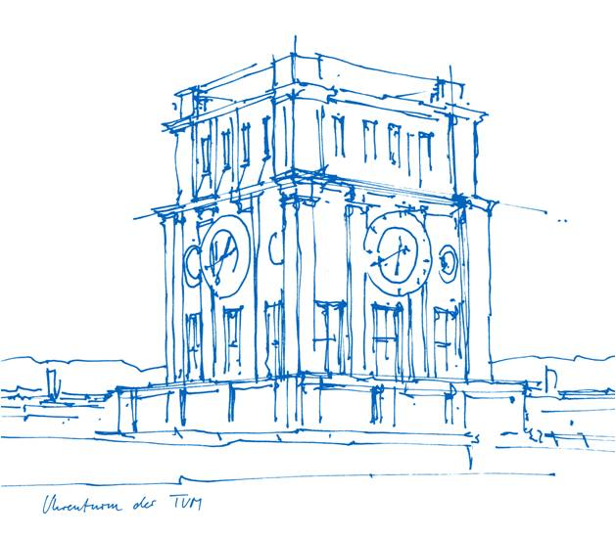
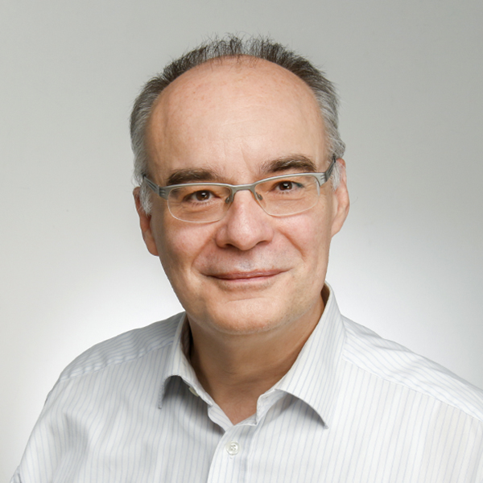
European Standards and Verifiable Credentials for Higher Education Institutions
Dr. Matthias Gottlieb, Guido Bacharach
Bayerisches Staatsministerium für Digitales
Oskar-von-Miller-Ring 35 | Westminsterstr. 60
80333 Munich | 45470 Mühlheim, Germany
matthias.gottlieb@stmd.bayern.de | guido.bacharach@freenet.de
13th of October 2022

Slide 2
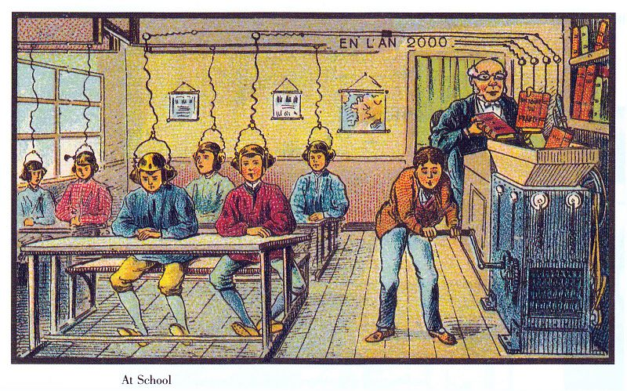
Vision for learning in the year 2000
by Jean-Marc Côté around 1900
Source: http://publicdomainreview.org/collections/france-in-the-year-2000-1899-1910

Slide 3
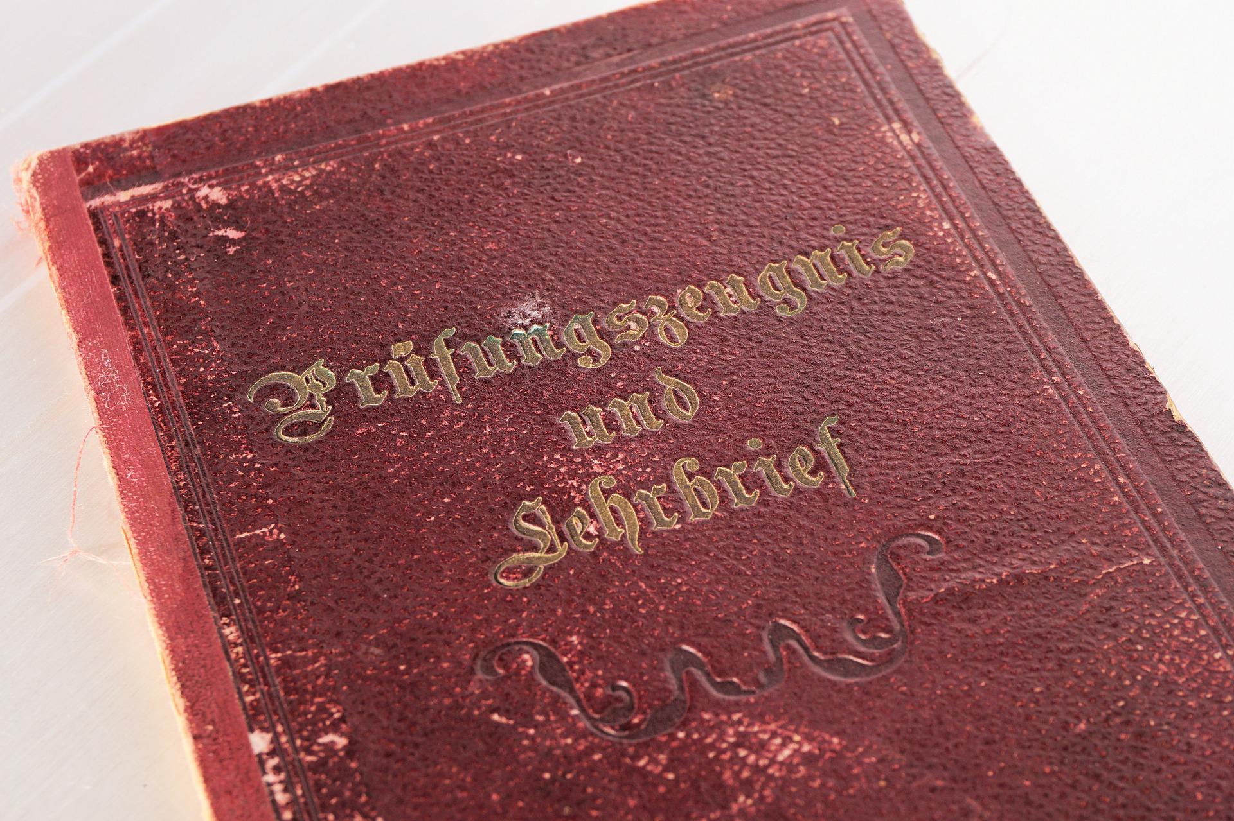
Motivation
Analoge
Digital
☑
☑
 | Verify (manuel)
 | User sphere of influence
 | Verify (automatical)
 | User sphere of influence
 | Fully automatically
☑
☑
☑
3
Notes:
Analogen Bildungsnachweisen fehlt es an einem Verfahren zum automatisierten Verifizieren und Auswerten der inhaltlichen Daten. Zusätzlichen beanspruchen sie viel Platz.
Hingegen sind Digitale Bildungsnachweise kompakt und lassen sich vollständig automatisieren. Dies ermöglicht Ihnen als Verwaltung einen effizienten und platzsparenden Prozess. Erfassung und elektronische Weiterverarbeitung erfolgen dann medienbruchfrei.
Allerdings fehlt es bisher an einem Machbarkeitsnachweis für einen interoperablen Infrastrukturstandard.

Slide 4
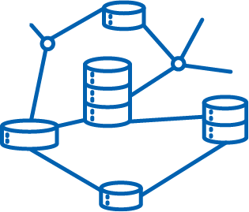
Infrastructure Standard 4 Digital Credentials
Widerrufen
Umschlag (Metaebene)
Datenobjekt
Ausstellen
Prüfen
Digital Credential
Teilen
Transportieren/
Speichern
4
Notes:
Idee: Mittels einer Art Briefumschlag ein Datenobjekt - digitaler Bildungsnachweis – sicher und verifiziert zu versenden, sodass dessen Inhalt vorerst keine Relevanz hat. Das bedeutet, einen Briefumschlag mit Daten des Empfängers (Bildungsnachweis der innehabende Person) und Absenders (ausstellende Institution) sowie einem Siegel (Publik-Key-Verfahren) zu versehen. Einem verifizierbaren digitalem Bildungsnachweis auch Digital Credential genannt.
Zum Verfahren: Eine Institution stellt einem Lernenden ein Digital Credential aus. Der Lernende transportiert dies und speichert es bequem in der Wallet seiner Wahl. Er bewirbt sich bei einer Dritten Partei (Arbeitgeber oder weiteren Bildungseinrichtung) mit seinen digitalen Bildungsnachweisen. Zwecks überprüfen ist ein Vertrauensanker notwendig eine sog. Trusted Data Registry. Das ermöglicht ein unabhängiges Prüfen der Dokumente auch im Hinblick auf ein Widerrufenen des Bildungsnachweises beispielsweise bei Tippfehlern im Namen oder Aberkennung.

Slide 5
Key Data Digital Educational Credentials for Universities
Project Partner
Project Goal
Based on the DCC white paper: Explore an infrastructure standard for issuing, storing, presenting, and verifying digital academic credentials for German higher education institutions from an international perspective.
Running Time
Funding Agency
Contact
Links
Matthias Gottlieb (Project Manager, TUM)
Alexander Mühle (Team Lead, HPI)
Kathleen Clancy (Team Lead, DAAD)
www.dibiho.de
12/2020 – 12/2022
Fkz: M534800

Slide 6
Coupling Layer / Proxy
Legend:
Schema
Verifiable Credential
Not verified yet
ELMO
Focus
Model
ELM linked to VCs
Information density
ELM based ELMO
National (German)
XHochschule
ELM V3
XSchule
EDCI uses ELM
EDCI
Infrastructure
DigiZ uses Converter to ELMO
EWP applies ELMO
EMREX applies ELMO
Europass aligned with ELMO
Europass uses EDCI
Europass stores VCs
EBSI uses ELM & VCs
DigiZ uses ELMO
DigiZ
Service
EWP
EMREX
Europass
EBSI
ESSIF use case of EBSI
ESSIF

Slide 7
Coupling Concept
Legend:
Schema
VCs can transport ELMO
Verifiable Credential
Not verified yet
ELMO
Model
ELM linked to VCs
Information density
ELM based ELMO
National (German)
XHEIE
ELM V3
XSchule
EDCI uses ELM
EDCI
Infrastructure
OOTS
DigiZ uses Converter to ELMO
SDG
EWP applies ELMO
DigiZ
EMREX applies ELMO
Europass aligned with ELMO
Europass uses EDCI
Europass stores VCs
EBSI uses ELM & VCs
DigiZ uses ELMO
Service
ESCI
EWP
EDSSI
EMREX
Europass
EBSI
ESSIF use case of EBSI
ESSIF

Slide 8
Coupling Layer / Proxy
Legend:
Schema
Verifiable Credential
Not verified yet
ELMO
Focus
Model
ELM linked to VCs
Information density
ELM based ELMO
National (German)
“A verifiable credential can represent all of the same information that a physical credential represents. The addition of technologies, such as digital signatures, makes verifiable credentials more tamper-evident and more trustworthy than their physical counterparts.” Src: M. Sporny, D. Longley, and D. Chadwick, "Verifiable Credentials Data Model v1.1," https://www.w3.org/TR/vc-data-model/
XHochschule
ELM V3
XSchule
EDCI uses ELM
EDCI
Infrastructure
DigiZ uses Converter to ELMO
EWP applies ELMO
EMREX applies ELMO
Europass aligned with ELMO
Europass uses EDCI
Europass stores VCs
EBSI uses ELM & VCs
DigiZ uses ELMO
DigiZ
Service
EWP
EMREX
Europass
EBSI
ESSIF use case of EBSI
ESSIF

Slide 9
Coupling Layer / Proxy
Legend:
Schema
Verifiable Credential
Not verified yet
ELMO
Focus
Model
ELM linked to VCs
Information density
ELM based ELMO
National (German)
XHochschule
ELM V3
XSchule
EDCI uses ELM
EDCI
Infrastructure
DigiZ uses Converter to ELMO
EWP applies ELMO
EMREX applies ELMO
Europass aligned with ELMO
Europass uses EDCI
Europass stores VCs
EBSI uses ELM & VCs
DigiZ uses ELMO
DigiZ
Service
EWP
EMREX
Europass
EBSI
ESSIF use case of EBSI
ESSIF
Notes:
ELMO is an XML format that supports assessment information included in Diplomas, Transcripts of Records, and Diploma Supplements. Moreover, it describes these assessments' qualifications, programs, and courses [9]. The ELMO format is used by EMREX [10], EWP [11], and the ELM format [7] is based on ELMO.

Slide 10
Coupling Layer / Proxy
Legend:
Schema
Verifiable Credential
Not verified yet
ELMO
Focus
Model
ELM linked to VCs
Information density
ELM based ELMO
National (German)
XHochschule
ELM V3
XSchule
EDCI uses ELM
EDCI
Infrastructure
DigiZ uses Converter to ELMO
EWP applies ELMO
EMREX applies ELMO
Europass aligned with ELMO
Europass uses EDCI
Europass stores VCs
EBSI uses ELM & VCs
DigiZ uses ELMO
DigiZ
Service
EWP
EMREX
Europass
EBSI
ESSIF use case of EBSI
ESSIF
Notes:
Learning processes (learning specifications, learning qualifications, and learning achievements, learning outcome, learning activity and learning activity specification, assessment and assessment specification)
Description of issuer and credential subject
Concepts for describing learning opportunities and accreditation
Price Details
Concepts for verifiable presentation and Europass presentation
Definition of the Europass extension of a Europass Verifiable Credential
Definition of the Europass extension of a Europass Verifiable Presentation
Definition of a Europass learning opportunity

Slide 11
Coupling Concept
Legend:
Schema
VCs can transport ELMO
Verifiable Credential
Not verified yet
ELMO
Model
ELM linked to VCs
Information density
ELM based ELMO
National (German)
XHEIE
ELM V3
XSchule
EDCI uses ELM
EDCI
Infrastructure
OOTS
DigiZ uses Converter to ELMO
SDG
EWP applies ELMO
DigiZ
EMREX applies ELMO
Europass aligned with ELMO
Europass uses EDCI
Europass stores VCs
EBSI uses ELM & VCs
DigiZ uses ELMO
Service
ESCI
EWP
EDSSI
EMREX
Europass
EBSI
ESSIF use case of EBSI
ESSIF

Slide 12
Coupling Layer / Proxy
Legend:
Schema
Verifiable Credential
Not verified yet
ELMO
Focus
Model
ELM linked to VCs
Information density
ELM based ELMO
National (German)
XHochschule
ELM V3
XSchule
EDCI uses ELM
EDCI
Infrastructure
DigiZ uses Converter to ELMO
EWP applies ELMO
EMREX applies ELMO
Europass aligned with ELMO
Europass uses EDCI
Europass stores VCs
EBSI uses ELM & VCs
DigiZ uses ELMO
DigiZ
Service
EWP
EMREX
Europass
EBSI
ESSIF use case of EBSI
ESSIF

Slide 13
Coupling Layer / Proxy
Legend:
Schema
Verifiable Credential
Not verified yet
ELMO
Focus
Model
ELM linked to VCs
Information density
ELM based ELMO
National (German)
XHochschule
ELM V3
XSchule
EDCI uses ELM
EDCI
Infrastructure
DigiZ uses Converter to ELMO
EWP applies ELMO
EMREX applies ELMO
Europass aligned with ELMO
Europass uses EDCI
Europass stores VCs
EBSI uses ELM & VCs
DigiZ uses ELMO
DigiZ
Service
EWP
EMREX
Europass
EBSI
ESSIF use case of EBSI
ESSIF

Slide 14
Coupling Concept
Legend:
Schema
VCs can transport ELMO
Verifiable Credential
Not verified yet
ELMO
Model
ELM linked to VCs
Information density
ELM based ELMO
National (German)
XHEIE
ELM V3
XSchule
EDCI uses ELM
EDCI
Infrastructure
OOTS
DigiZ uses Converter to ELMO
SDG
EWP applies ELMO
DigiZ
EMREX applies ELMO
Europass aligned with ELMO
Europass uses EDCI
Europass stores VCs
EBSI uses ELM & VCs
DigiZ uses ELMO
Service
ESCI
EWP
EDSSI
EMREX
Europass
EBSI
ESSIF use case of EBSI
ESSIF

Slide 15
Coupling Concept
Legend:
Schema
VCs can transport ELMO
Verifiable Credential
Not verified yet
ELMO
Model
ELM linked to VCs
Information density
ELM based ELMO
National (German)
XHEIE
ELM V3
XSchule
EDCI uses ELM
EDCI
Infrastructure
OOTS
DigiZ uses Converter to ELMO
SDG
EWP applies ELMO
DigiZ
EMREX applies ELMO
Europass aligned with ELMO
Europass uses EDCI
Europass stores VCs
EBSI uses ELM & VCs
DigiZ uses ELMO
Service
ESCI
EWP
EDSSI
EMREX
Europass
EBSI
ESSIF use case of EBSI
ESSIF

Slide 16
Conclusion
Developed: Coupling concept illustrating interplay between different data models and infrastructures
Major European data standards: ELM and ELMO
Interoperability: ELM version 3 with ELMO version 1.7
SDG and OOTS connection and location to the coupling concept is in discussion
Specific National data formats such as German Xschule and XHEIE currently not interoperable to the international formats

Slide 17
Future Work
Creating governance concept to keep interoperability
Discussion: How to validate and strengthen the validity of a coupling concept?
Clarification: How to design the coupling concept:
Using the smallest common denominator as interoperability concept?
Using the biggest common denominator for best semantic coverage?
Clarification of connection and location regarding interoperability of
SDG / OOTS
National data formats
Flexibility: How to create a coupling concept open for new data formats and infrastructures?

Slide 18
Contact
Dr. Matthias Gottlieb, Guido Bacharach
Bayerisches Staatsministerium für Digitales
Oskar-von-Miller-Ring 35 | Westminsterstr. 60
80333 Munich | 45470 Mühlheim, Germany
matthias.gottlieb@stmd.bayern.de | guido.bacharach@freenet.de
13th of October 2022

