Slide 1
Creating Mobility
with Next Generation Interoperability and Collaborative Networks

Slide 2
Challenge Questions for Next Three Days
What can you do to advance learner mobility?
What connections can you build to advance the ideal mobility scenario?
What more can you contribute?

Slide 3
Questions we are thinking about
Who are we and what motivates us to improve data portability and citizen mobility?
What exemplars do a good job to reduce mobility barriers in the digital technology space?

Slide 4
Audience Poll
What is THE priority barrier to digital portability or learner mobility?
How do we solve these barriers?

Slide 5
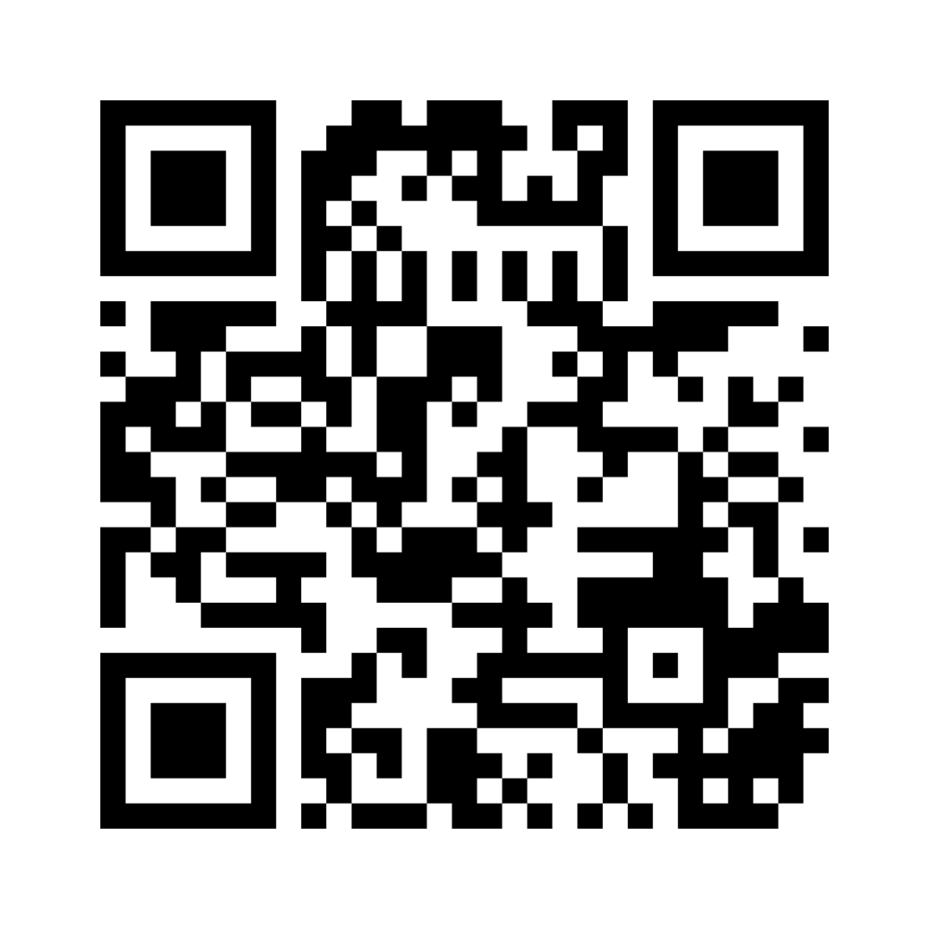
Audience Poll
Go to menti.com
Enter 8396 7155
https://www.mentimeter.com/app/presentation/alrjgd9uvxhjn4uzr8weijc4rt8rwz6e/fzmn7i9yqqib

Slide 6
Where do we go from here?
What other structural or social barriers prevent transparency and portability of digital documents and ultimately citizen mobility?
What is necessary to break down barriers to learner mobility?
What partnerships will help us overcome these?

Slide 7
For the Panel
Based on what you heard today, what final reflections come to mind?

Slide 8
Challenge Questions for Next Three Days
What can you do to advance learner mobility?
What connections can you build to advance the ideal mobility scenario?
What more can you contribute?

Slide 9
Have a great meeting!
Creating Mobility and Digital Portability with Next Generation Interoperability and Collaborative Networks

