Slide 1
CLRs, LERs and Badges Can we make U.S. educational achievements portable, scalable, and reflective of a learner’s capabilities?
The Groningen Declaration Network Annual Meeting
12:10p, October 13, 2022

Slide 2
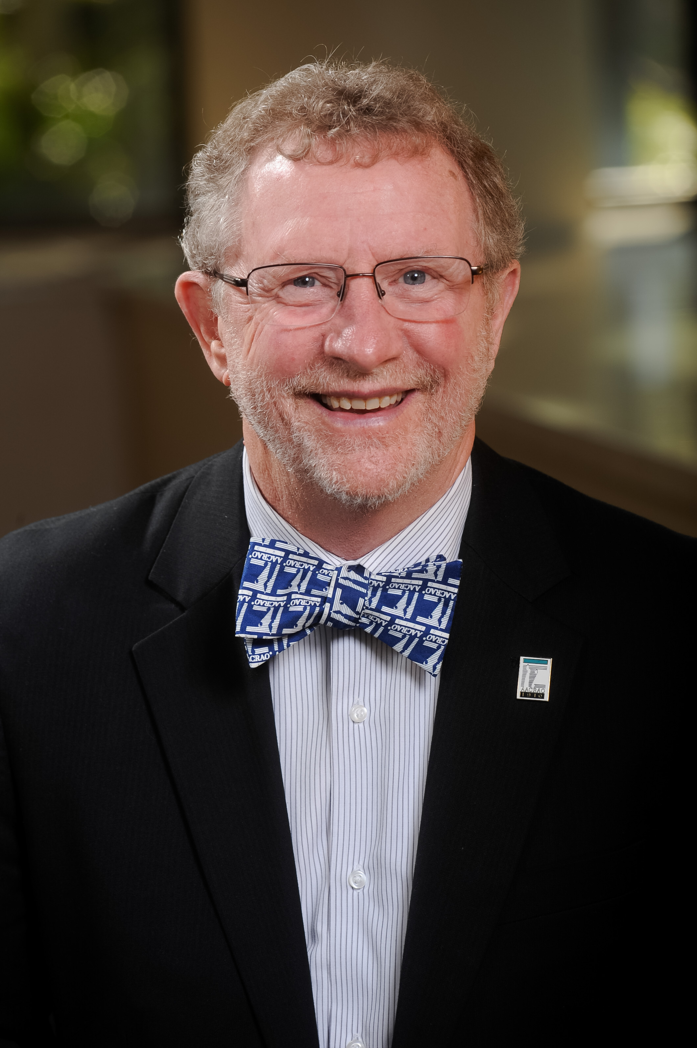
Rob Groot
Managing Director Learner Mobility &
Experience, National Student Clearinghouse
Mark McConahay
AACRAO Sr. Consultant and CLR/LER Coordinator

Slide 3
Agenda Digital Credentials - What do we mean in the US? What is the LER Vision in the learner/talent Market LER and CLR? Status of Digital Credentialing in the US Challenges in the business space. US Digital Credential Initiatives via AACRAO and NSC

Slide 4
How is the US discussing Digital Credentials in Higher Education?
Badges
Online representations that recognize skills, achievements, membership affiliation, and participation. Open Badges are a type of digital badge.
Micro-credentials
An award that is a subset of learning achievements/outcomes less than a full degree. It may or may not be asserted with a recognized authority.
Comprehensive Learner Record (CLR)
A record focused on learning that occurs throughout the educational experience that usually includes multiple learner achievements.
Learning and Employment Records (LERs)
A comprehensive digital record of a worker’s skills and competencies. LERs can document learning wherever it occurs, and they may include records of people’s credentials, degrees, and employment histories.

Slide 5
Demand for Digital Credentials
CLOSING THE SKILLS GAP 2019
A joint project of Wiley Education Services and Future Workplace
Wiley Education Services, & Future Workplace. (2019). Closing the skills gap 2019. Louisville, KY: Wiley edu, LLC
Notes:
Robert Bajor made a better case for this!

Slide 6
Agenda Digital Credentials - What do we mean in the US? What is the LER Vision in the learner/talent Market LER and CLR? Status of Digital Credentialing in the US Challenges in the business space. US Digital Credential Initiatives via AACRAO and NSC

Slide 7
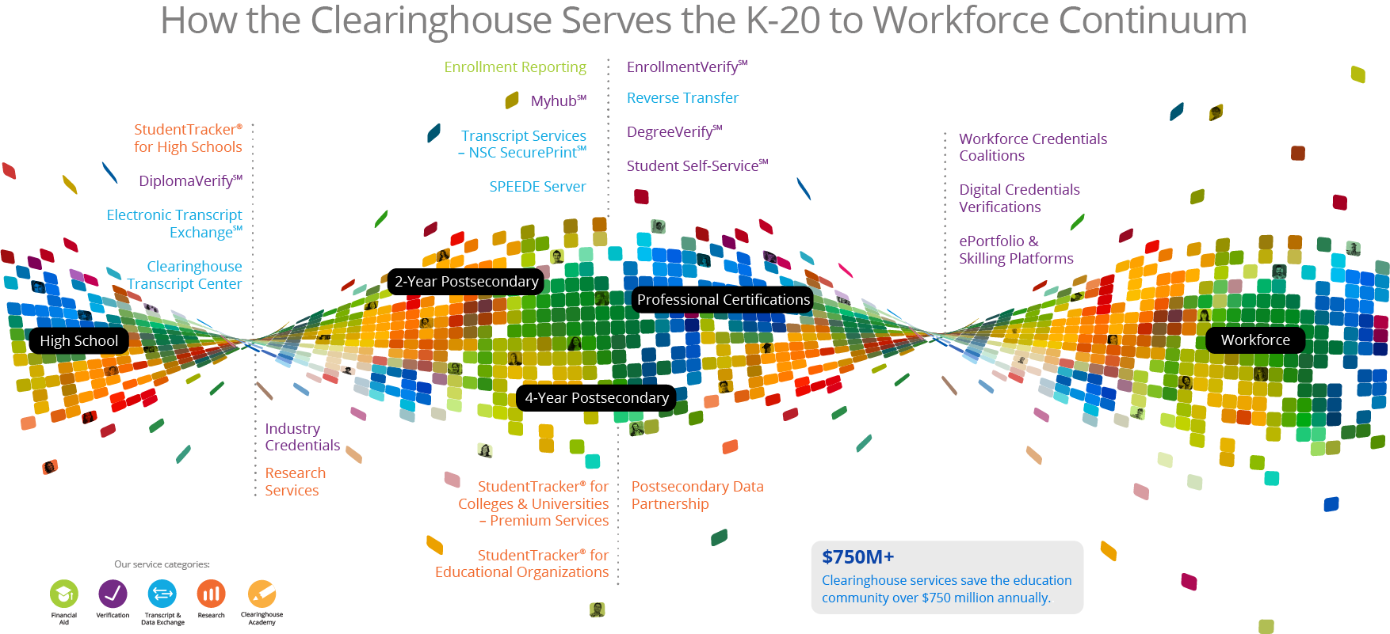
4,734,300,000 Education Data Transactions in FY22 (4.7B)

Slide 8
The Learner Journey
The self attested record
Career Growth
Other data
Experience
Ambition
Resume
Military Experience
Trusted data
Assertions
Industry Credentials
LER
Course & Grade
Badge Data
Degree Data
Enrollment data
The official record
8

Slide 9
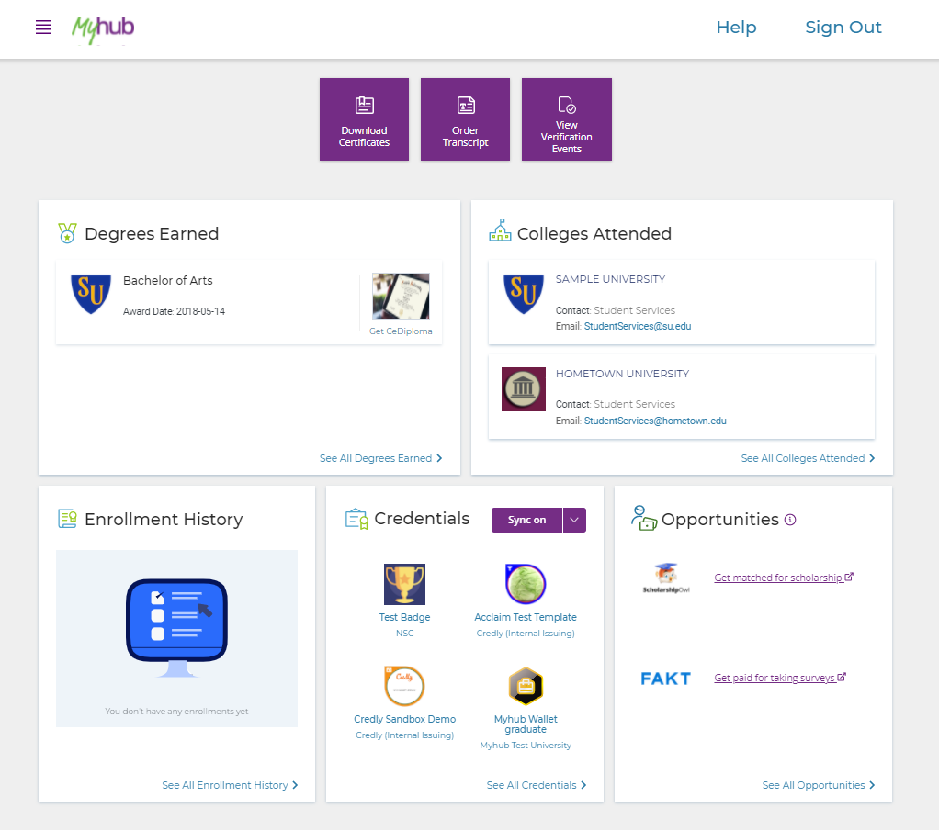
Available Solution
Clearinghouse data
Transcripts
Digital Diplomas
Third Party data
Attestations
Additional Services

Slide 10
Agenda Digital Credentials - What do we mean in the US? What is the LER Vision in the learner/talent MarketLER and CLR? Status of Digital Credentialing in the US Challenges in the business space. US Digital Credential Initiatives via AACRAO and NSC

Slide 11
Transcript Facts
Based on the Clearinghouse experience, 30% transcript market share and operating the SPEEDE (EDI) network:
1,225 Post Secondary Institutions use NSC for Transcripts
Nearly 8M transcripts delivered
48% of transcripts stay on ETX network
Vast majority (87%) in PDF
SPEEDE: 1.7M EDI transactions
States backing out of state solutions
More than 54% of transcripts go to another education institution, 17% goes to “Self”, and 9% goes to “other”

Slide 12
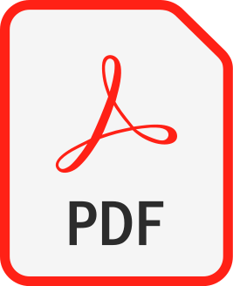
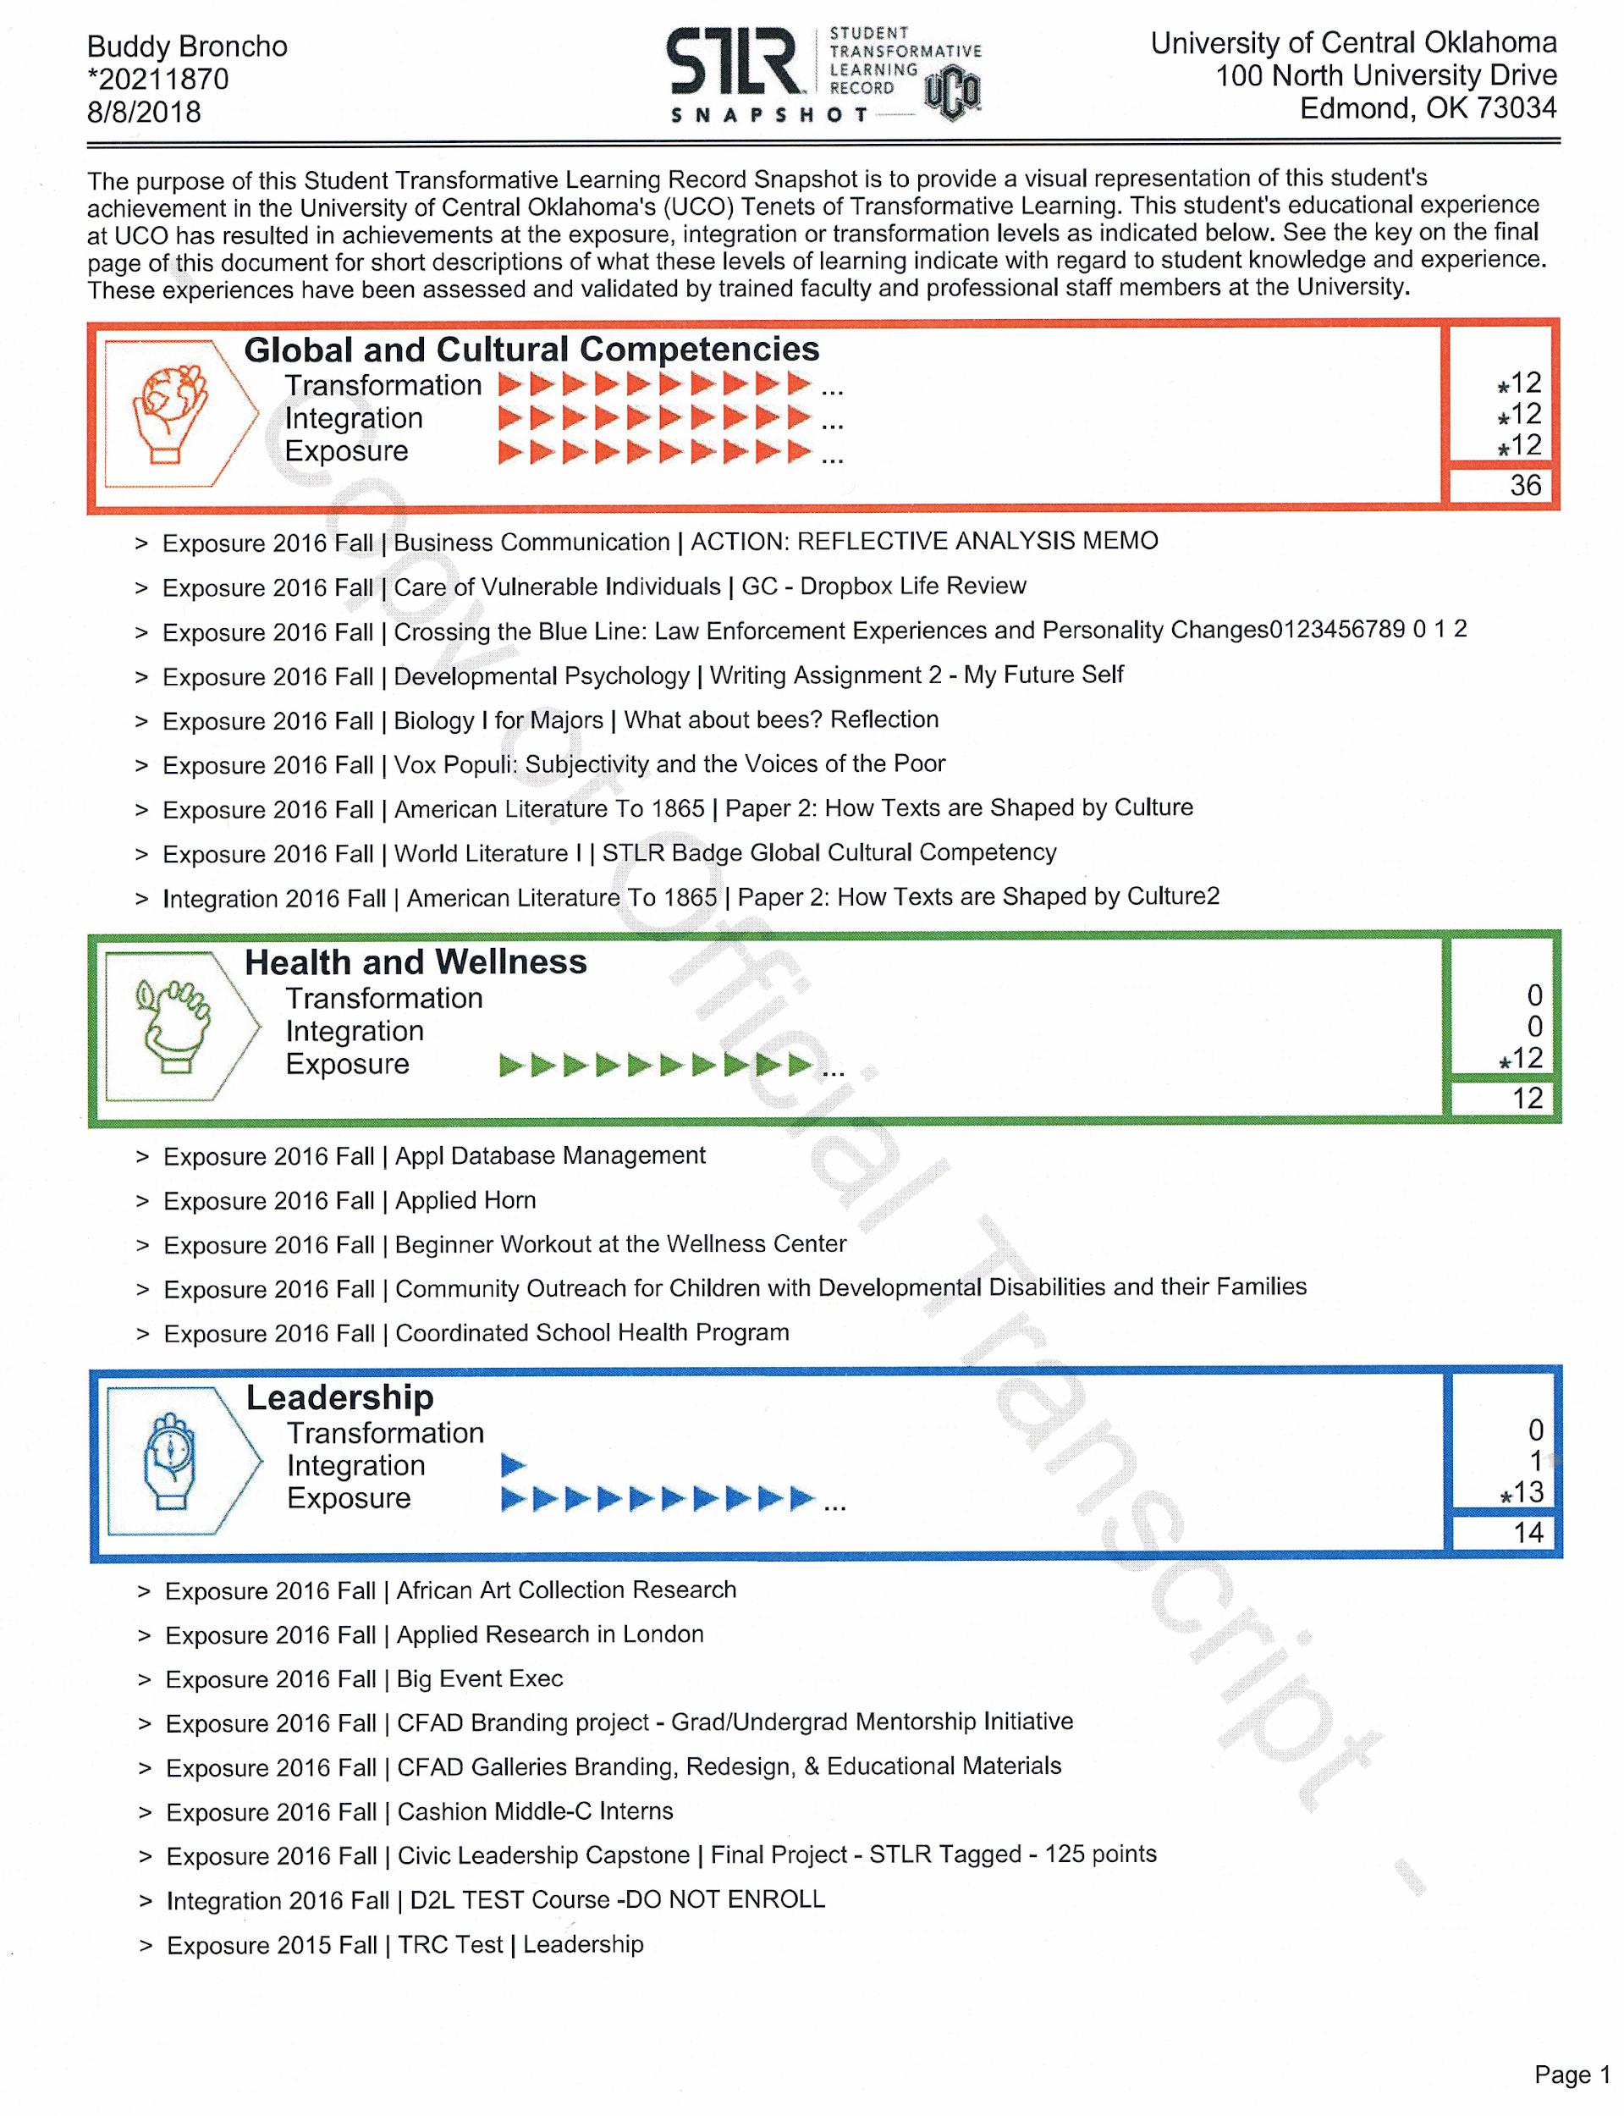
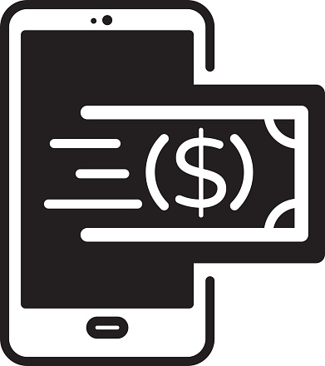
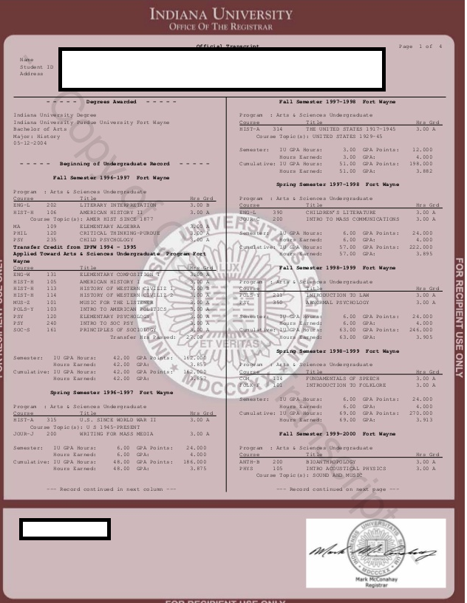
Credential Distribution and Exchange in 2022
CLR
Transcript
~82%
Transcript Fee
Data Entry
EDI
Digital Exchange
~18%
XML

Slide 13
Future Credential Distribution and Exchange
Transcript or CLR Credentials as:
-PDF
-Text (e.g., CSV)
-SPEEDE EDI
-SPEEDE XML
-CLRv2
-OBv3
Conversion Utility
Output:
-Text (e.g., CSV)
-SPEEDE EDI
-SPEEDE XML
-CLRv2
-OBv3

Slide 14
Agenda Digital Credentials - What do we mean in the US? What is the LER Vision in the learner/talent MarketLER and CLR? Status of Digital Credentialing in the US Challenges in the business space. US Digital Credential Initiatives via AACRAO and NSC

Slide 15
Challenges associated with Digital Credentials
US – No Central or Federated Oversight/Control
State of digital interoperability
Technologies not Aligned
Standards are plentiful
Business disincentives
Semantic Interoperability
(HE -> HE, Post-secondary -> Talent marketplace, etc.)
Institutions not aligned on their vision of Self-Sovereign Records

Slide 16
Agenda Digital Credentials - What do we mean in the US? What is the LER Vision in the learner/talent MarketLER and CLR? Status of Digital Credentialing in the US Challenges in the business space. US Digital Credential Initiatives via AACRAO and NSC

Slide 17
AACRAO: Initiatives in the Digital Credential Space
Increase Adoption - the need to scale!
Enabling Digital Record Distribution and Exchange (Interoperability)
Digital Standards (e.g., SPEEDE, 1EdTech CLR Standard, etc.)
Achievable pathway to convert PDF document to machine readable data
Semantic Standards (e.g., learning outcomes, skills, competencies expressed through CASE, ACE, others)
Mitigating Business Model Disincentives
Transactional Transcript Fees
Prior Learning Assessments
Enabling CLR information in Systems of Record
Do not support recording of learning activities, outcomes, etc.
Establishing Governance for non-academic learning activities

Slide 18
High Level Market Solution Model
Skills Development Engines
Data
Aggregation
Data Exposure
/Wallet
Applications & Services
Trusted Education Data
Additional
Self-
Reported
& Assessed
Achieve-
ment
Data
Trusted &
Verified
Credentials
Experiential & Industry data
Recruiting, Job Search, ROI
Education & Career Pathways
Self Attested Data
Blockchain

Slide 19
Questions and Discussion

Slide 20
Some important terms
Learner: a more inclusive term than “student”, which connotes a more traditional person or environment for learning
Learning activity: any course, co-curricular event that results in demonstrated learning
Credential: an earned award that carries with it validation of learning, knowledge, skills; this may be a degree, certificate, transcript, CLR, etc.
Micro-credential: an award that is a sub-set of learning achievements/outcomes less than a full degree. It may or may not be asserted with a recognized authority.
Authority: the governance structure that stands behind a credential; these include state education agencies, accreditors (institution and program-level), and within an institution, a specific college or department

Slide 21
Some important terms
Trust: The recipient's belief that the credentials received have value (governance), are validated (true), are associated with the learner (identity) and are unchanged (immutable).
Assessment: A process that ensures appropriate rigor and expertise to evaluate a learning activity to determine to what extent learning may have occurred
Validation: A process that ensures that the results of an assessment are legitimate and conform to expected standards specific to that activity
Immutable: a record may not be altered without evidence of tampering
Self-sovereignty: the ability of a learner to control the sharing of her credentials without a required intermediary (i.e., registrar’s office) without violating trust.

