Slide 1
Collaborating to Create Comprehensive Supports for Learners: A Canadian Example ARUCC MyCreds™ | MesCertif™ National Network
Groningen Declaration Meeting October 2022
Association of Registrars of the Universities and Colleges of Canada – ARUCC
Julie Green, ARUCC Board Chair; Registrar, University of King’s College - Halifax
Darran Fernandez, ARUCC Board Ontario University Registrars’ Association (OURA) Representative; Registrar, York University
Charmaine Hack, ARUCC MyCreds™ Board Director; Past Board Chair, ARUCC; Vice President, Strategic Enrolment Management, Centennial College
JG

Slide 2
ARUCC
Incorporated
Not-for-profit
Sector owned
ARUCC owns MyCreds™
National participation
Colleges + Universities
Nationally supported
Partners include: Pan-Canadian Council on Admissions and Transfer (PCCAT), Canadian University Council of Chief Information Officers (CUCCIO), Canadian Postsecondary Electronic Council User Group (CanPESC)
Sector supported
MyCreds™ is endorsed by our: Colleges and Universities, Students, Credential Evaluation Organizations, Governments
JG
Notes:
Briefly, here is a slide that provides a quick overview of the ARUCC.
It and the MyCreds Network are owned and led by registrars.
ARUCC, a federally incorporated not-for-profit, owns MyCreds | MesCertif and created this solution in partnership with registrars, CIOs, CISO experts, and other higher education partners to address real problems and opportunities, using a shared service model.
The MyCreds | MesCertif project, both now and since its inception in 2015, was inspired by the Groningen Declaration Network a national organization that is dedicated to student mobility through learner portability. With conversations beginning in 2015, the effort was led by Kathleen Massey, a former registrar of Centennial College and McGill University. She and others worked on behalf of the registrars to first determine if digitizing documents and credentials and changing the approach to delivery and verification was achievable at the national level. The registrars agreed that this was possible and have continuously provided formal unanimous support to continue forward with this initiative.
After extensive consultation and additional higher education endorsements and unanimous support, ARUCC contracted in June with a service provider to help it build a fully bilingual Canadian network and wallet.
ARUCC conducted extensive research before making this move and advanced its governance and leadership capacities, including hiring an Executive Lead (Joanne Duklas), experts, and an implementation team to support the project.

Slide 3
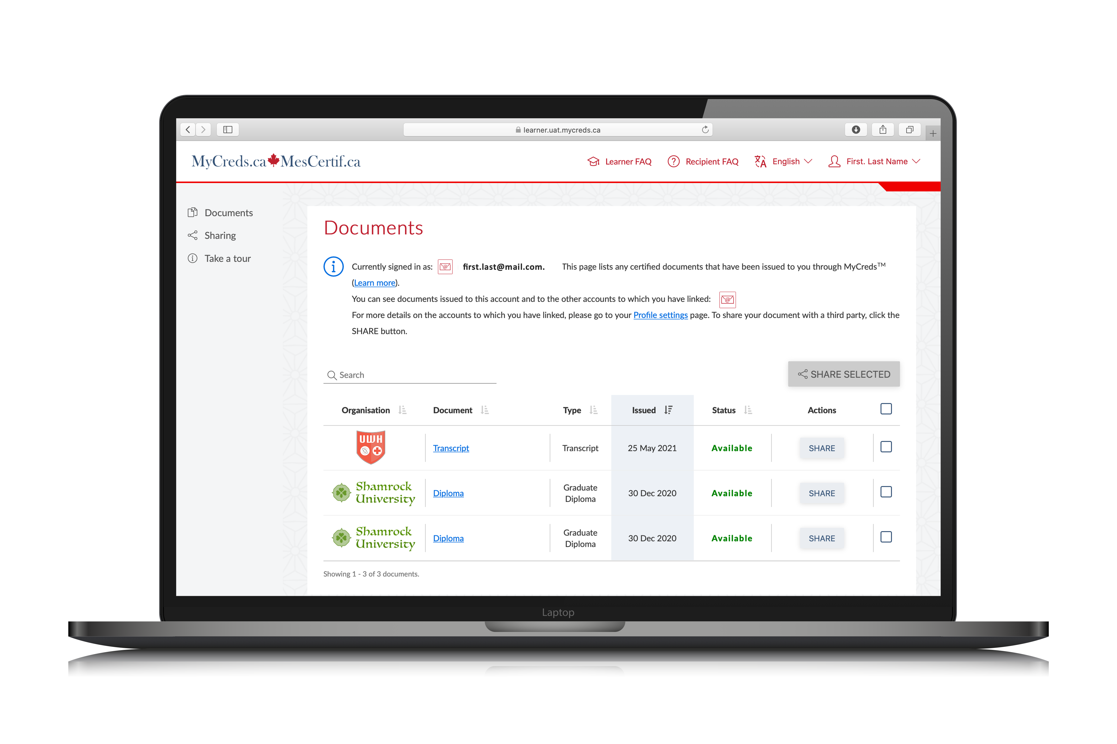
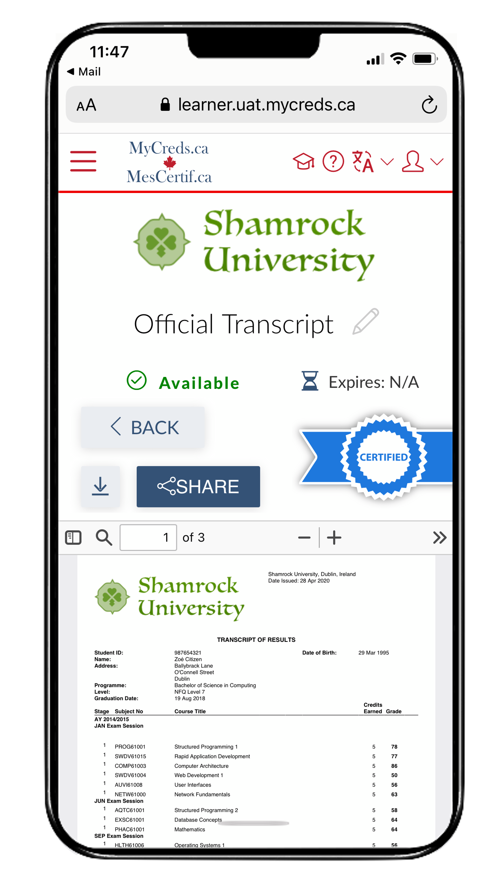
ARUCC MyCreds™
What is MyCreds™?
24/7 virtual credential wallet + digital exchange highway for digitized documents and credentials
Shared service
Provides regional, national, and international connectivity
What does MyCreds™ support?
Inbound admissions; support letters to help learners access funding, student authorizations, and other govt support; transition support to jobs and regulatory bodies
Outbound: transcripts, parchments, badges, micro-credentials, letters, degrees, diplomas, certificates, etc.
JG
Notes:
MyCreds provides a new way of supporting learners that builds on past successes and goes beyond admissions, one particular institution or one region.
Through a shared service model, it provides a new way of handling documents and credentials.
It is provincial, national, and international in scope and ensures our schools are both supporting learners more holistically, regardless of their location.
It provides a virtual credential wallet for learners and a way to share official digitized documents with colleges, polytechnics, universities, employers, and government, both in Canada and beyond.
It supports admissions, current student needs, and graduating student needs. It supports the entire lifecycle of the learner.

Slide 4
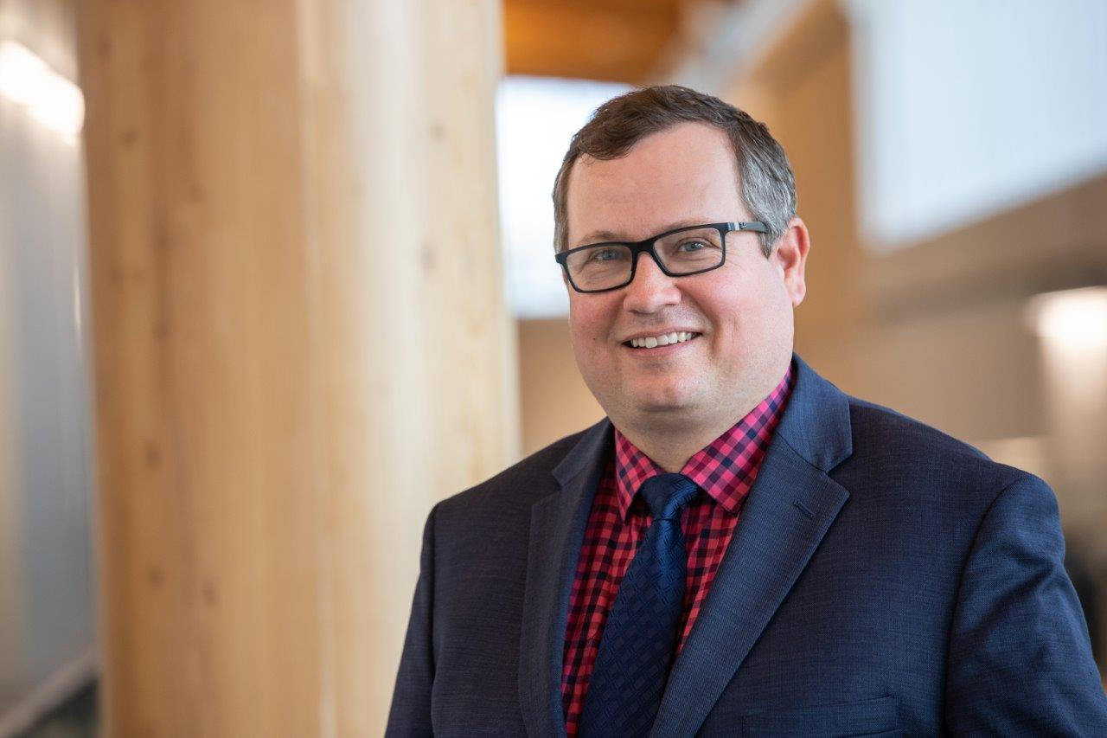
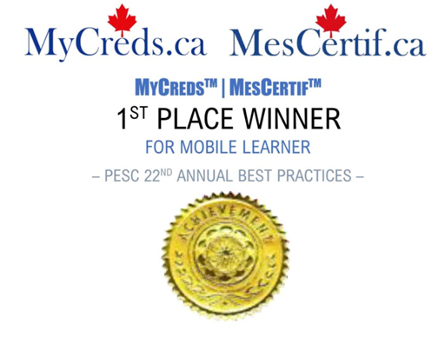
MyCreds™ is growing
Overall
Canada and internationally as part of Digitary/Parchment Network
3M learners worldwide
10M+ documents
Canada is 13% of the world network and growing
In Canada
At scale in Ontario, Alberta, Newfoundland, Saskatchewan, and soon, Nova Scotia
Attracting government participation and/or grant funding
Attracting industry and trades participation
“We are very happy with how MyCreds has been working for us and our students. As a next step, we are excited to expand our usage in the coming months with additional document types as will build out our institutional adoption of digital verifiable solutions to support learners.”
Mark Hilgersom, registrar, Lethbridge College
An award Winning Not-for-Profit Solution
JG

Slide 5
Who Benefits & How?
Post-Secondary Institutions
Learners
Government
Employers, Third Parties
Provides permission-based access directly at source
Ensure accuracy and currency with automatic updating
Mitigates document
Enables comprehensive workflow management
Ensure full learner control
Provides 24/7 access to virtual digitized credentials​
Provides self-sovereignty and agency
Enables mobility
Saves costs
Full document/credential access for their learners
Comprehensive dashboard reporting and analytics
Integration with full suite of enterprise solutions
Branding​
Cutting edge technologies and data sharing models
Saves costs
Align with government policy and labour mobility goals
Supports open standards adoption
Provides relevant, accessible, and achievable innovation​
Ensures sector efficiency and collaboration
Saves costs
Ensure speed, quality, efficiencies and mobility using innovative practices and technology
CH
Notes:
Learners:
Learner control
Control of documents and credentials​
24/7 virtual digitized sharing of credentials​
Self-sovereignty and agency over micro-credentials, badges, diplomas, degrees, and certificates
Enables learner mobility
PSI
Ability to provide access to official letters, transcripts, parchments, badges, and micro-credentials to learner digital wallets
Comprehensive dashboard reporting and analytics
Integration with enterprise student information systems
Provides white label branding​
Connectivity to existing application centres (over time and pending further scoping)
Full suite of solutions at scale, including micro-credentials, and badges, using cutting edge technologies and data sharing models, including SSI/blockchain (planned next stage extension of digital wallet in development phase)
Third parties
Permission from learners to access authentic, official, certified documents that cannot be altered
Documents are accessed directly at source (issuing organization)
Documents are automatically updated
Registered receiving organizations join an international network and are provisioned with a comprehensive document management dashboard
Government
Aligns with government digitization infrastructure goals in accordance with open standards
Represents relevant and achievable innovation​
Ensures sector efficiencies​
Supports sector collaboration​
Improves efficiencies and seamless transfer​
Enables governments to support and incentivize ease of adoption

Slide 6
Governance = Trusted Engagement
ARUCC Board
ARUCC MyCreds™ Steering
ARUCC MyCreds™ Strategic Advisory Board
ARUCC MyCreds™ Registrars Group
ARUCC MyCreds™ Deputy Registrars group
ARUCC MyCreds™ Communications Working Group
ARUCC MyCreds™ Integrated Working Group
ARUCC MyCreds™ Banner User Group
Technical MyCreds™ Community group
MyCreds™ strategic plan
CH

Slide 7
Partnerships
Inspired by the Groningen Declaration Network approach to collaboration
Higher Education Community
Government
Not-for-profit sector leadership
Industry
Registrarial sector leadership organizations
Federal Treasury Board
Ontario
Nova Scotia
Government owned regulatory bodies
Core service providers:
Universities’ Canada
Colleges and Institutes Canada
DIACC
ID Lab
Regulatory bodies
Student Information System providers
Other nodes
CH

Slide 8
Sample: Govt grant funding for the Ontario Virtual Skills Passport
To support microcredentials and Virtual Skills Passport work in SSI technology space
$1.8M grant funding from Ontario government
10 Ontario colleges and universities, plus one Indigenous school won the Expression of Interest process – Press release
Use case: microcredentials
Industry partners participating
Partners with ARUCC: Digitary/Parchment & MATTR
Open standards ecosystem being developed
Opportunities to explore in future years: expanding participation and technical infrastructure capacities at schools; expanding use cases to include all graduates and other document types
CH

Slide 9
Our Approach
Ensuring:
Versatility
Interoperability
Integration
Scalability
Innovation
Onboarding:
Flexible
Responsive
Accessible
Comprehensive Usage
White Labelling
CH
Notes:
Our approach to Onboarding is agile and responsive with a laser focus on ensuring the sustainability of the network through two primary objectives:
Onboarding PSIs
Raising support from government and friends of MyCreds

Slide 10
What Document Types?
Transcripts
Parchments
Confirmation letters
Awards
Badges
Micro-credentials
& more…
DF

Slide 11
Communications
1
2
3
STUDENTS
INTERNAL TEAM
EXTERNAL STAKEHOLDERS
Webpage
Inquiries
FAQs
Videos
Demos/info sessions
Presentations
User guides
User groups
Press releases
Newsletters
Listservs
Outreach letters
Stakeholder management
DF

Slide 12
Video Channel + Learner Supports
A video made by our learners that shows how the wallet works.
https://youtu.be/HFLyECIced4
Series of ”How-to” instructional videos of common FAQs:
https://www.youtube.com/playlist?list=PLA2Sw6XbX8RnzCchd4nje3FGm3QvAIRDr
DF

Slide 13
Looking Forward
Collaborative engagement
Continuity plan
ARUCC board strategic plan
Strategic Advisory Board work
Next phase of MyCreds work
MyCreds™ strategic plan
Collaborative initiatives
Banking sector
Govt collaborations
Regulatory bodies
DF – CH/JG

Slide 14
Thank you!
Email. info@aruccnationalnetwork.ca
Website. mycreds.ca/
JG

