Slide 1
How Digital Credential Networks Support International Learner Mobility
Kevin Martin - General Manager, Higher Education
kevin@parchment.com

Slide 2
Presenter
Kevin Martin, General Manager, Higher Education
Like you, Kevin believes that education matters and transforms lives.
As General Manager of Higher Education and member of the Executive Team at Parchment, Kevin pursues Parchment’s mission to help turn credentials into opportunities. With direct responsibility for Parchment’s Higher Education portfolio, Kevin works with talented team members to achieve Parchment’s goals of new member acquisition, implementation, account management, business development, and providing leadership to the Parchment Advisory Board.
Notes:
Presenter: Kevin
Notes:
Coming to Holland feels like a bit of a homecoming for me.
Where I came up in southern Ontario, Canada there was a large Dutch-Canadian population there.
My friends had Oma’s and Opa’s, and they’d often ask me “are you sure that your surname isn’t Van Martin?”.
When I’d go to their houses I’d eat Stomppot and get Droppee’s as a special treat.
Today I live in the United States in the state of Michigan, where there’s significant Dutch-American population and towns like Zealand and Holland, Michigan.
So thank you for the opportunity to be here and to speak with you today.

Slide 3
Topics
1 | A Look Into the Past
2 | Present Day
3 | What the Future Holds
Notes:
Presenter: Kevin
Notes:
As a senior executive at Parchment I hope that the themes and trends that I share today resonate with you and provide some insight into how we are thinking about How Digital Credential Networks Support International Learner Mobility.
To do so, I have three well-worn lenses through which to look with you today: The Past, The Present, and The Future.

Slide 4
A Look into the Past..
“History is the interpretation of the significance that the past has for us.”
- Johan Huizinga
Notes:
Quote by Johan Huizinga a Dutch historian and one of the founders of modern cultural history

Slide 5
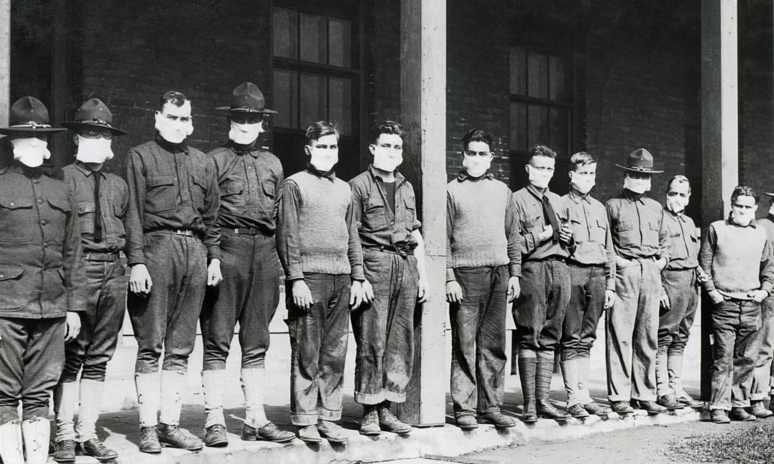
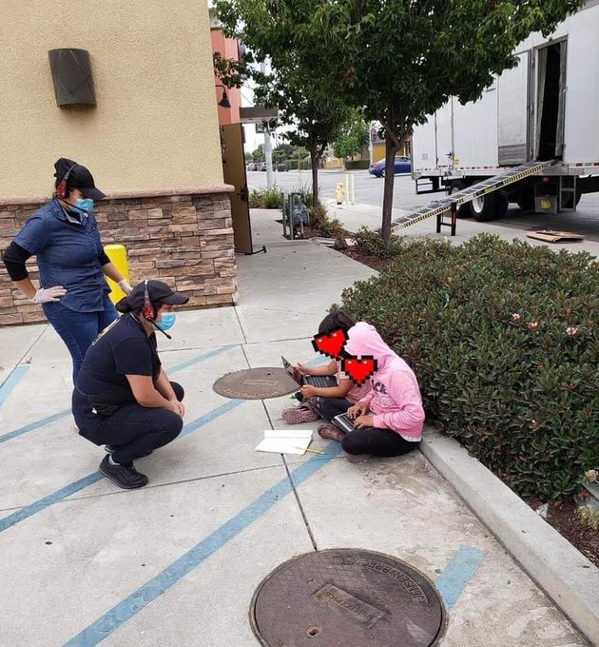
How do we learn from the past to secure the future..
1918
2020
The concept of remote learning didn’t exist in 1918. It was a time of increased socioeconomic inequality.
In the face of the COVID-19 pandemic, education institutions and educators were tasked with shifting from in person platforms of teaching, learning, and graduating to online platforms.
Notes:
Presenter: Kevin
Notes:
Have you ever found yourself in a moment that feels familiar? A little deja vu perhaps.
History doesn’t necessarily repeat, but it certainly feels like it rhymes.
In 1918 there was an increase in socioeconomic inequality due to the pandemic then. Despite our best efforts this time around, there has been an acceleration of socioeconomic inequality due to the lack of access to virtual online learning platforms.

Slide 6
The Effects of Displacement on Student Mobility
For those escaping situations such as war, documents like transcripts, diplomas, and certificates are a critical tools for rebuilding their lives and regaining a sense of autonomy.
This is especially the case for those pursuing postsecondary education, where these kinds of materials are required to attend college, graduate, and secure a job.
PLACEHOLDER
Notes:
Presenter: Kevin
Notes:
As a younger person I recall watching global conflicts on CTV on the news.
As our world has grown closer over the last 20-years (or we in America have just become more aware of how close we have always been), the impact of these conflicts on learners has become much more salient. Concurrently with the pandemic, these wars and conflicts make it difficult (if not impossible) to access the credentials relevant to their prior learning.
One instance where Parchment had the opportunity to directly serve in this space was with the American University of Afghanistan. These learners credentials are now available securely, and kept out of the hands of the Taliban, to these learners when they need them to finish their educational journey, or move on to employment.

Slide 7
Where we have seen these effects in the last 10 years
Syria
Afghanistan
Ukraine
Notes:
Presenter: Kevin
Notes:
GDN has gone into the issue of Refugees and credentials in great detail as discussed during yesterday’s panel presentation.
Syria
More than a decade of conflict has disrupted all sectors across Syria, including the higher education (HE) sector, depriving much of a generation of Syrian youth of access to HE in areas to which they have been displaced.
Opportunities to study elsewhere are greatly lacking in part to the lack of international recognition, loss of documentation, as well as financial limitations.
The adoption of hard copy systems due the lack of finance and skills to support digitisation, coupled with a lack of standards whether study-related or other, are clearly constraining student transitions.
Afghanistan
In 2021 it was reported that the Taliban, in full control of Afghanistan after years of war, was confiscating and destroying documents at checkpoints. Afghans themselves were also burning them, to avoid retribution.
The stakes are especially high for Afghan women, whom the Taliban have historically oppressed and barred from receiving an education.
Without access to technology such as digital credentials many face “a double edged sword,” they’re forced to choose between holding onto documents that could indicate resistance to authoritarian regimes or destroying the documents, upending their education.
Ukraine
The Ukranian education system is all but on hold today. Today due to the war in Ukraine medical students who returned to India from war-torn Ukraine are facing difficulties in retrieving their university documents from Ukraine. There are thousands of students who either want to cancel their admission in Ukrainian universities or their parents do not want to send them back to the war-torn country.
This is why, these students are looking for alternatives in countries around Ukraine with most of them trying to get admissions in Russian universities. With the war still going on however, the Ukraine government is not cooperating with these students to return their educational documents.
I’d be remiss to note that Parchment has a number of staff from Ukraine that work with us; while the country is in our thoughts, these Parchies and their families are in our thoughts in particular.

Slide 8
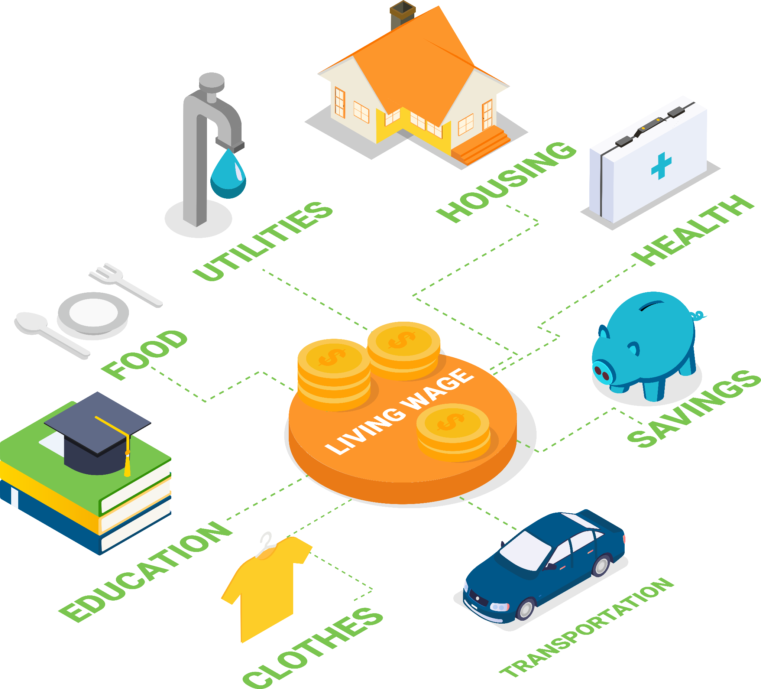
How has the cost of education affected international student mobility?
Studying abroad often brings the promise of a high-quality education, cultural and social experiences, and a route to a better job.
The high cost of tuition, rising costs of living in major metropolitan centres, and unfavourable currency exchange rates make international education one of the single largest investment decisions for many students.
Coupled with this the traditional student student isn’t the same as it once was, meaning greater considerations towards international study.
Notes:
Presenter: Kevin
Notes:
The affordability and the cost of studying abroad has always been an important consideration for international students.
More so than ever, the increased cost of higher education generally has made studying abroad from your home country an option only for those with much, and completely out of reach for those with little.
What untenably compounds this point is the massive YOY fluctuations in foreign exchange rates. Against the US dollar, the FX rates of England, Australia, New Zealand, Canada, and the Euro have dropped between 10-15% YOY.
For many students studying in the US, their tuition just went up due to FX; and maybe the school increased it too!

Slide 9
How have costs changed over the years?
1978 - 1979 School Year
2008 - 2009 School Year
Present Day
It cost the modern equivalent of $17,680 per year to attend a private university and $8,250 per year to attend a public university.
By the 2008 - 2009 school year those costs had grown to $38,720 at private universities and $16,460 at public universities.
Today, costs are closer to $48,510 and $21,370, respectively.
That means costs increased by roughly 25% at private universities and about 30% at public universities.
Notes:
Presenter: Kevin
Notes:
The data that is noted on the screen is particular to the United States, but in speaking with many of you, the scale of the problem seems to resonate, at least anecdotal, in many of the countries represented here today.
10-years ago, the average cost of a private university in the US was nearly 2.5x that of the cost of a public university.
Now, the cost is 2.25x. And private college cost increased at a rate of 25%, whereas Public colleges rose at a rate of 30%.
Wouldn’t you love it if your income level increased at a similar rate?!?!
Speaking of income, in the present day, the median income in the US rose about 30% to $64,994 from $50,221. So median incomes rose at a similar rate, but the cost as a function of income, is so high!
Beyond that, the accelerated rate of increase at public universities relative to private universities suggests a general disinvestment by state legislatures in higher education.
Sources: Research.com, Savills Research

Slide 10
Present day..
“History may often appear to students as something that happens to other people, but the present moment offers a unique opportunity for them to create their own historical record.”
-Kevin M. Levin
Notes:
Quote by Civil War historian and high school educator Kevin M. Levin

Slide 11
What is happening around the world today?
Ireland
United Kingdom
Launched in Dublin, Ireland, in 2005, Digitary is now a globally trusted online platform used by employers, education providers and government agencies in over 125 countries to verify the authenticity of degrees, transcripts, and other academic records online.
Canada
Through the ARUCC MyCreds™ | MesCertif^{MC} National Network, Canadian colleges and universities are providing credential wallets to learners, giving them 24-7 access and helping them securely send their documents, badges, microcredentials, transcripts, and parchments wherever and whenever they want - anytime, anywhere.
EduCampus Services delivers top class IT shared services to the higher education sector. With a vision to provide new, imaginative and flexible approaches to IT shared services, and to implement, maintain and support business critical systems for our client community.
China
CSSD specialises in information and career guidance for students of higher education institutions. This includes higher education enrollment, students' record and qualification management and graduates' employment.
United States
Parchment has helped learners, high schools, universities, licensing boards, and employers and over 13,000 districts, exchange millions of transcripts, diplomas, certificates, comprehensive learner records (CLRs) and other credentials globally.
Europe
The European Commission is working to support learners with the Europass service. Through helping to find opportunities across Europe that match their skills and experiences.
Australia and New Zealand
The Emrex network will act as a global platform for connecting expertise, sharing knowledge and enhancing collaboration to help unlock the full potential of student data.
My eQuals, managed by Higher Education Services (HES), is the official tertiary digital credentials platform for the Australian and New Zealand higher education sector, students and verifiers.
The National Student Clearinghouse offers solutions that meet reporting, research, verification, transcript, and data exchange demands across the K-20 to workforce continuum.
The Erasmus without Paper initiative is about replacing a paper-based workflow by a digital one, streamlining technical solutions for student mobility and creating free public infrastructure
The Universities Admissions Centre (UAC) processes applications for admission to most undergraduate courses at participating institutions.
Notes:
Presenter: Kevin
Notes:
Shifting gears to the present day, I’d like to highlight a number of the significant projects, partnerships, companies, and initiatives today that are scaling academic and professional records exchange across the globe.
Through the ARUCC MyCreds™ | MesCertif^{MC} National Network, Canadian colleges and universities are providing credential wallets to learners, giving them 24-7 access and helping them securely send their documents, badges, microcredentials, transcripts, and parchments wherever and whenever they want - anytime, anywhere.
EduCampus Services delivers top class IT shared services to the higher education sector. With a vision to provide new, imaginative and flexible approaches to IT shared services, and to implement, maintain and support business critical systems for our client community.
The National Student Clearinghouse offers solutions that meet reporting, research, verification, transcript, and data exchange demands across the K-20 to workforce continuum.
The European Commission is working to support learners with the Europass service. Through helping to find opportunities across Europe that match their skills and experiences.
CSSD specialises in information and career guidance for students of higher education institutions. This includes higher education enrollment, students' record and qualification management and graduates' employment.
The Emrex network will act as a global platform for connecting expertise, sharing knowledge and enhancing collaboration to help unlock the full potential of student data.
My eQuals, managed by Higher Education Services (HES), is the official tertiary digital credentials platform for the Australian and New Zealand higher education sector, students and verifiers.
The Universities Admissions Centre (UAC) processes applications for admission to most undergraduate courses at participating institutions.
The Erasmus without Paper initiative is about replacing a paper-based workflow by a digital one, streamlining technical solutions for student mobility and creating free public infrastructure

Slide 12
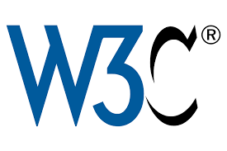
Building towards a united future
The World Wide Web Consortium (W3C) is doing great work to develop Web standards. W3C's vision for the Web involves participation, sharing knowledge, and thereby building trust on a global scale.
The Postsecondary Electronic Standards Council (PESC) leads the establishment and adoption of trusted, free and open data standards across the education domain by serving as an ​​open standards-development and open standards-setting body.
The 1EdTech community provides collaborative leadership that shapes the foundation of an open edtech ecosystem now and into the future to enable unlimited potential in every learner.
Notes:
Presenter: Kevin
Notes:
I was just in the UK and Ireland last month and assumed that my Ireland plug would work just fine for my electronic devices when I came here to Holland. I was mistaken!
Fortunately the front desk at the hotel had a branded plug that would work…validating that I’m not the only one! Don’t tell me that I’m the only one who made this mistake.
Standards are important!
When we think about standards today, there are several organizations that come to the forefront of our minds
Organizations like WC3, PESC, and 1EdTech (the artist formerly known as IMS Global) play an important role in casting the vision for, and standards of, academic credentials now and into the future.

Slide 13
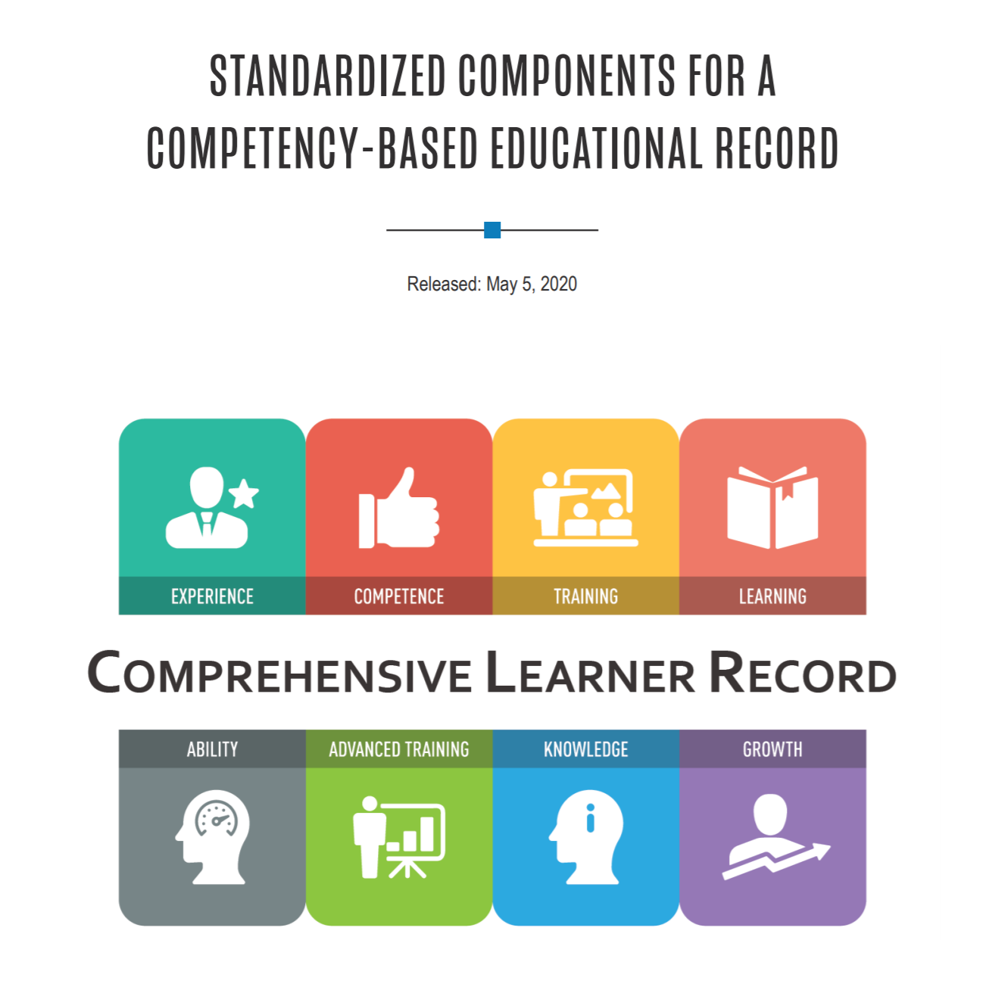
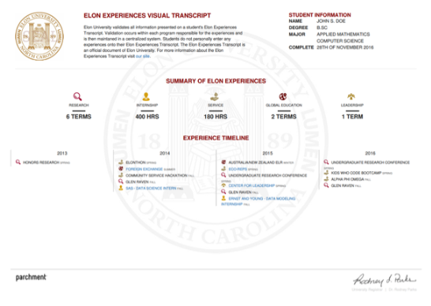
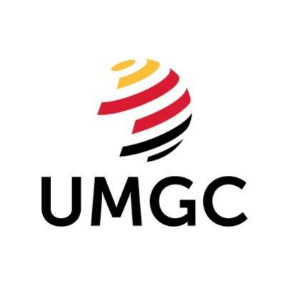
Credential innovation supporting learners in our modern society
The conversation started over a decade ago around academic transcripts, but has quickly expanding to include Diplomas, Certificates, Digital Badges, Verifications, CLRs, LERs, and so on.
‘New Credentials’ have emerged aim to provide a fuller picture of a learners capability and represents the breadth of what learners know and can do, and who they have become, as a result of their learning.
Notes:
Presenter: Kevin
Notes:
We want to represent what the learner knows and how well they know it.
Beyond that, we want to provide credentials to learners that meet their specific needs along their enrollment and employment pathways.
This has led to tremendous innovation in credentials, not limited to academic transcripts, but Diplomas, Certificates, Badges, and Comprehensive Learner Records.

Slide 14
What does it mean to innovate academic credentials?
1 | Go digital. Beginning with the eTranscript and expand to all credential types: diplomas, certificates, verifications and digital badges.
2 | Do what paper can’t. Take the digital form beyond just an image of its paper counterpart with clickable, visual and machine-readable data for added functionality.
3 | Create new pathways. Enhance credential exchange to support the diverse pathways learners take across institutions on their way to an academic degree, ensuring portability of courses and credits to maximize degree completion and learner success.
4 | Communicate more content. Add competency-based and experiential, or co-curricular, data to show the full impact of a postsecondary education.
5 | Make it actionable. Align with our digital and mobile culture, enabling learners to store credentials in one place where information can be easily displayed in online profiles, such as professional or social networking sites.
Notes:
Presenter: Kevin
Notes:
You have to start somewhere.
It’s difficult to innovate paper.
Today institutions are going digital, not just with Transcripts (which started over a decade ago), but diplomas, badges, etc.
If you think about the types of credentials that higher education issues, each has a role to play, aligned from highest level to the most detailed. Diplomas and non- degree certificates are mechanisms for verifying degree completion, and in many ways act as the learner currency most aligned with the labor market.
Quickly institutions are partnering with organizations like those mentioned earlier to create new pathways, communicate more content, and make these credentials actionable for learners.

Slide 15
What the future holds..
"The only way you can predict the future is to build it."
-Alan Kay
Notes:
Quote by Alan Kay, computer scientist and winner of the 2003 A.M. Turing Award, the highest honour in computer science.

Slide 16
The Rise of Skills-Based Hiring
With the rise of skills-based hiring, there is an even greater need for skills data.
Employees are progressively needing to learn new skills as demand moves from physical and cognitive to more technical and socialisation skills.
We need equitable, interoperable systems built to inform and empower learners.
Notes:
Presenter: Kevin
Notes:
The emergence of digital credentials has been creating a culture of recognition.
The next step is to put those credentials to work.
Employers are beginning to use new techniques in hiring and assessing employees such as analysis of data to make employment decisions. At the most basic level, employers assess the success of students from particular universities and direct their recruiting efforts to those universities that yield the most competent employees.
In the future, employers will be able to analyze thousands of potential applicants as digital credentials become tied to specific job skills and are listed on online resumes and web-based profiles. Digital credentials will become the building blocks for both applicants and employers as the marketplace for skills and technology becomes more sophisticated.

Slide 17
Standards, Interoperability, and Transparency
Notes:
Presenter: Kevin
Notes:
The place for standards organizations will persist into the future.
But the need for interoperability and transparency will be built on the foundation of those standards.
Two organizations in the United States come to mind:
Credential Engine provides web-based services that creates a centralized Credential Registry to house up-to-date information about all credentials, a common description language to enable credential comparability, and a platform to support customized applications to search and retrieve information about credentials.
Credential As You Go focuses on building an incremental credentialing system. Recognizing that many types credentials document an individual’s learning, and credentials are awarded by many types of providers including community and technical colleges, four-year colleges and universities, third-party organizations, employers, military, and state licensing boards.

Slide 18
Continuing to Build National Networks, and Bridge Them
If ever there was a time when the value of global collaboration was starkly evident, that time is now, as we exit the pandemic that every nation in the world grappled with.
Given the compelling need to collaborate and the increasing use of digital technologies, there is value in collaboration to build the infrastructure and processes needed to:
Continue to build national networks
Bridge these national networks to ensure that we have equitable, interoperable systems built to inform and empower greater student mobility.
Notes:
Presenter: Kevin
Notes:
I’m incredibly impressed with the individuals and institutions that are represented in this room.
Over the next 10-years I expect that we will continue to build national networks. We need to do this and can’t leave out those countries that need it most.
Finally, for all of the reasons discussed today, in particular for the most vulnerable populations in our localities, countries, and world, we need to bridge these networks to ensure that all people have access to equitable, interoperable systems that enhance their mobility.

