Slide 1
Europass
Take the next step

Slide 2

Europass and My diplomas
Agenda
Introduction
Old school Europass
New digital Europass
Connection Europass – My diplomas

Slide 3
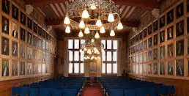
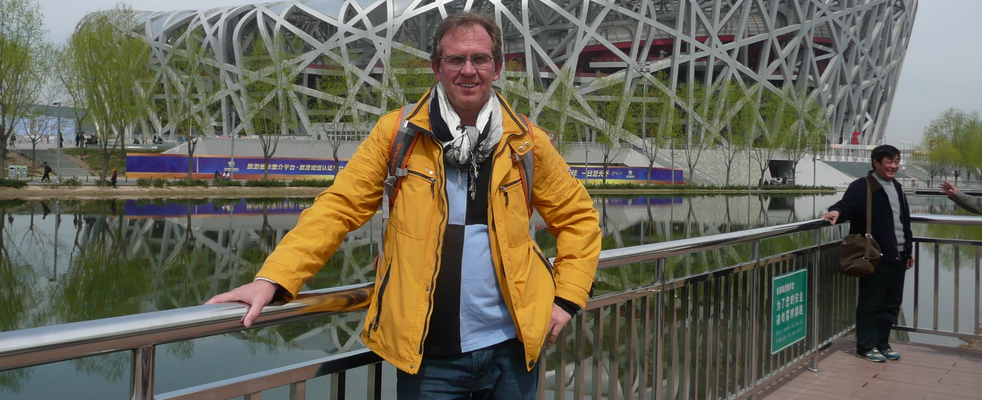
1. Introduction
Dik van der Wal
One of the founding fathers of the GDN
In 2012 International launch of the Dutch Diplomaregister at the RUG
Became famous for wearing a yellow jacket
Manager International Services at DUO
Chair Dutch Europass consortium
New job in a few weeks….
My final GDN-meeting

Slide 4
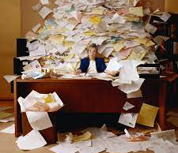
2. Old school Europass
2005 - 2020

Slide 5
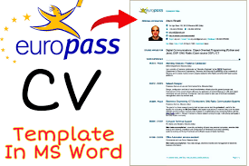
Old school Europass
Europass 2005-2020
5 different standardised paper documents:
  Europass CV
  Certificate Supplement
  Diploma Supplement
  Europass Mobility
  Language Passport
  In NLD extra: Certificate for Volunteers

Slide 6

History
Focus on international student mobility
Europe as knowledge continent, international mobility promotes peace and understanding
Similar documents makes international mobility a lot easier
The CV is the most important document
About 200.000.000 Europass CV’s

Slide 7

Some Dutch successes
More than 800 different Certificate Supplements in Dutch and English available at SBB
Diploma Supplement in Dutch and English awarded by each graduation in HE
Europass Mobility used by Erasmus programs
Mobility for volunteers
Language Passport is incorporated in the Europass CV

Slide 8

3. New digital Europass
Started in 2020

Slide 9
New Europass
Completely digital
Flexible instead of standard
Focus on supporting Lifelong Learning (LLL)
National and international
For students and (inter)national jobseekers
For free
Close connected to other European networks and developments (EURES/Euroguidance/Wallets/E- Identity)
You are yourself the owner of your data / free control of personal data
Self-assessment of skills to help define career and learning goals;

Slide 10

Three building blocks
1. Europass e-portfolio
2. Europass portal
3. Digital credentials

Slide 11
1. E-portfolio
Support individuals to document and describe their skills, qualifications and experience and to manage their career from a lifelong learning perspective.
Europass gives the possibility to upload and store your documents (educational, work experience)in a safe way.
The EU-login is totally safe. Europass is off course GDPR compliant.
The user is the owner of his own documents and decides himself with whom and when he shares the data.
You can make your own personalized CV in different formats, cover letters etc.
Similar to LinkedIn (but not commercial, for free and with certified documents).
Europass E-portfolio is a digital Wallet in which you can store all kind of information, par example about your applications.

Slide 12
Example
E-portfolio

Slide 13
2. Europass portal
Provide information and links to national sources to help users find jobs, courses and local support.
Information about Europass
Information about Euroguidance
Information about the European Qualification Framework (EQF)
Country information about learning and working
Available in all European Languages

Slide 14
3. Digital Credentials Infrastructure
One European Framework for issuing digital credentials.
A credential, in its most essential form, is a documented statement containing claims made about a person.
A European Digital Credential for Learning describes that the owner has certain skills or has achieved certain learning outcomes through formal or non-formal learning context.
A digitally-signature (e-Seal) guarantees the origin and integrity of the document.

Slide 15
3. Digital Credentials Infrastructure
One European Framework for issuing digital credentials.
Issue credentials and send them to their owners;
01
Store credentials securely in a single online or offline wallet;
02
Verify if the credential is authentic, valid and issued by an accredited organization;
03
Share the information in the credential with any other person or organization.
04

Slide 16
Example of a
Digital credential

Slide 17

4. Europass and My diplomas:

Slide 18
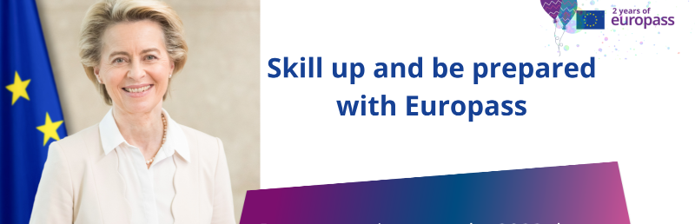
Europass and My diplomas
You can also safely store all documents from My diplomas in your own Europass portfolio and share it (possibly as a CV) when and with whome you want.

Slide 19
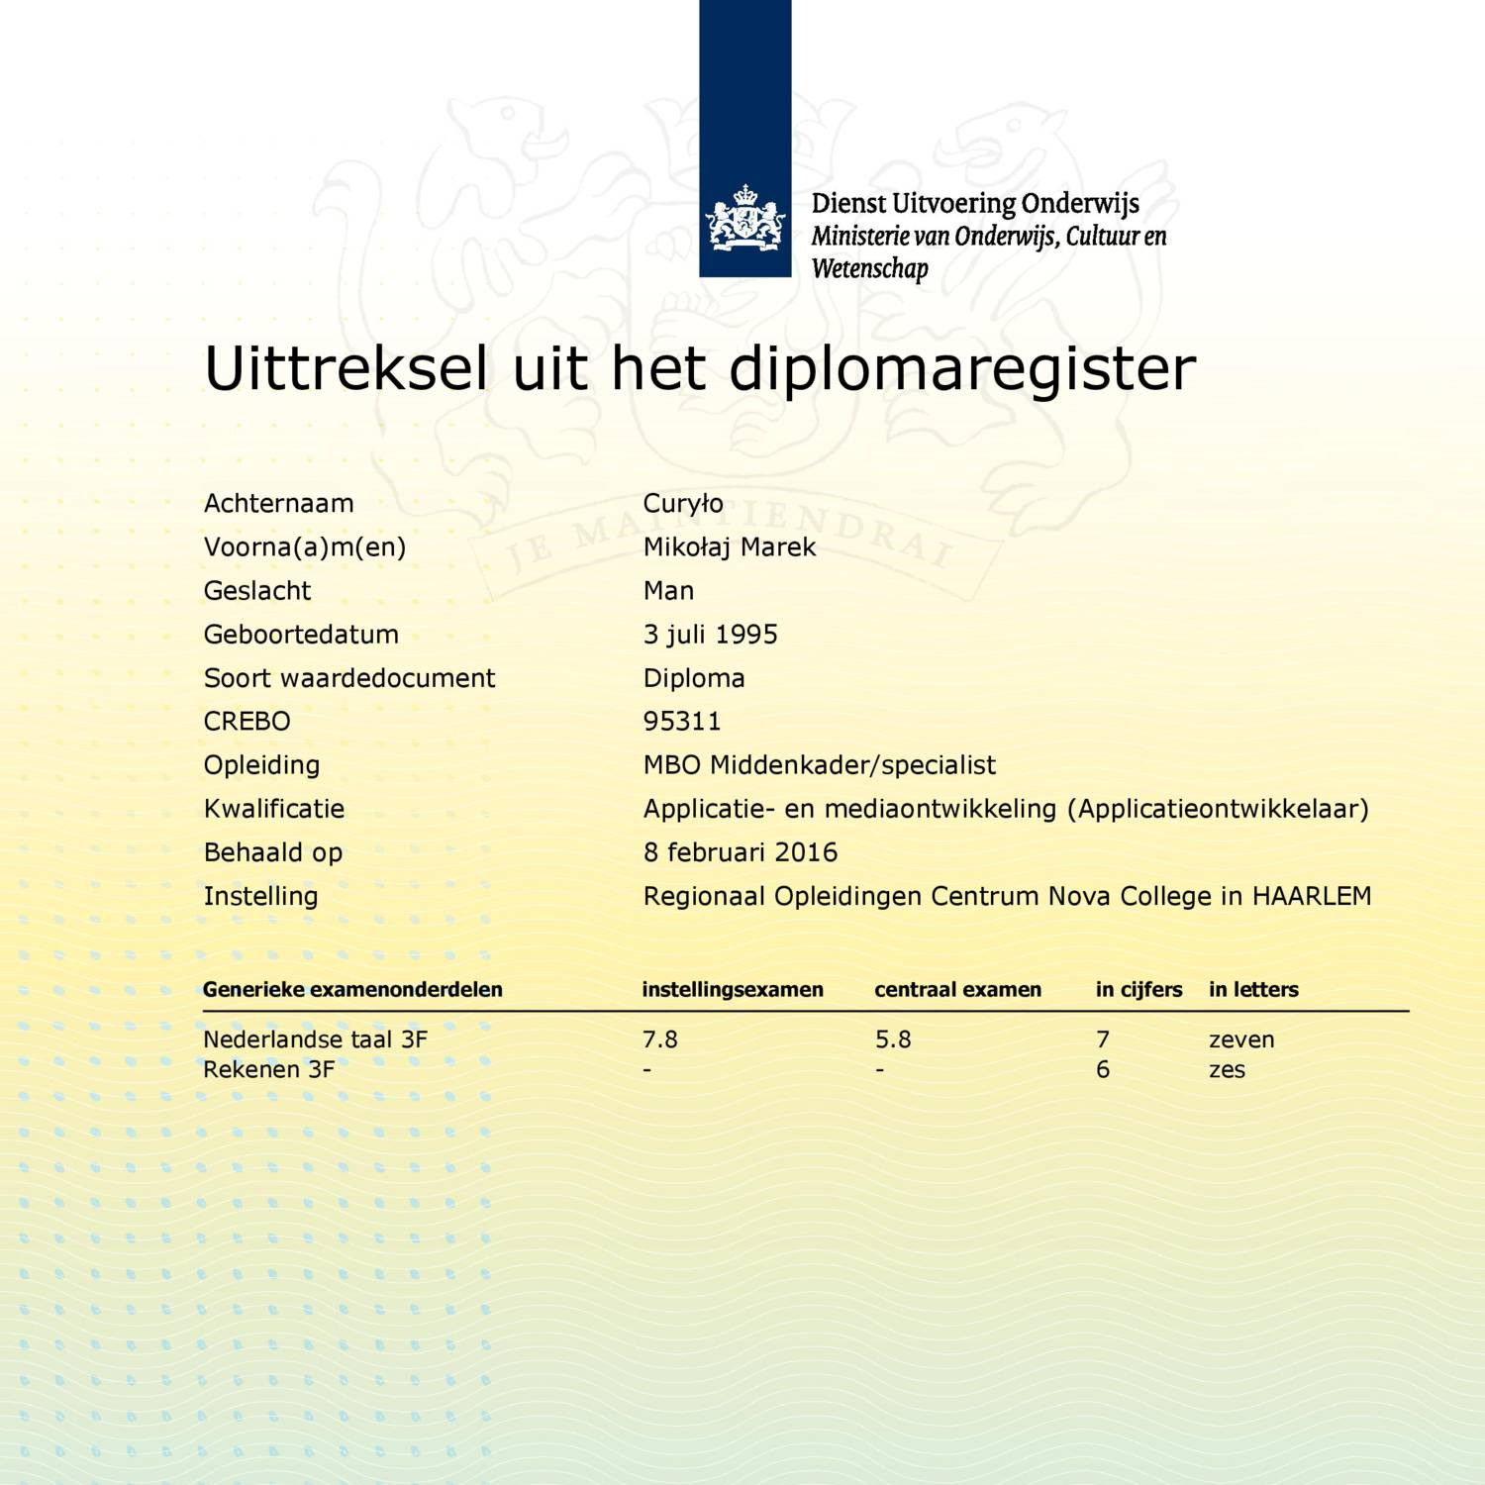
Near future:
1. Europass Certificate Supplement automatically shared while downloading your Vocational diploma from My diplomas
2. Financial diploma’s stored by DUO and shared by My diplomas
3. Europass Diploma Supplement stored in My diplomas
4. Microcredentials stored in a MC register by DUO and shared by My diplomas

Slide 20
Thank you!

