Slide 1
From Learning to Earning
the Relationship of Skills & Higher Education
Western Governors University
Sarah DeMark
Vice Provost, Workforce Intelligence & Credential Integrity
Kacey Thorne
Sr. Director, Skills Architecture
Darin R. Hobbs
Vice President, Academic Records, Credentials, and Career
© 2021 Western Governors University – WGU. All Rights Reserved​

Slide 2
PROUDLY NONPROFIT
Founded in 1997 by a bipartisan group of 19 governors.
CORE EXPERIENCE 100% ONLINE
Competency-based and self-paced
MADE UP OF FOUR SCHOOLS
Business, IT, Health Professions, K-12 Teacher Education
INNOVATIVE CURRICULUM DESIGN
Workforce-aligned
Skills-based
Built industry certifications into our curriculum.

Slide 3
Problem Statement:
Learners need to gain new skills & communicate the value of their accomplishments.
Academic achievements don’t encompass the skills employers desire.
Learner records are flat transcripts that tell little of a learner's journey.
Pathways are static, inflexible, and discount learners’ unique needs
© 2021 Western Governors University – WGU. All Rights Reserved​
Notes:
We want to promote a more equitable, skills-driven national talent pipeline that matches earner/learners with skills-based education and career opportunities to the benefit of the individual, employer, and economy at large.
A national open infrastructure is critical to support the future of work and the development of agile and robust talent pipelines where all individuals have the opportunity to achieve their career goals.

Slide 4
WGU’s Use Case
Design and configure academic achievements based on open technical standards to enable the interoperability of skills, pathways, achievements, and records at scale for more equitable pathways to opportunity.
© 2021 Western Governors University – WGU. All Rights Reserved​

Slide 5
A Case for Open Standards machine-readable and actionable
Learner/Earners
Open Skills
Open Records
Open Pathways
Open Achievements
Employers
Education
Providers
© 2021 Western Governors University – WGU. All Rights Reserved​
Notes:
Open standards are the foundation for enabling WGU’s Achievement Architecture.
Through adoption of open standards, WGU seeks to ensure dynamic, personalized learning experiences for all learners that lead to a meaningful, actionable learner-owned record to be curated and shared across education providers and employers.
Open Skills: Reduces cost and improves the quality of documentation of in-demand skills from the labor market through a shared, machine-readable, and translatable format.
Open Pathways: Creates a standard logic to stack and share learning achievements within and across multiple education and employment providers.
Open Achievements: Serves as a consistent, machine-readable protocol for packaging information about accomplishments and recognition of experience and learning.
Open Records: Enables learners to access verifiable achievement records from any institution or platform and to share them with any education provider or employer using a standard messaging protocol

Slide 6
A Case for Open Standards machine-readable and actionable
Open Skills
Enable a common language of skills.
Open Records
Open Pathways
Enable digital assertions to a learner-owned record.
Enable personalized learning pathways.
Open Achievements
Enable verifiable and sharable digital achievements.
© 2021 Western Governors University – WGU. All Rights Reserved​
Notes:
Open standards are the foundation for enabling WGU’s Achievement Architecture.
Through adoption of open standards, WGU seeks to ensure dynamic, personalized learning experiences for all learners that lead to a meaningful, actionable learner-owned record to be curated and shared across education providers and employers.
Open Skills: Reduces cost and improves the quality of documentation of in-demand skills from the labor market through a shared, machine-readable, and translatable format.
Open Pathways: Creates a standard logic to stack and share learning achievements within and across multiple education and employment providers.
Open Achievements: Serves as a consistent, machine-readable protocol for packaging information about accomplishments and recognition of experience and learning.
Open Records: Enables learners to access verifiable achievement records from any institution or platform and to share them with any education provider or employer using a standard messaging protocol

Slide 7
Why Open Skills
Earner/learners need:
to identify, represent, and communicate the value of their skills in a common language
Employers need:
to create clearer, skills-based job descriptions
to make better, faster, cost-effective hiring and training decisions
to understand the skillset of their current workforce
Education providers need:
to ensure their programs and curriculum reflect the skills learners need to be successful in the workforce
to develop more transparent, value-based, student-centric credentials
Open Skills
Enable a common language of skills.
© 2021 Western Governors University – WGU. All Rights Reserved​
Notes:
Open standards are the foundation for enabling WGU’s Achievement Architecture.
Through adoption of open standards, WGU seeks to ensure dynamic, personalized learning experiences for all learners that lead to a meaningful, actionable learner-owned record to be curated and shared across education providers and employers.
Open Skills: Reduces cost and improves the quality of documentation of in-demand skills from the labor market through a shared, machine-readable, and translatable format.
Open Pathways: Creates a standard logic to stack and share learning achievements within and across multiple education and employment providers.
Open Achievements: Serves as a consistent, machine-readable protocol for packaging information about accomplishments and recognition of experience and learning.
Open Records: Enables learners to access verifiable achievement records from any institution or platform and to share them with any education provider or employer using a standard messaging protocol

Slide 8
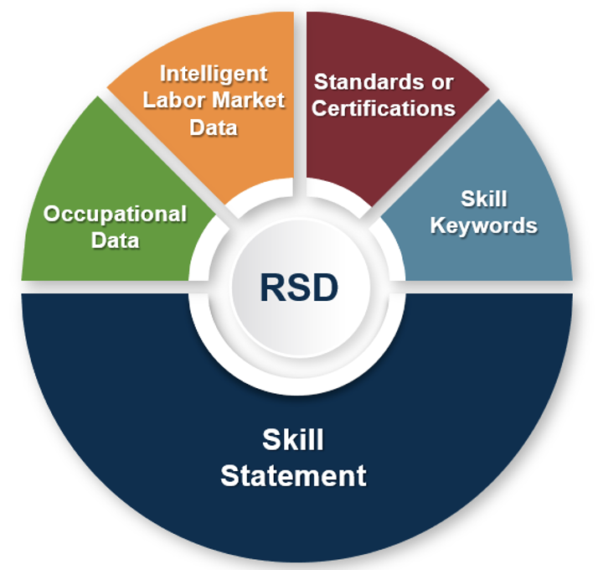
Rich Skill Descriptor (RSD)
A Rich Skill Descriptor (RSD):
Contextualized skill statement
Associated metadata
= Interoperability of skills.
© 2021 Western Governors University – WGU. All Rights Reserved​
Notes:
Slide owner: Allison Blackwell lead, Wayne provide input/supporting info
**Can also revamp image to include employers, maybe remove skill keywords?

Slide 9
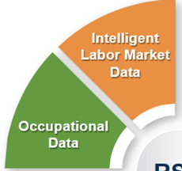
Market Information Strategies
Data Resources
Lightcast (formerly Emsi Burning Glass)
Industry reports & forecasts
Skills demand reports from other learning organizations (Coursera, LinkedIn)
Industry skills frameworks
Accreditation & licensure requirements
Open skills libraries
Industry Engagement
Employer partners at community & national level
Workforce development organizations
Focus groups with hiring managers
Employer & alumni surveys

Slide 10
WGU Skills Library Collections
At WGU, we use our skills library to inform competencies in our educational model. This ensures that our courses are reflective of labor market demands.
Skills Libraries:
Centralized and structured collections
Contain skills data, qualifications, and attributes
Create a unified understanding of skills for employment, curriculum development, job architecture, or competency grouping
WGU Open Skills Library

Slide 11
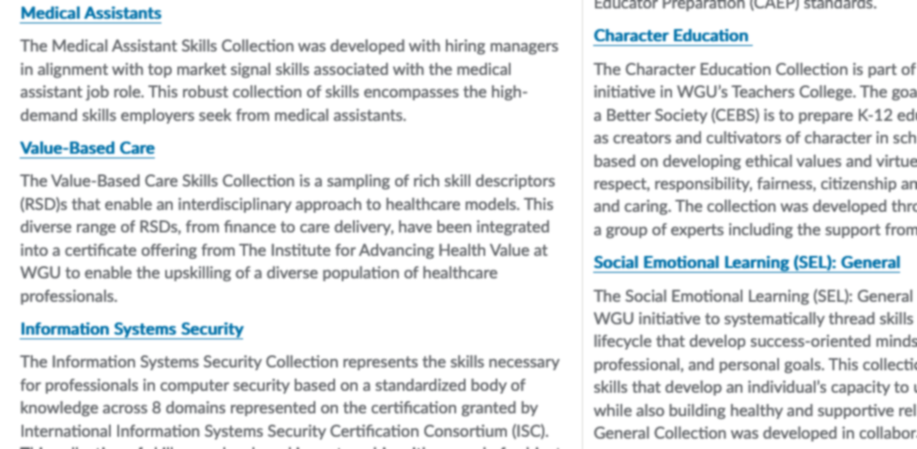

Slide 12
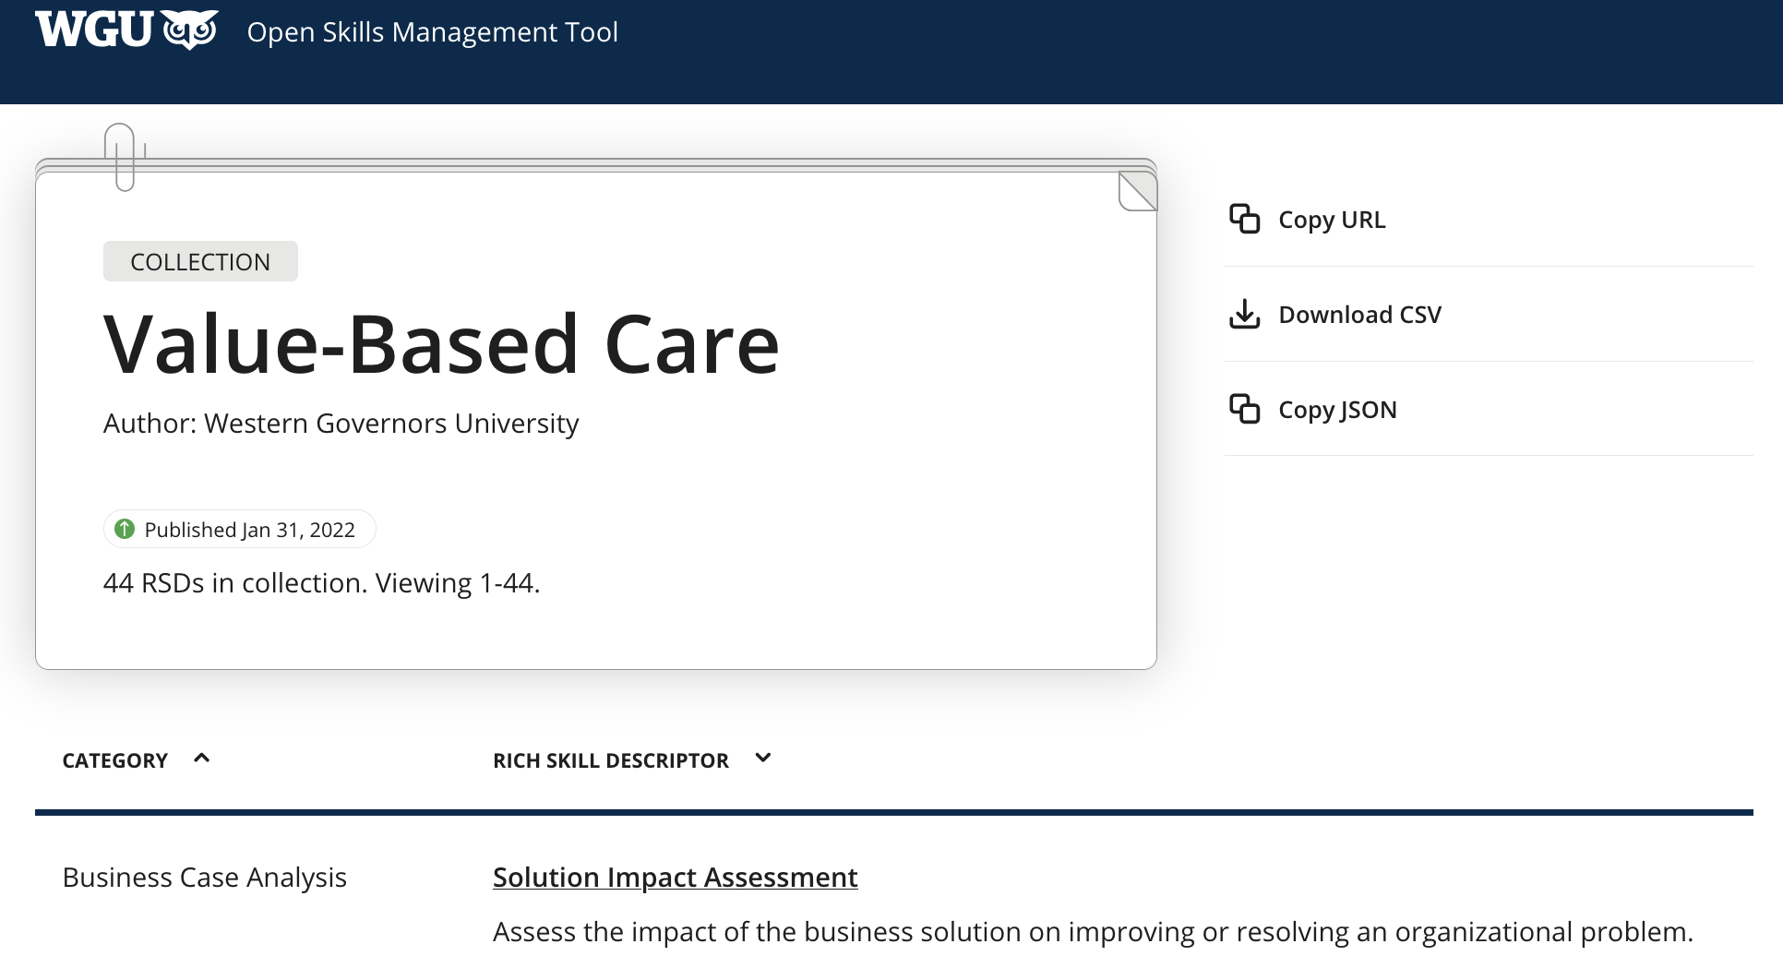

Slide 13
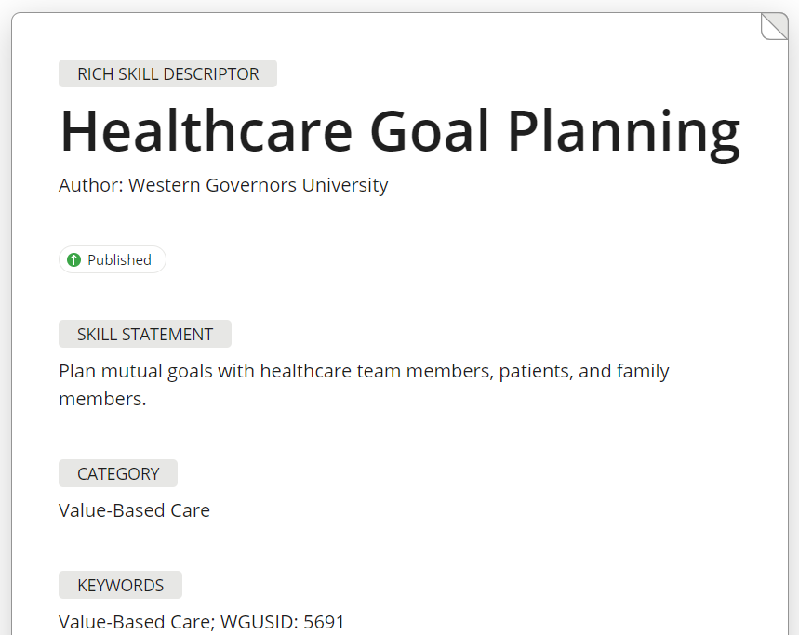
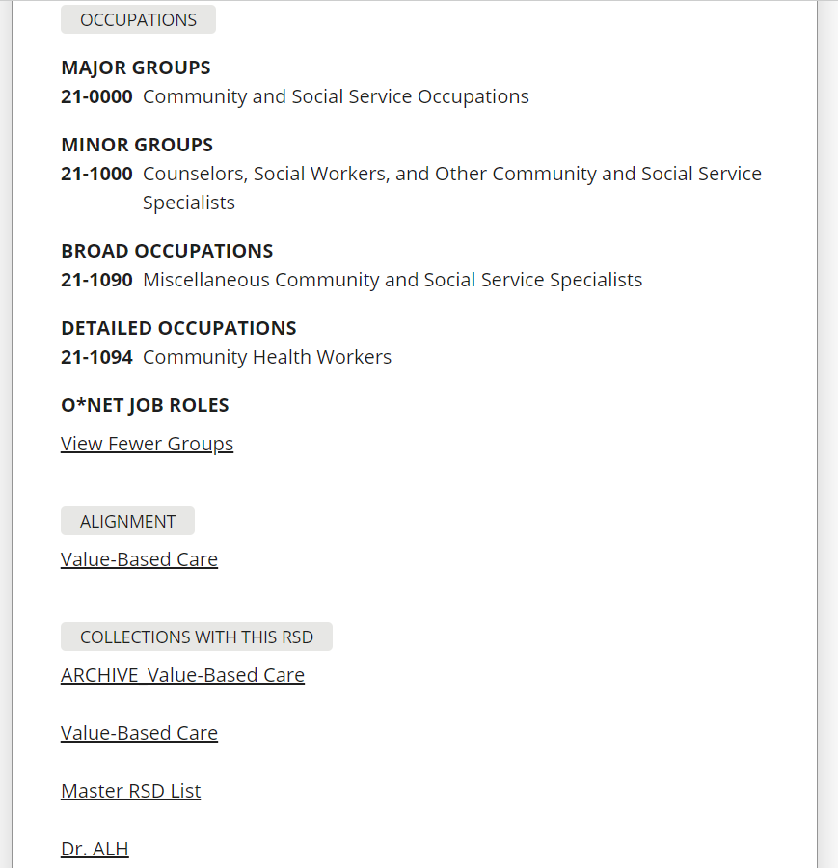
Sample RSD: Healthcare Goal Planning

Slide 14
Why Open Achievements
Earner/learners need more transparency:
to understand the value of their achievements in the context of skills and competencies
to represent experiences, trainings, and accomplishments that aren’t found on traditional records
Employers need more transparency:
to view the skills that earner/learners obtained through credentials and experience
Education providers need to provide more transparency:
to recognize skills and achievements beyond the degree
Enable verifiable and sharable digital achievements.
Open Achievements
© 2021 Western Governors University – WGU. All Rights Reserved​
Notes:
Open standards are the foundation for enabling WGU’s Achievement Architecture.
Through adoption of open standards, WGU seeks to ensure dynamic, personalized learning experiences for all learners that lead to a meaningful, actionable learner-owned record to be curated and shared across education providers and employers.
Open Skills: Reduces cost and improves the quality of documentation of in-demand skills from the labor market through a shared, machine-readable, and translatable format.
Open Pathways: Creates a standard logic to stack and share learning achievements within and across multiple education and employment providers.
Open Achievements: Serves as a consistent, machine-readable protocol for packaging information about accomplishments and recognition of experience and learning.
Open Records: Enables learners to access verifiable achievement records from any institution or platform and to share them with any education provider or employer using a standard messaging protocol

Slide 15
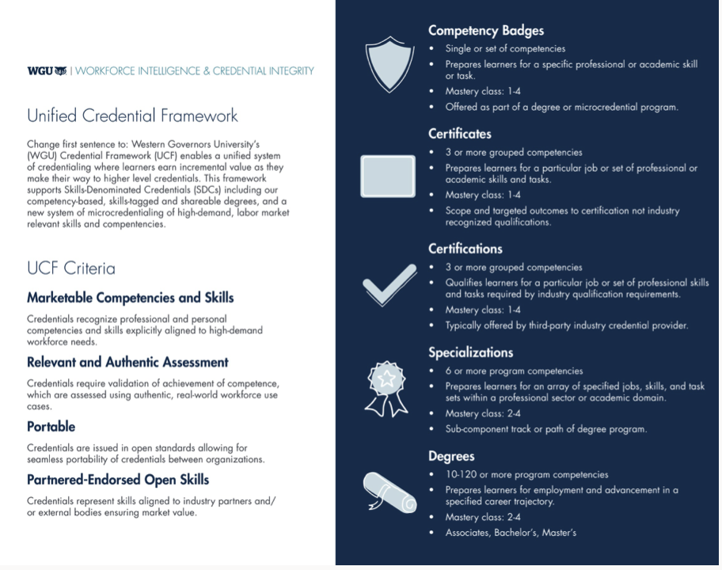

Slide 16
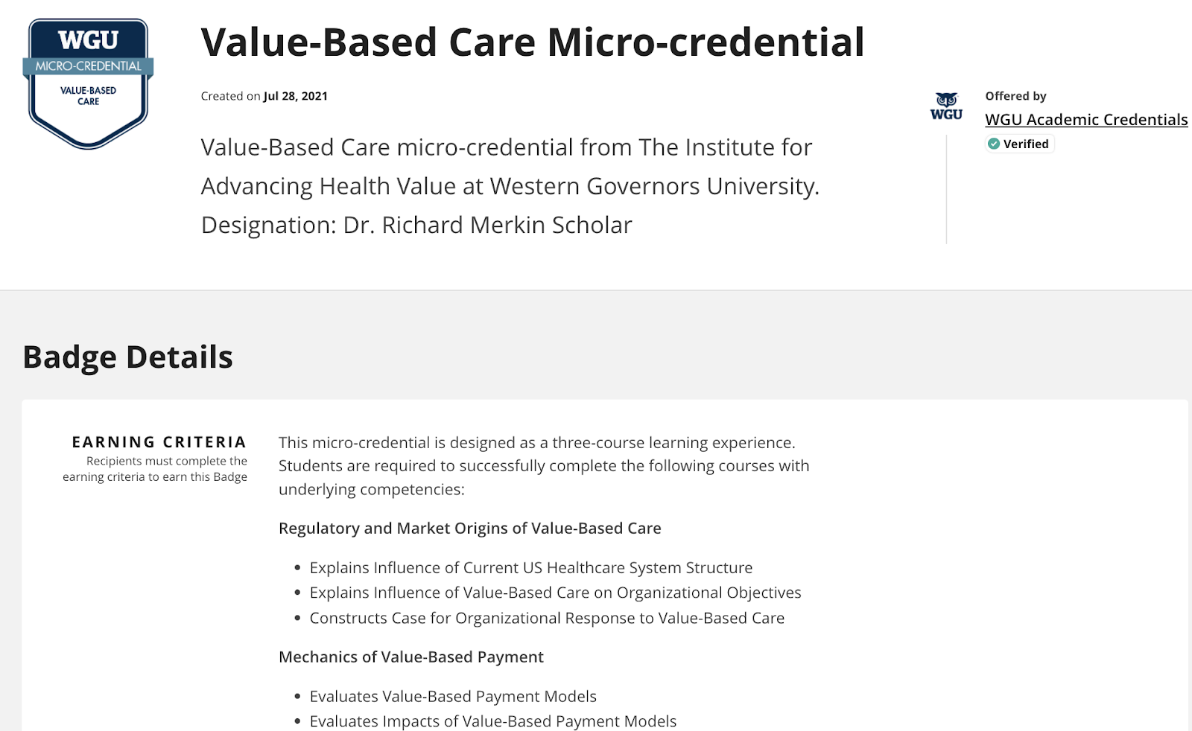
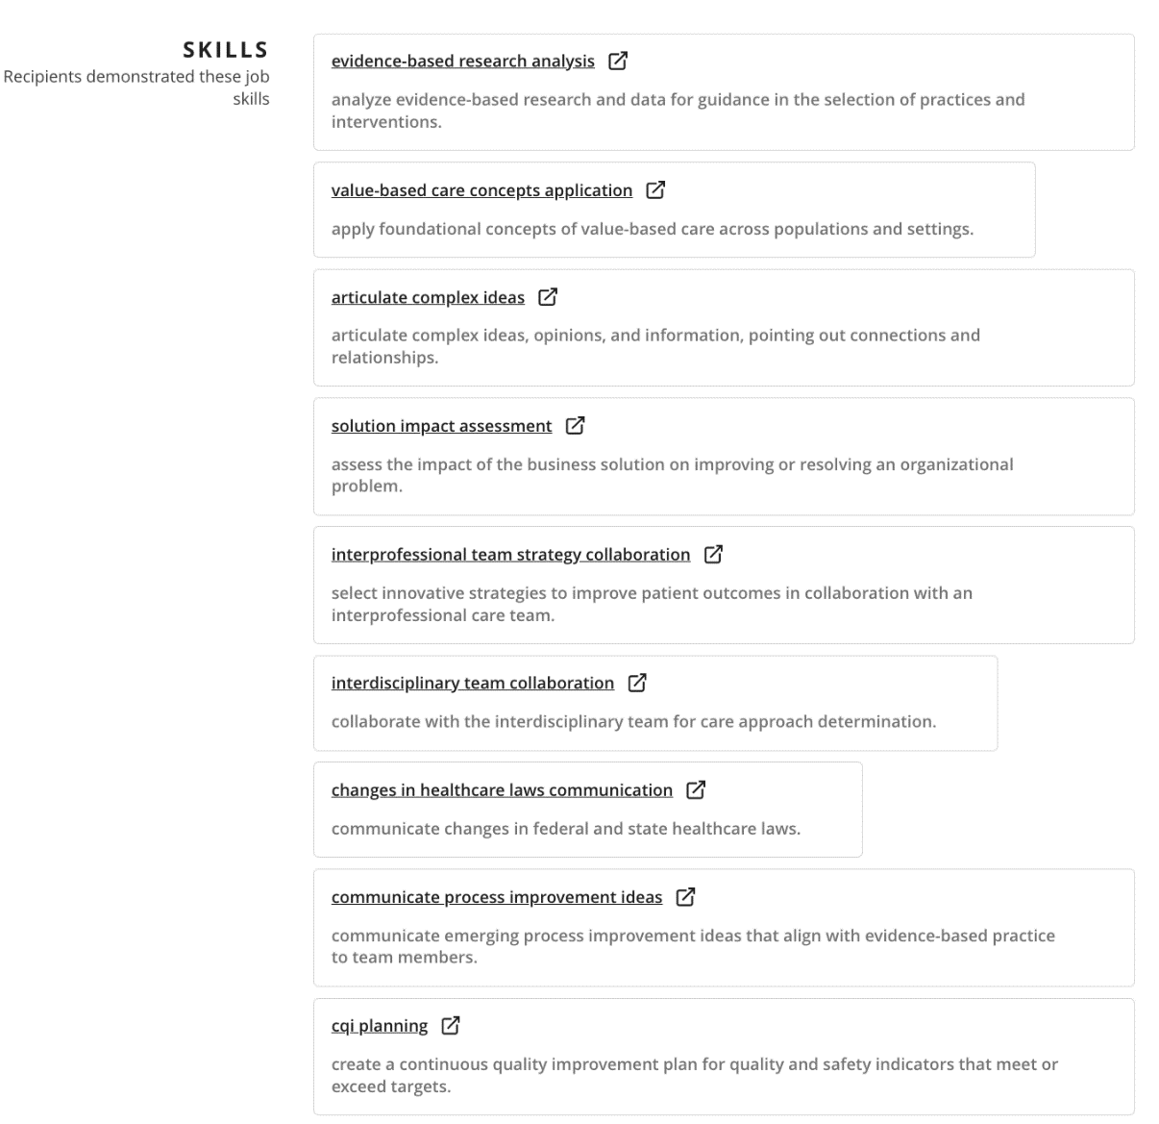

Slide 17
Why Open Records
Earner/learners need to:
own, curate, and share their unique talent brand in a competitive job market
Employers need to:
locate job-ready talent
expedite the hiring process
Education providers need to:
accelerate enrollment and admissions decisions
assert and signify learner achievements as they are earned
Open Records
Enable digital assertions to a learner owned record.
© 2021 Western Governors University – WGU. All Rights Reserved​
Notes:
Open standards are the foundation for enabling WGU’s Achievement Architecture.
Through adoption of open standards, WGU seeks to ensure dynamic, personalized learning experiences for all learners that lead to a meaningful, actionable learner-owned record to be curated and shared across education providers and employers.
Open Skills: Reduces cost and improves the quality of documentation of in-demand skills from the labor market through a shared, machine-readable, and translatable format.
Open Pathways: Creates a standard logic to stack and share learning achievements within and across multiple education and employment providers.
Open Achievements: Serves as a consistent, machine-readable protocol for packaging information about accomplishments and recognition of experience and learning.
Open Records: Enables learners to access verifiable achievement records from any institution or platform and to share them with any education provider or employer using a standard messaging protocol

Slide 18
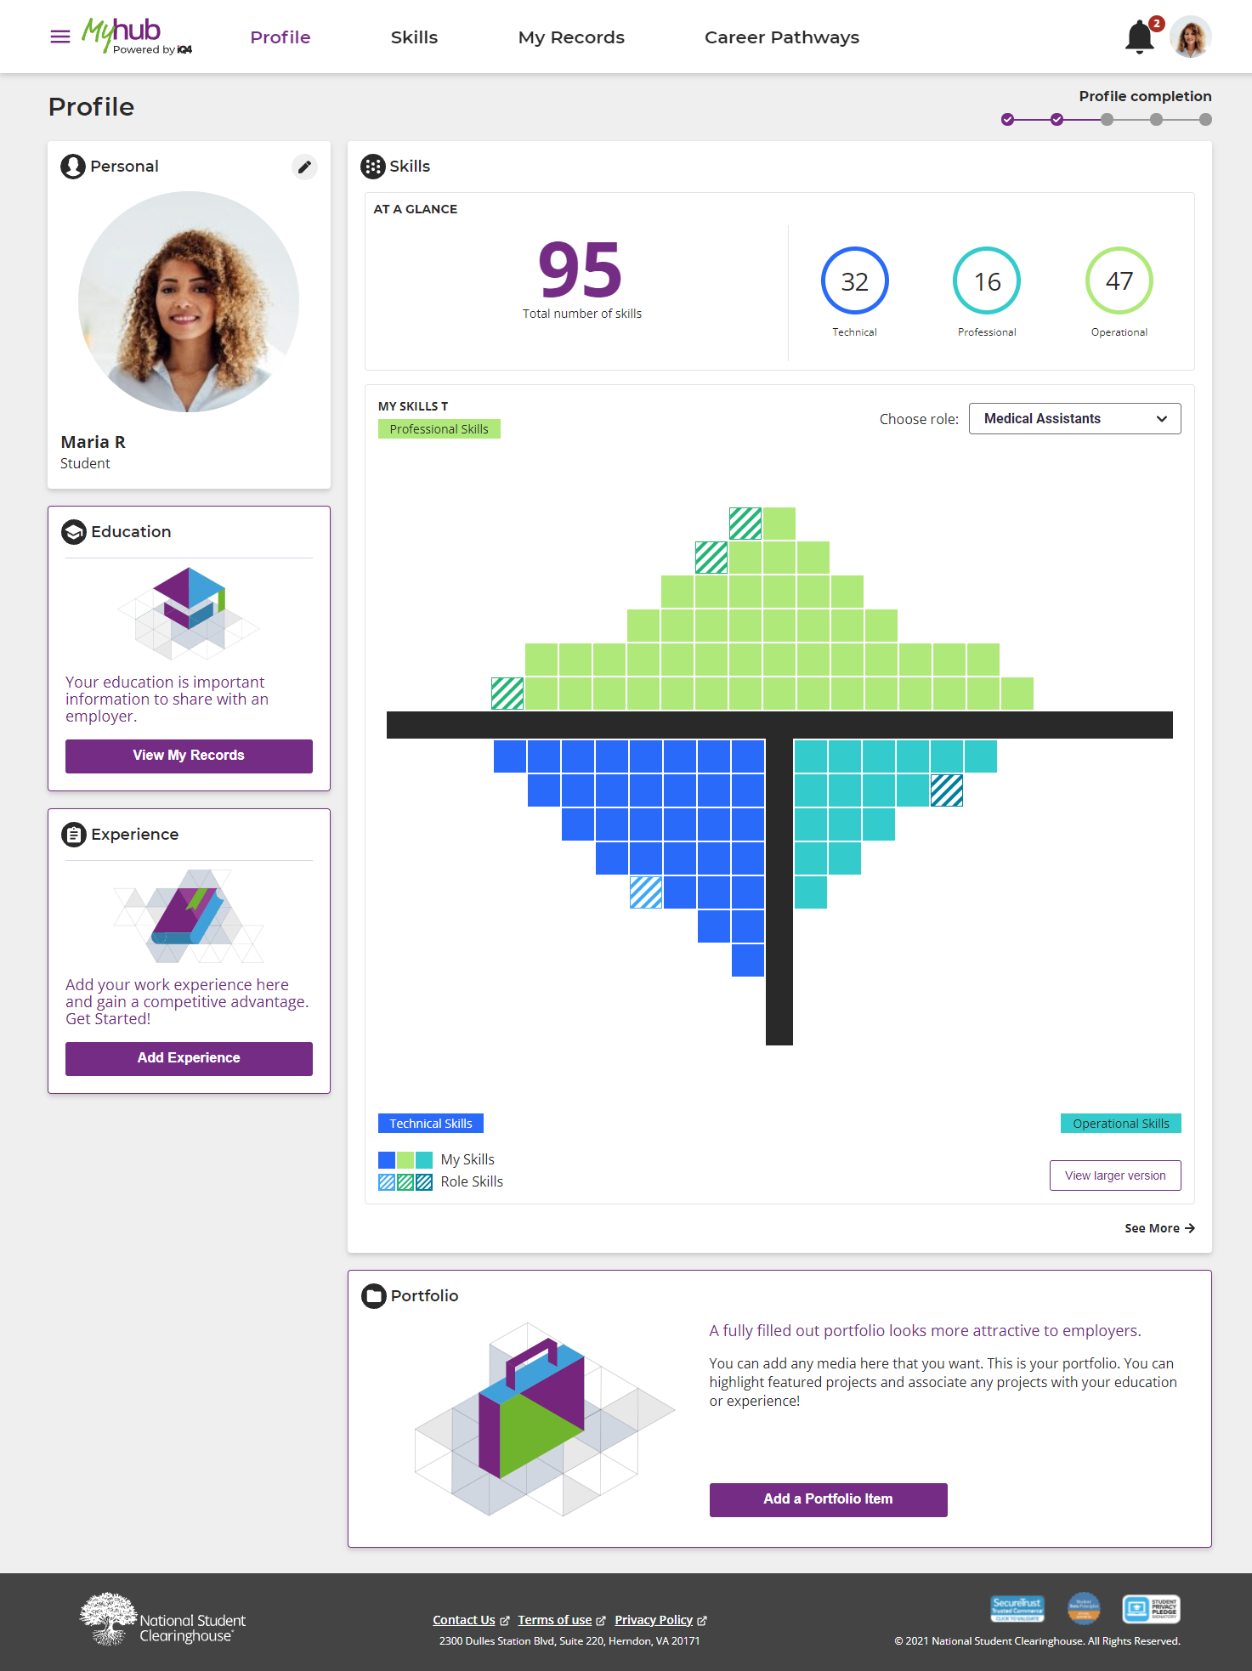
Profile
Skills
My Records
Career Pathways

Slide 19
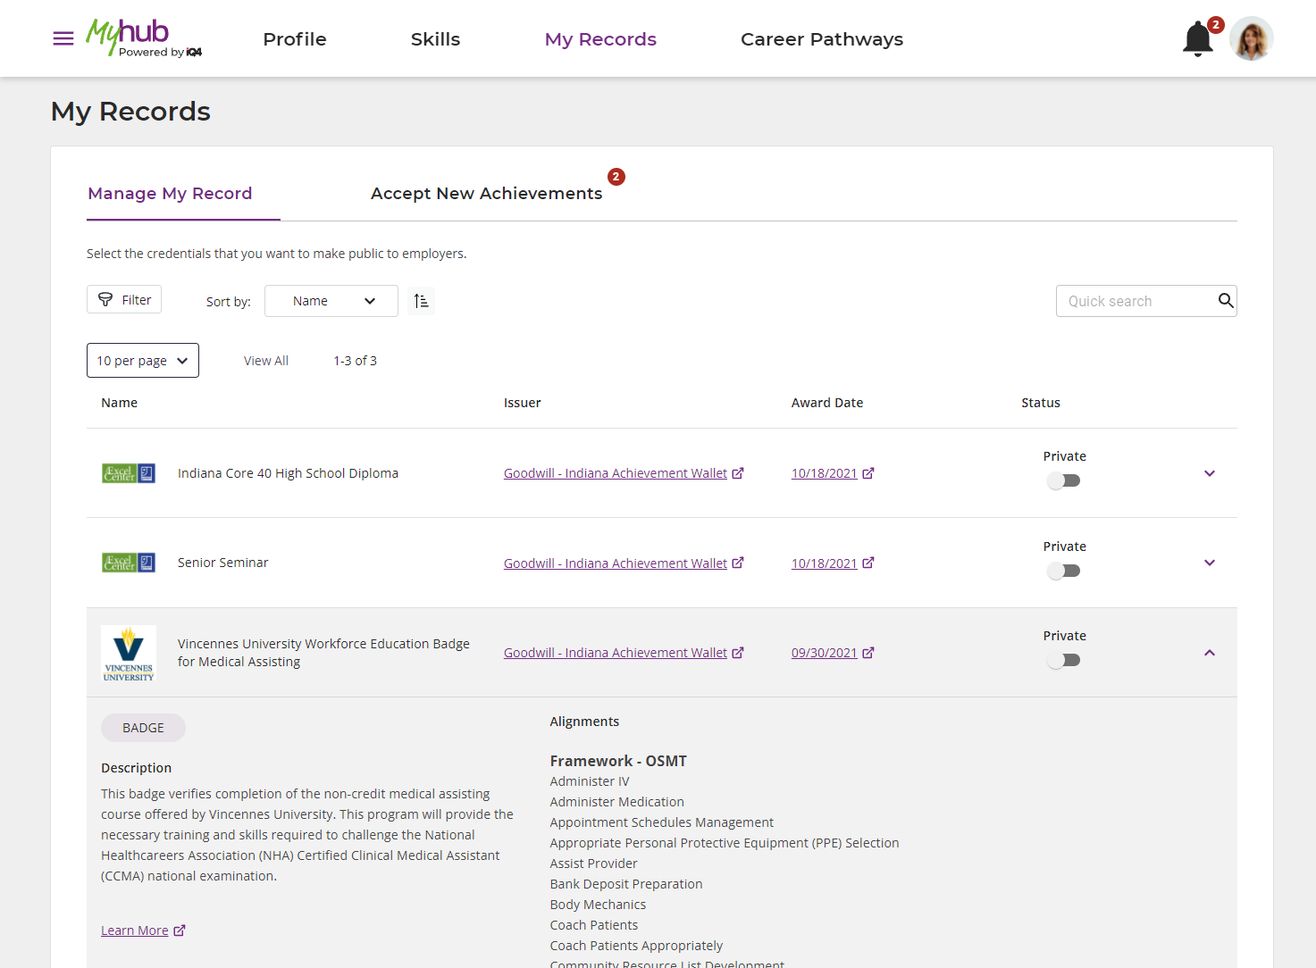
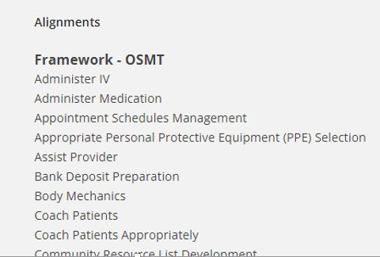
Profile
Skills
My Records
Career Pathways

Slide 20
Why Open Pathways
Earner/learners need:
to explore a variety of pathways to opportunity
to identify next steps to achieve their goals
Employers need:
to create transparent career trajectories
to know and grow their talent
Education providers need:
to create pathways that enable seamless skilling, reskilling, and upskilling
to be proactive, agile, and responsive to shifting workforce needs
Open Pathways
Enable personalized learning pathways.

Slide 21
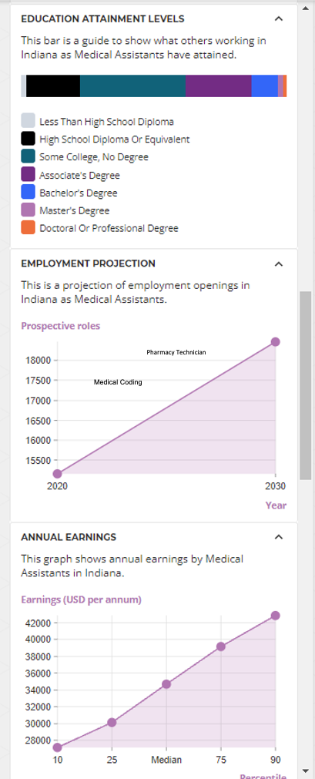
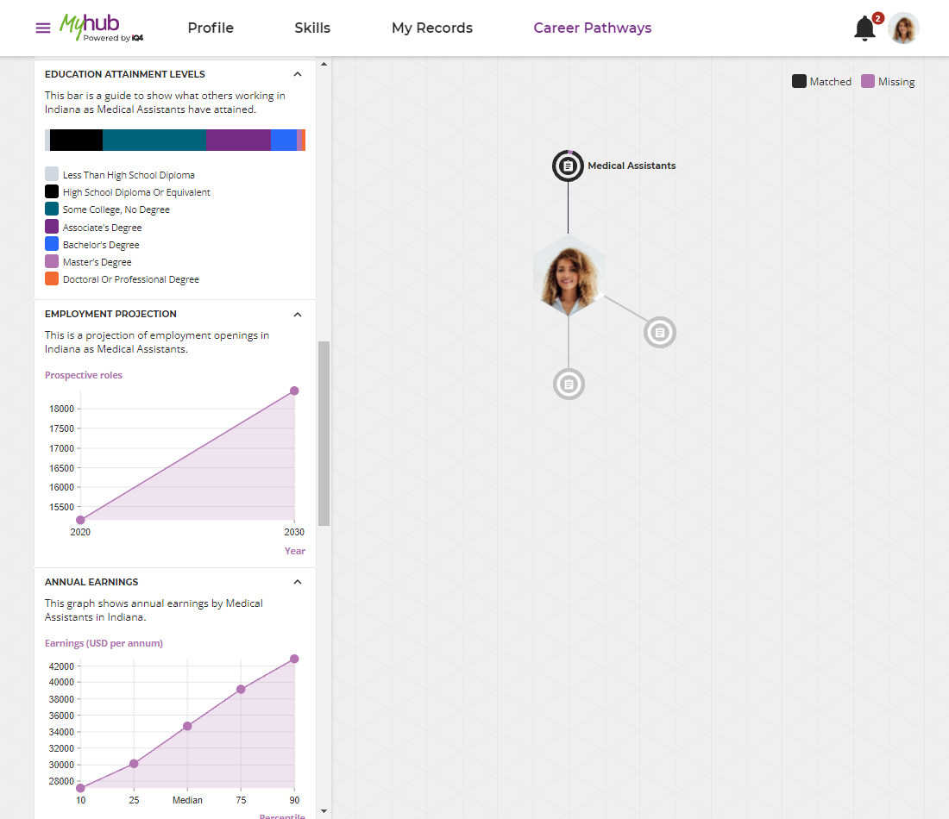
Profile
Skills
Pharmacy Technician
Medical Coding
My Records
Career Pathways

Slide 22
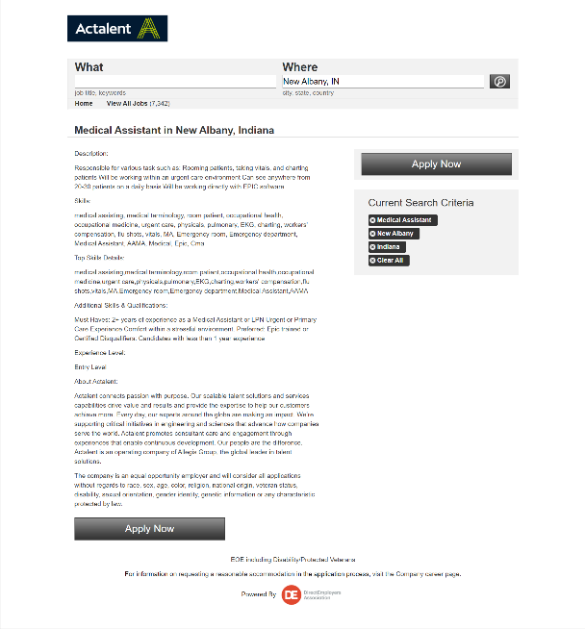
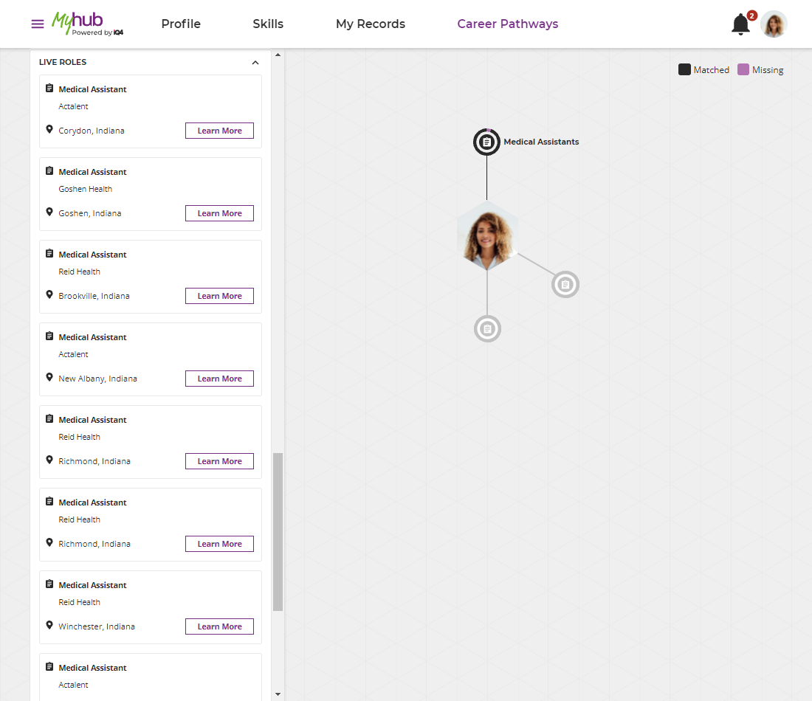
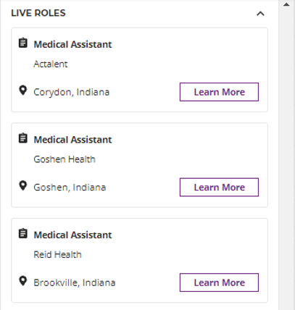
Profile
Pharmacy Technician
Skills
Medical Coding
My Records
Career Pathways

Slide 23
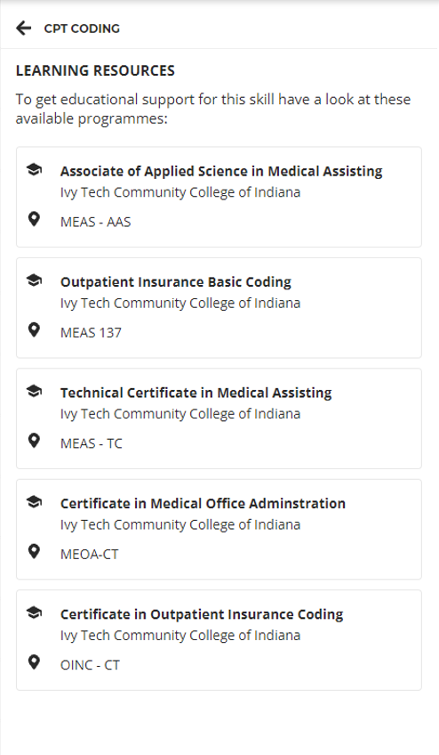
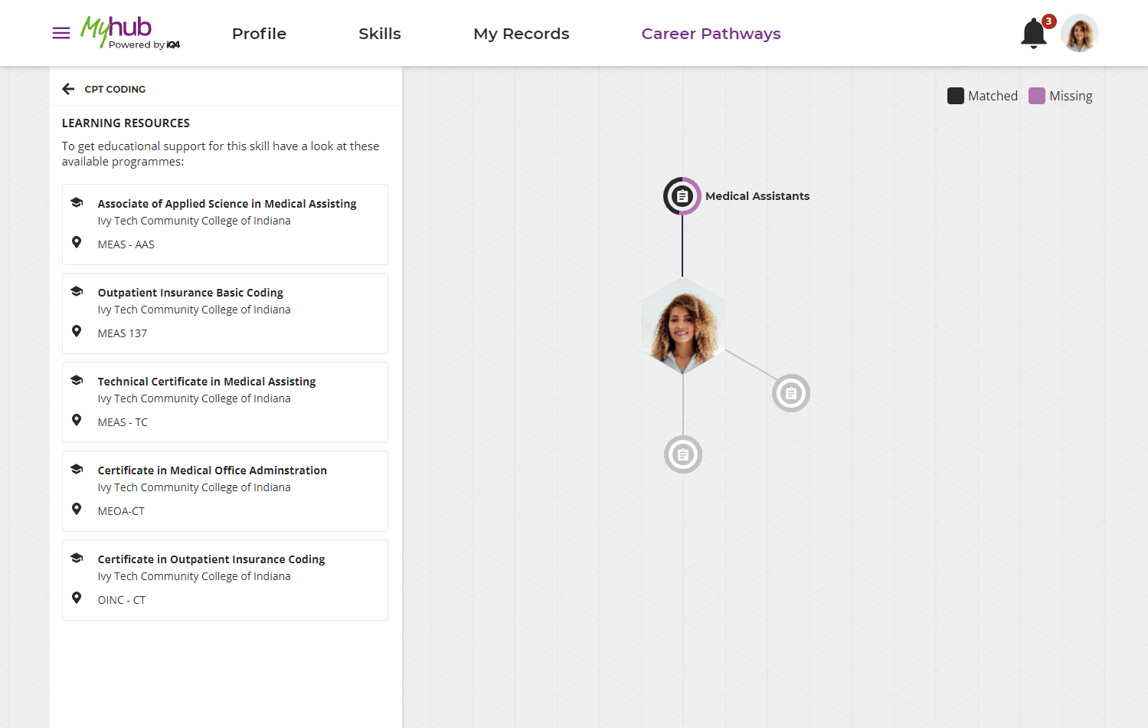
Profile
Skills
Pharmacy Technician
Medical Coding
My Records
Career Pathways

Slide 24
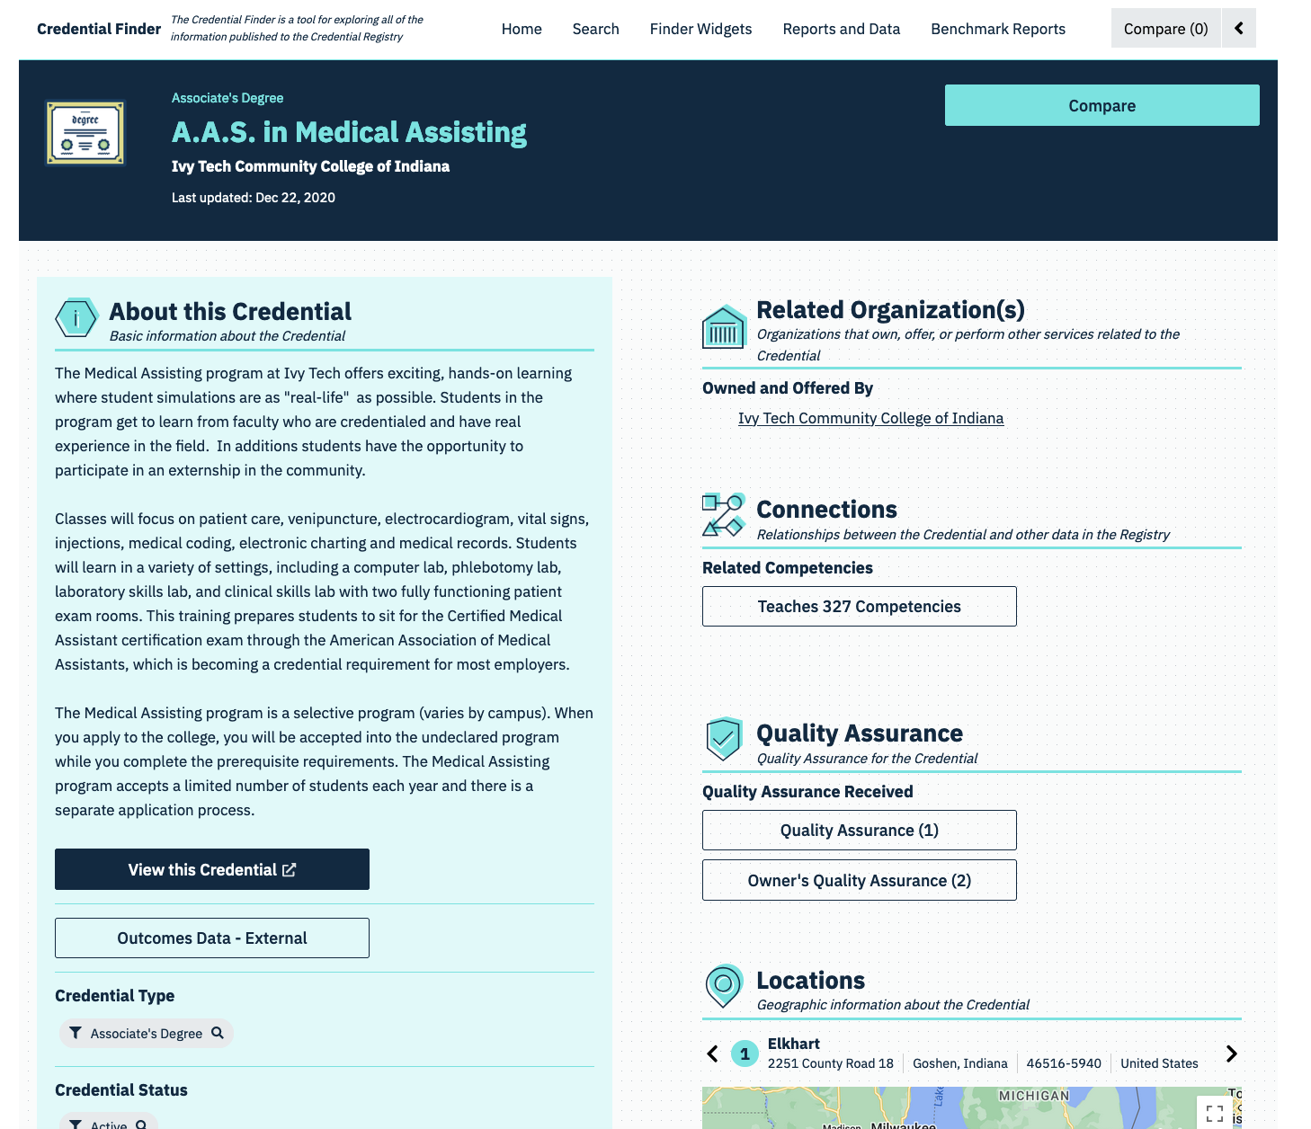

Slide 25
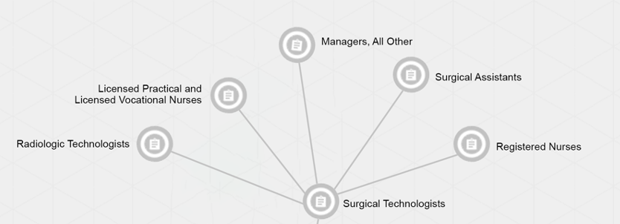
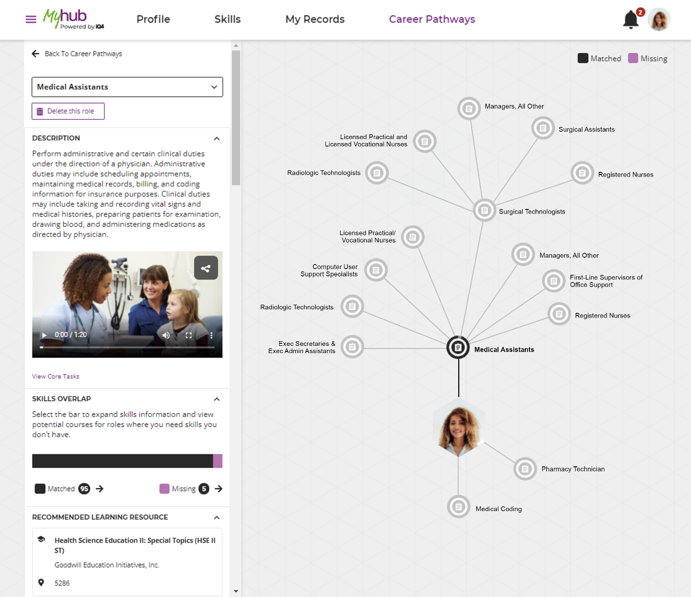
Profile
Skills
My Records
Career Pathways

Slide 26
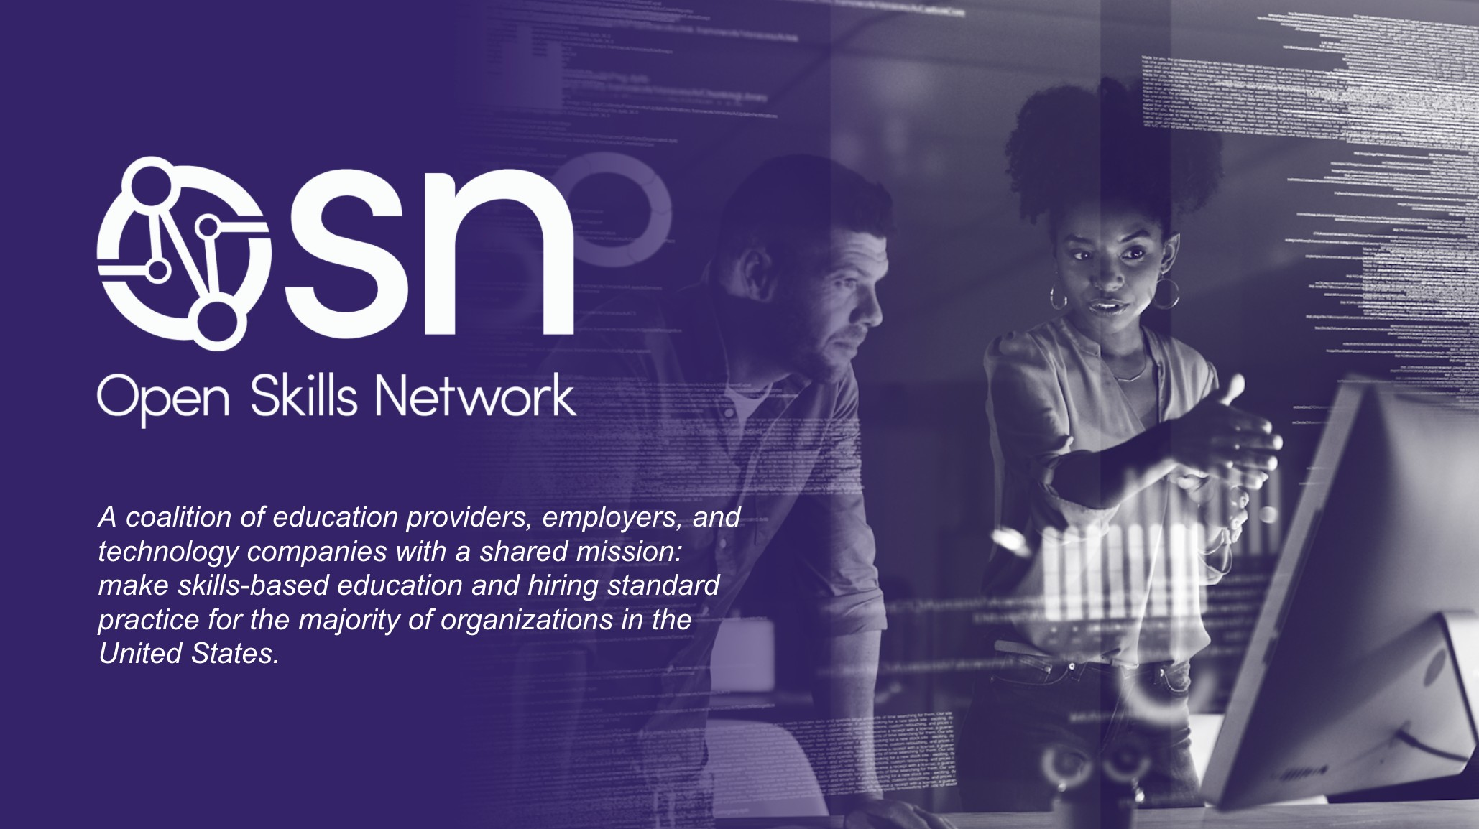
Benefits of Membership
Thought Leadership
Networking
Workgroups
Education
Resources & Tools
Community
Visit us at
openskillsnetwork.org

Slide 27
Thank You!
kacey.thorne@wgu.edu
darin.hobbs@wgu.edu
sarah.demark@wgu.edu

