Slide 1
Digital Credentials and
Physician Mobility
digital clinician passport
Board of Physicians
Notes:
Demo of Maryland login want for presentation

Slide 2
Agenda
Introduction
PB in Pandemic
Self-owned, verifiable
Truu Eco-System (diagram)
Scenario Slide 1
Scenario Slide 2
Future uses (telemed) / next steps / roadblocks

Slide 3
Who is FSMB?
A trade association for medical licensing boards in the United States. Services include identity and credential verification.
Who is Truu?
Truu is a UK based techonology company focused on providing a secure, portable digital passport for a modern healthcare ecosystem.

Slide 4
Provider Bridge

Slide 5
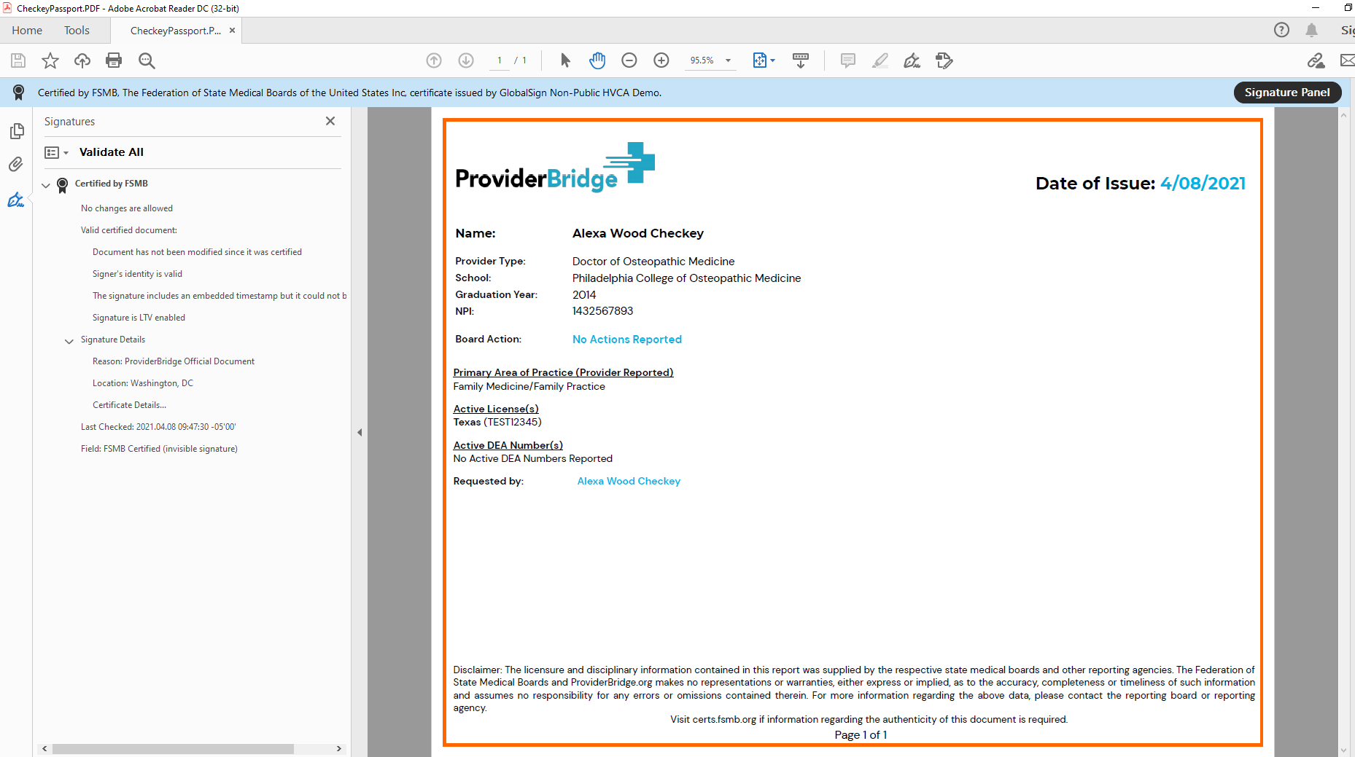
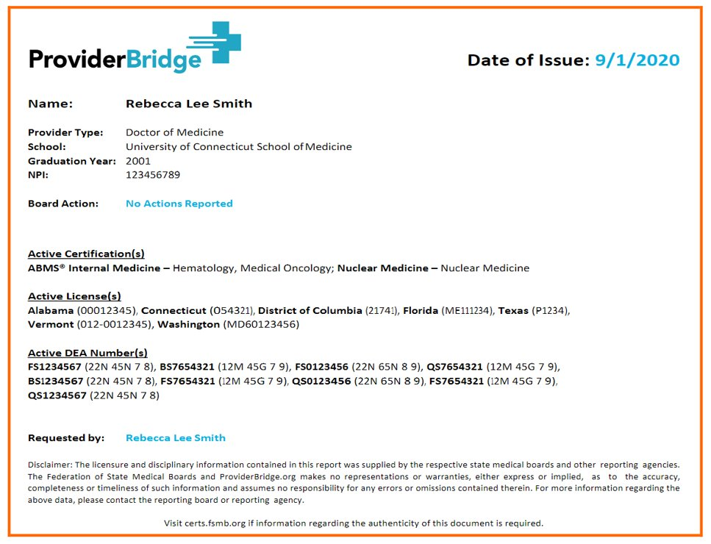
Notes:
Here is an example of the actual passport document. Each Passport is a digitally certified document containing the providers’ identification information, their specialty certification, … their current active licenses (other countries might refer to these as registrations), …and active DEA numbers, which is the registration that permits a provider to prescribe medications. If they have any board actions those would be listed as well. A few security features of note.
The date of issue on the upper right this gives the recipient the indication of the currency of the document data in case it needs to be refreshed for more current data
Note the “Blue Ribbon” on the top of the report and the certificate signatures on the left. This is the digital certification that Aaron talked about earlier. This gives the entity the assurance that this document is authentic, was generated by the FSMB for Provider Bridge, and has not be altered in any way since it was generated.
Why is this a unique product, to verify Rebecca, three state medical boards – assuming you know that in advance, abms has a lookup site and there is no DEA site, a verification of known DEA numbers exists

Slide 6
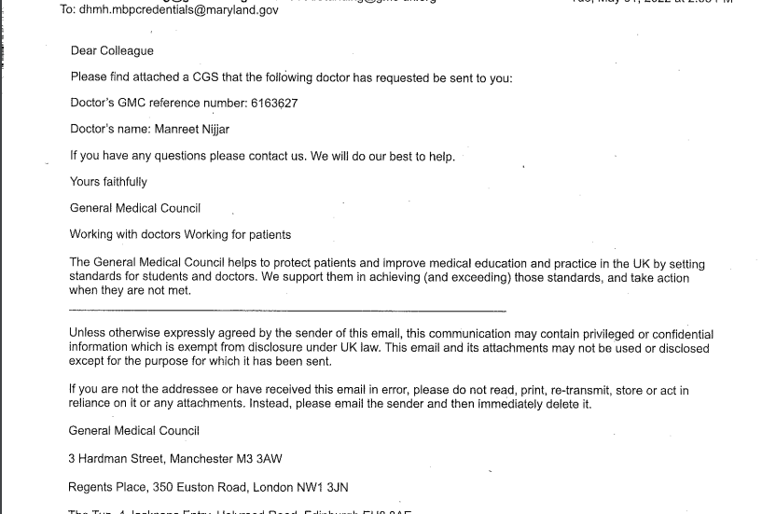
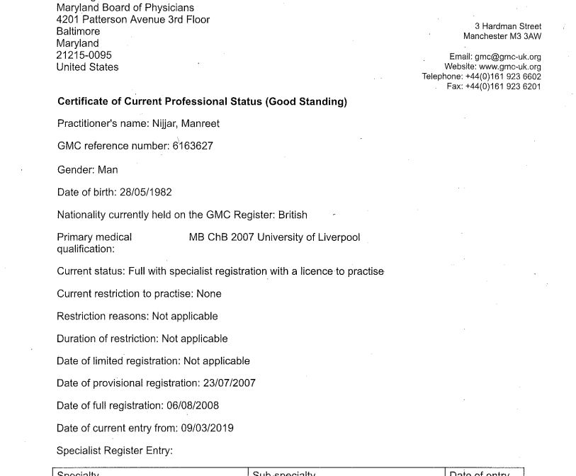
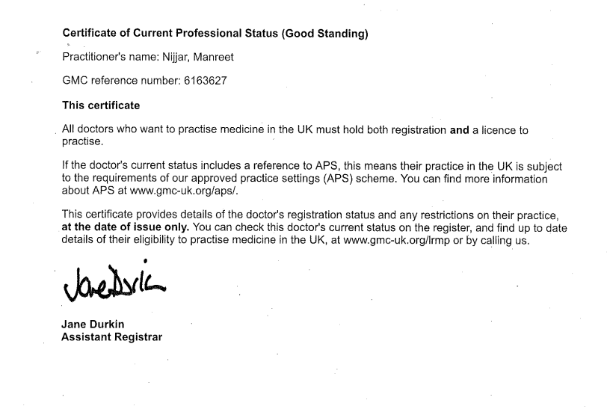
Notes:
Certificate of good standing using email, xxxx days from request to response. Maryland had to watch for it, staff not sure what to do with it. Lots of text to sift through, just need the data. Formal letter. Email not considered best source for primary source verification. Three pages, page one is name and identification number, page two has primary source data, page three trust me.

Slide 7
Truu Ecosystem

Slide 8
Trial by fire: How physicians responding to the COVID-19 pandemic illuminated the need for digital credentials - James Brogan, Henry Goodier, Manreet Nijjar, Christian Rose, 2022 (sagepub.com)

Slide 9
Holders:
Physician who receives credentials
Holders:
The healthcare professionals who receive credentials
Issuers:
Organizations authorized to issue credentials
Examples:
University of Maryland Medical School
Maryland Board of Physicians
American Board of Internal Medicine
FSMB
Issuers:
Organizations authorized to issue credentials
Examples:
Blackpool Teaching Hospitals
General Medical Council
Post Office
Disclosure & Barring Service
Verifiers:
Organizations that are authorized to verify credentials
Examples:
Blackpool Teaching Hospitals
Oxford University Hospitals
Verifiers:
Organizations that are authorized to verify credentials
Examples:
Maryland Board of Physicians
John Hopkins Hospital
Trust Diamond
Governing Authority:
Sets rules for credentials and specifies who is allowed to issue, hold, and verify them
Example:
NHS England
Governing Authority:
Sets rules for credentials and specifies who is allowed to issue, hold, and verify them
Example:
Federation of State Medical Boards
Adapted from Lacity, M., & Carmel, E. (2022). Implementing Self-Sovereign Identity (SSI) for a digital staff passport at UK NHS.
Notes:
Added cite
Manny fix and own

Slide 10
Decentralisation that relies upon Trust Anchors
LAYER 4:
Application Ecosystems
Physician identity and credentialling ecosystem
LAYER 3:
Data exchange Protocols
Verifiable Credentials Exchange
Verifiable
Credential
Anon Creds
Holder
Proof
BBS + Creds
Trust
Verifier
Issuer
LAYER 2:
Peer to Peer Protocol/ OIDC
DID comm
Unique pairwise DID connection
Peer DIDs
OIDC
Agent/ Wallet
Connection
Unique pairwise DID connection
OIDC
Agent/ Wallet
LAYER 1:
Public Utilities
NB -does not have to be a blockchain
DID method
DID SOV
DID ION
DID WEB
Utility
SOVRIN
ION
WEB
Notes:
Manny fix and own
https://docs.google.com/document/d/1gfIz5TT0cNp2kxGMLFXr19x1uoZsruUe_0glHst2fZ8/edit?pli=1#heading=h.n5k2u6fkhf74
Appendix D of the Sovrin Glossary
Agent to Agent Layer Roles
Identity owners
Every wallet is associated with an agent and every agent is associated with a wallet
The distinction between Edge and Cloud Agents is most important when it comes to key management. With Edge Agents, private keys are by definition stored “at the edge”, where in most cases they can enjoy the highest security because they are under the local control of the Identity Owner and not available via the open Internet. Cloud Agents, on the other hand, should store private keys and other cryptographic material in an HSM (Hardware Security Module) or other secure storage that is protected from unauthorized access (ideally even from the cloud service provider or hosting Agency).
Decentralisation that relies upon centralisation and intermediaries

Slide 11
Proof of Concept Use Cases

Slide 12
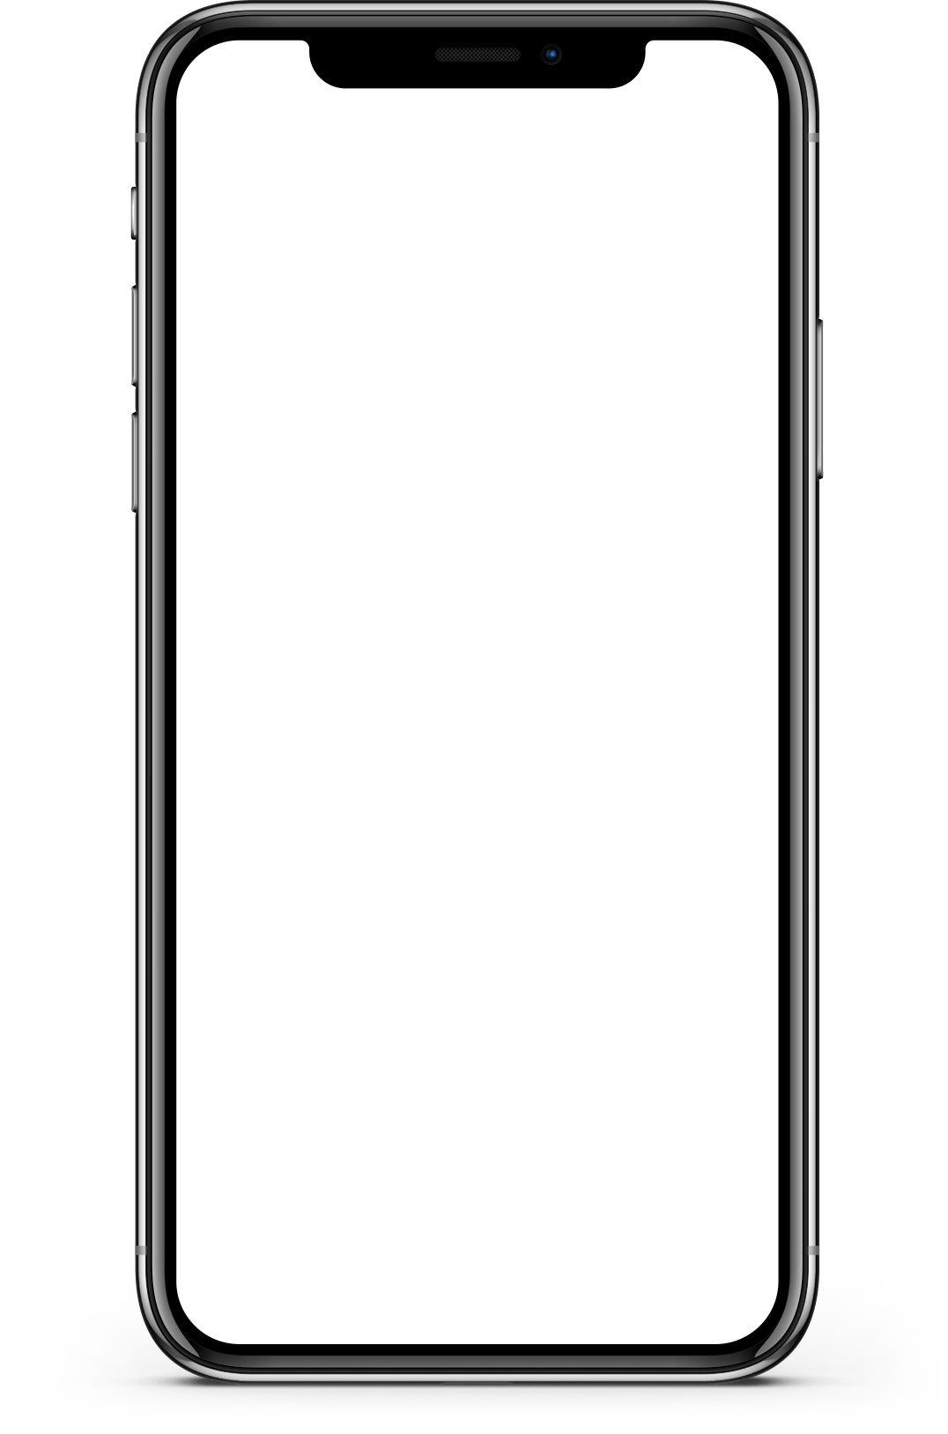
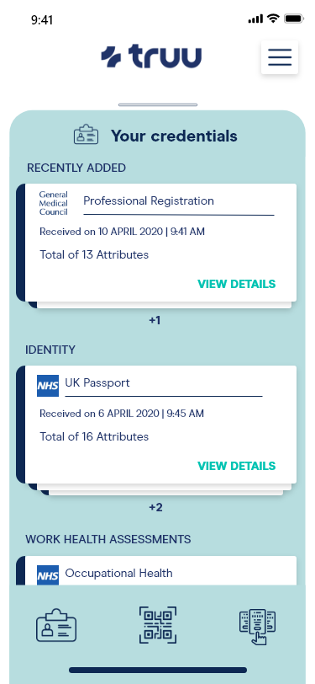
Use Case 1 – UK Credentials to Maryland Licensing Board
Issuer | Credential(s)
University of Liverpool | Medical degree
General Medical Council | Certificate of Good standing
Verifier | Verified data received
 | Certificate of Good standing Medical Degree
Certificate Good standing
UNIVERSITY
Medical Degree
Board of Physicians
Physician’s Wallet

Slide 13
Use Case 2 – US Credentials to Maryland Licensing Board
Issuer | Credential(s)
 | Medical degree Residency Program
 | AVR
AVR
Verifier | Verified data received
 | Medical degree/Residency Program/ AVR
UNIVERSITY
Medical Degree
Board of Physicians
Physician’s Wallet

Slide 14
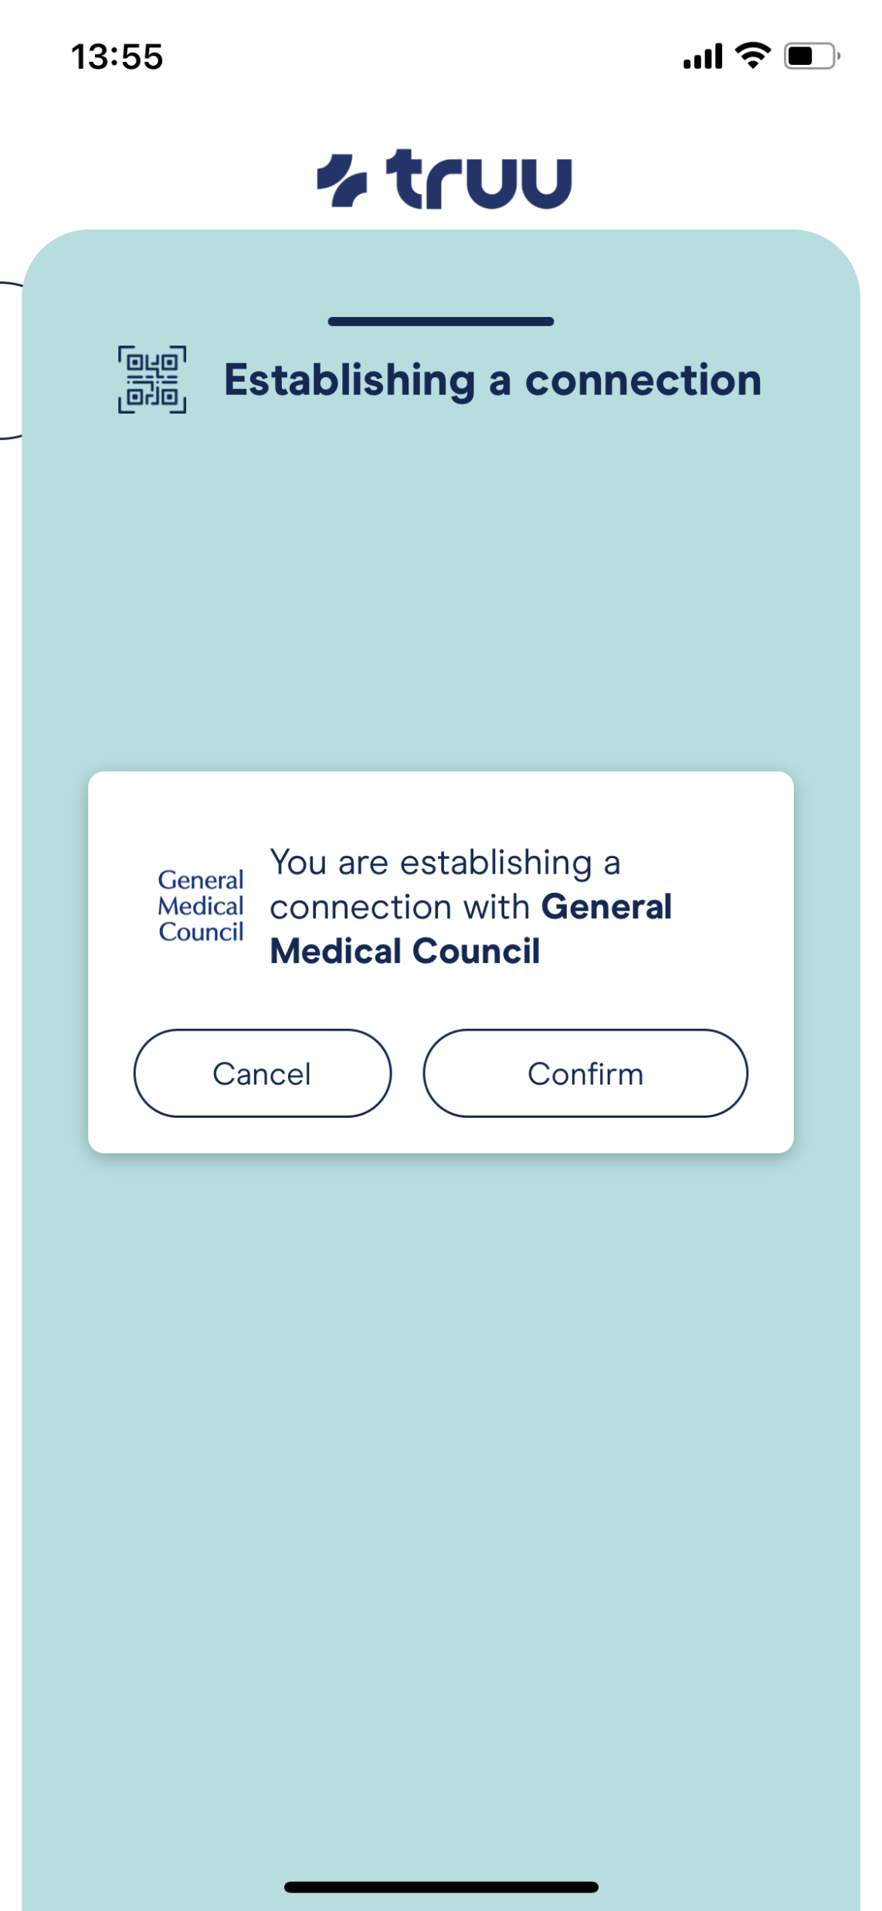
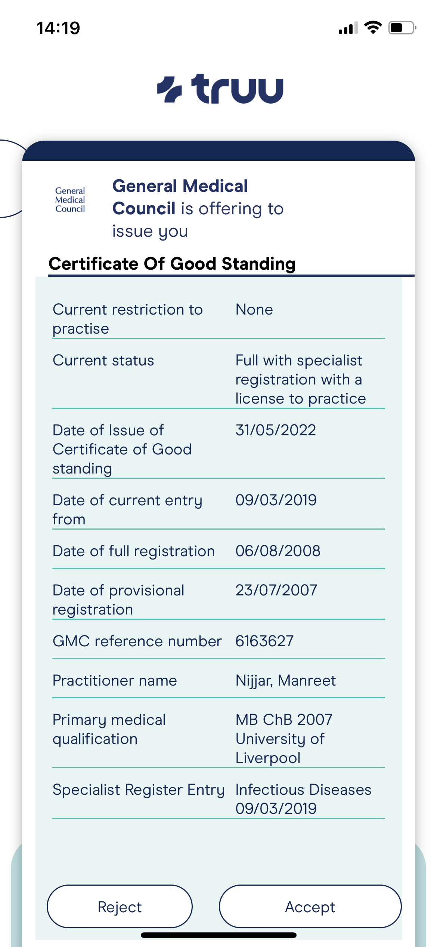
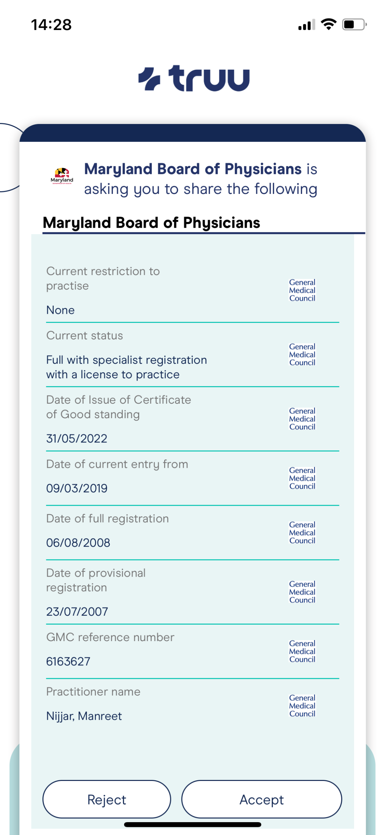
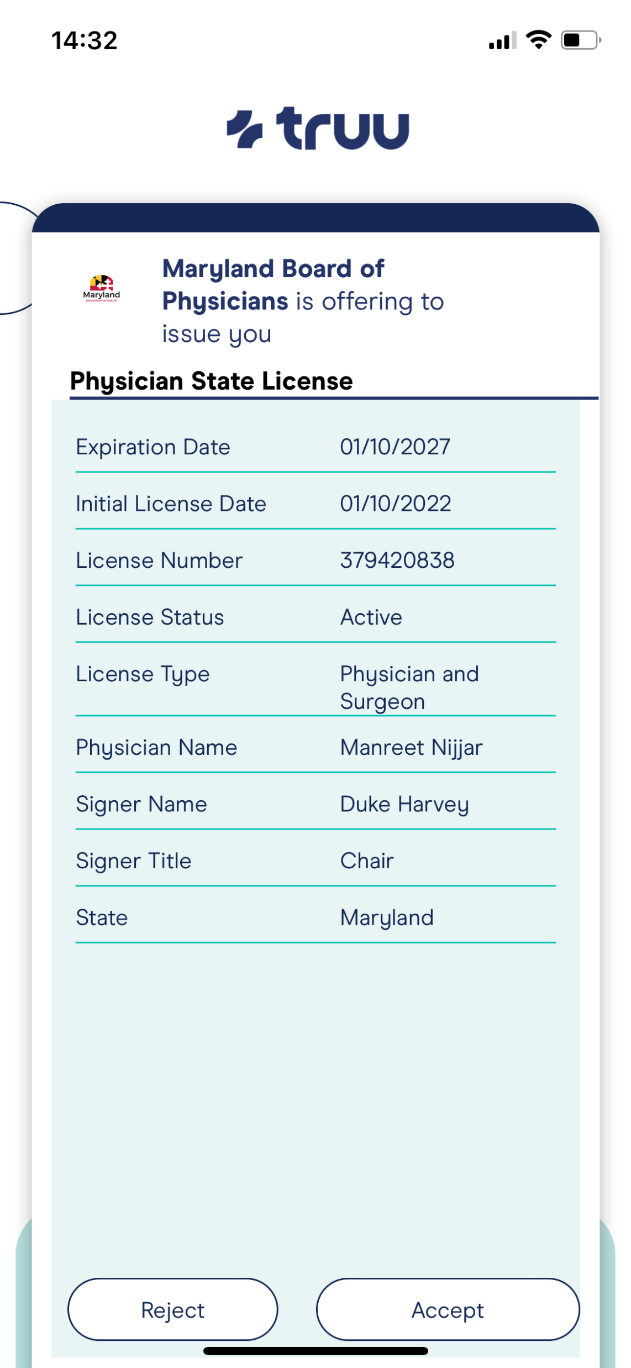
Make connection
Get credentials
Share credentials
License decision
A
B
C
D
Notes:
This slide was created from the individual slides below, the idea was taken from page 21 of this document
Physician perspective
Need Maryland perspective
ImplementingSSIForADigitalStaffPassportAtUKNHS.pdf

Slide 15
international medical verification that practically meets current expectation 43 days later and a happy ending
Dr. X starts new job Sept 1, 2022, in New York, Colon and Rectal Surgery.
1 Day
FCVS application
ECFMG Verification in progress
Medical School uses third party for transcripts
22 Days
FCVS and ECFMG are requesting from third party not school
31 Days
Third party cannot complete Medical Board Form, can provide partial information and FCVS can complete form with partial information FCVS cannot complete forms they are not the custodian of
Third party makes exception to complete form with partial information through normal inquiry and fee process Third party must get permission from school
36 Days
Escalated call from Dr. X
Dr. X is making plans to fly to UK with form if no response from dean
42 Days
Many hours and phone calls to Medical School
Dr. X connects with dean of Medical School
Dean completes form and sends form and transcripts to FCVS via Email
43 Days
New York gets FCVS profile
Dr. X did not have to fly to the UK
The end
Notes:
This happened beginning 8/22/2022, the school is in the UK

Slide 16
Use Case 3 – US Licensing Board to US Licensing Board (future)
Issuer | Credential(s)
 | Washington State Physician Licence
 | USMLE step AVR
Physician License
Verifier | Verified data received
 | Washington State Physician License USMLE step AVR
UNIVERSITY
AVR
Board of Physicians
Physician’s Wallet

Slide 17
Use Case 4 – US Licensing Board to US Training Program (future)
Issuer | Credential(s)
 | Maryland State Physician Licence
 | USMLE step AVR
Physician License
Verifier | Verified data received
 | Maryland Physician License USMLE step AVR
Board of Physicians
UNIVERSITY
AVR
Physician’s Wallet

Slide 18
Lessons Learnt?
Administrative Standards across national borders must be addressed as many institutions are accustomed to specific credential forms
Worldwide higher education institutions have varying acceptance of digital tools such as electronic signatures and digital wallets
Initial setup requires detailed, schema level work
Maryland licensing board is currently an exception, not the rule in accepting verified information directly from individuals

Slide 19
What Next?
Continued POC work to show hands on results
Leverage pandemic success for uses such as Global Telemedicine
Trusted convener needed in the US
Broader adoption of ‘self-sovereign’ tools such as wallets
Education of regulators needed to spur acceptance

Slide 20
Wallet Workflow

Slide 21
Questions / Discussion

Slide 22
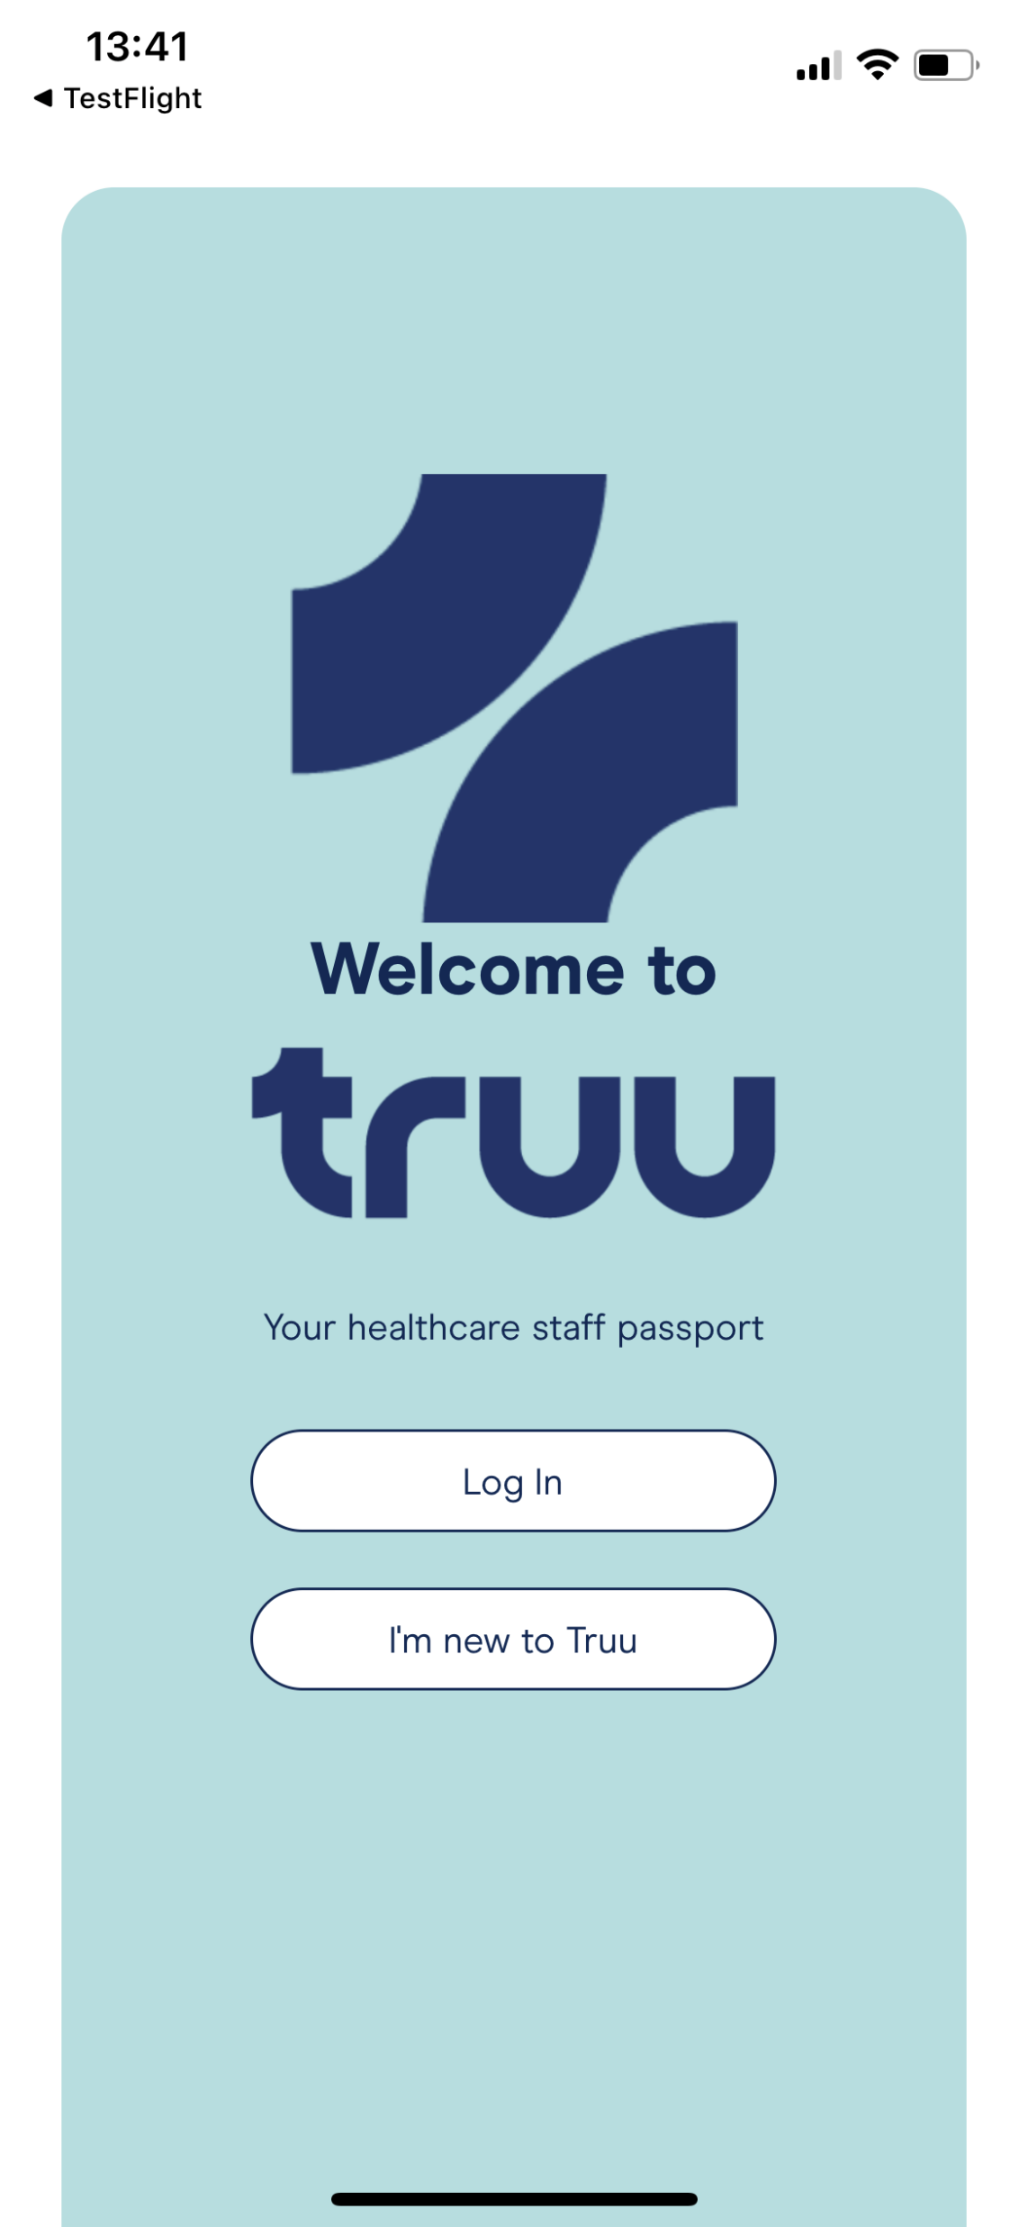
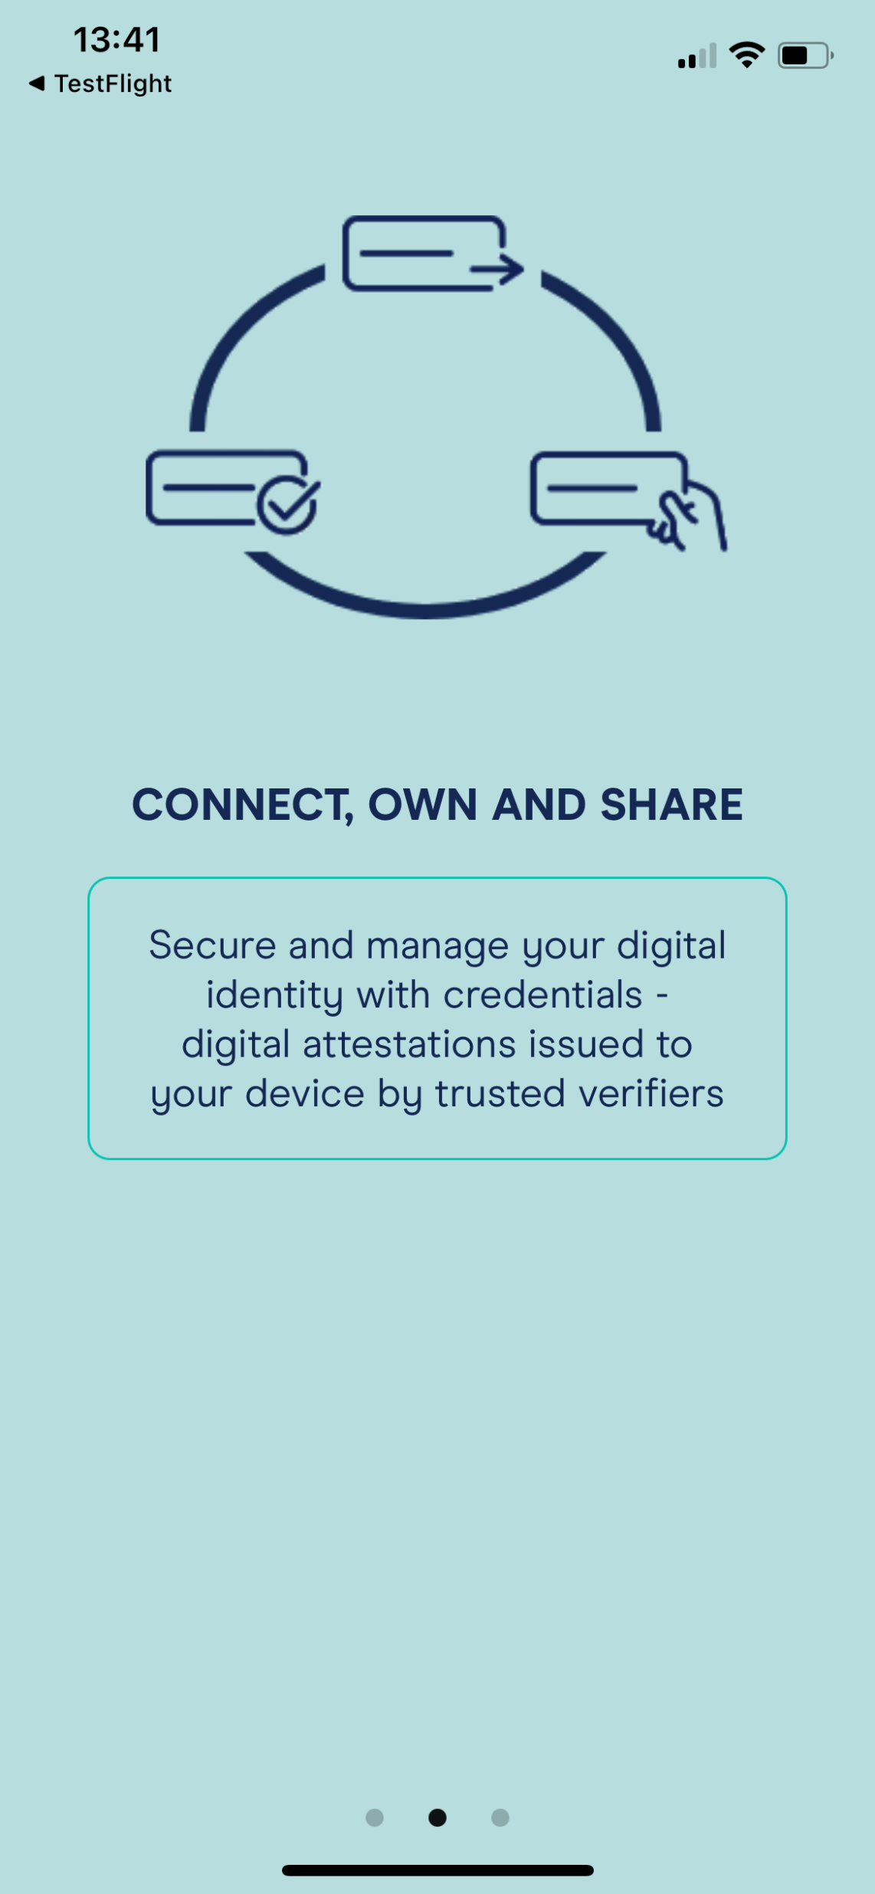
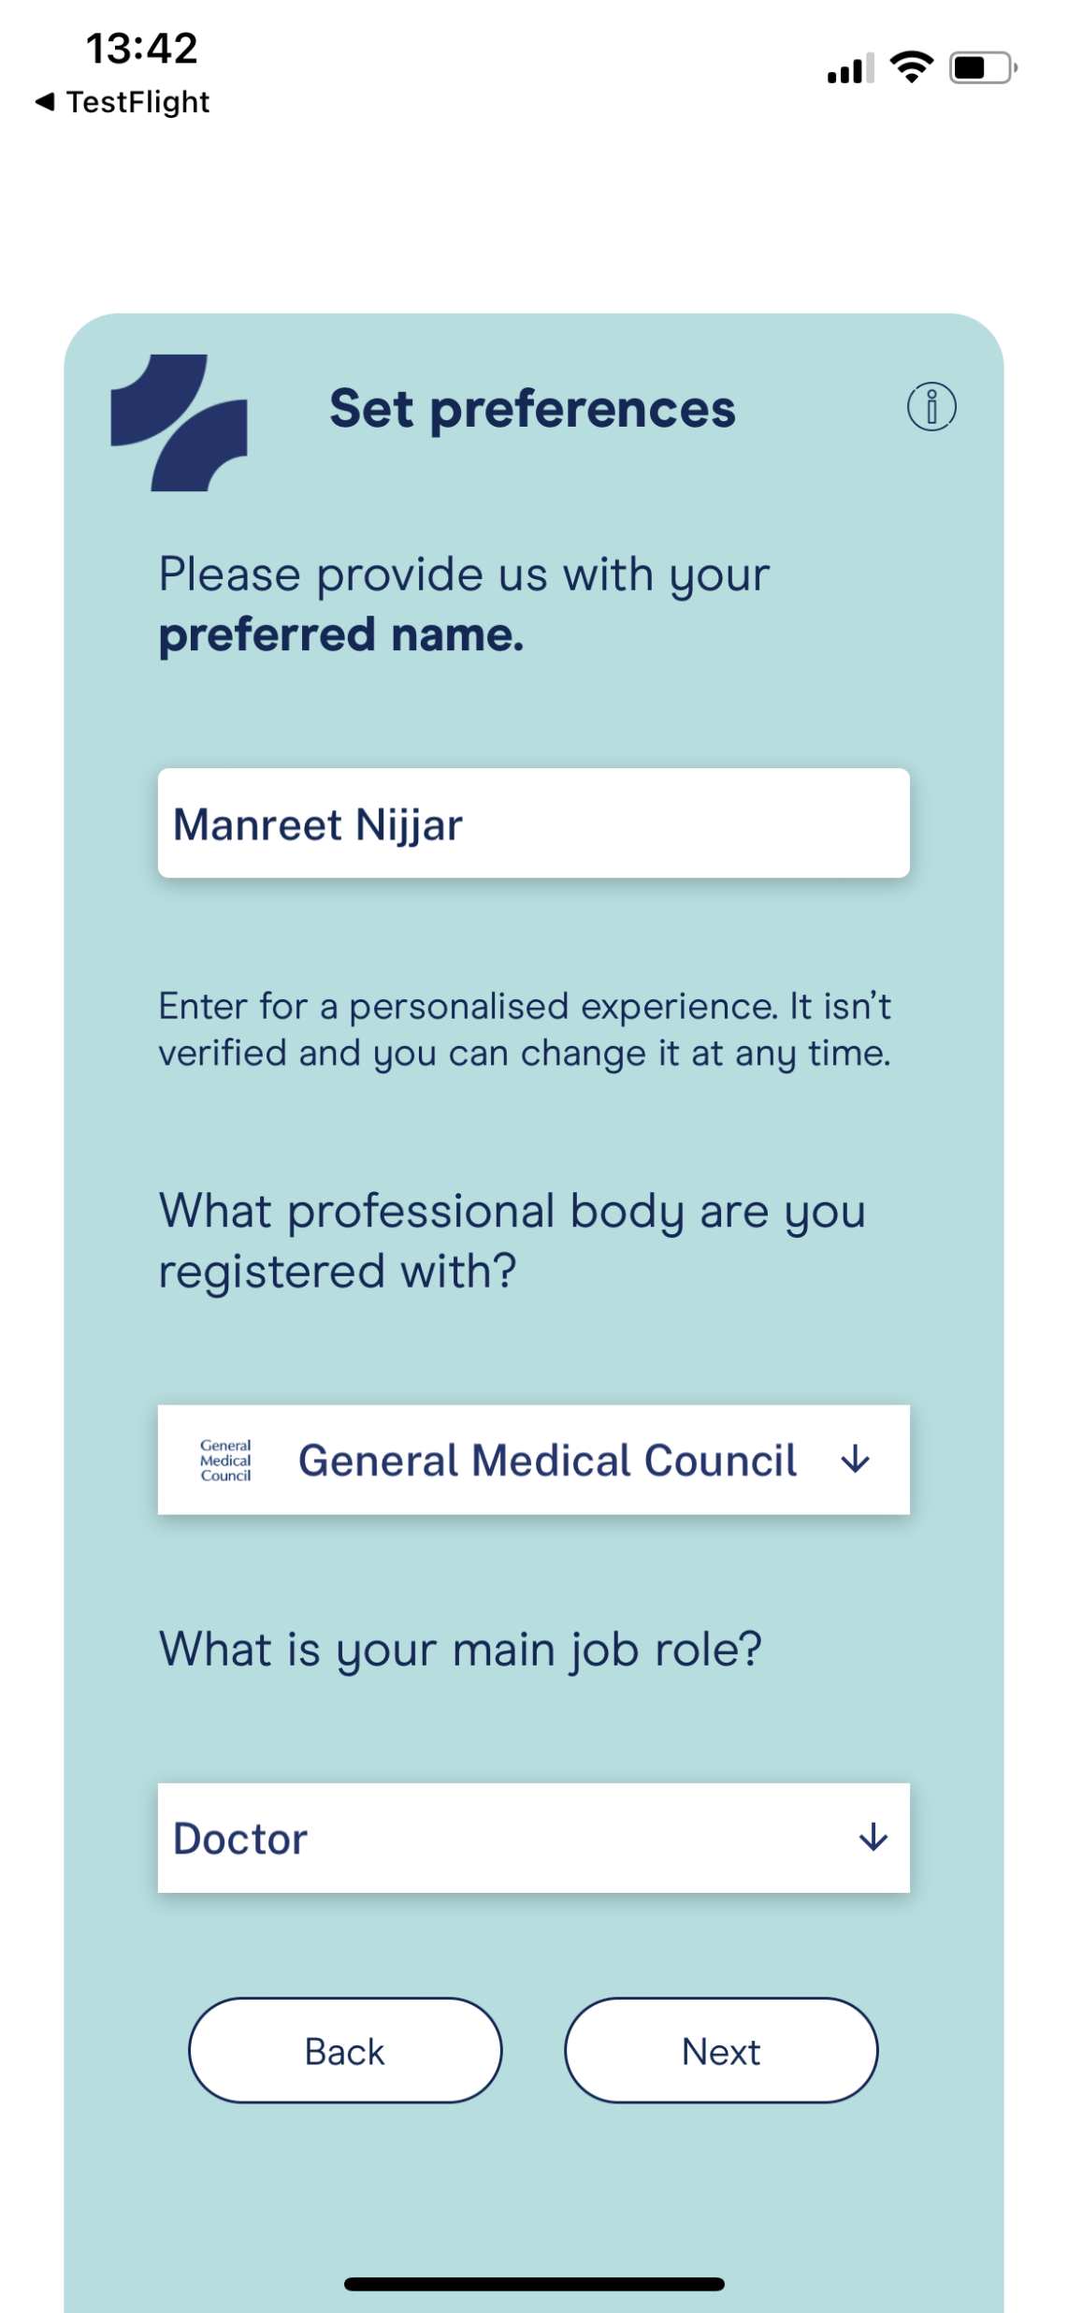
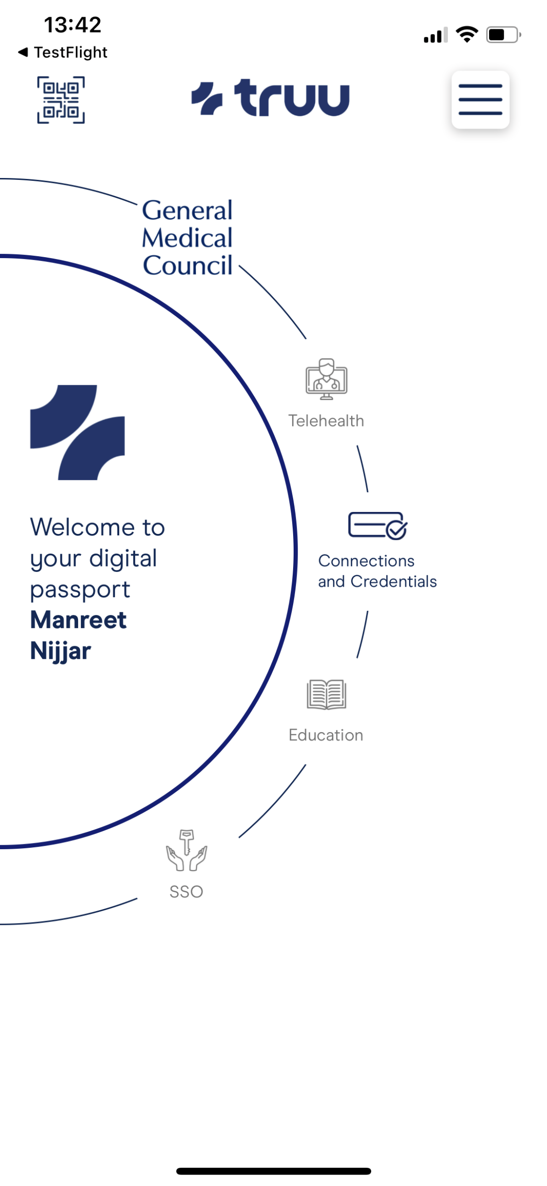
Launching Physicians Truu Wallet App

Slide 23
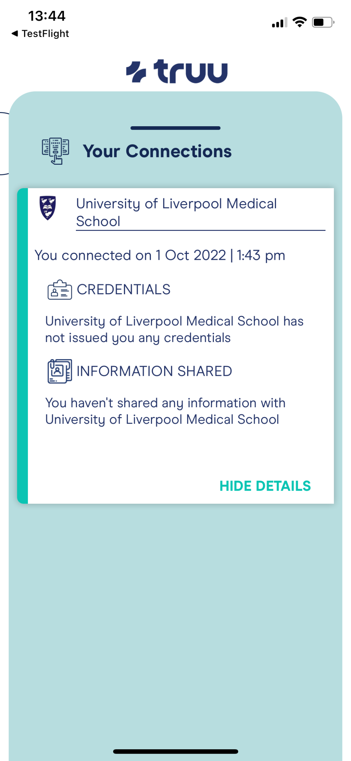
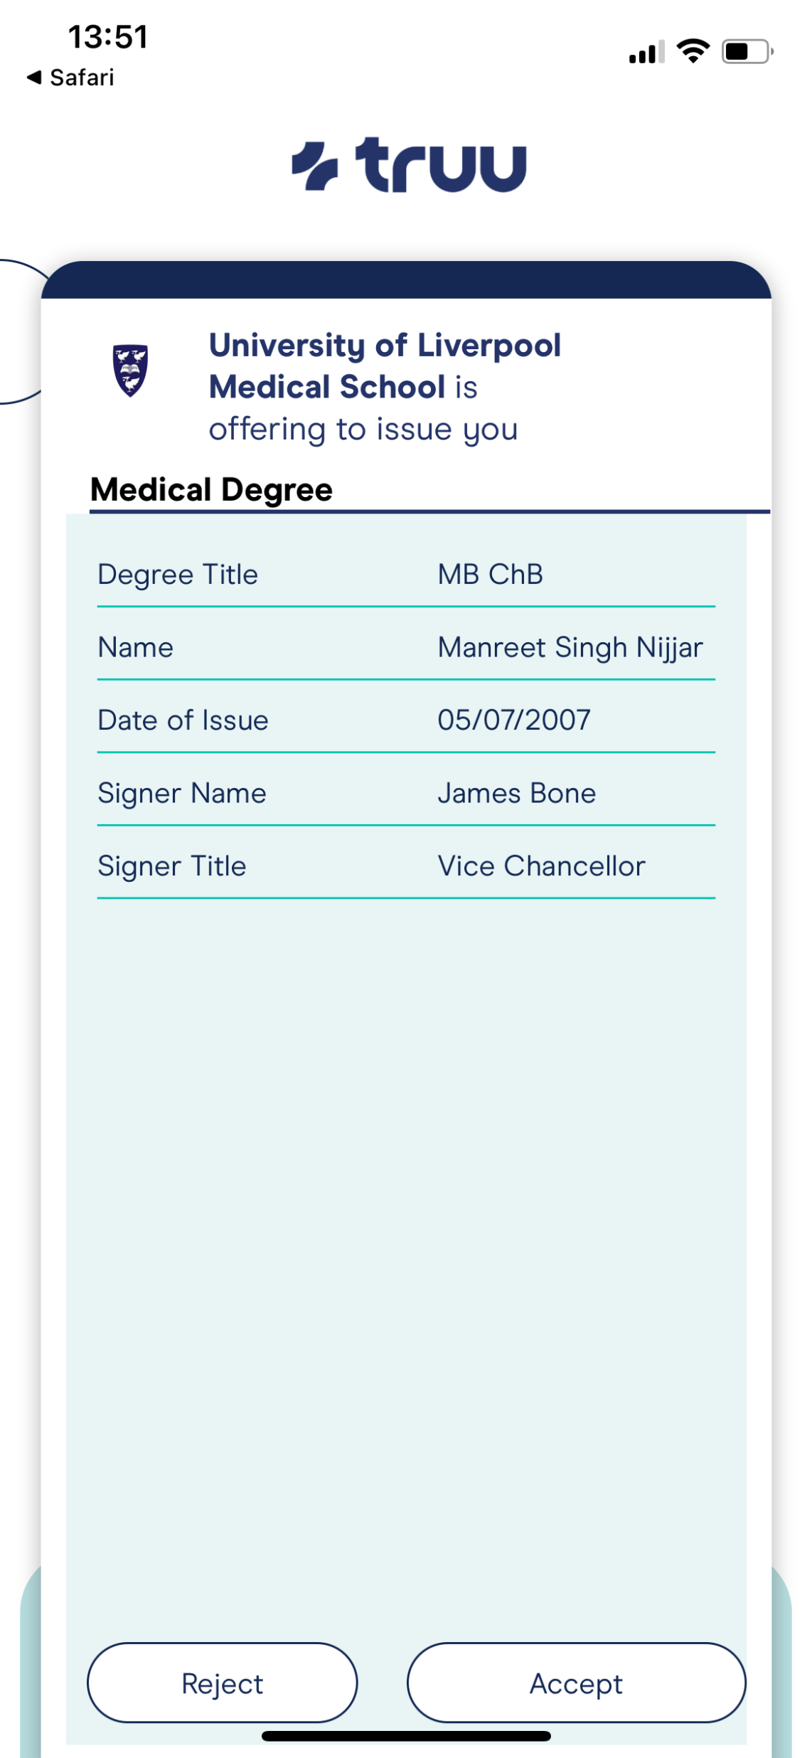
Physician Truu Wallet app University of Liverpool Medical Degree issuing

Slide 24
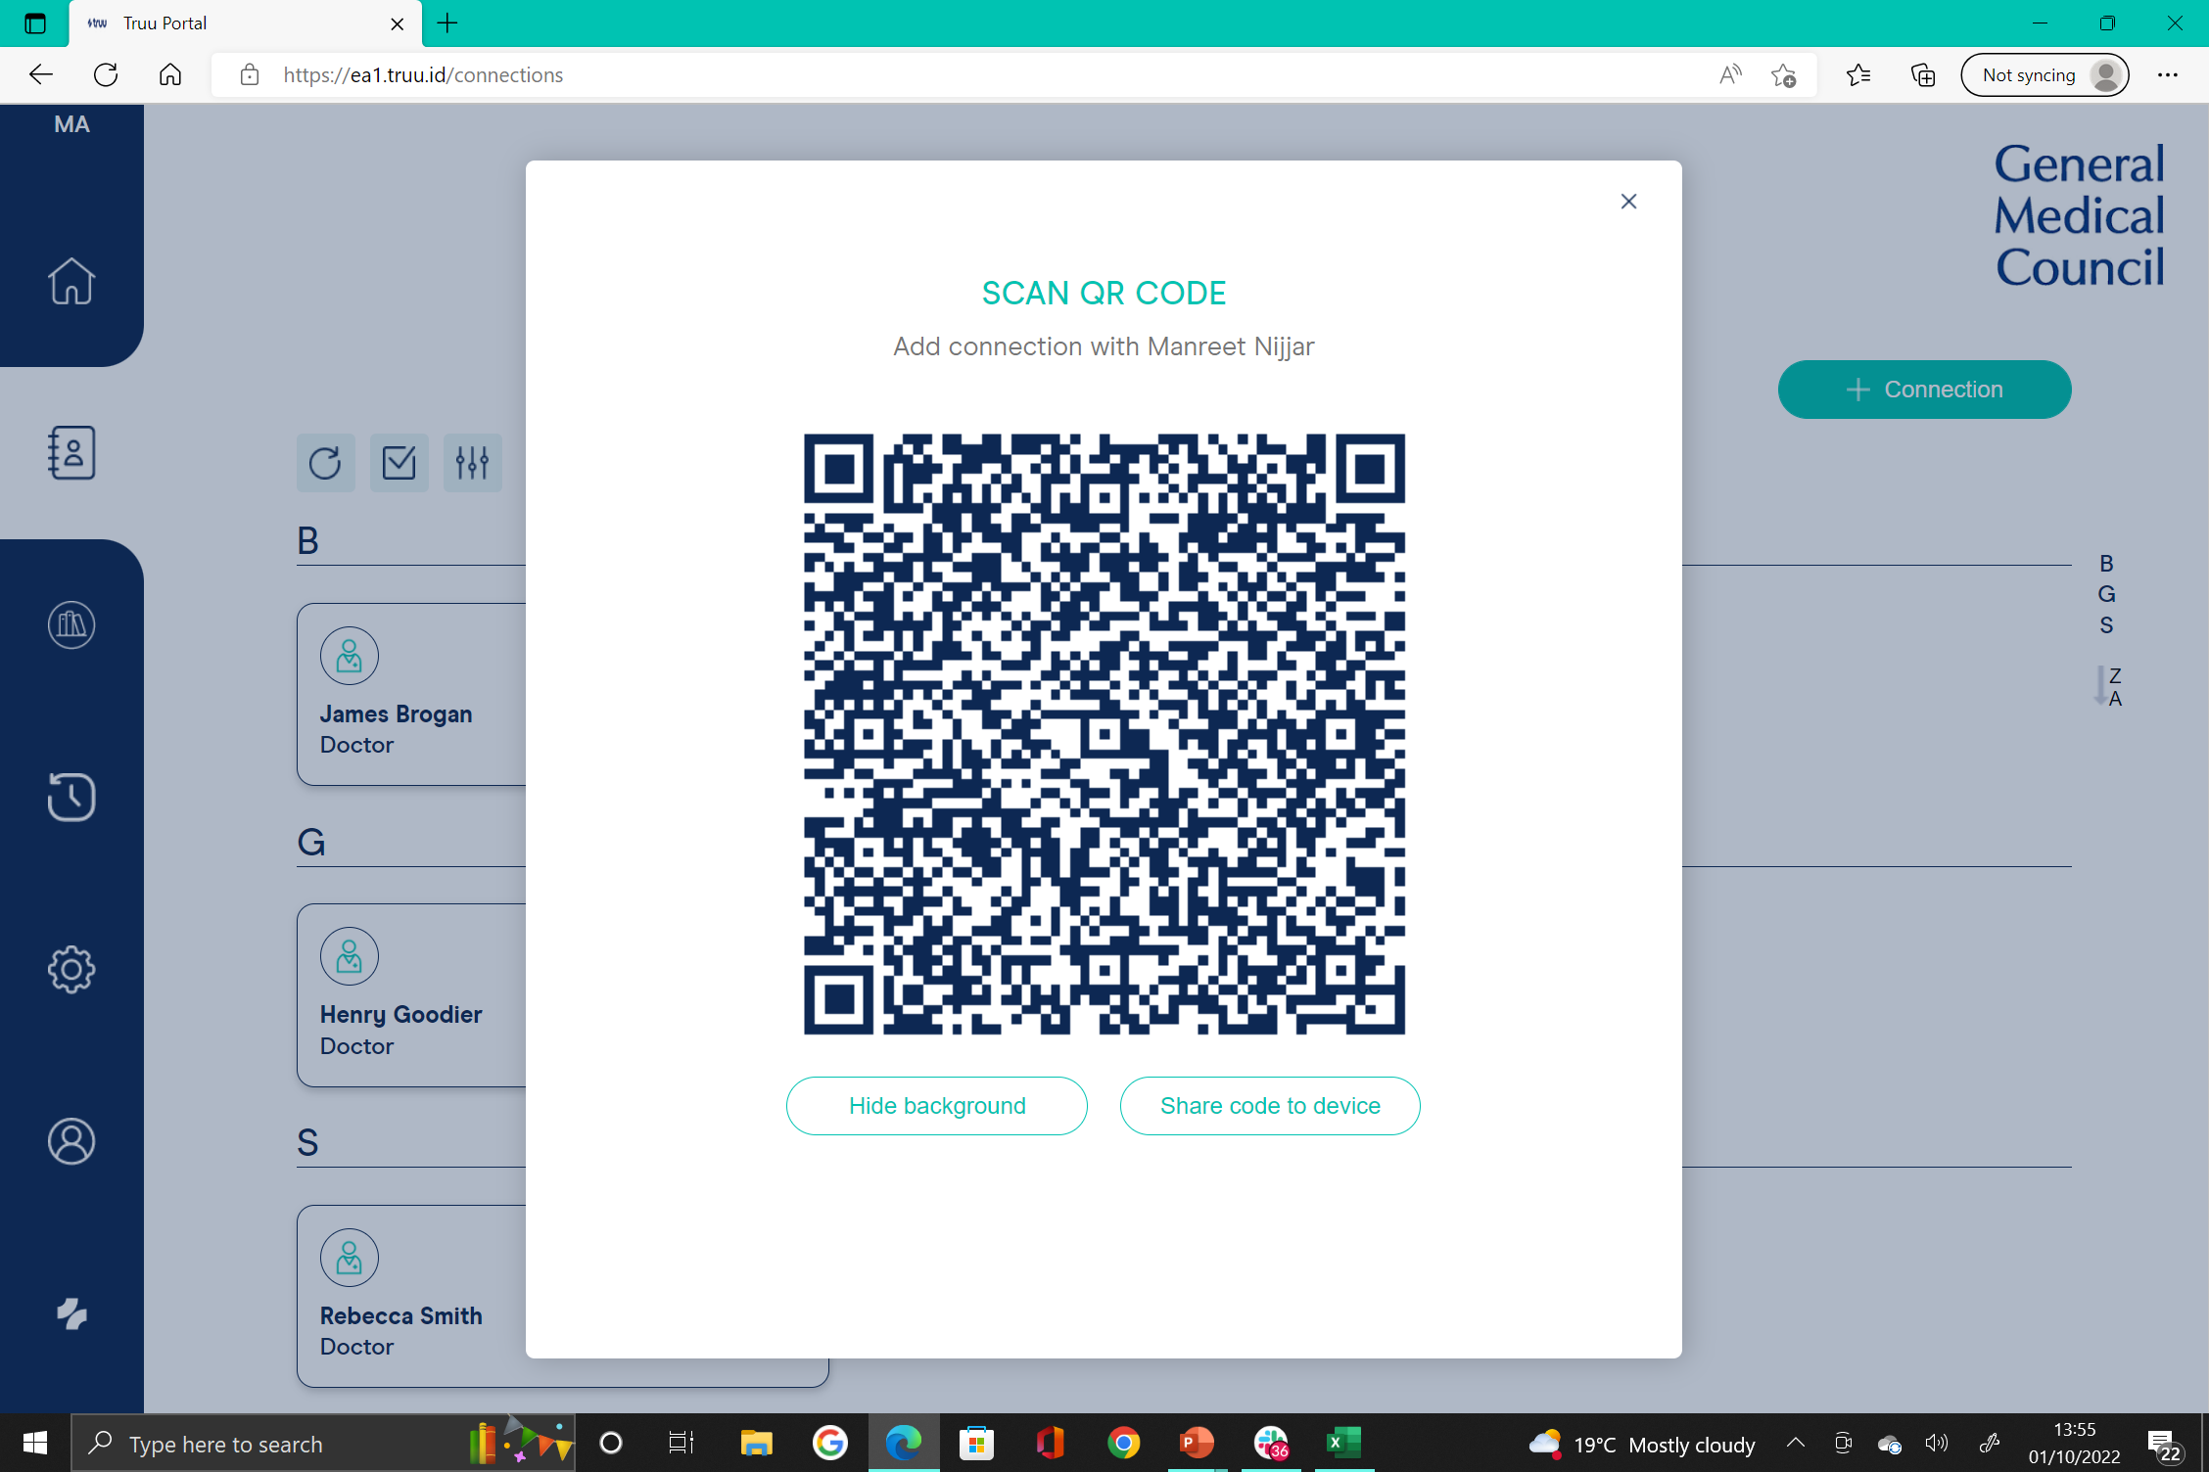
Connecting between GMC organisational portal and Physician’s Truu wallet app

Slide 25
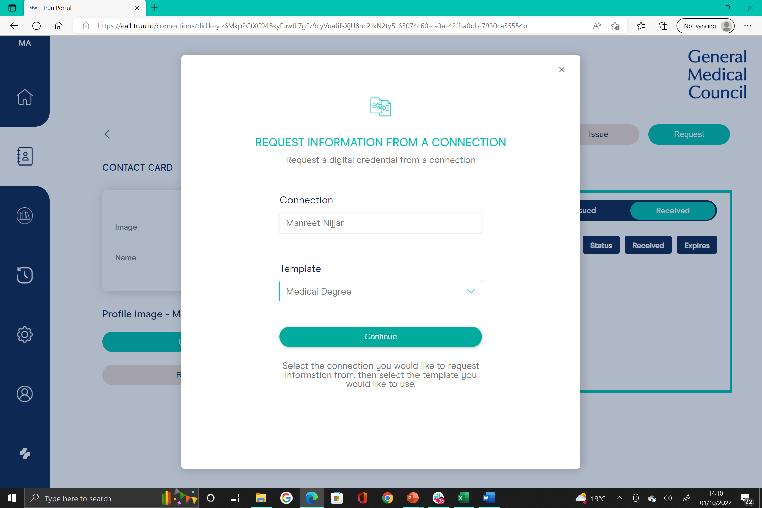
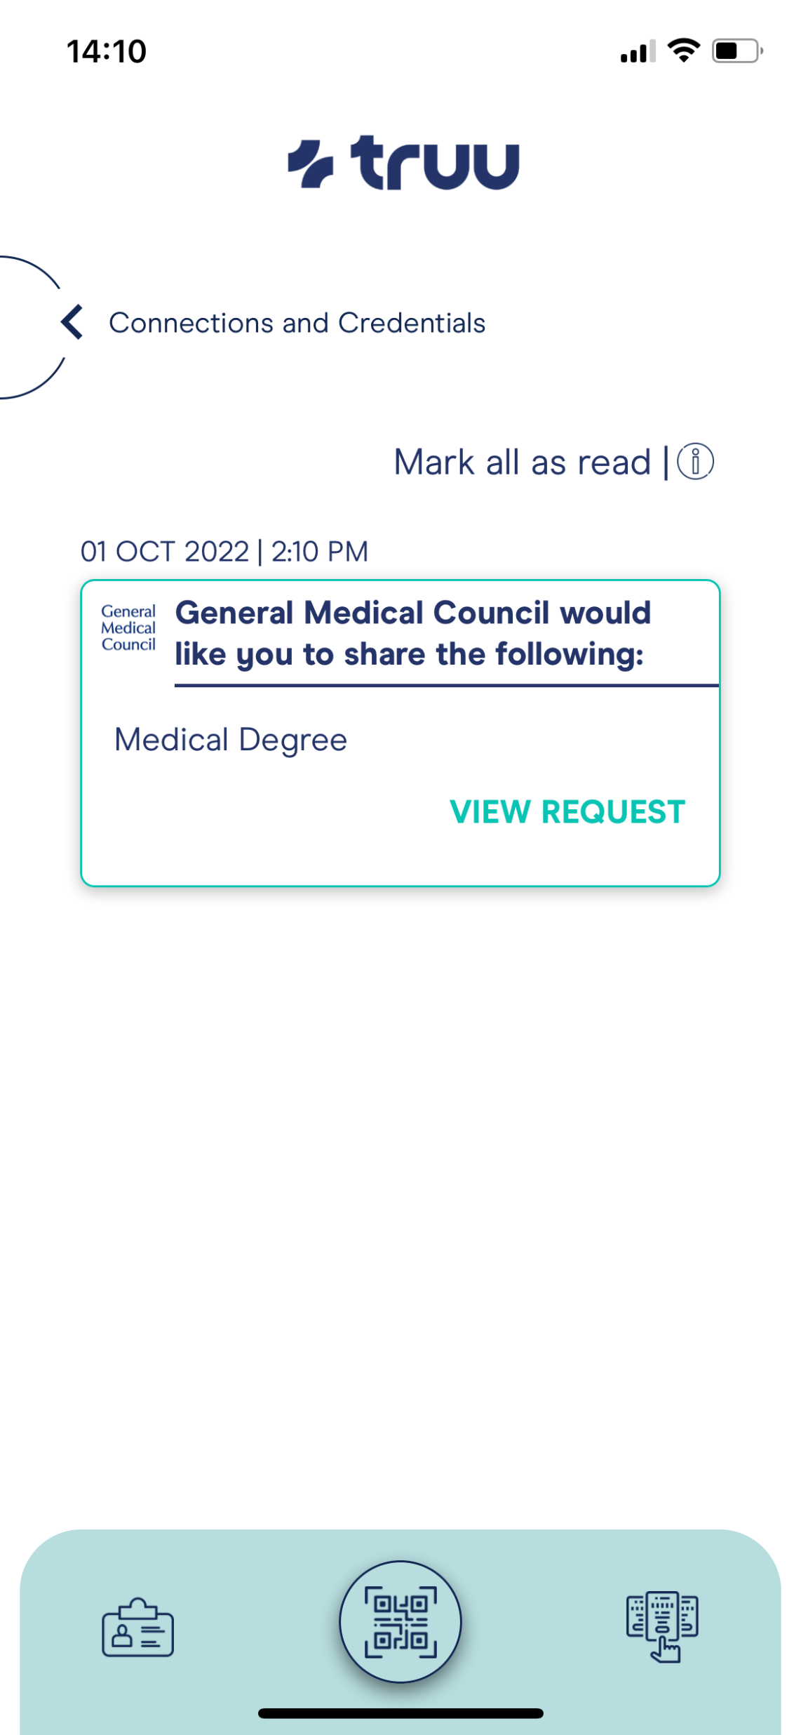
GMC requesting and verifying Medical Degree from Physician’s Truu wallet app

Slide 26
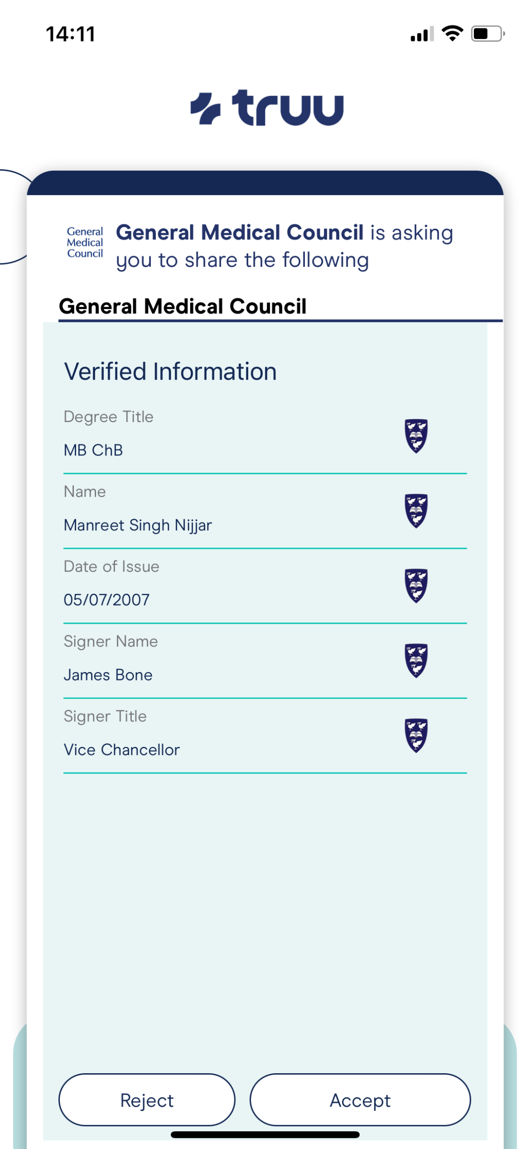
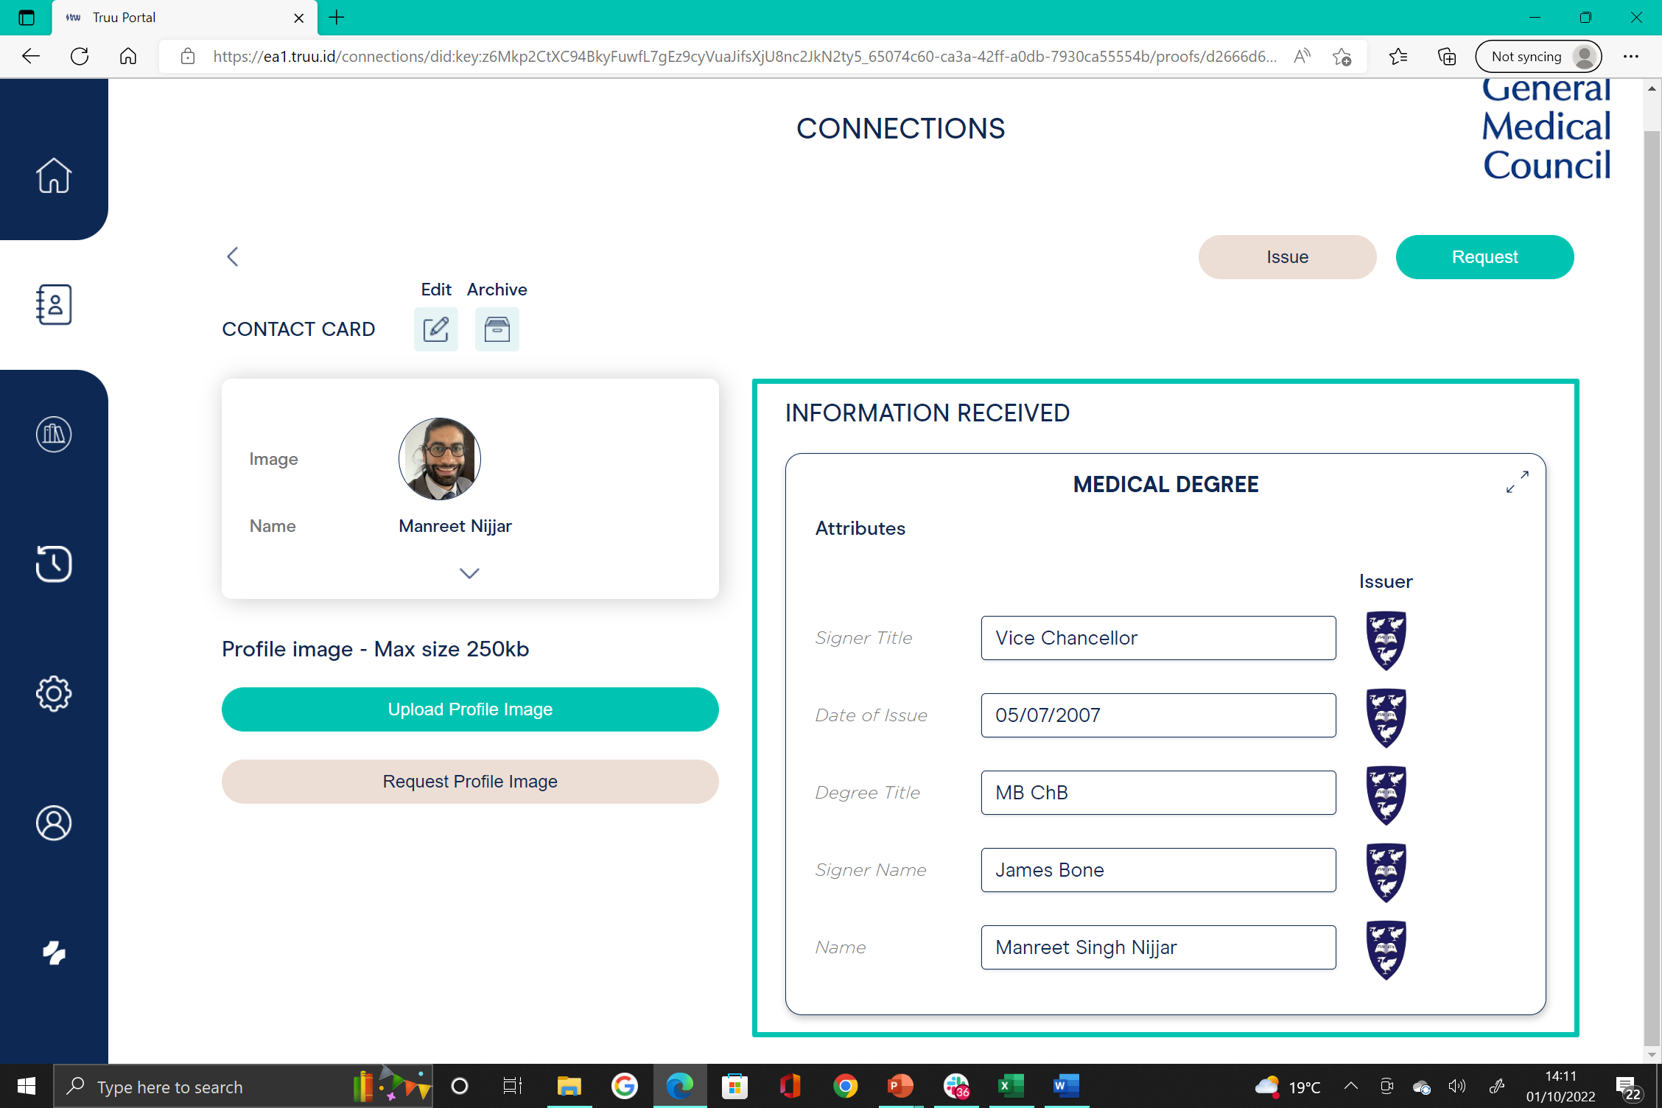
GMC requesting and verifying Medical Degree from Physician’s Truu wallet app

Slide 27
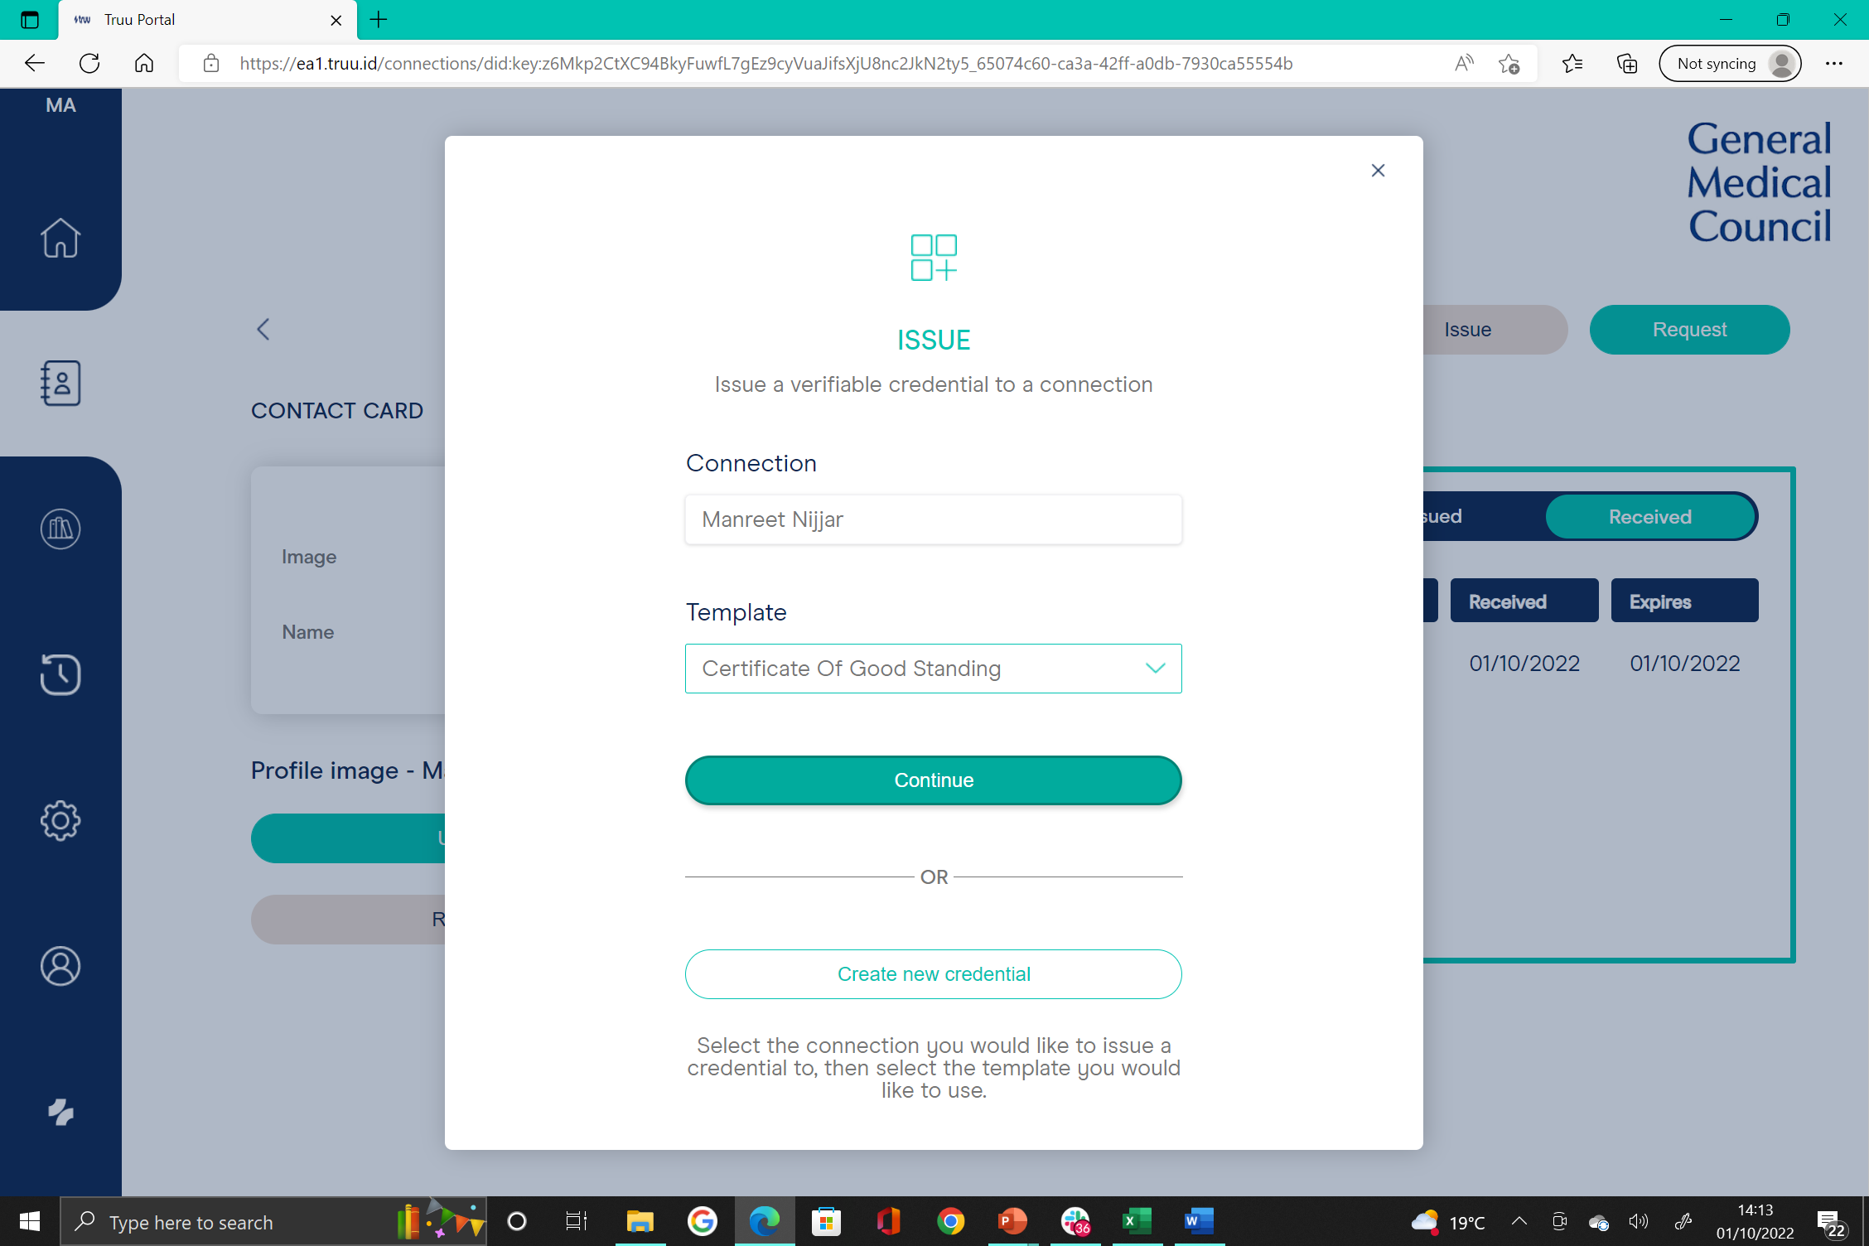
GMC issuing Certificate of Good Standing to Physician’s Truu wallet app

Slide 28
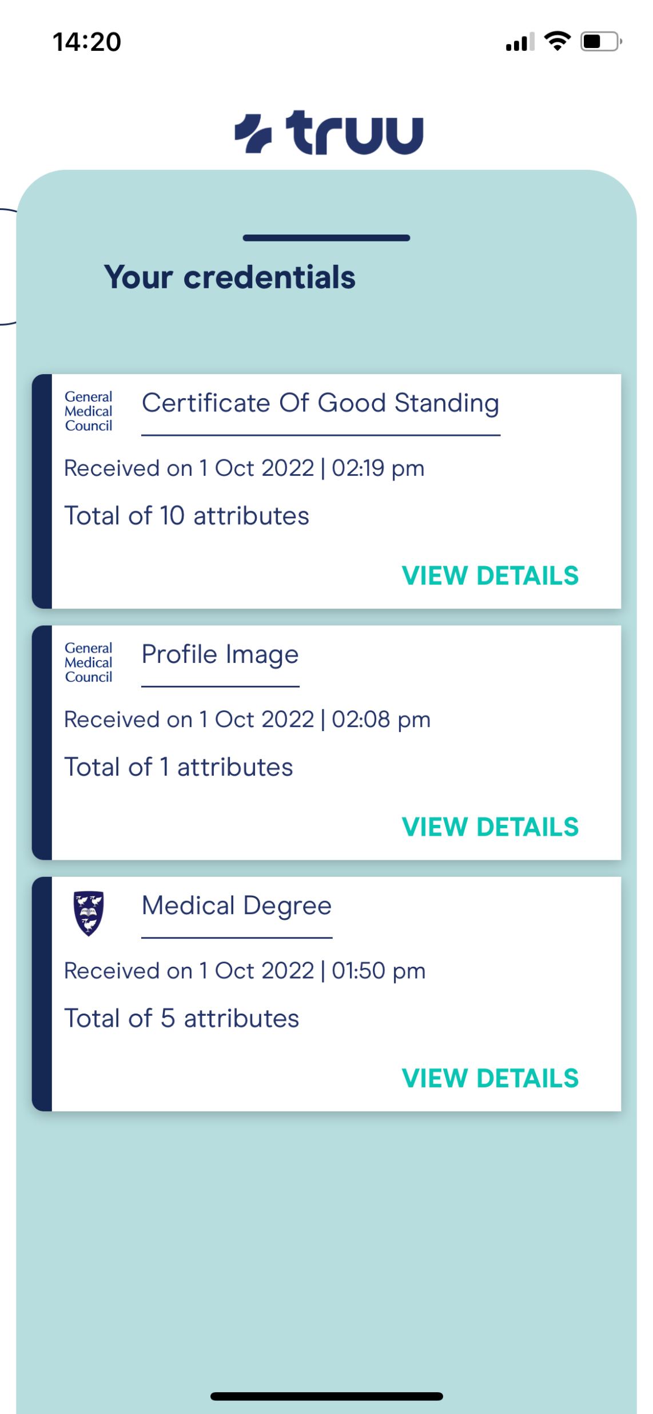
Physician’s Truu wallet app now contains Medical Degree and Certificate of Good Standing

Slide 29
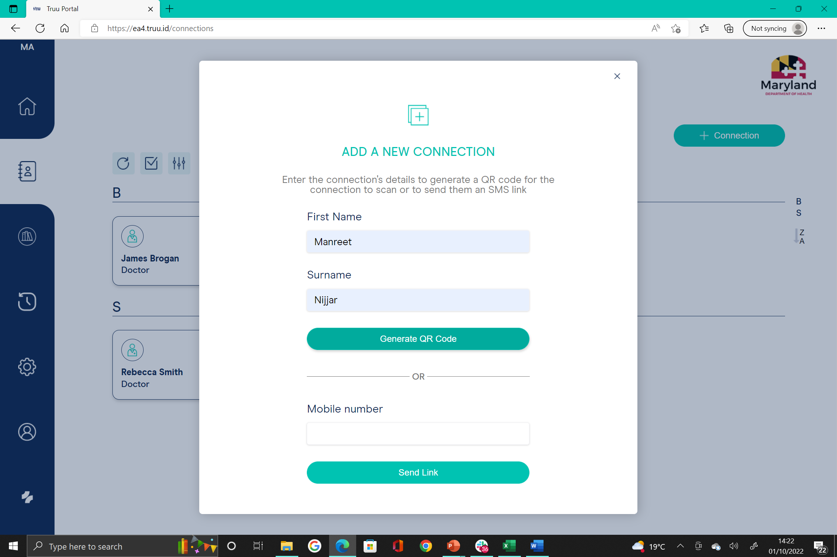
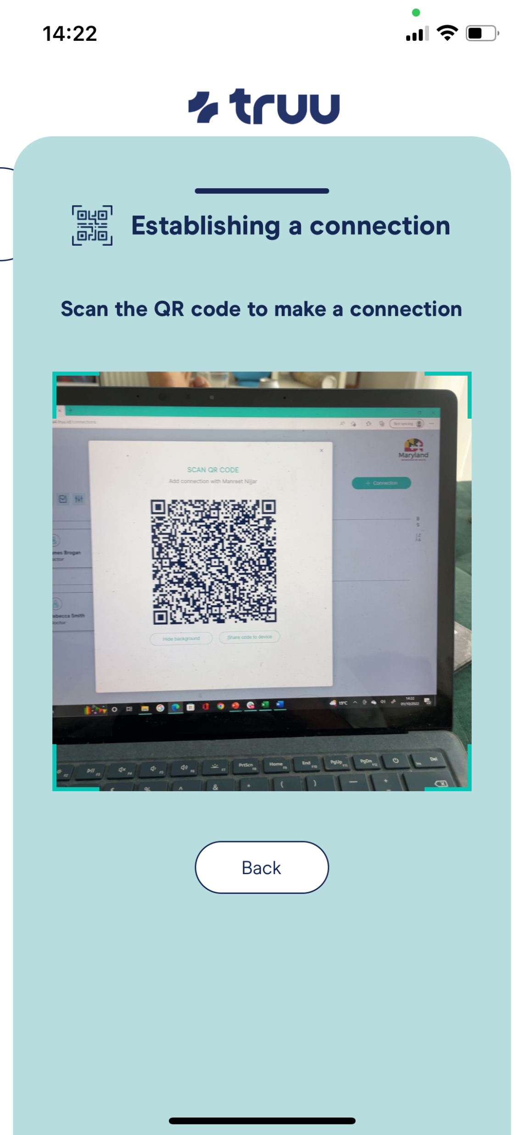
Connecting between Maryland Board of Physician’s organisational portal and Physician’s Truu wallet app

Slide 30
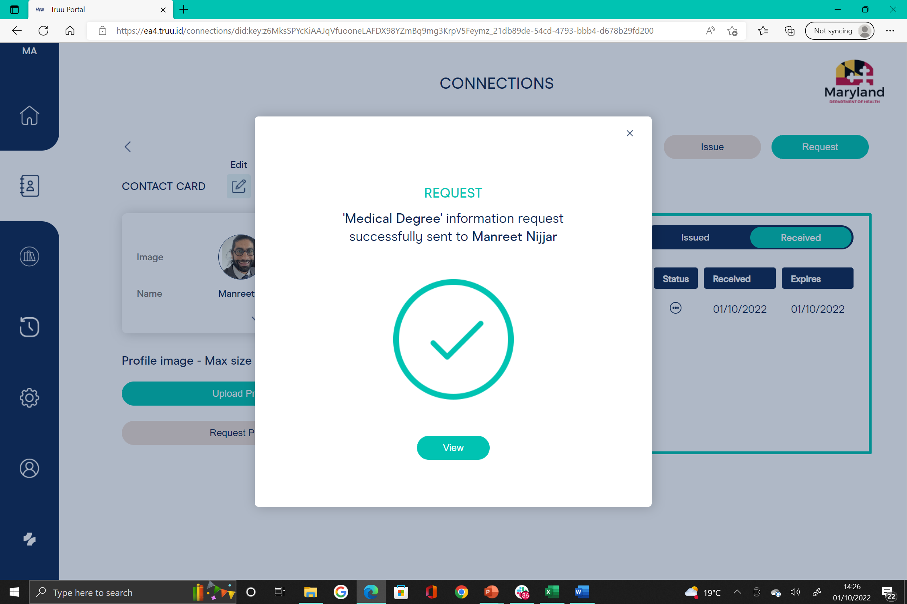
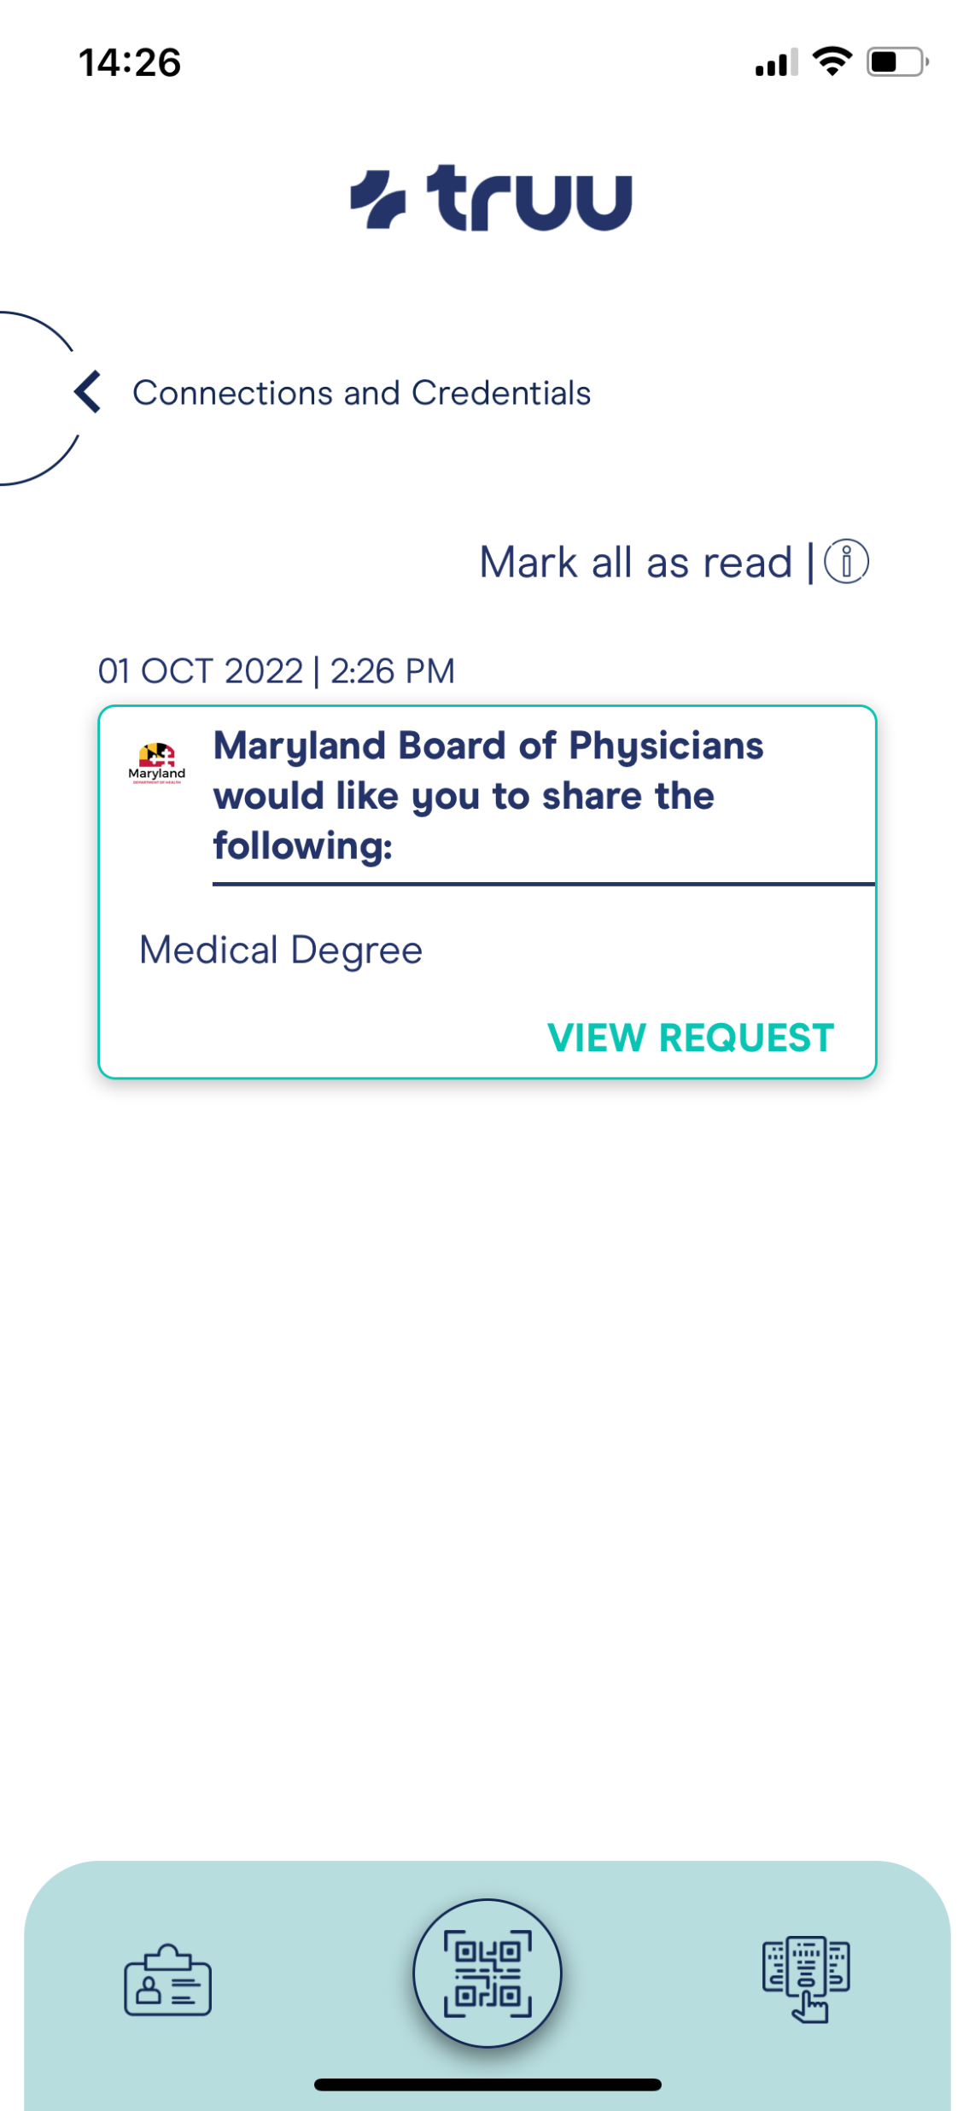
Maryland Board of Physicians requesting and verifying Medical Degree from Physician’s Truu wallet app

Slide 31
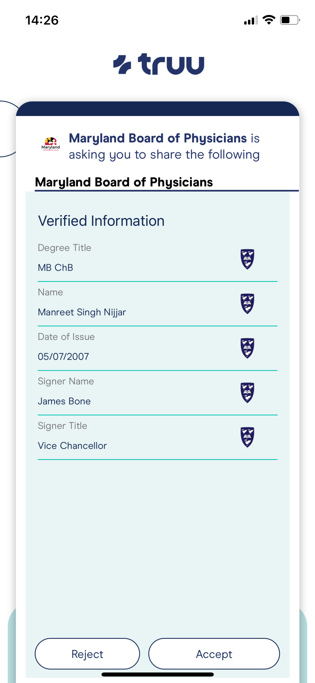
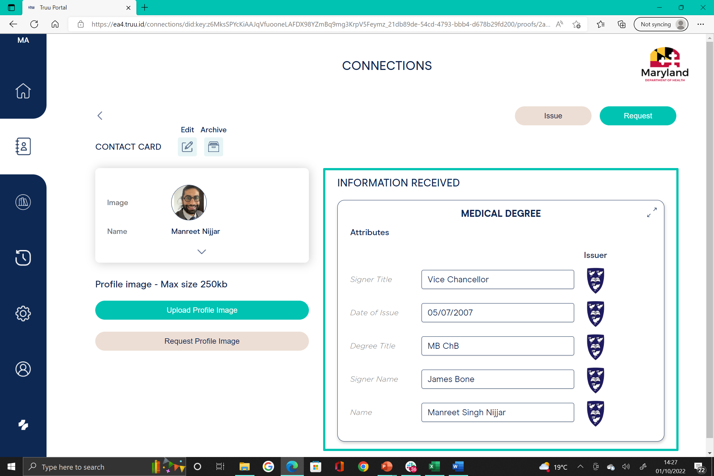
Maryland Board of Physicians requesting and verifying Medical Degree from Physician’s Truu wallet app

Slide 32
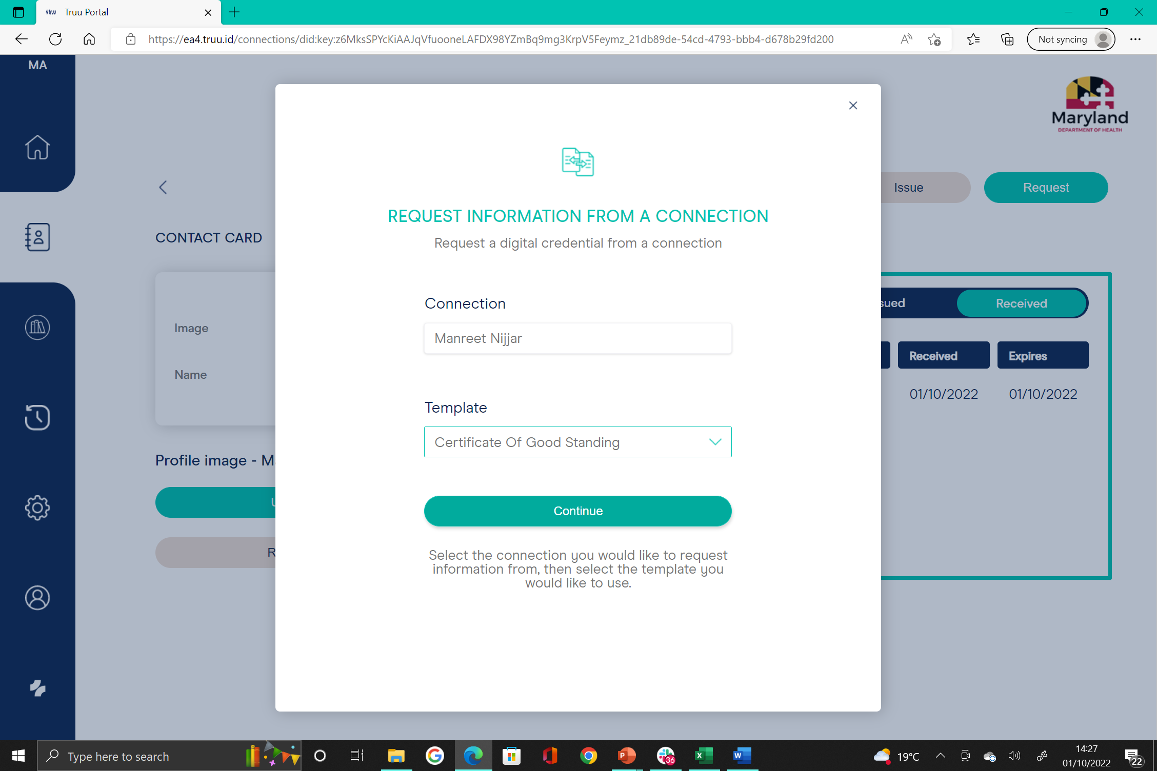
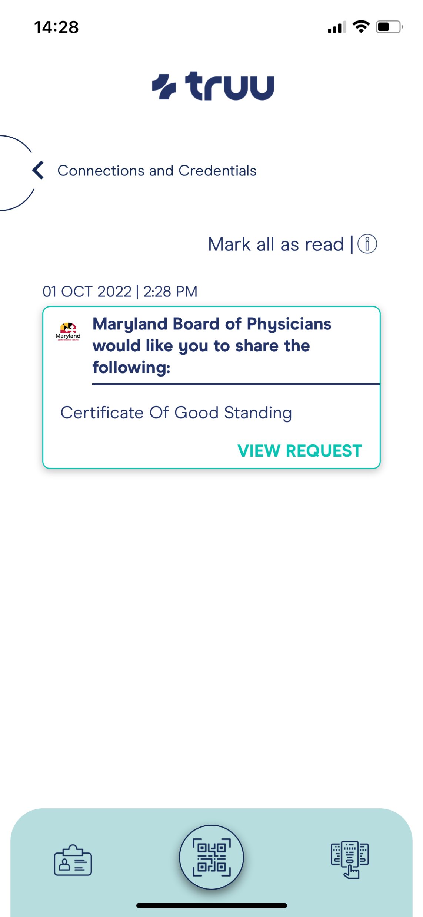
Maryland Board of Physicians requesting and verifying Certificate of Good Standing from Physician’s Truu wallet app

Slide 33
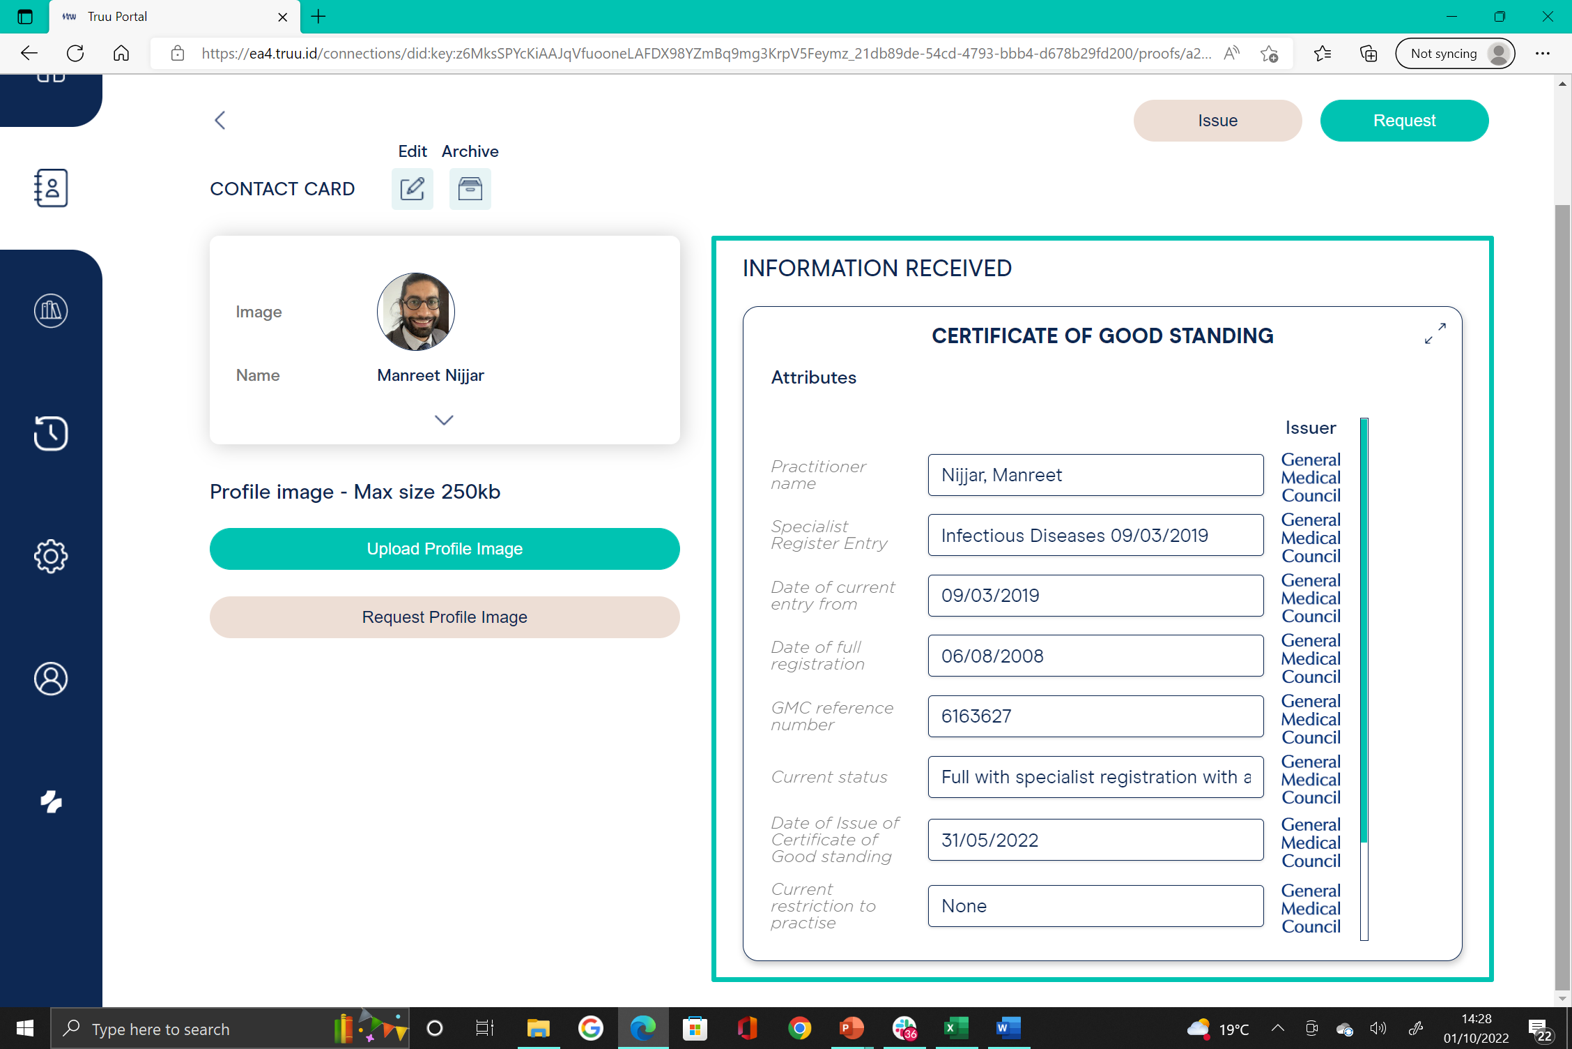
Maryland Board of Physicians requesting and verifying Certificate of Good Standing from Physician’s Truu wallet app

Slide 34
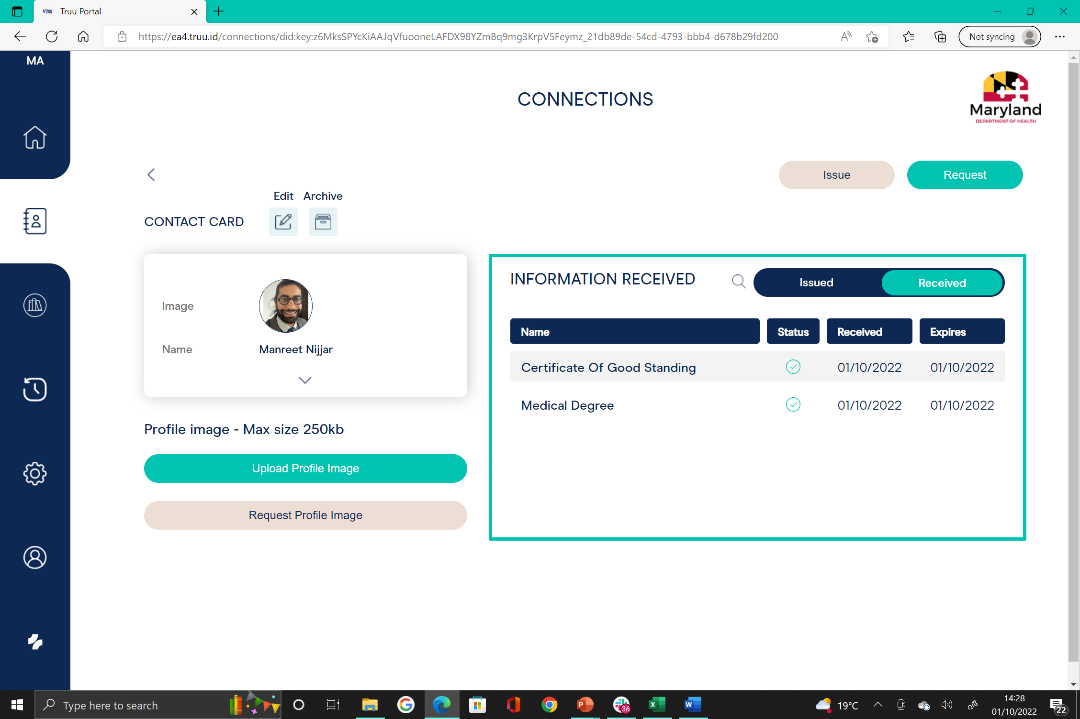
Maryland Board of Physicians now holds Physicians verified Medical Degree and Certificate of Good Standing information

Slide 35
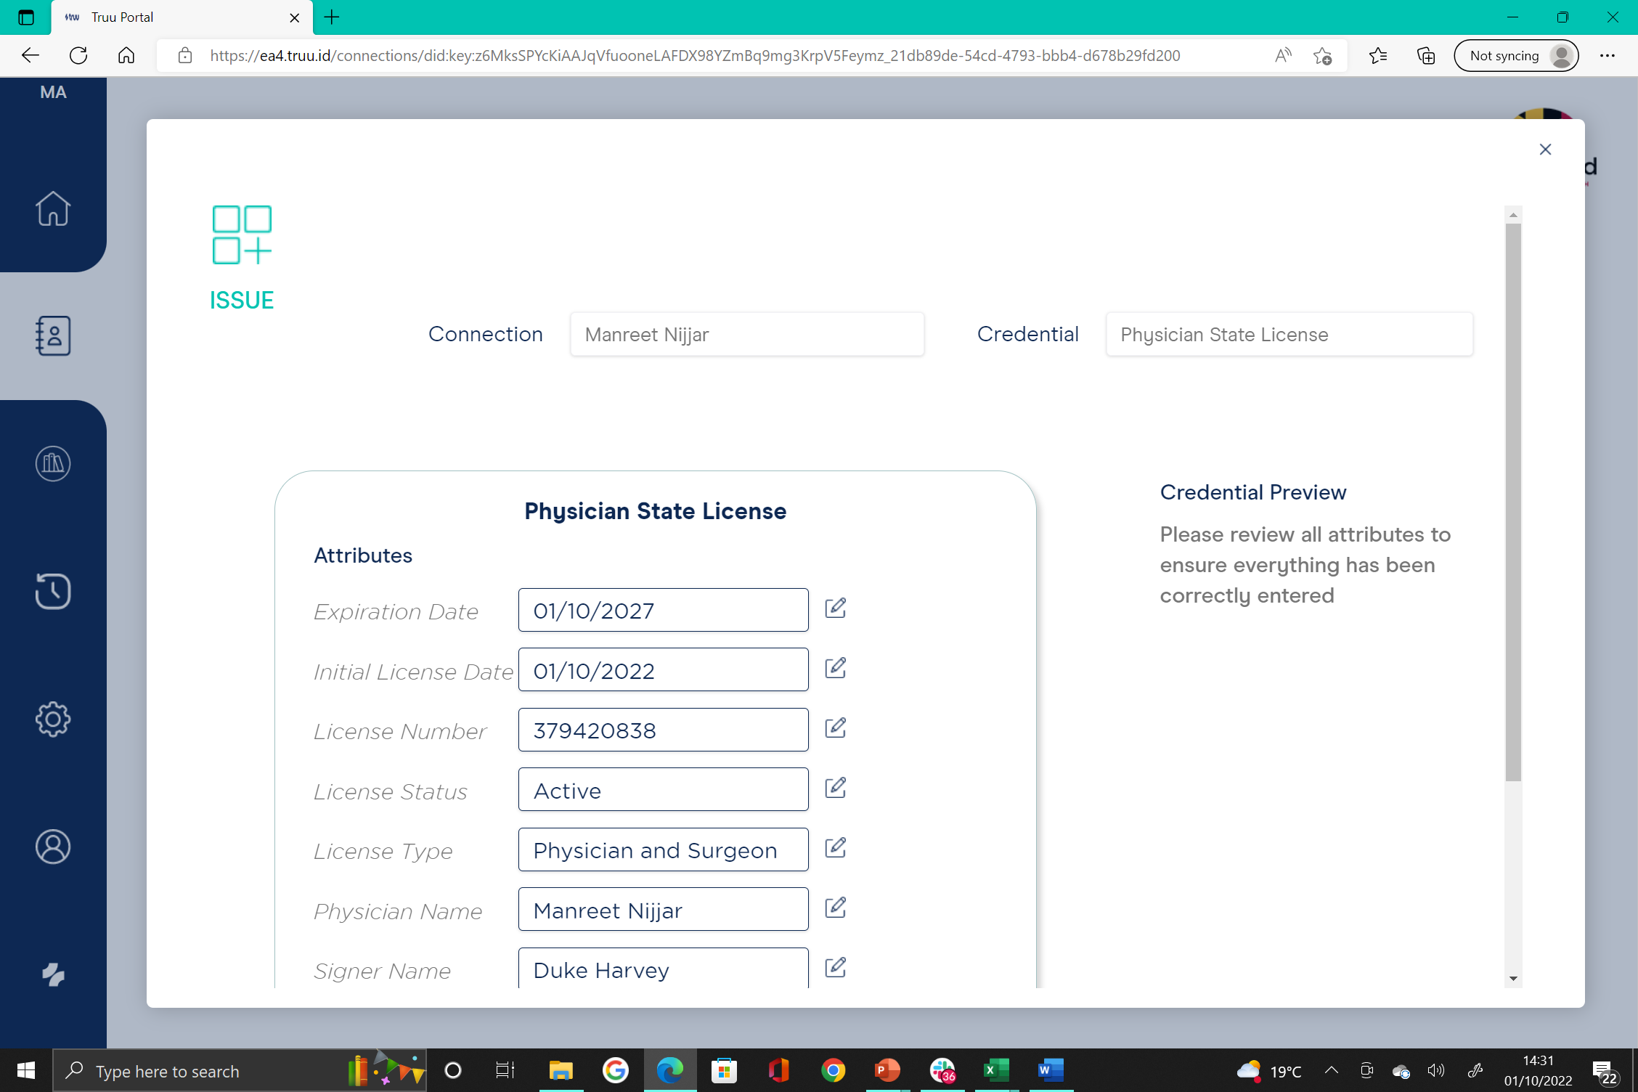
Maryland Board of Physicians now issue Physician State License into Physicians Truu Wallet App

Slide 36
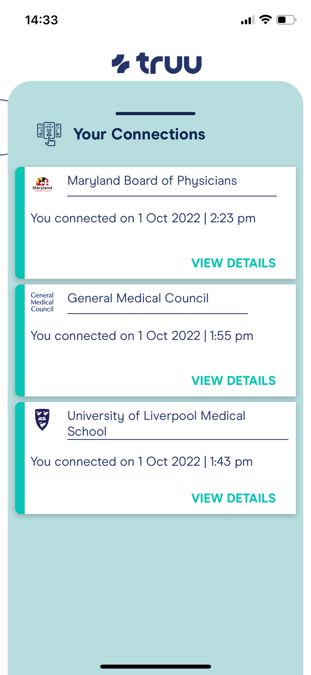
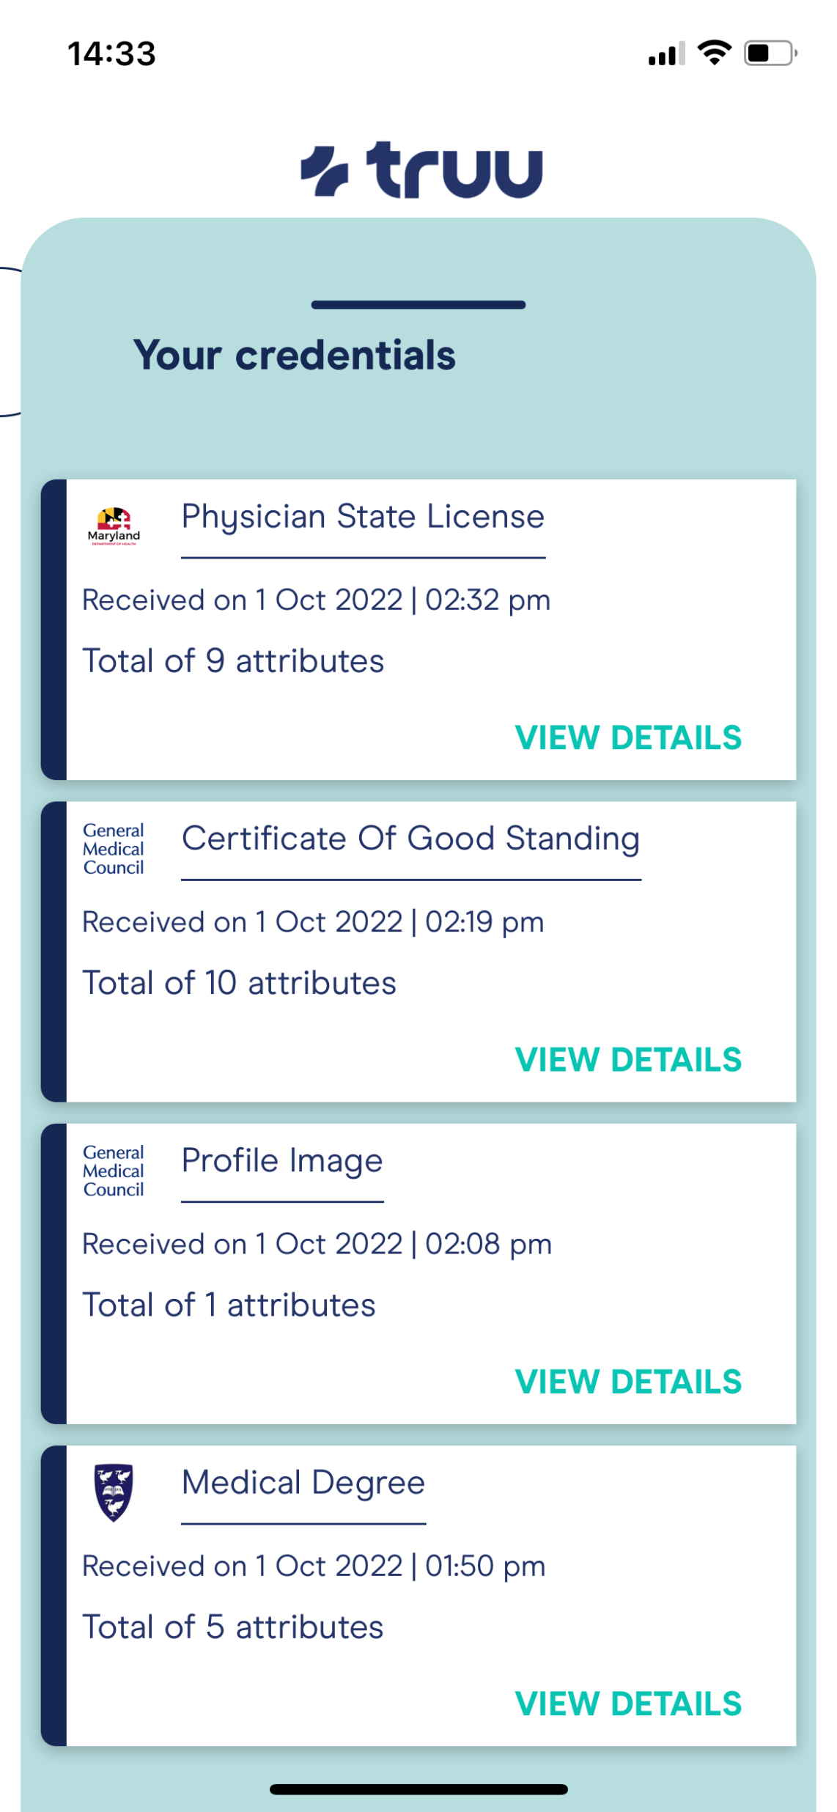
Physicians Truu Wallet App showing Physicians connections to organisations and verified credentials held

