Slide 1
Learner Record Mobility –
How Educational Achievements Travel
Aleks Morwaski
Director of Evaluation Services, Scholaro Inc.
Annetta Stroud
Director, Content & Curriculum, AACRAO

Slide 2
Paper vs. Digital Records
Sources:
Awarding Institution
Examination Board
Professional Licensing Board
National Data Depository (Credit Bank System)
Non-Profit Public Service (Article 26 Backpack)
Private Agency
CLR
Learner Record =
Transcript / Diploma
Course Certificates
Resume / CV
Recommendation letter
Badges/Microcredentials
Notes:
When we think about academic and how to capture learning

Slide 3
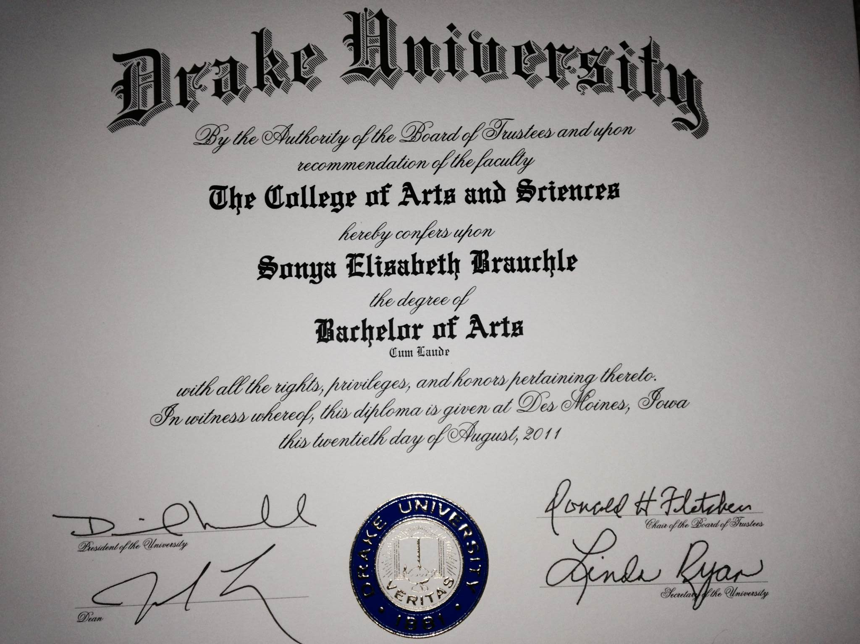
Awarding Institution
+ Most “official”
+ Lack of third-party bias
+ Academic, professional, vocational purposes
- Only OK when institution still open
- Cost and time to process
- Only for its own credentials
- No practical experience
- No assessed skills post/outside of awarded credential

Slide 4
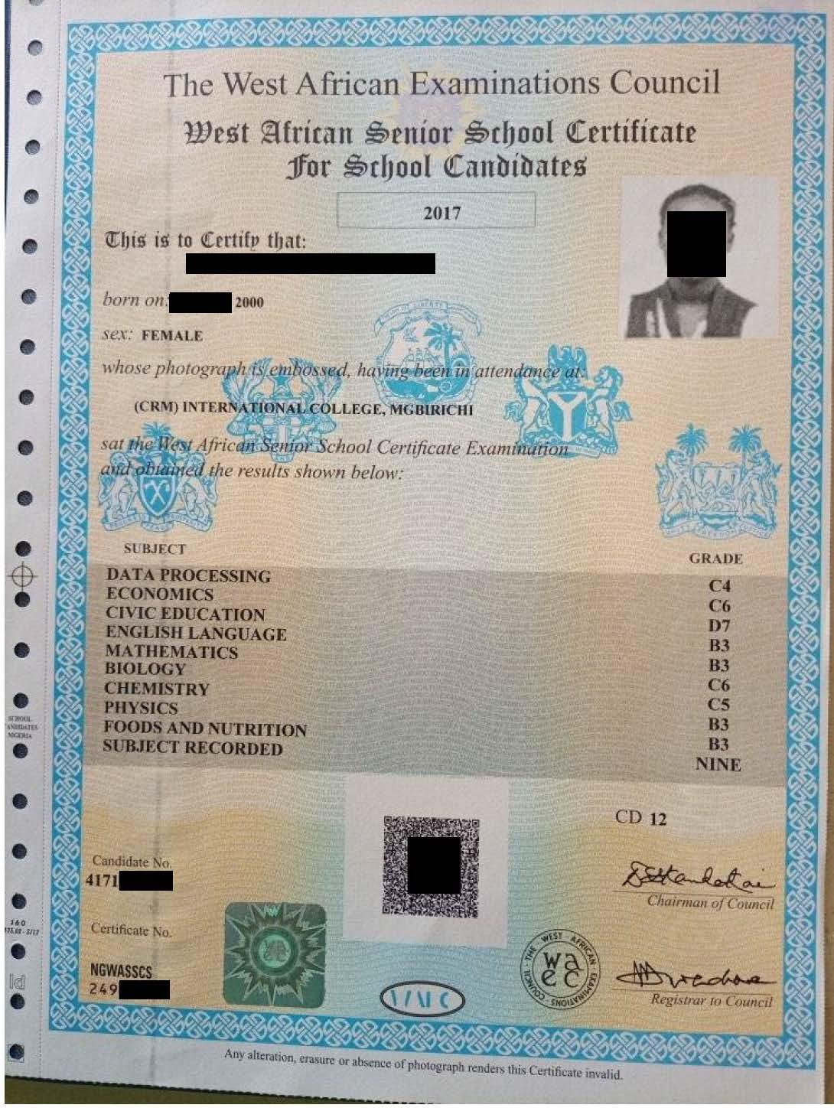
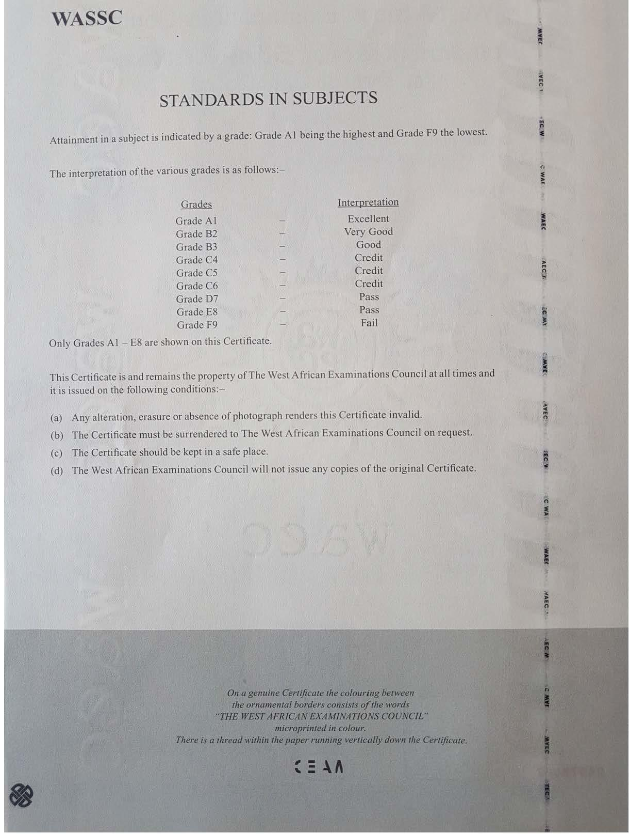
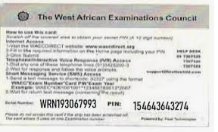
Examination Board
+ Capable of storing large data sets
+ Universally accepted in own region
+ Academic, professional, vocational purposes (not inclusive)
+ Travel well if verifiable
- Duration of data validity
- Cost and time to process
- Only for its own examinations
- No practical experience
- No guarantee of validity outside of region

Slide 5
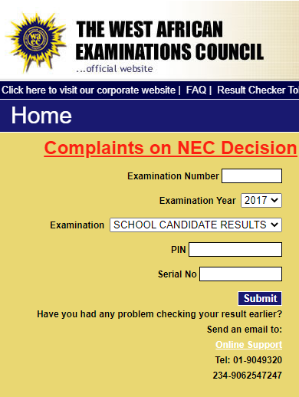
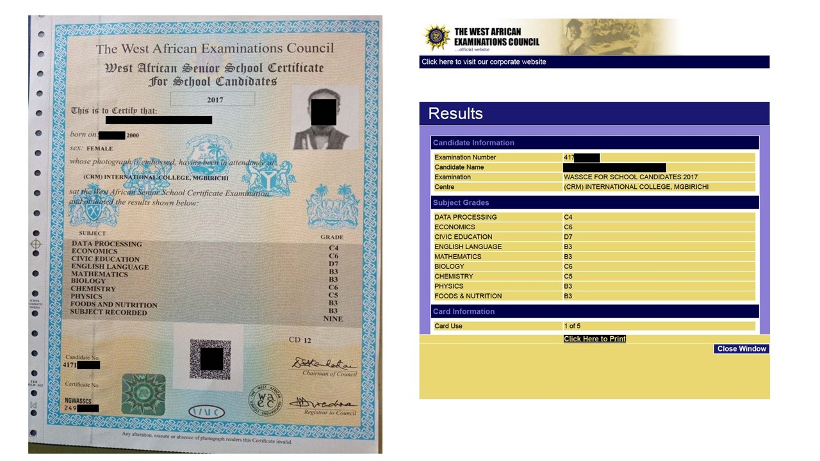
Examination Board

Slide 6
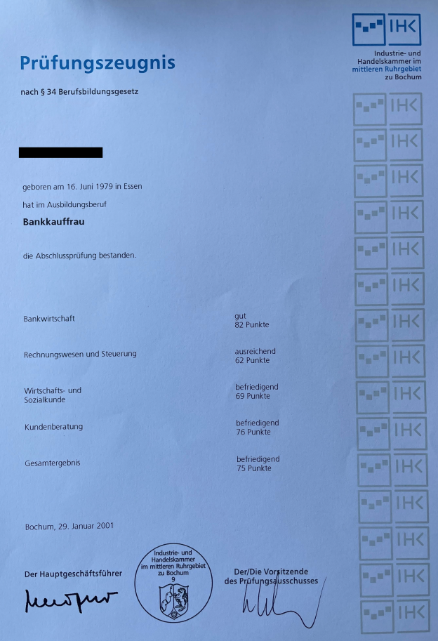
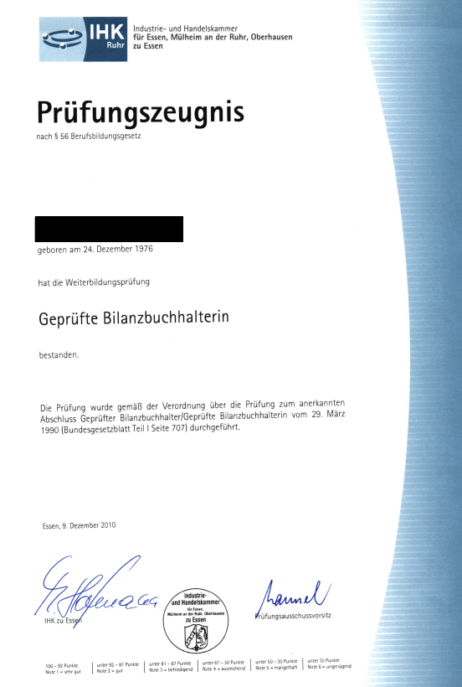
Professional Licensing Board
+ Grants a professional qualification
+ Universally understood/accepted in own region
+ May belong to a Qualifications Framework
- Duration of data validity
- Unclear academic value without QF
- Can not account professionally unrelated learning
- Not recognized for academic transfer by educational institutions*
- No guarantee of validity outside of region

Slide 7
Implemented 1998
Post-secondary only (open enrollment with HS diploma)
Credit awarded for:
Part-time study
Non-formal education
Technical certification
Self-taught degree exams
Standardized curricula & syllabi
General
Major
Electives
DEGREE GRANTING AUTHORITY
Korean Credit Bank
+ Flexibility in pathway to degree
+ Variety of training recognized
+ Non-competitive
- Nation-centric (no international learning option)
- Pre-approved education means only
- Negative perception in job market

Slide 8
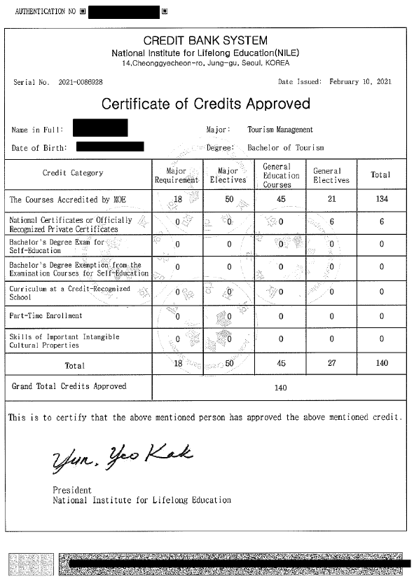
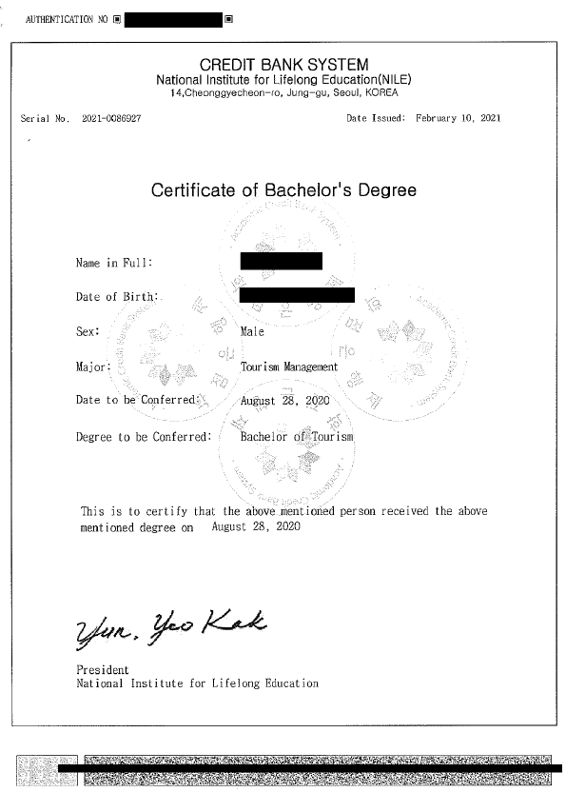
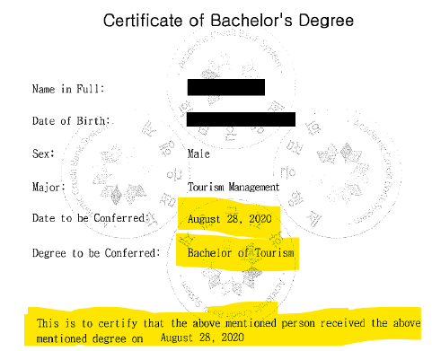
Korean Credit Bank

Slide 9
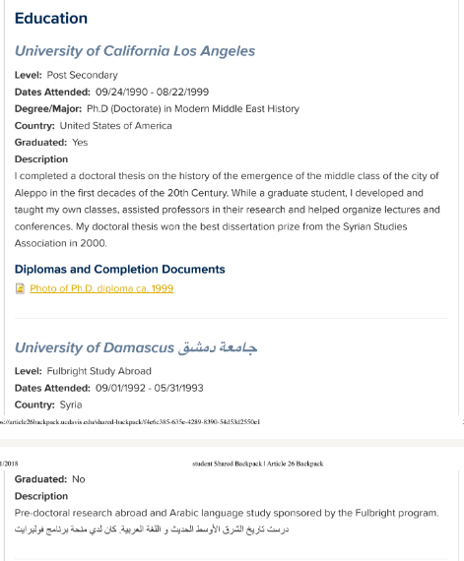
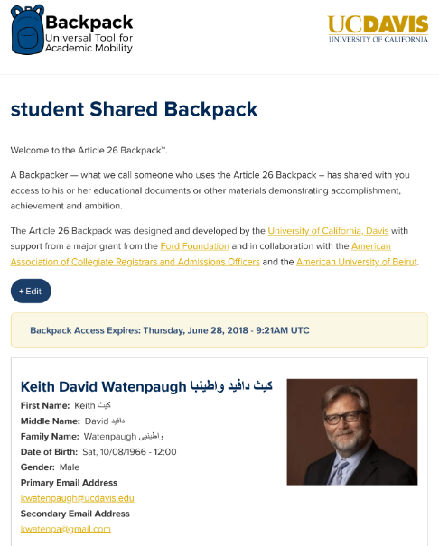
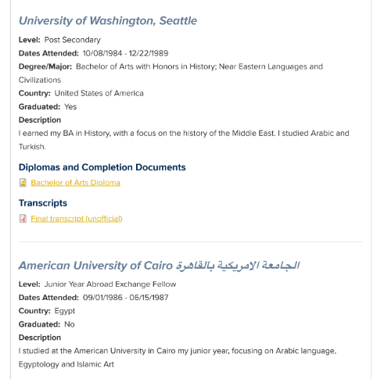
Article 26 Backpack
+ Safe and secure document locker
+ Multiple languages
+ Accessible multiple devices and low bandwidth areas
+ Contents securely sharable
- No verification of authenticity of contents
- No current interoperability with third party
- Not in overall use by institutions or employers

Slide 10
Independent Agency (Credential Evaluation)
+ Unbiased assessment for multiple purposes
+ Can include multiple levels of education
+ Prepared for education standards of destination
+ Digitally verifiable* (select organizations)
- Only for international credentials
- Validity imparted by trust in the agency
- May not replace “official” documents requirements
- Cost – public versus private agencies
- Access

Slide 11
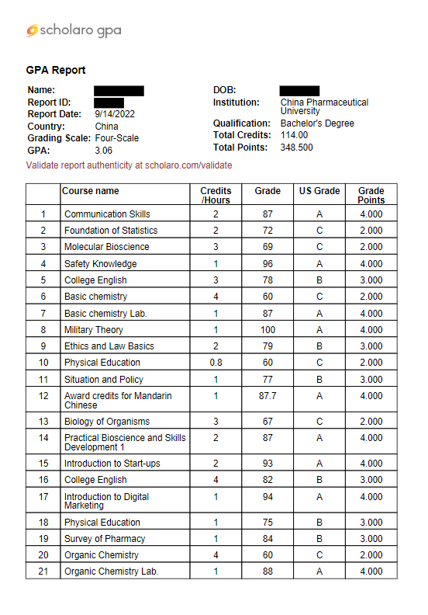
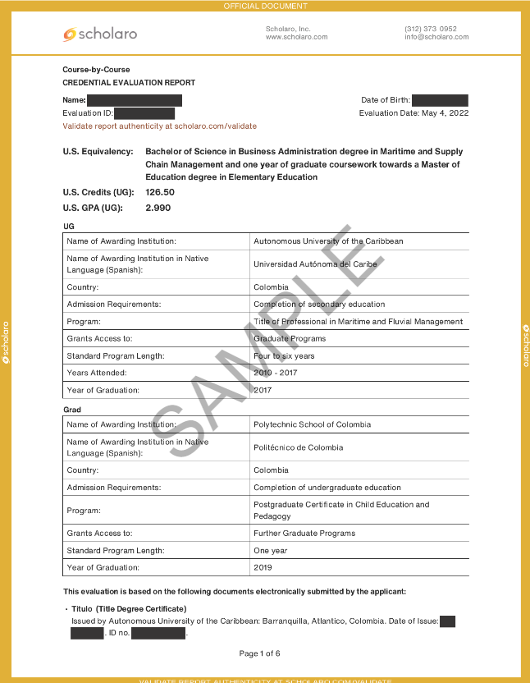
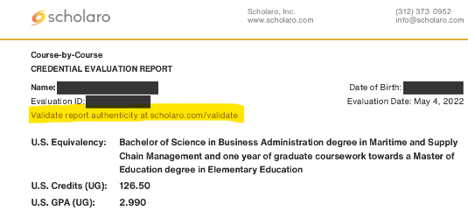
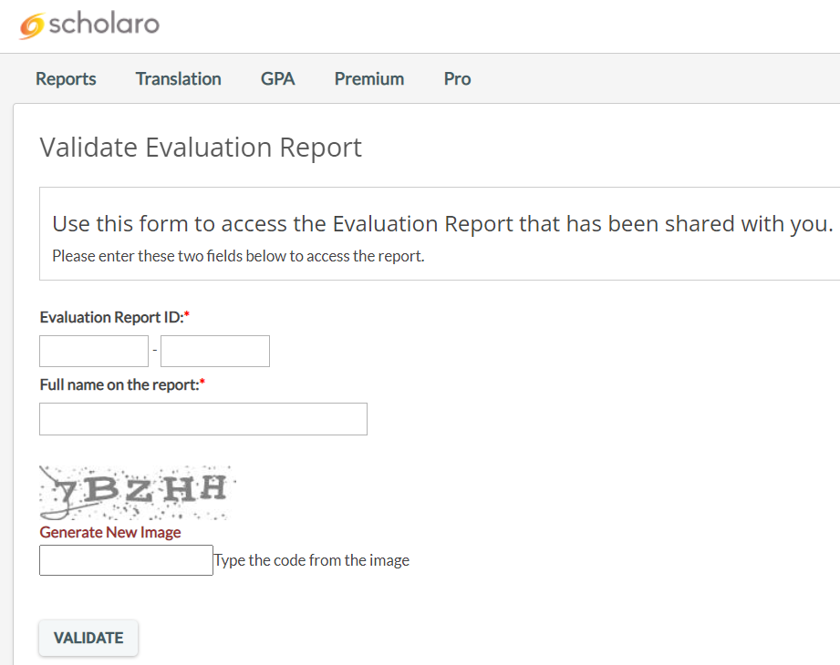
Independent Agency (Credential Evaluation)

Slide 12
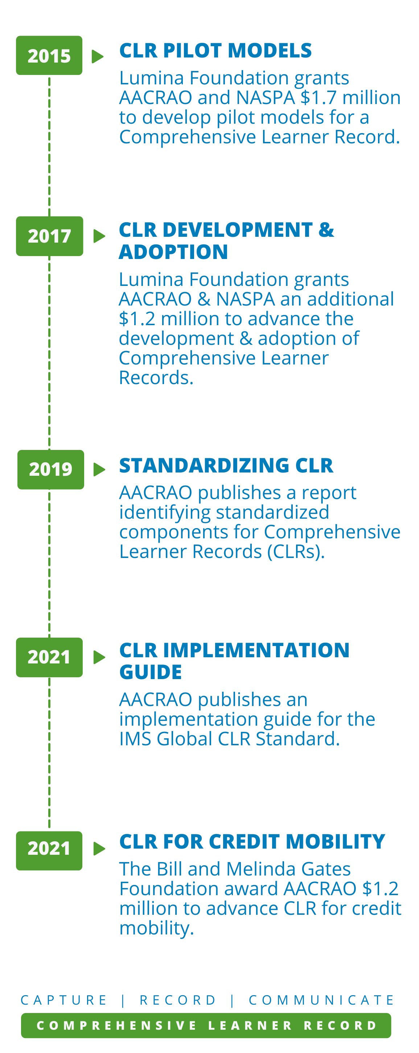
CLR a record focused on learning that occurs throughout the educational experience that usually includes learner achievements
Comprehensive Learner Record (CLR)
+ Official record issued by degree granting HEI
+ Capture learning outside the traditional classroom
+ Demonstrates value
+ Interoperatibliy through IMS Global Standard
- Not widely used

Slide 13
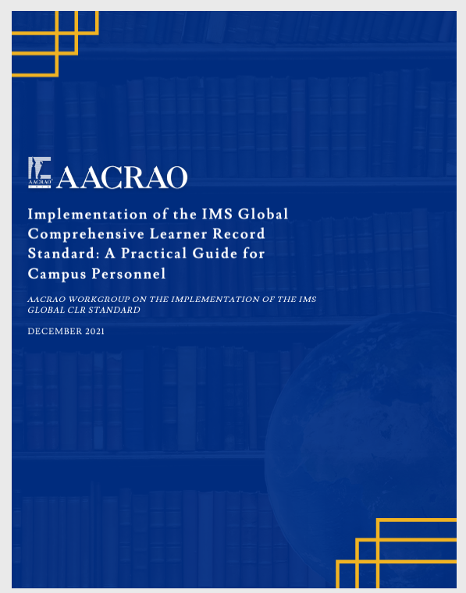
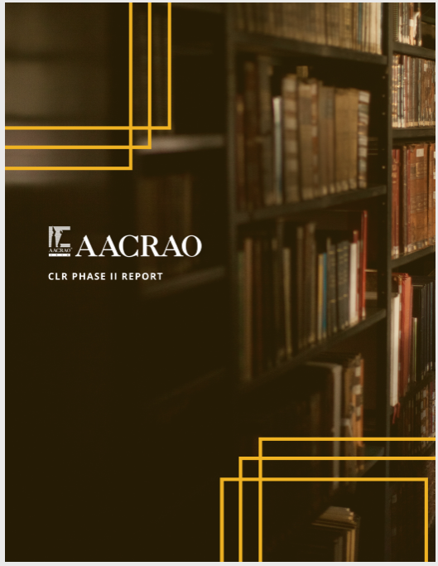
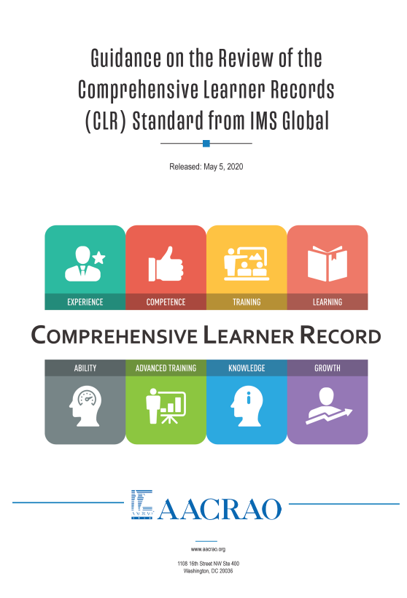
AACRAO Signature Initiative
Comprehensive Learner Record (CLR)
https://www.aacrao.org/signature-initiatives/comprehensive-learner-record-learning-and-employment-record#resources

Slide 14
Questions?
Thank you!
This presentation is available at scholar.com/presentations

