Slide 1
Uncovering obstacles: Developing a visual knowledge resource informing digital credentials policy
Welcome!
GDN Annual Meeting 2022 Groningen
A joint initiative of DAAD-GDN-UNESCO
12.10.2022
Notes:
Challenges to seamless data mobility are multifaceted. During last year's annual GDN meeting DAAD, UNESCO and GDN announced that they are joining forces to bridge yesterday and tomorrow, by providing a collaborative visual knowledge resource that is meant to inform policy on the worldwide regulation of digital credentials. The implementation of a global, interoperable infrastructure for learner credentials would have knock-on effects on the operating fields of all three organisations: student mobility, lifelong learning and sustainable development and global learner agency. The set aim is to visualise multiple layers of information on Digital Credentialing: Geographic proximity, Projects and their interconnections, standards, applicable legal regulations and legacy systems in order to aid understanding on the subject and improve decision-making. This session will outline the data collection methods used, introduce first functionalities of the interactive tool and invite participants to contribute to the knowledge resource by sharing updated information.

Slide 2
Resolving the issue of globally interoperable digital credentials through…
Global Learner Rights and Agency
Sustainable Development and Lifelong Learning
Worldwide Academic Mobility and Access
Notes:
Borhene

Slide 3
Digital Credentials in Education
Benefits for lifelong learning, global learner rights and learner mobility
Notes:
Borhene

Slide 4
Digital Credentials for Lifelong Learning
The discussion around Digital Credentials is anchored in the context of sustainability. The technology of interoperable credentials is making flexible educational pathways accessible to all.
Lifelong learning (LLL) is ‘rooted in the integration of learning and living, covering learning activities for people of all ages [...], in all life-wide contexts (family, school, community, workplace and so on) and through formal, non-formal and informal modalities which together meet a wide range of learning needs and demands.’
The demographic transition and technological change lead to a need for the development of technologies, policies and strategies for skilling, upskilling and reskilling within sustainable economies.
UNESCO, 2014. Lifelong learning. UNESCO Institute for Lifelong Learning Technical Note. https://uil.unesco.org/fileadmin/keydocuments/LifelongLearning/en/UNESCOTechNotesLLL.pdf (Accessed 11 March 2022.)
Notes:
Borhene, hand over to Alex (DAAD)

Slide 5
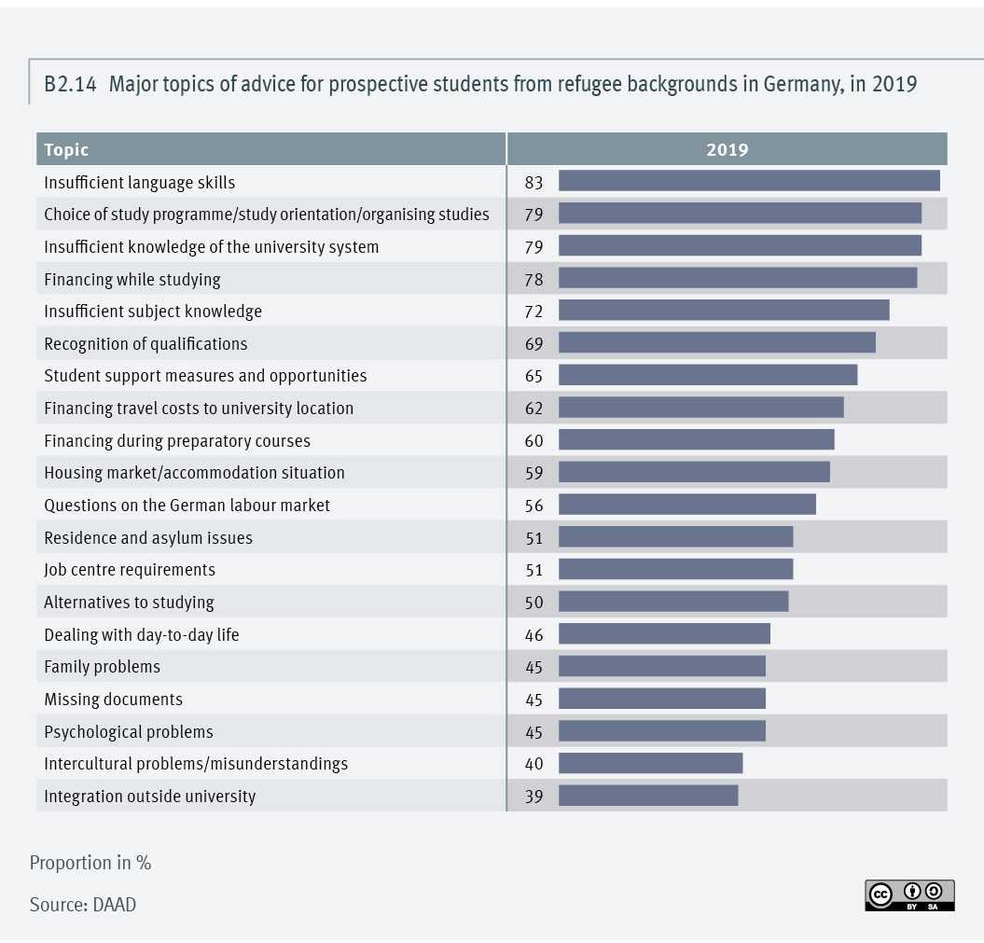
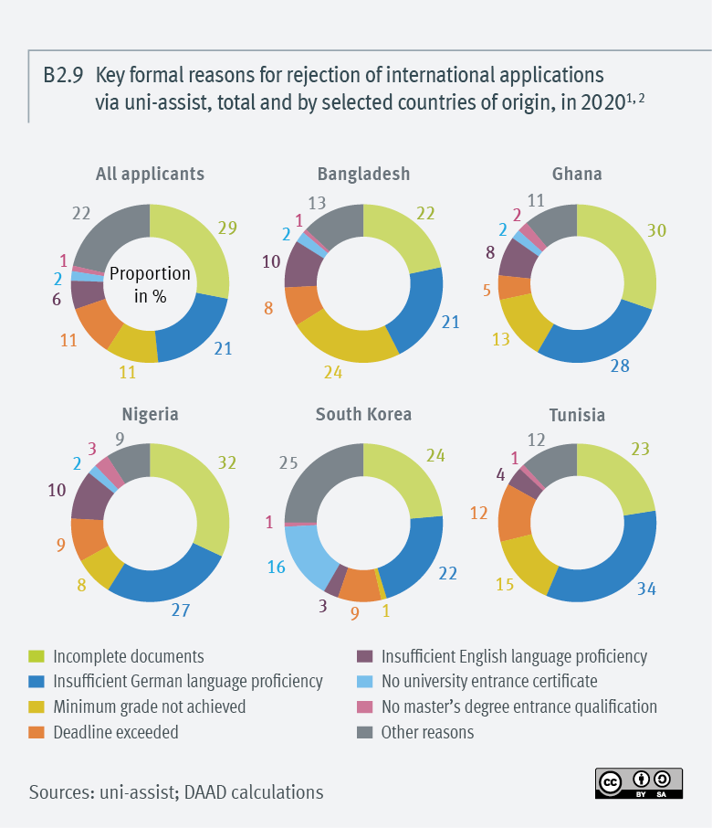
Digital Credentials for Student Mobility
Figure 1 – “Major topics of advice for prospective students from refugee backgrounds in Germany, in 2019 [B2.14]” (Wissenschaft Weltoffen 2021)
Figure 2 – “Key formal reasons for rejection of international applications via uni-assist, total and by selected countries of origin, in 2020 [B2.9]” (Wissenschaft Weltoffen 2021)
Notes:
Alexander, hand over to Herman (GDN)

Slide 6
Global Learner Rights
Data Privacy
“Citizens worldwide should be able to consult and share their authentic educational data with whomever they want, whenever they want, wherever they want.”
Learner Autonomy
Interoperable Standards
Agency
Interoperable Standards
Self-
Sovereignty
Ownership
of Data
Duklas, J., Schatzman, M., Knoth, A., De Leeuw, H., Manahan, A., Keevy, J., Ramina, B., Massey, K., Schwarzwald, B., Van der Hijden, P. and Gottlieb, M. 2021. Micro-credentials: Towards a Universal Definition. Groningen Declaration Network Position Statement on Micro-credentials. https://www.groningendeclaration.org/wp-content/uploads/2021/07/GDN-Position-Paper-for-the-European-Commission-public-consultation-on-micro-credentials-July-12-2021-final-v2.pdf (Accessed 15 March 2022.)
Notes:
Herman

Slide 7
Challenges to Seamless Learner Data Mobility
Notes:
Herman

Slide 8
Building Competencies along the Learner Journey
Professional
Vocational
Tertiary
Secondary
Primary
- Study orientation
- Propaedeutics
- Language test
- University Entrance Qualification
- Application
- Admission
- Apply for a scholarship or study abroad programme
- Recognition of credits earned abroad
- External achievements and additional job qualifications such as MOOCs, Modules & Micro Degrees
- Final diploma
- Lifelong learning portfolio
Icon: Freepik
Notes:
Herman

Slide 9
Establish trust
Establish a common understanding of credentials through classification
Recognise qualifications between regions through political frameworks
Standardise data governance practices
Notes:
Borhene, hand over to Alex
Establishing trust (data integrity, institutional legitimacy, user sovereignty) is the overarching goal
Achievement through:
Common understanding of credentials (Taxonomy for a Credential Comparability Ecosystem)
Qualification recognition (Interoperability frameworks, no data silos, Governmental resources for cross-border interoperability)
Standardisation of data governance practices (machine readable learner data, inclusion of stakeholder communities in decision-making)

Slide 10
Visualisation as a Method
Notes:
Borhene

Slide 11
Information gathering and knowledge creation
Notes:
Alexander

Slide 12
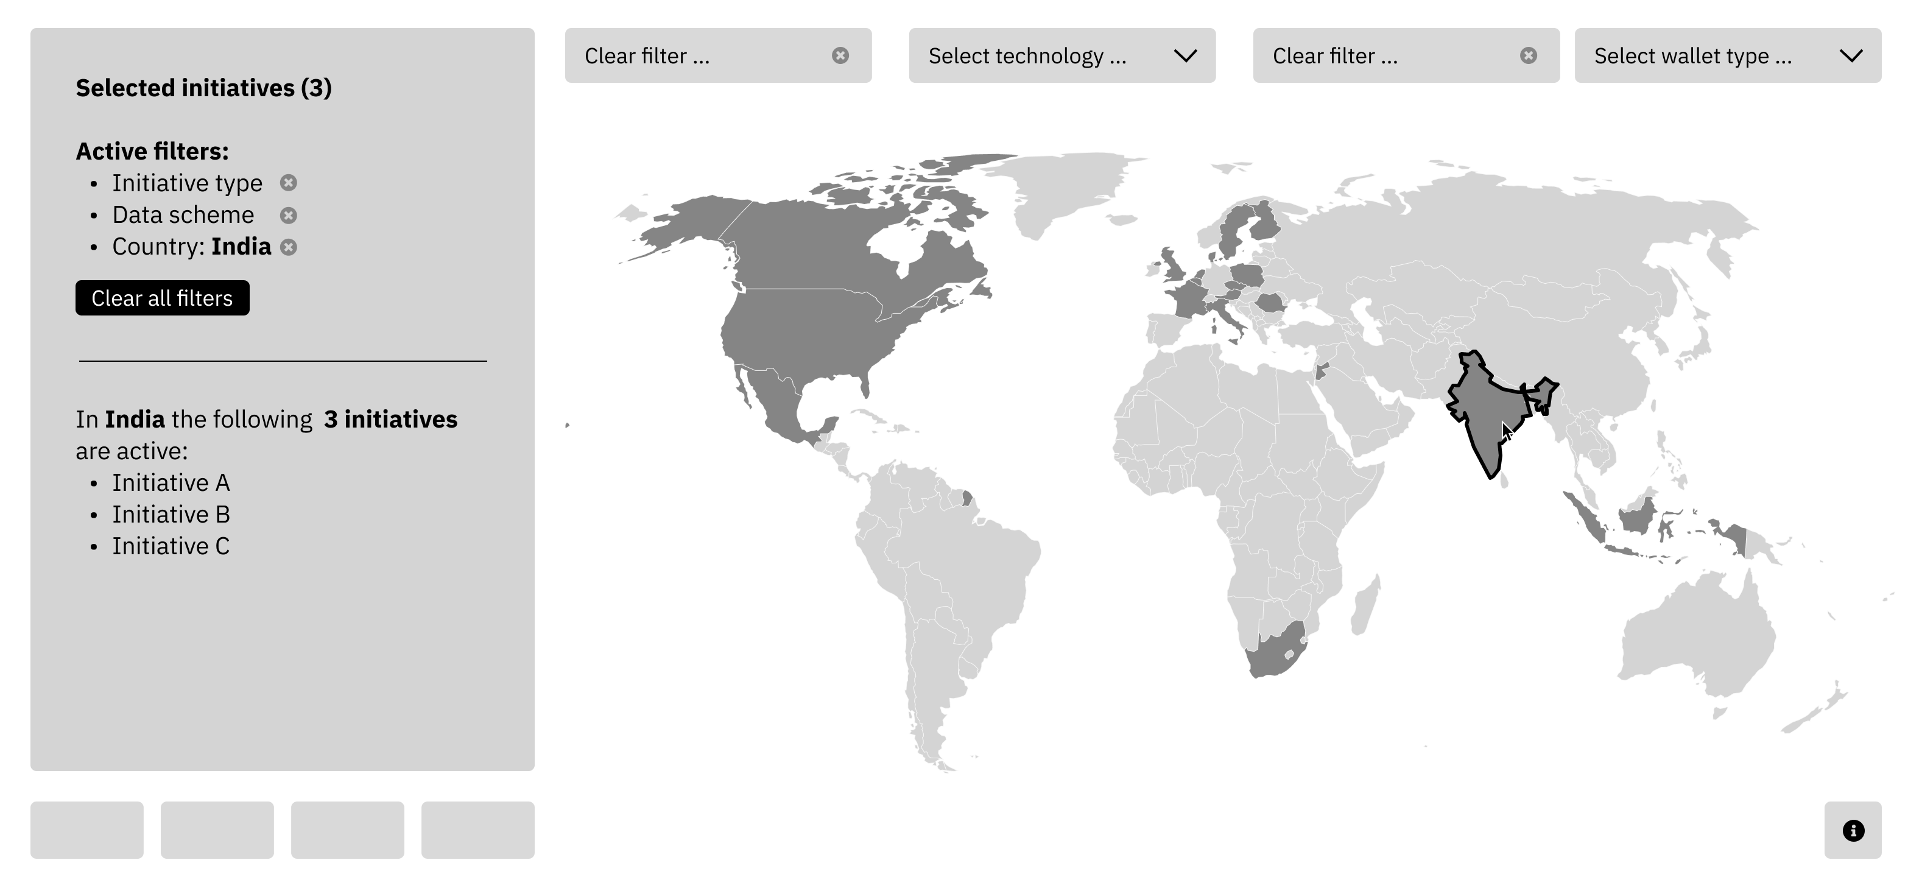
Creating a collaborative resource tool
Multiple layers:
Geographic proximity
Connected projects and initiatives
Standards and wallets in use
Applicable legal regulations
Historic/Legacy systems
Early Wireframe of the Visualisation from the conception stage (Credit: Alsino Skowronnek)
Notes:
Alexander
“See patterns, spot trends, identify outliers“
Identify similarities and differences of DC initiatives around the globe
Design powerful visualisations to make data more accessible
Represent the historical evolution of DC initiatives and legacy systems
Make the historical developments of concepts visible
Improve decision-making by stakeholders by aiding understanding

Slide 13
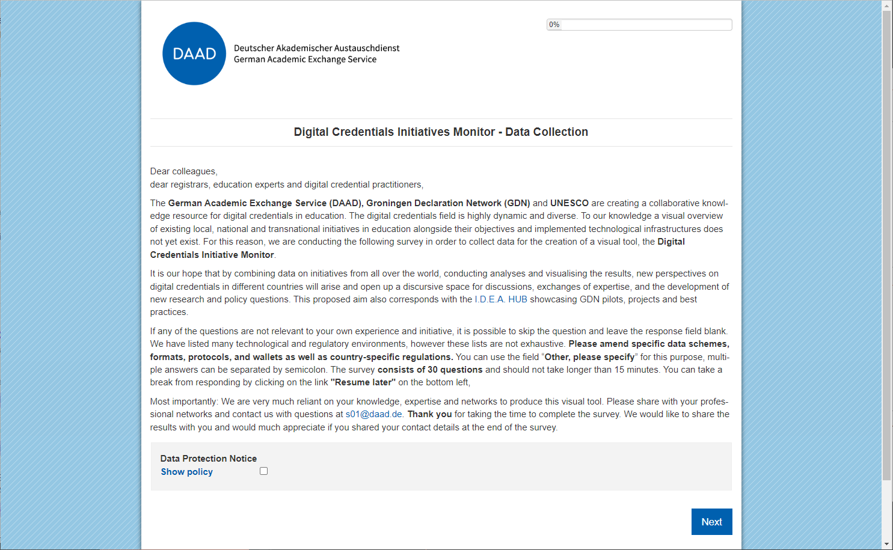
Are we asking the right questions?
name
used protocols, components
initiative type
wallets
description
primary issuance format
objectives
trust model
productive use
relevant eID services
founding date
relevant data protection regulations
countries
relevant skills and competency frameworks
organisations involved
relevant recognition frameworks
scope (processed credential data)
interoperability
dataschemes
milestone for digital credentials
data model
support mobility and access agenda
data formats
future developments
Notes:
Was this actually the data that needed to be collected? This will be shown with every survey that is entererd.
With every version Next steps: Manage data in back-end

Slide 14
Trees or forest?
Notes:
What level of granularity is needed?
Pitfall: Inability to see the forest for all of the trees (Den Wald vor lauter Bäumen nicht sehen)
Fine balance between being caught up in (important) technical details, but still trying to find categories that can be applied to different types of initiatives, in order to allow for overarching analysis.
Granular stages >> wie grenzt man sinnvoll ein, um analyse zu ermöglichen?
Man sieht den Wald vor lauter Bäumen nicht?

Slide 15
Introducing the Digital Credentials Initiatives Monitor
Notes:
Alexander

Slide 16
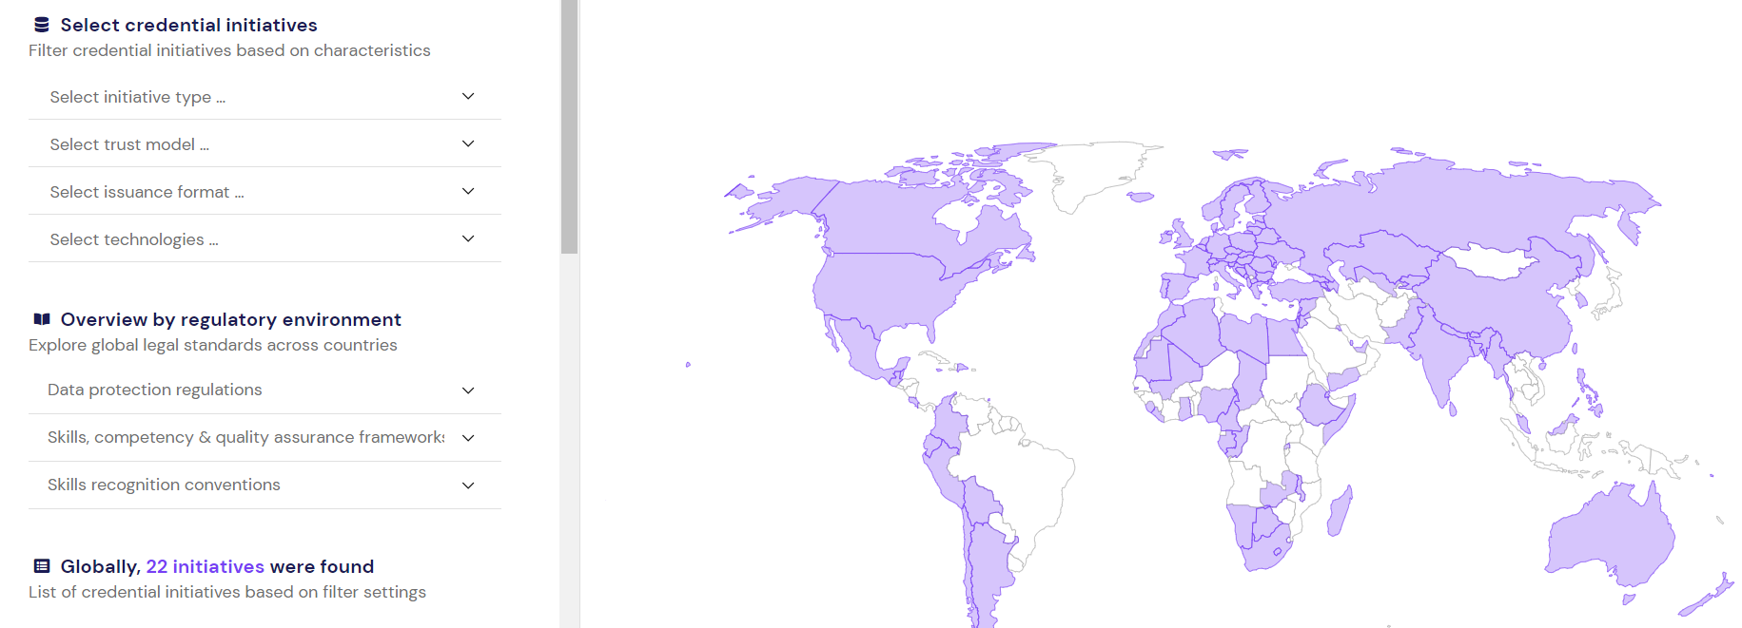
Structured search with filters (but: small sample size)
Notes:
This is our first version with a very small sample size, so please keep this in mind, as I proceed.
- This presentation is of course a call to action: We need your expertise, we need your data!
- Once we have a solid amount of correct data, it will be possible to develop theories from the provided material and begin to extrapolate questions
- Even at this early stage, we had difficulty structuring, e.g. the different "initiative types
Credential verification service, databse of trusted issuers, infrastructure project, national credential repository, policy initiative, research project, trans-international credential repository
- multiple selection is not possible in the current version
- Or even here, one can tell semantic clarity is missing. For example Herman and I had a short discussion about using depository (to bring across an active user) or the more frequently used repository in tech.

Slide 17
A few screenshots demonstrating explorative analysis
- bisher recht zentralisiert - viele repositories mit Daten, aber diese sind nicht vernetzt
Rahmen schaffen, um isolierte repositories miteinander zu vernetzen
Aus dem Material Theorien entwickeln. Regelmäßigkeiten identifizieren und davon Potentiale ableiten. Structured viewing of existing initiatives
Mobility flows in D, woher kommen Studierende? Wo gibt es den größten Nutzen, wenn wir Interoperabilität herstellen? EU interne Operabilität wird gestärkt.
Notes:
Wie unterscheidet man Initiativen? Types? Mehrfachauswahl ist nicht möglich
Sind technische Dinge relevant? Lassen sich diese voneinander zu trennen?
Viele sind keine repositories? Semantic clarity when using terminology
Granular stages >> wie grenzt man sinnvoll ein, um analyse zu ermöglichen?
Man sieht den Wald vor lauter Bäumen nicht? Active or inactive status?

Slide 18
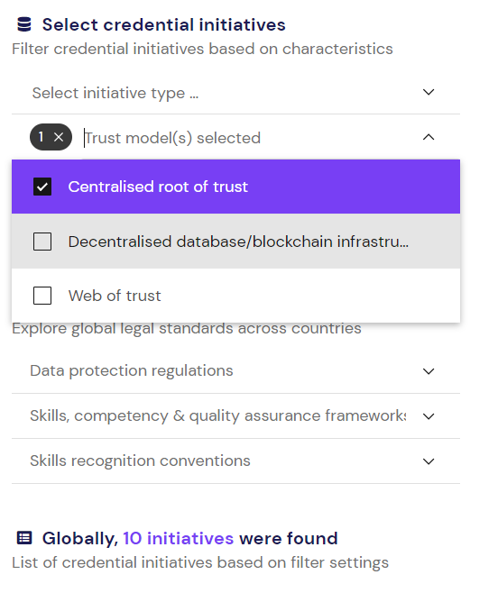
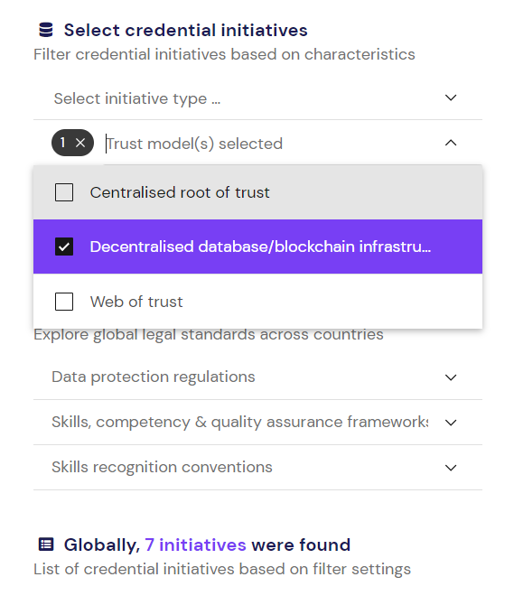
Trust model
Notes:
- filters for initiative types
- trust model used

Slide 19
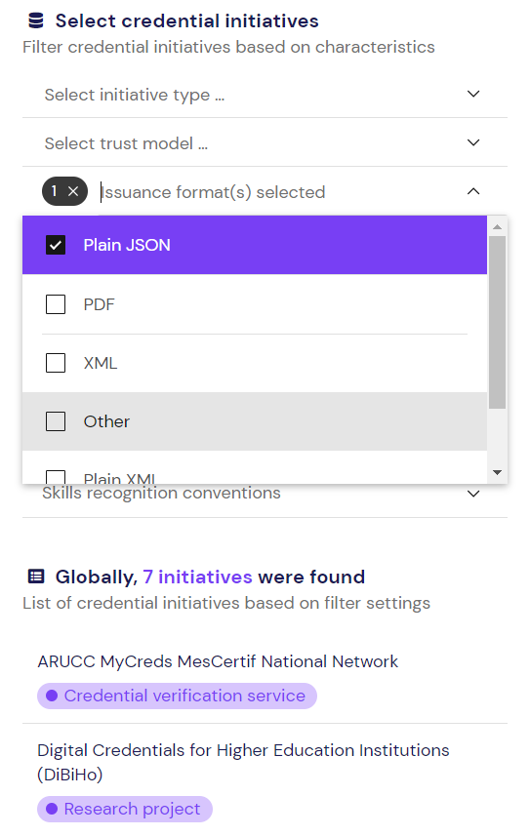
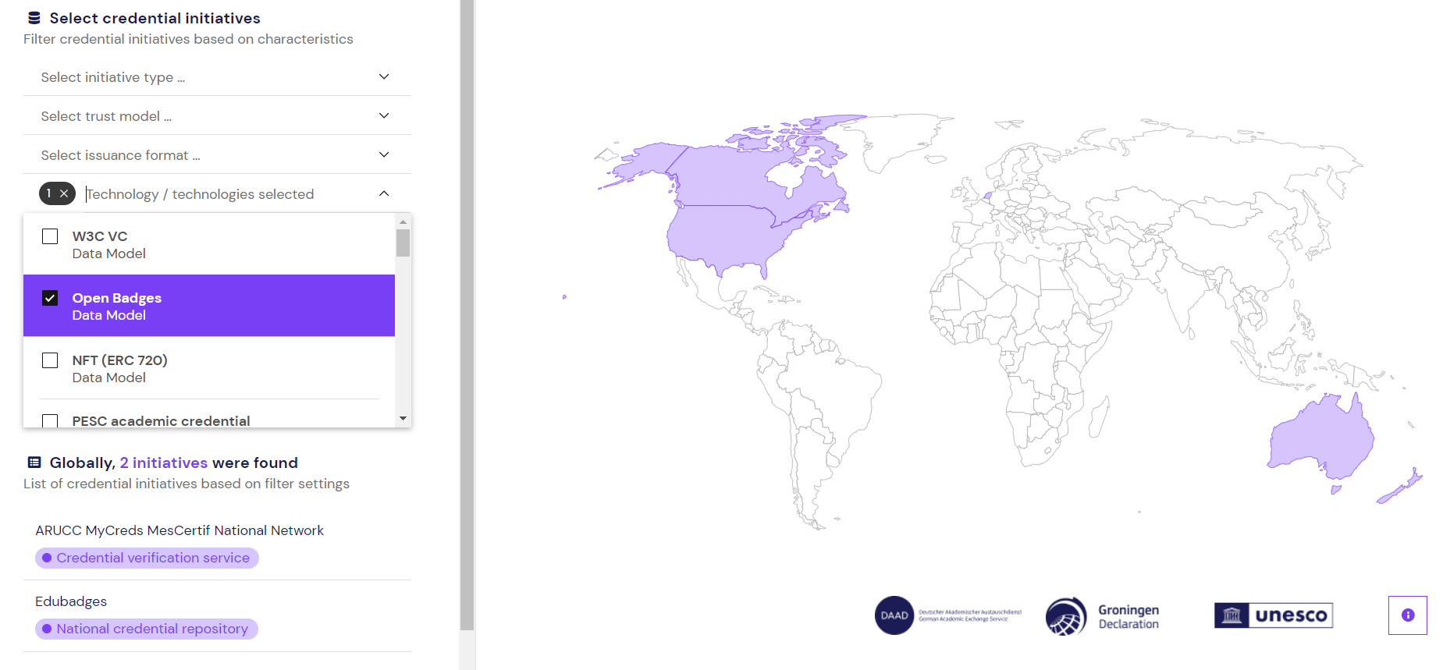
Issuance format and technology
Notes:
Filter by -
Issuance format
Technology used, the corresponding countries will be highlighted in the case of ARUCC: USA, Canada, Australia, New Zealand
But:
- Are technologies really relevant? For example, we had initially collected data on wallet types, but later decided that this was not necessarily the most significant component.
- It also isn't easy to separate certain technologies or protocols from one another, as these are often connected. And where does one stop? With which version update?
- We had also thought about adding a filter on inactive or active status and may still do so once the data set grows.

Slide 20
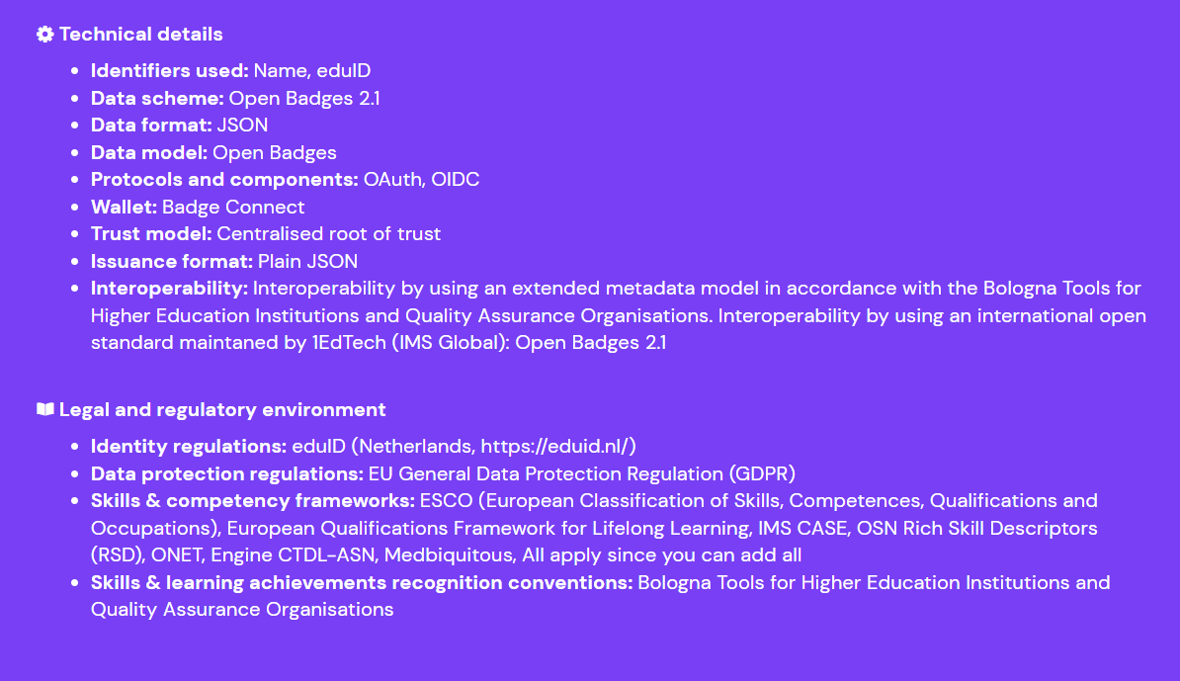
Information on individual initiatives

Slide 21
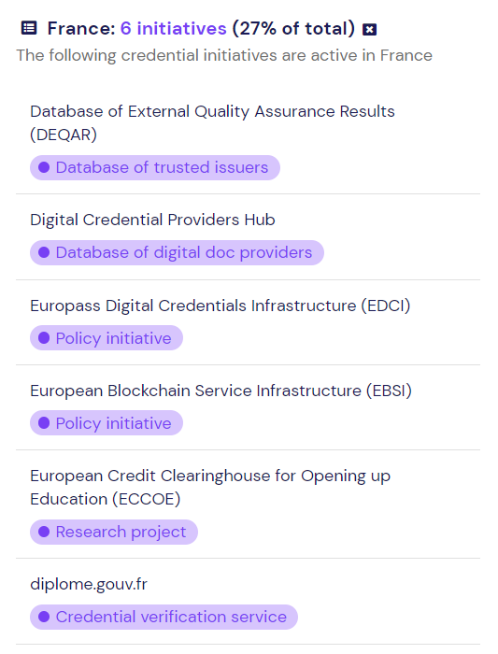
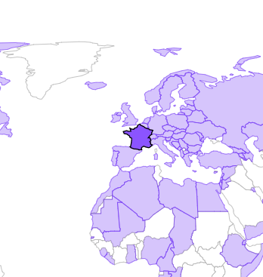
By country
Notes:
I can also use the monitor by clicking on a country and viewing the initiatives present and active in a specific country

Slide 22
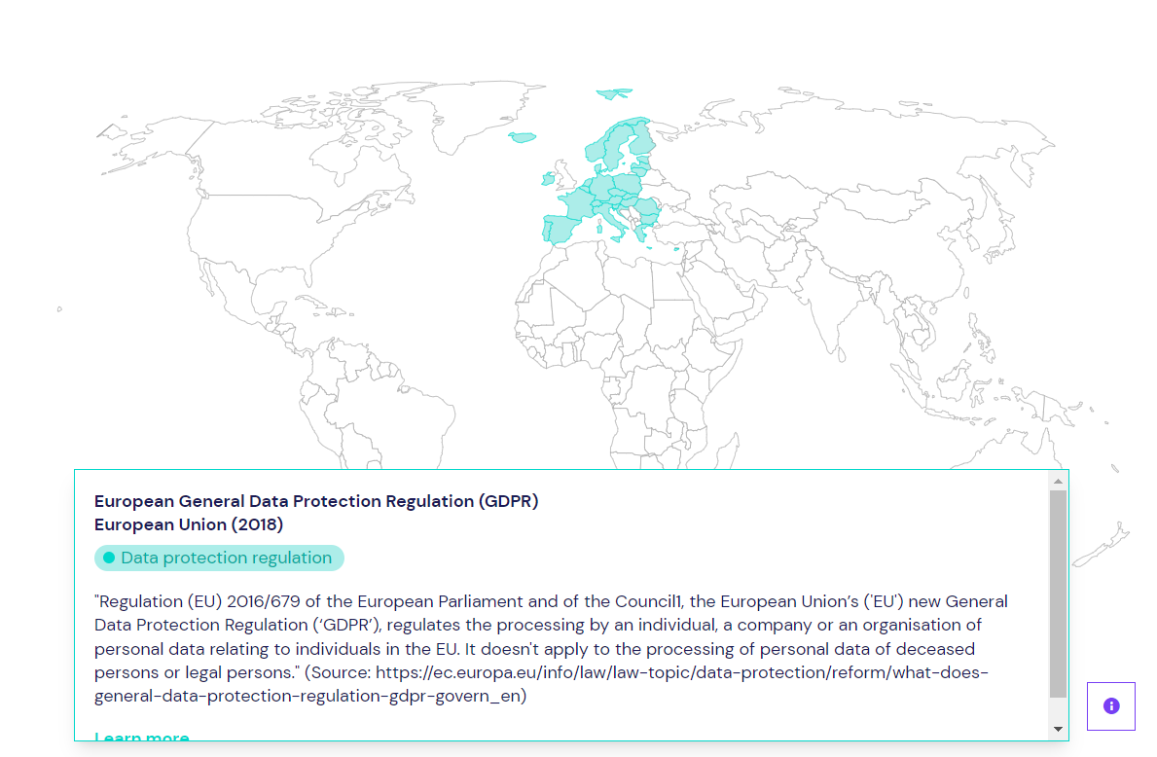
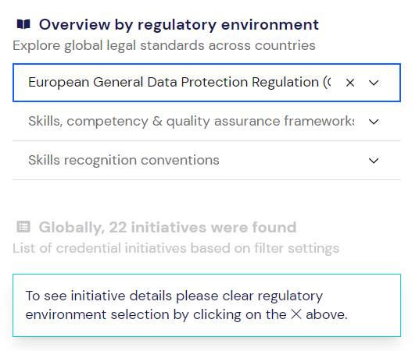
Overview by regulatory environment
Notes:
Overview by regulatory environment offers the most potential in our view, but is also currently underdeveloped.

Slide 23
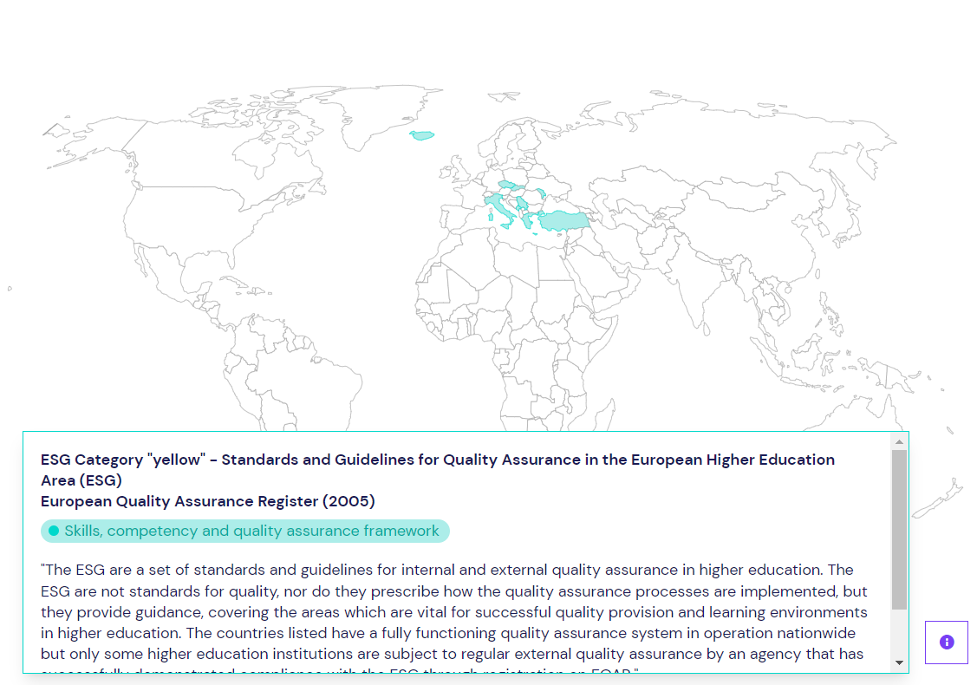
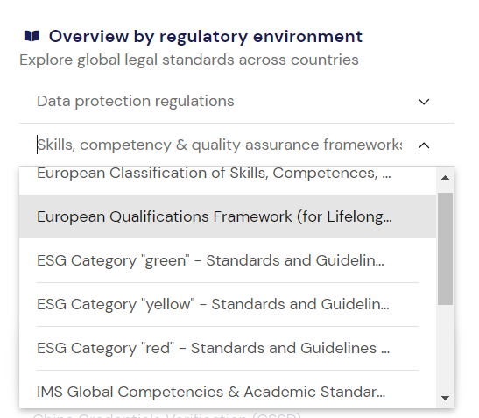
Skills, competence and quality assurance frameworks

Slide 24
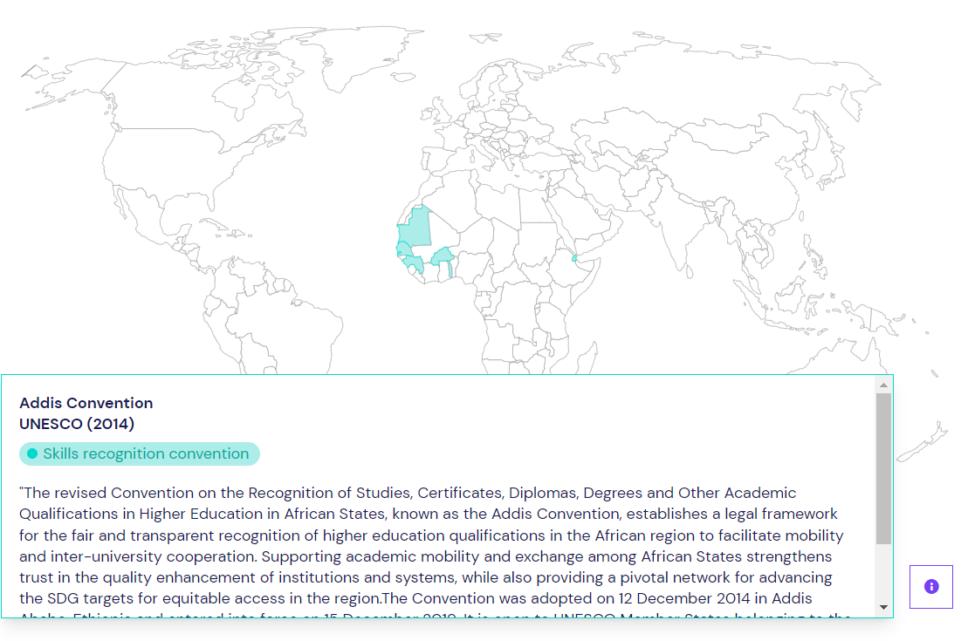
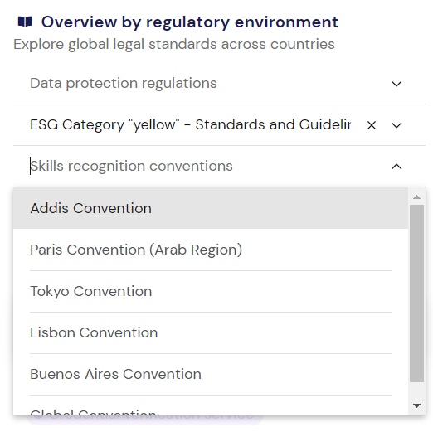
Skills recognition conventions

Slide 25
Setting future priorities
Efficiency gains when establishing interoperability?
Focus efforts on specific regions or technologies?
Notes:
Mobility flows in D, woher kommen Studierende? Wo gibt es den größten Nutzen, wenn wir Interoperabilität herstellen? EU interne Operabilität wird gestärkt.

Slide 26
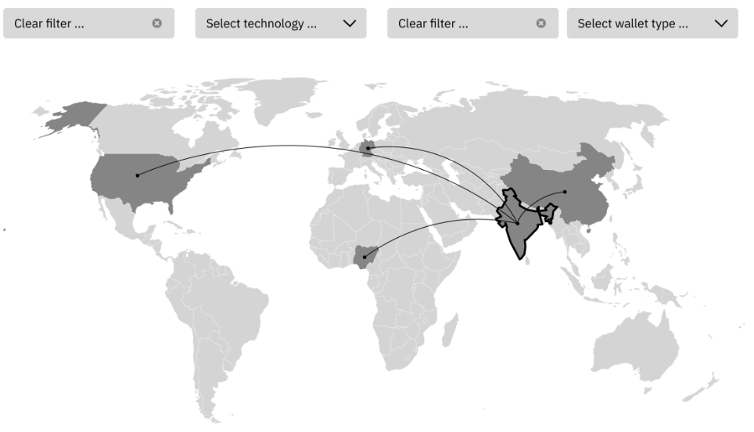
Next steps
Continue to collect data whilst updating and amending data sets
Further development of regulatory frameworks
Develop the display of individual initiatives alongside corresponding frameworks (currently only visible in description)
Develop the display of regional interoperability networks (as envisioned at the outset)

Slide 27
Start exploring!
Is your initiative missing? Please take part in our survey:
https://www.daad.de/credentials-monitor
https://daad-credentials.vercel.app/

