Slide 1
Welcome!
Trusted Edtech supporting the learner journey
Gill Ferrell, Simone Ravaioli, Evelien Renders, Geir Vangen

Slide 2
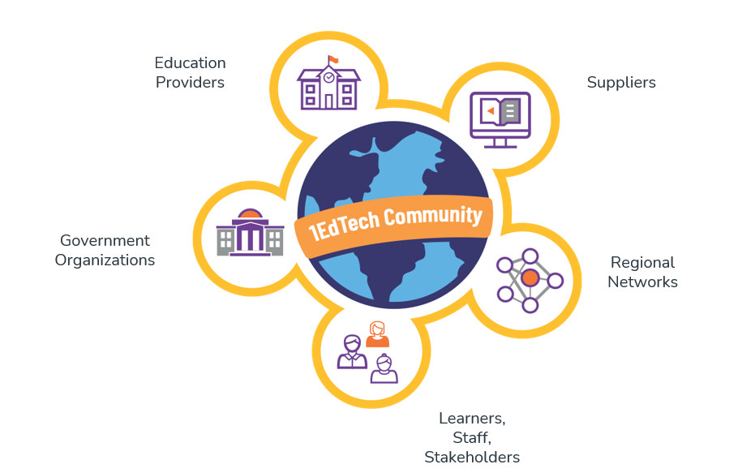
The 1EdTech community in Europe
Notes:
At 1EdTech we like to say: Out of many one. Out of one many.”
We have an unparalleled set of diverse stakeholders as members that guide our trajectory. It is often noted that our organization is the only one where supplier and institutional stakeholders work shoulder to shoulder to further the future of educational technology.
This connected ecosystem is owned by all education participants and stakeholders, enabling both public and private good. There is literally no other place where all of these stakeholders are investing in a common foundation that furthers all interests.
Today, over 7000 individuals represent the member organizations in the work of 1EdTech.
We also support regional collaboratives around the world, notably Europe, Japan, South Korea, Australia, New Zealand and Middle East North Africa.
In creating the 1EdTech brand we were aided by expert marketing firms that dug deep with our members to understand what are our core strengths. We call these the “pillars” of the brand:
Inspiring breakthrough collaborations
Our community is very unique and influential because we are collaborating across boundaries (e.g., supplier/institutional, K-12/HED/corporate learning, IT/instruction/academics, bridging across walled-garden ecosystems, collaboration across regions) to create the technical work that sets expectations for the future of the edtech ecosystem. We bridge across and break down these boundaries every day. Anyone who has experienced our community knows that we represent the best and brightest in edtech.
Advancing ecosystem connectivity
We produce open standards that provide the connectivity for an open edtech ecosystem of products that work together for better user experiences and better insights to inform learner success. Because of the extent of our membership collaboration, there is more investment in integrations using our standards than any other approach. So, the open edtech ecosystem is the fastest way for suppliers and institutions to get to innovation at scale.
Accelerating digital learning transformation
Our member organizations design and adopt scalable, sustainable, and responsive digital innovation by adopting the open technical foundation and the collaboration from close partnerships developed via the member experience. Educational institutions and suppliers have an unparalleled network of partnerships with other members that have shown over and over to accelerate their efforts to implement best-in-class digital learning.
Enriching teaching and learning experiences
For years we have called this effect of our combined activities "Learning Impact" and have challenged our community to provide evidence of impact through our annual Learning Impact Awards. Our members individually design and implement the products that support better experiences. At the same time, collectively, we enable what is available to practitioners and how they use and take advantage of the ecosystem we are creating together.
all education participants and stakeholders, enabling both public and private good.stakeholders, enabling both public and private good.

Slide 3
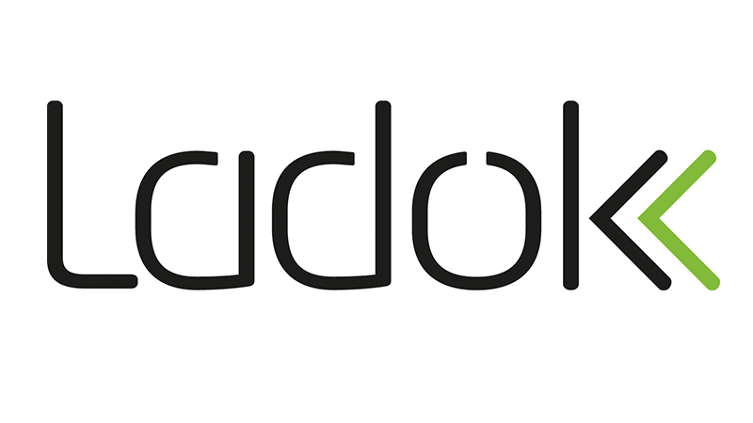
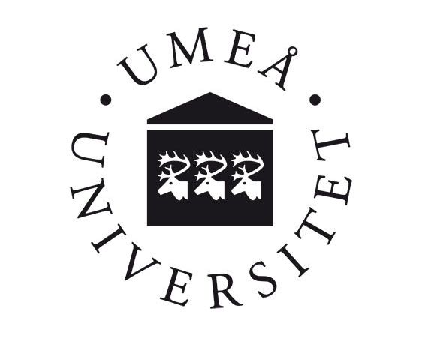
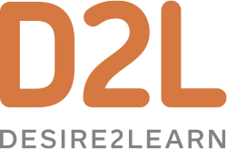
Some of our European Members
Notes:
This is a small selection to show the range of our membership from ministries of education and government bodies to individual universities and other education providers.
The suppliers shown here are only those who have their HQ in Europe.
All of the major global edtech suppliers are also IMS members.

Slide 4
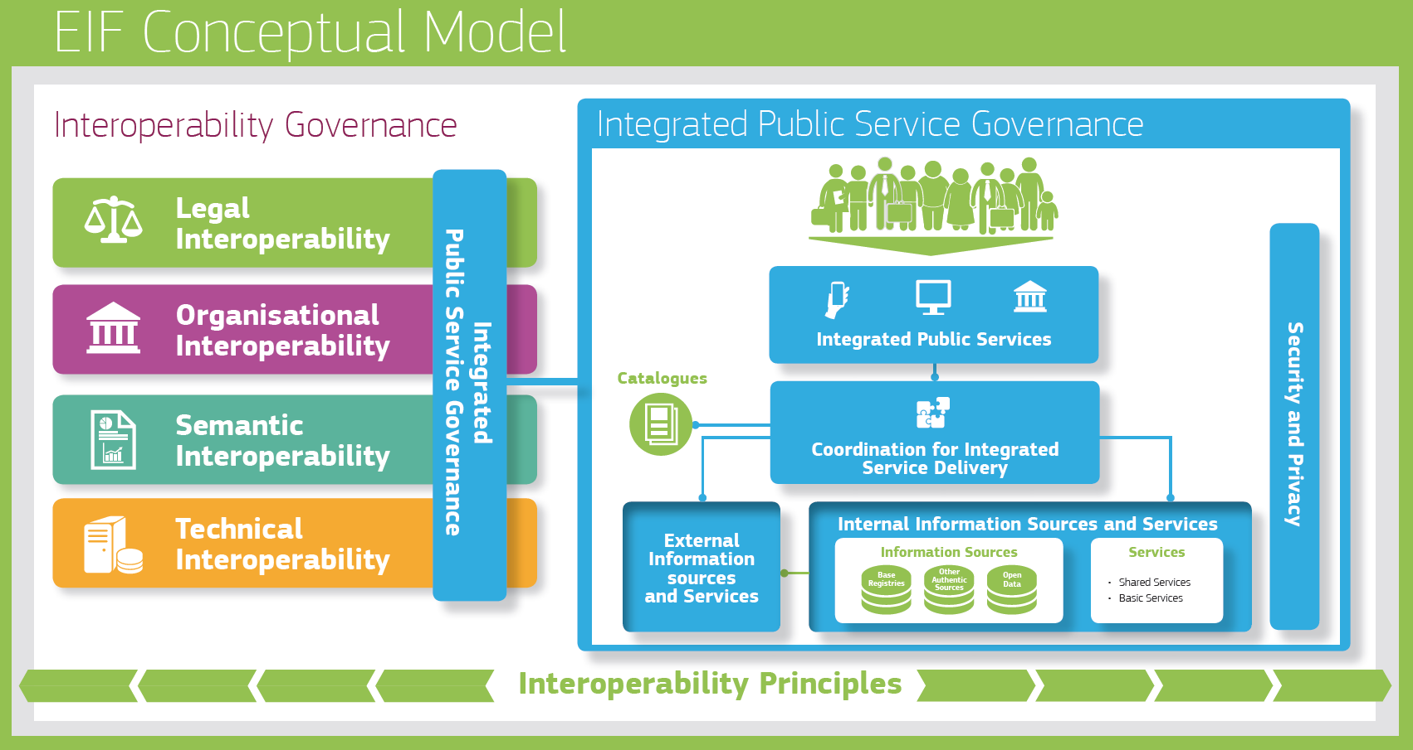
European Interoperability Framework
Notes:
Supplier value taken as read:
integrate with other tools
benefit from the huge investment in the testing and validation tools
credibility that comes with certification
Collaborative problem solving
For individual institutions, the benefits are mainly for those who want to take a leadership role, who are doing in-house development or sharing open source tools and the role of the NREN in supporting the many who aren't the movers and shakers is something we'll come back to. There's a message for everyone that they need to understand the value of standards and hold their suppliers to account but for the vast majority of institutions, the relationship with their NREN might be the main way to pursue this.

Slide 6
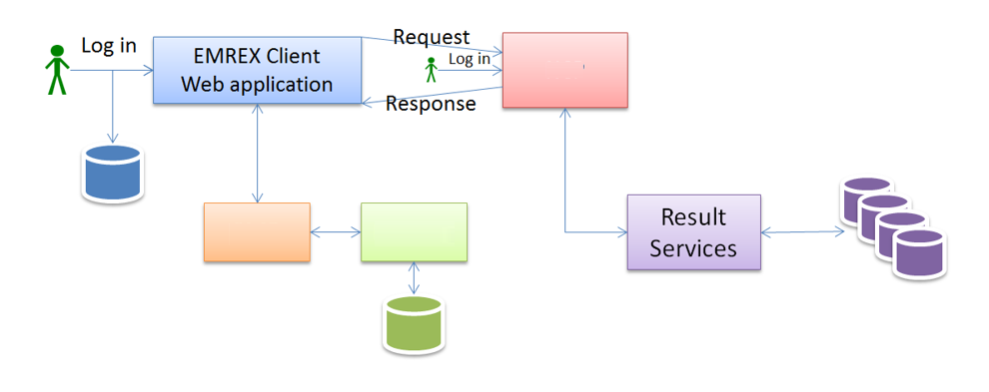

Slide 8
Institutions vs Learner centricity

Slide 9
Think Tank in Brussels – 11 October
EUNIS & 1EdTech & NTNU – facilitated by SURF
Coordination group
Working towards a discussion paper of the challenges

Slide 10
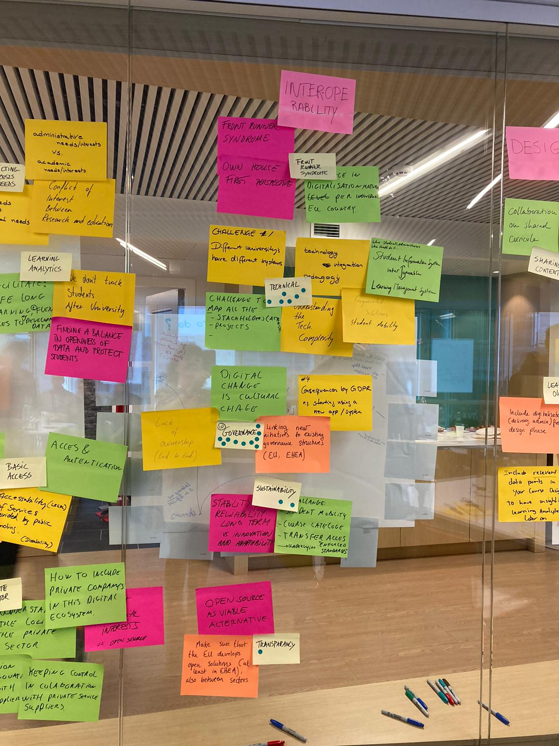
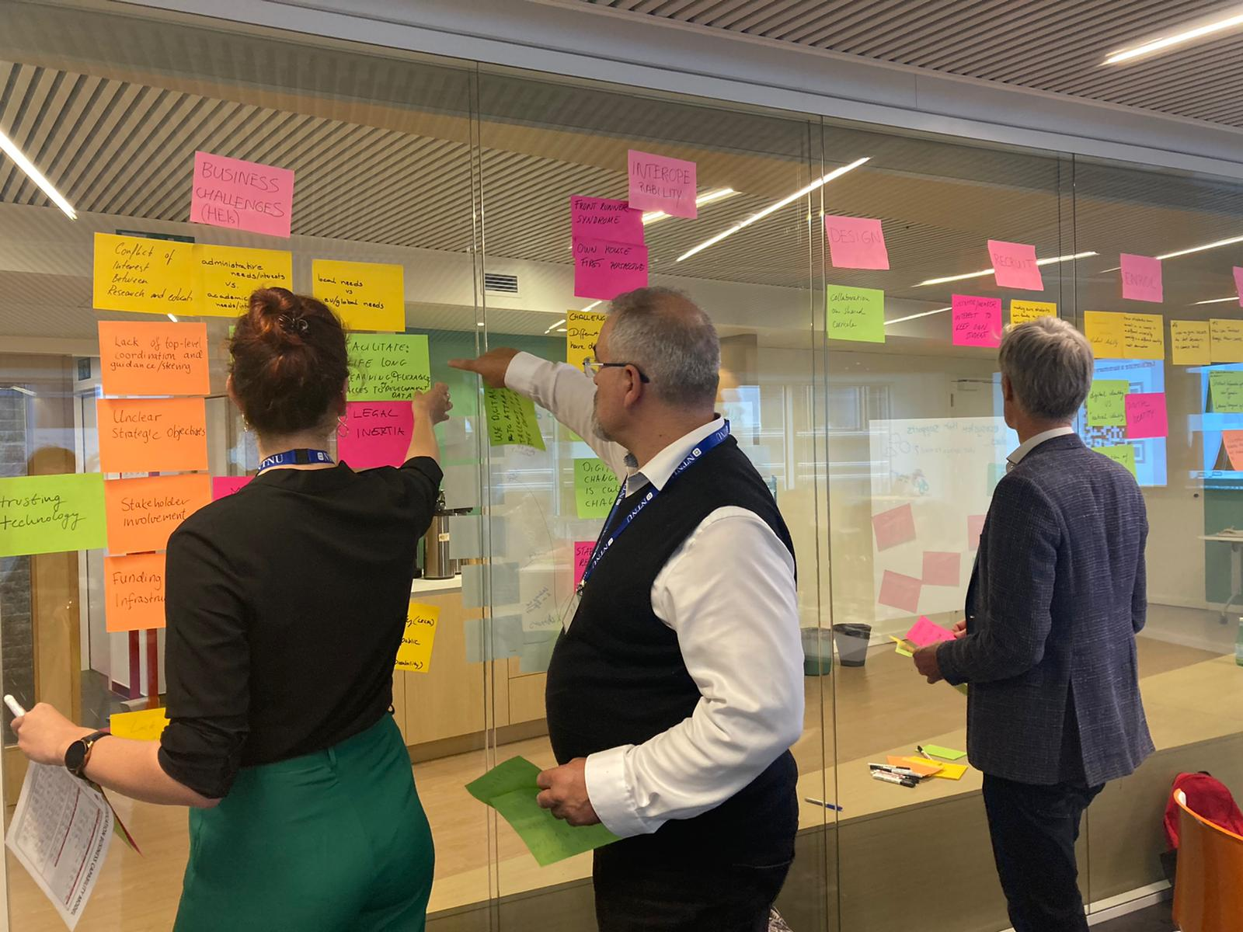
Think Tank in Brussels – 11 October
EUNIS & 1EdTech & NTNU & SURF

Slide 11
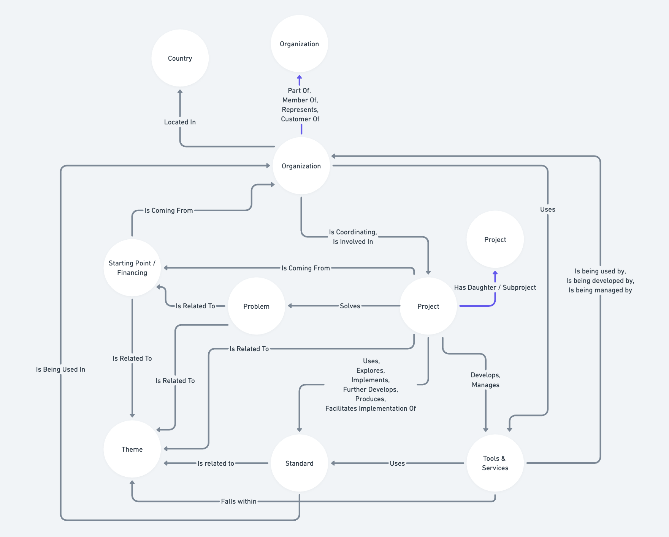
EduXS.eu
http://eduxs.surf.nl
eduxs@surf.nl
Workshop in Berlin on 22& 23 November
Call for participants is open now!
Deadline 24 October

