Slide 1


Digital Credential Recognition:
Mapping and Identification of Digital Credit Transfer System Needs in ASEAN
Sintho Wahyuning Ardie, Anthony F. Camilleri
The 11th Groningen Declaration Network Annual Meeting
Notes:
[Narration]
Thank you Darren and all
My name is Sintho and I’m representing IPB University as one of SHARE partner universities.
It is my great honour to deliver part of our study in the 11th Groningen Declaration Network Meeting.
This study was done in 2021 together with our colleague from Knowledge Innovation Center, Mr. Anthony Camilleri

Slide 2
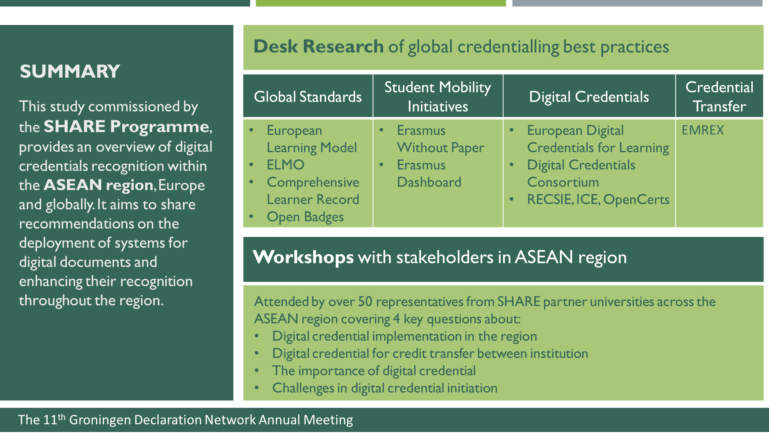
Notes:
[Narration]
Our study was a desk research of global credentialling best practices combined with focus group discussion with SHARE partner universities across ASEAN region to map the needs of Digital Credit Transfer System in the region

Slide 3
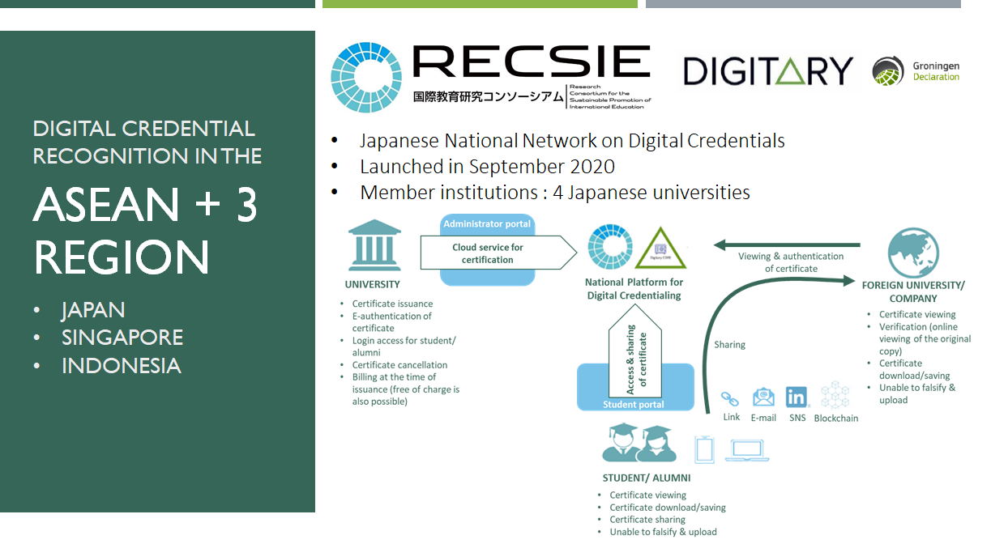
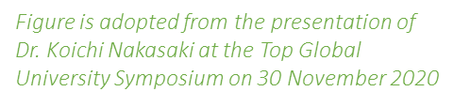
Notes:
[Narration]
ASEAN should learn from how Europe and US are progressing in their Digital Credential implementation.
To implement digital student data portability, some initiatives on digital credentialing have also emerged in the ASEAN+3 Region. We’ve took Japan, Singapore and Indonesia as examples of country developing their national digital credential network.
In Japan, a non profit organization called RECSIE (Research Consortium for the Sustainable Promotion of International Education) was established in 2014 and continuously preparing their national digital credential system. RECSIE joined the Groningen Declaration Network in the early 2020 and collaborate with Digitary in the late 2020 to build the Japanese National Network.
Once fully operational, the national network will enable learners and alumni of Japanese HEIs to access and share their official digitised transcripts and credentials online at any time.

Slide 4
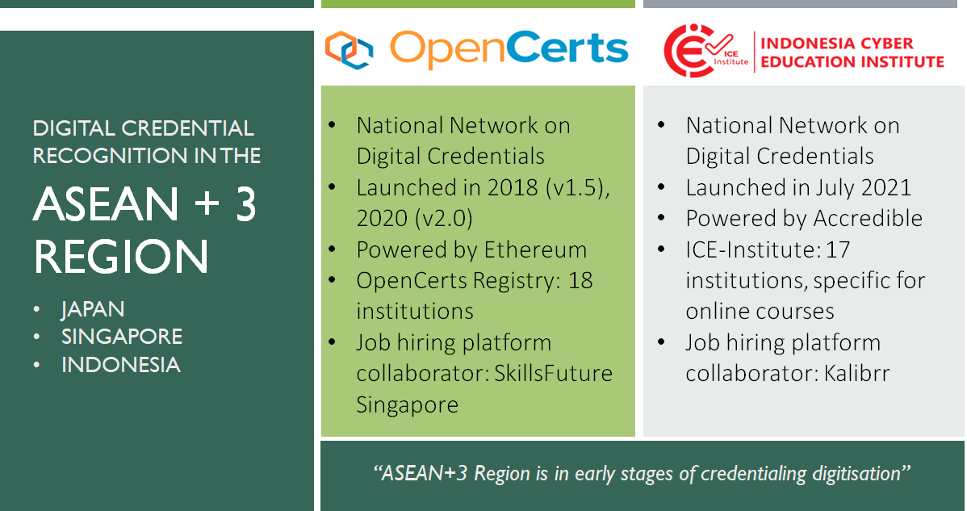
Notes:
[Narration]
In ASEAN, Singapore and Indonesia have also initiated the implementation of Digital credentialing.
OpenCerts is an initiative of digital credentialing in Singapore which was jointly developed by SkillsFuture Singapore (SSG), Government Technology Agency (GovTech), Ngee Ann Polytechnic (NP), and Singapore’s Ministry of Education (MOE) in 2018. OpenCerts launched its first version in 2018 and updating their second version in 2020.
Secure and reliable digital certificate issuance and verification is powered by a blockchain-based platform called Ethereum
Currently, there are 18 institutions in the OpenCerts registry maintained by SkillFuture Singapore. Certificates issued by institutions under the this registry can be viewed on a wallet called Skills Passport which is also connected to a job hiring platform called SkillsFuture Singapore.
In Indonesia ICE Institute was officially launched in July 2021 as a national center for quality assurance of online education. So, it is a bit different with OpenCerts and RECSIE, the main function of the ICE-Institute is to facilitate quality assurance of online education in Indonesia, specifically the registration of e-learning courses from Indonesian universities, as well as online courses from international universities and global MOOC platforms. Secure and reliable digital certificate issuance and verification is powered by a blockchain-based platform called Accredible. Currently, there are 17 institutions in the ICE-Institute registry, and the network is initiating collaboration with a job hiring platform called Kalibrr.
Taken together, based on our desk study we may say that ASEAN+3 region is still in early stages of credentialing digitisation

Slide 5
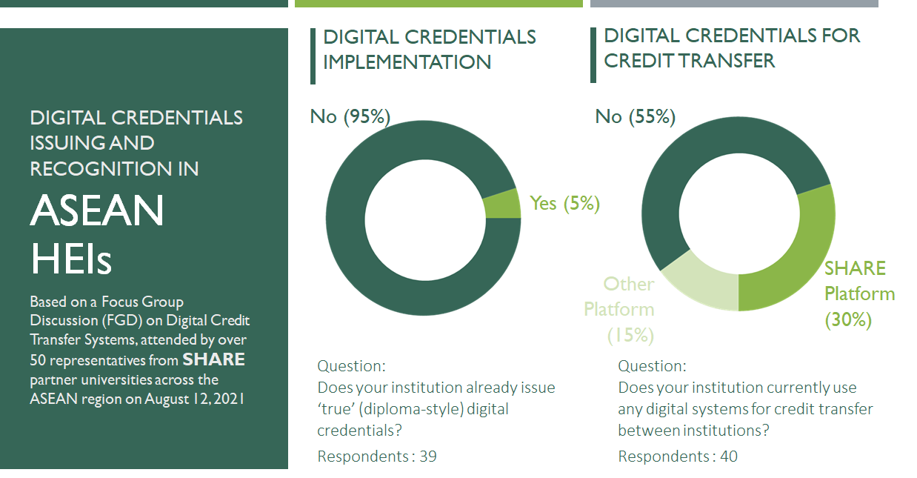
Notes:
[Narration]
In order to further map the digital credentialing status in ASEAN, SHARE has facilitated a Focus Group Discussion on this issue on August 12, 2021, which many of you had also participated. We’ve conducted an online polling and also in-depth discussion through small breakout rooms to address some key questions.
In the first two questions we wanted to identify how far is the implementation of digital credentialing in the HEIs in ASEAN.
95% of the FGD participants stated that they are not yet issuing ‘true’ digital credential. Most of these institutions still utilised PDF versions of credentials or at the most provided credentials that can be checked in the institution’s website.
However, in terms of digital systems of credit transfer, 45% of these institutions mentioned several credit transfer platforms which they have utilised and which they believe to be digital systems for credit transfer, including the SHARE AECTS platform, the AUN credit transfer, UMAP credit transfer, and the Erasmus+ credit transfer.

Slide 6
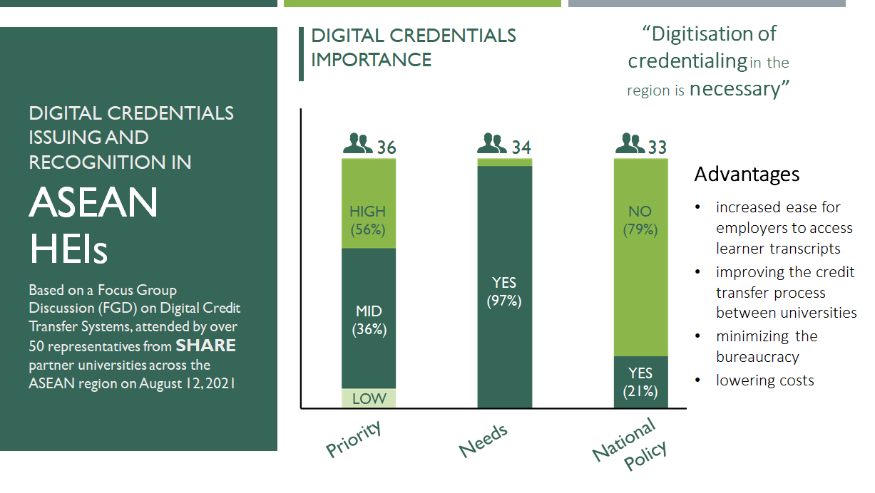
Notes:
[Narration]
In the next set of question, we wanted to identified the perception of the participants on how important of digital credentialing for them.
56% of the participants stated that increasing digitization of credentialing in their institution compared to other priorities as HIGH PRIORITY, and 97% of the participants agree that there is a need for increased digitization of credentialing; indicating that digitisation of credentialing in the region is necessary citing on major advantages of digital credentialing such as increased ease for employers to access learner transcripts, improving the credit transfer process between universities, minimizing the bureaucracy, and lowering costs
However, most of the participants also stated that there are no regional/national policies or projects on digitisation which are relevant to credentialing. The absence of national policy on digital credentialing is seen as one of challenges in digital credential development in ASEAN.

Slide 7
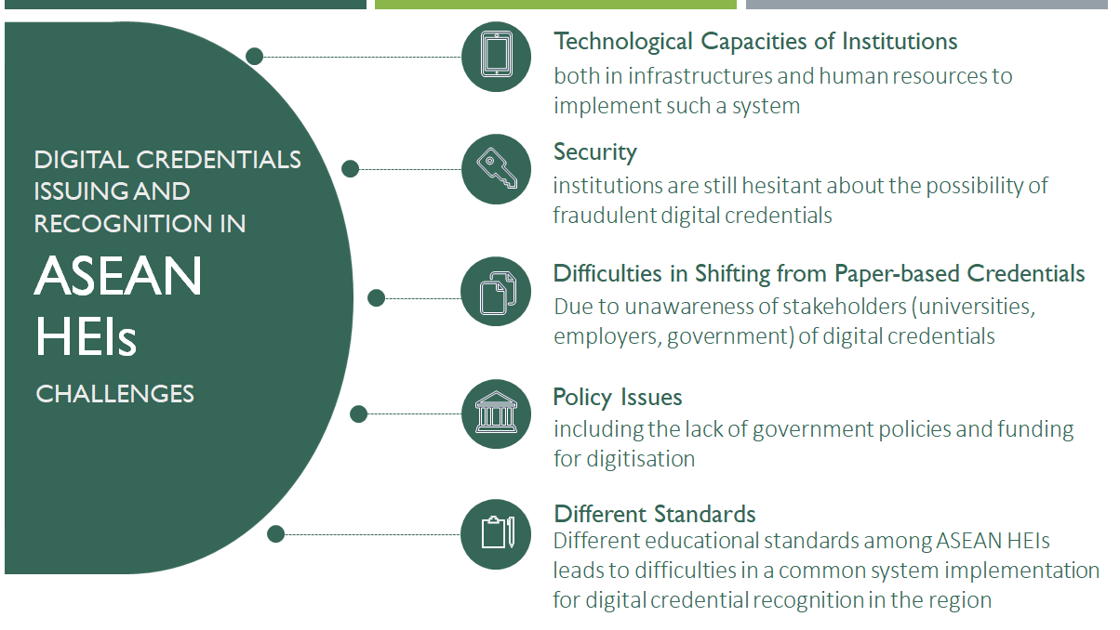
Notes:
[Narration]
Based on in-depth discussion with the FGD participants, we’ve mapped 5 major challenges in digital credential adoption in ASEAN region, including:

Slide 8
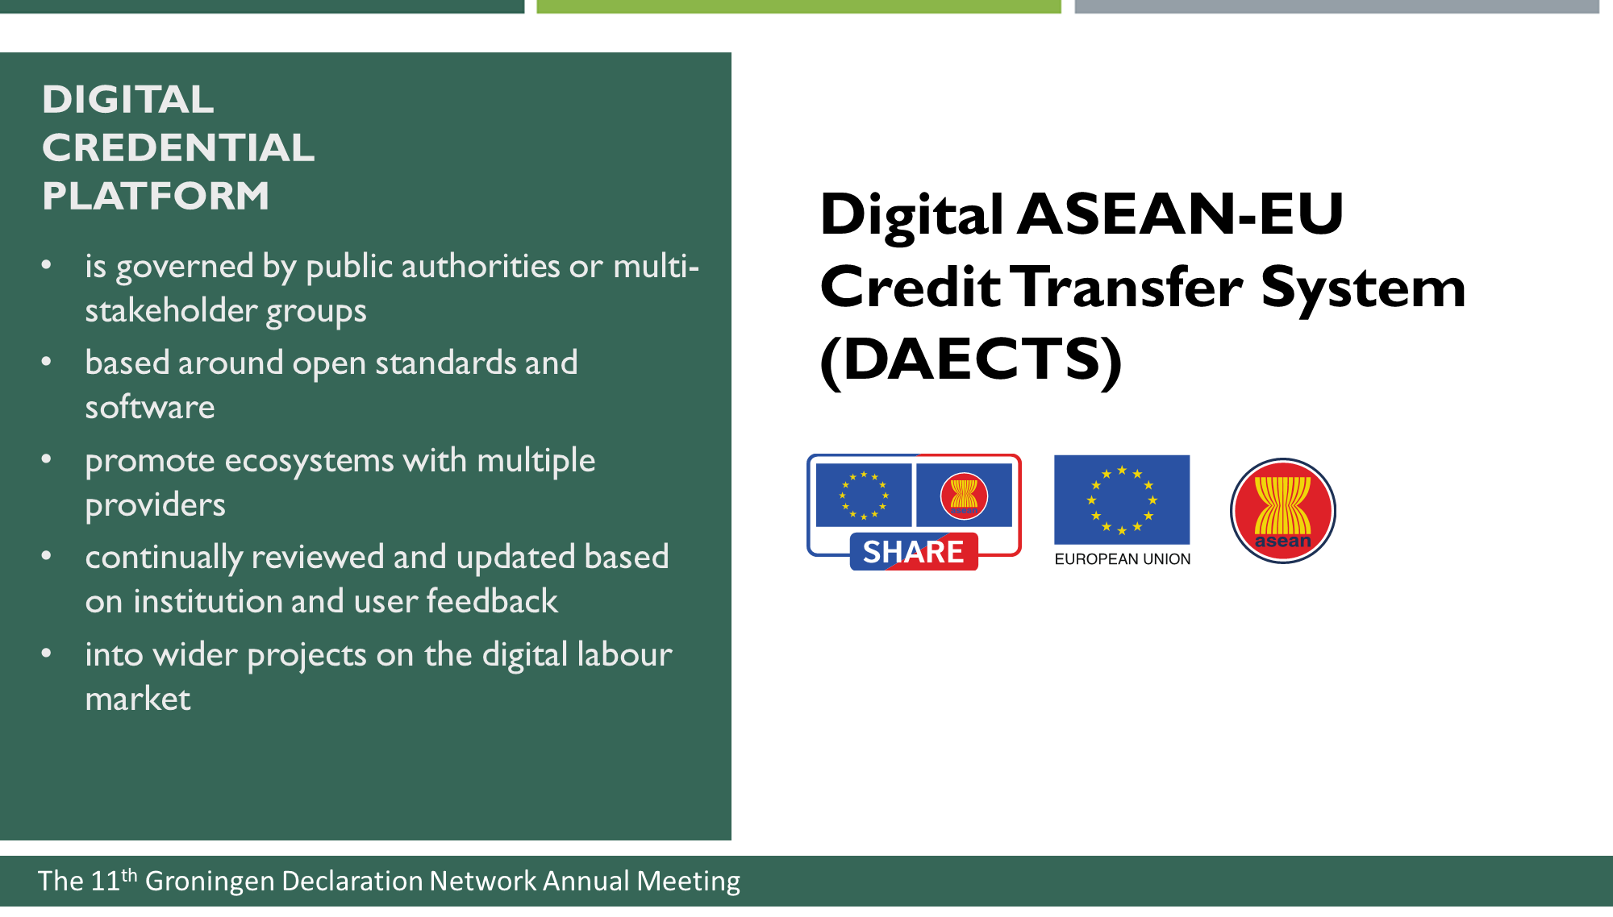
Notes:
[Narration]
Finally our desk research identified some key features of successful digital credential platform as follow
It should be governed by public authorities or multi-stakeholder groups
based around open standards and software
continually reviewed and updated based on institution and user feedback
And be is connected to digital labour market
We hope that the initiation of Digital ASEAN-EU Credit Transfer System will meet the needs of digital credentialing in ASEAN region
With this I shall transfer the stage to Carmen to introduce the SHARE DAECTS platform

