Slide 1


Slide 2




Groningen Declaration Network (GDN) – 11th Annual Meeting – 12-14 October 2022
Measuring and Comparing Achievement of Learning Outcomes in Higher Education in Europe
Enter Consumable Learning Outcomes in Digital Learner Records – Intertwining Networks is Key
Robert Wagenaar
International Tuning Academy

Slide 3
Outline
Content
Context: Social-Economic Reality: Financial and Economic crisis, 2008 – present
Context: Learning and Teaching - Change of paradigm
Instruments to evidence (quality of) learning
Role of Qualifications Frameworks
Global Tuning Initiative
CALOHEE: Measuring and Comparing Achievements of Learning Outcomes in Higher Education in Europe

Slide 4
1. Context: Social-Economic Reality
Vacancies / job openings: work experience required
High level competences required for employment
Highly flexible labor market: jobs for life exceptional
Social cohesion of societies challenged
Individual tolerance and self-confidence under pressure:
values
Mismatch capacities and needs
Digitalization:
Information Society
Implications for Higher Education Programmes?

Slide 5
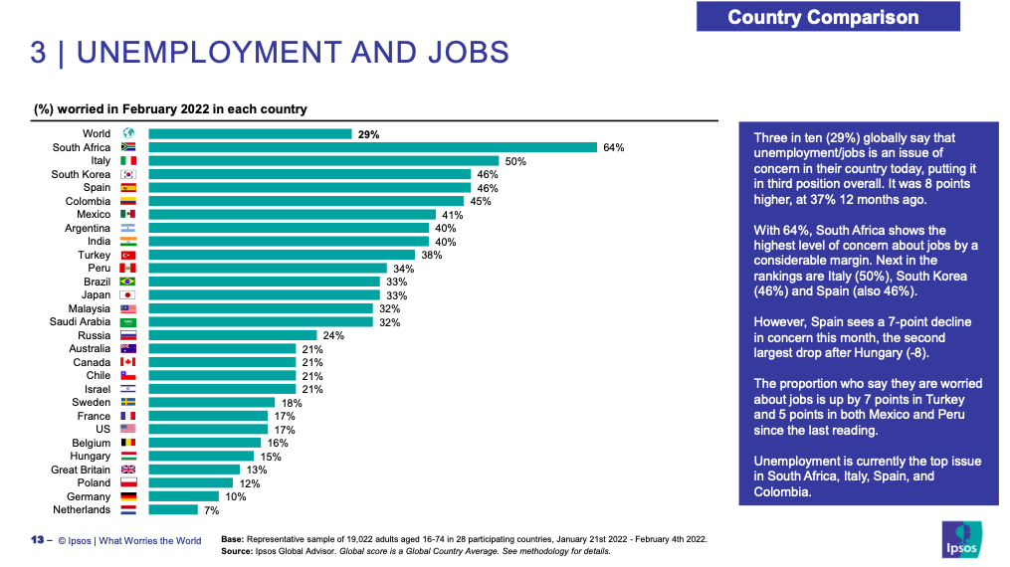
Context: Social-economic reality
Perceptions of citizens: outcomes IPSOS Survey 2022

Slide 6
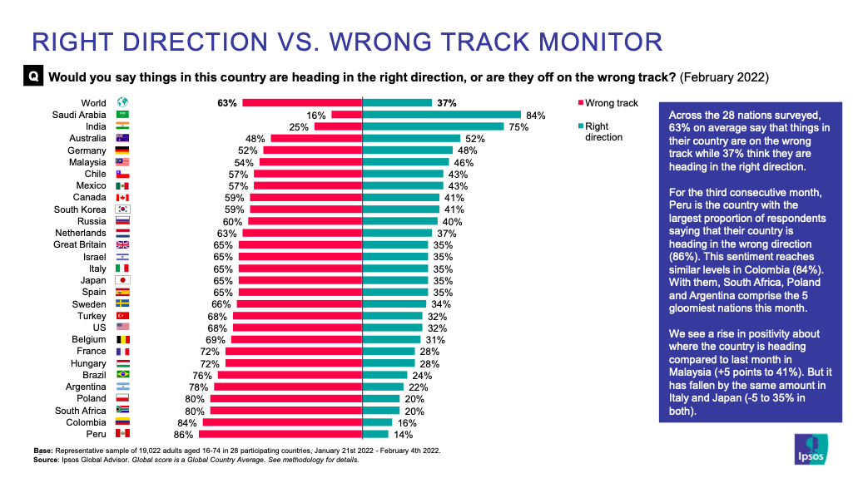
Context: Social-economic reality
National policies: perception of citizens (IPSOS Survey)

Slide 7
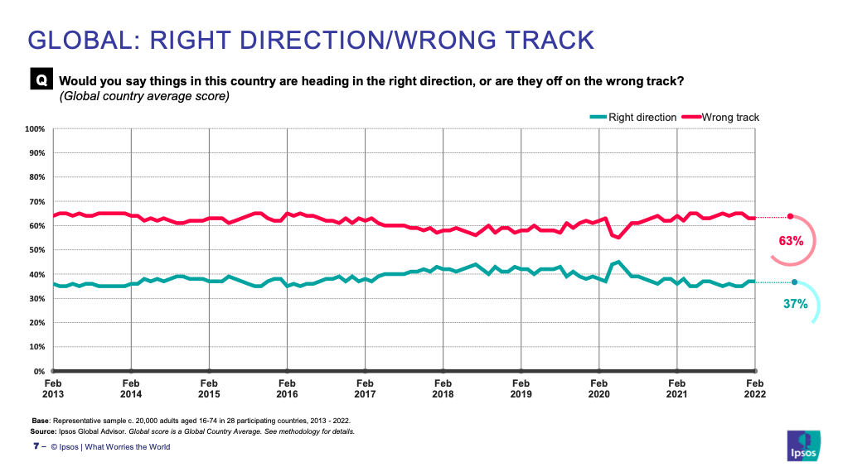
Context: Social-economic reality
National policies: perception of citizens overtime (IPSOS Survey)

Slide 8
2. Context: Learning and Teaching
Learning Paradigm is replacing the Instruction Paradigm:
output based
student-centered
competence based
Needs to be evidenced: preferably in an international context: what is/makes learning relevant and of high quality ?
HOW ? FRAMEWORK REFERENCE POINTS ?
What does this imply in terms of (digital) learner credentials ?

Slide 9
Digital learner credentials
According to EUROPASS
European Digital Credentials for learning can describe and certify:
qualifications (e.g. professional certificates, university diplomas and other learning achievements),
activities (e.g. participation in classes and non-formal learning events),
assessments (e.g. transcripts of records), and
entitlements (e.g. right to enroll in learning opportunities, or to undertake an occupation.
Key challenge globally: How to register level of achievement of learning ?

Slide 10
Digital learner credentials
Obvious need ! But do we have the instruments ?
ROME Communiqué of the Bologna Process Ministers of Education (19 Nov. 2020)
“Digital solutions will facilitate secure, efficient and transparent exchange of data. Joint digital approaches to enhance recognition, quality assurance and mobility are needed. We ask the BFUG to map existing and find new solutions to enhance the interoperability of digital systems and the exchange of student and institutional data in full respect of privacy and security, taking into account the experiences of the European Student Card Initiative and other initiatives.”

Slide 11
3. Instruments to evidence
(quality of) learning
Four key instruments:
Regional Recognition Conventions
Standards and Guidelines for Quality Assurance
Credit Systems
Overarching / National Qualifications Frameworks
All transparency instruments are meant to build trust to facilitate recognition of learning.
What do they tell us about what has actually been learned?

Slide 12
Instruments
Key challenge is the comparability and compatibility of instruments globally
Two leading credit systems in the world:
Carnegie Credit Hours System
European Credit Transfer and Accumulation System
Based on different assumptions and principles: credit hours versus student workload
Conversion possible:
Define achievement of learning by using the concept of learning outcomes
ECTS: Modularize degree programmes (also essential for micro-credentials)
Carnegie: Calculate more precisely student workload
Challenges:
Huge variations in the length of the academic year globally
Size and scope of theses, work based learning, independent work

Slide 13
Instruments
Going beyond registering the list of course units / modules:
- Course unit titles are an unreliable indicator of information, that is the content and outcomes covered
- Do not tell us what actually has been learned in terms of level of subject specific and generic competences achieved
More precise information is required for entitlements: next cycles / learning opportunities / labor market

Slide 14
4. Role of Qualifications Frameworks
How to define intended / achieved learning best?
Defining the formal level – Defining the actual learning
Formal level:
Regional overarching qualifications frameworks + National qualifications frameworks
Some initiatives:
European Qualifications Framework for LLL
Qualifications Framework for the European Higher Education Area
African Continental Qualifications Framework (ACQF)
ASEAN Qualifications Reference Framework (AQRF)
Arab Qualifications Framework (AQF)
Degree Qualifications Profile 3.0 (USA)

Slide 15
Role of Qualifications Frameworks
Actual learning:
Domain specific qualifications reference frameworks
Subject-specific qualifications reference frameworks
Examples:
Tuning Reference Points for Design and Delivery of Degree Programmes in ….
QAA Benchmark papers
Excellent basis for defining Learning Outcomes to be included in Digital Learner Records
HOWEVER …..

Slide 16
Role of Qualifications Frameworks
However …
Some conditions and considerations:
Learning outcomes Statements
Should meet agreed standards and formats
Should be reliable and consistent … to allow for inclusion in student (digital) records
Requires:
Alignment between different types of Reference Frameworks
Agreed concepts and compatible and comparable language
Should be sufficiently informative and up-to-date
These concerns initiated the CALOHEE initiative:
Measuring and Comparing the Achievements of Learning Outcomes in Europe (and beyond)

Slide 17
5. Global Tuning initiative
Mission of Tuning since 2000:
Contributing significantly to the Modernization agenda in Higher Education
Main drivers:
Realizing a paradigm shift: from expert-driven teaching and learning to student-centered learning (input to output)
Basing curricula on programme and module/unit learning outcomes
Making curricula relevant for the needs of society by educating disciplinary experts, who are employable and can contribute to the social-economic and cultural welfare of society
Main Tuning contributions:
Sophisticated methodology to reform Higher Education degree programmes
Frameworks or benchmarks of internationally agreed reference points for educational sectors and subject areas
Reform the European credit system ECTS from a transfer system into a transfer and accumulation system: conditional for programme design and quality assurance

Slide 18
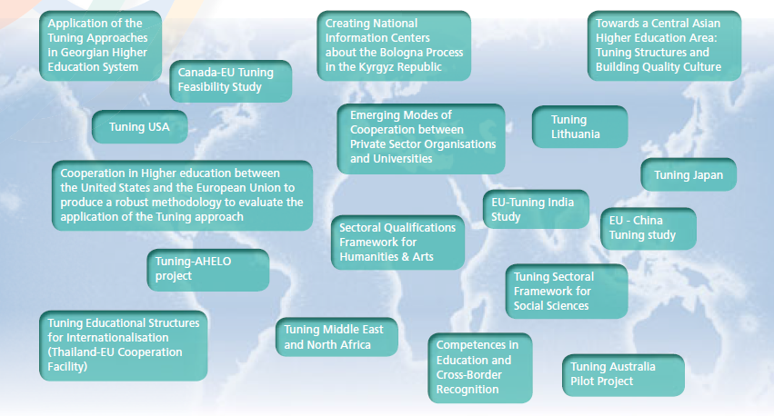
Tuning: A global initiative
Tuning Europa
CALOHE ASIA
(ASEAN)
TuCAHEA:
Towards a Central Asian Higher Education Area
Involving appr. 130 countries, many hundreds of HE institutions and many thousands of academics globally
Tuning America Latina - ACE
CALOHEE
Tuning Russia
Tuning Africa

Slide 19
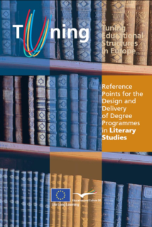
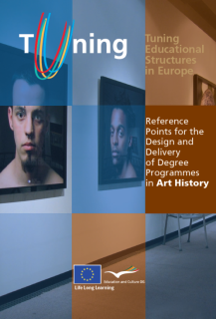
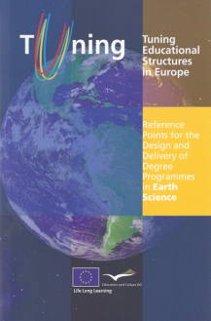
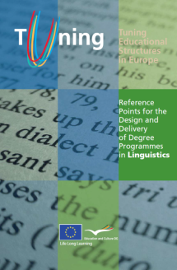

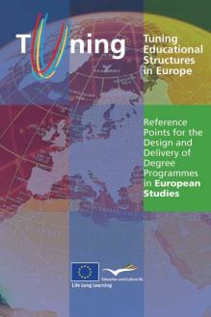

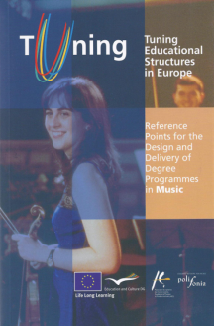
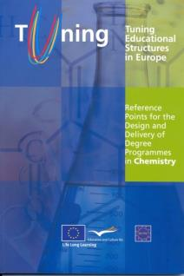


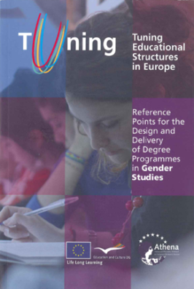




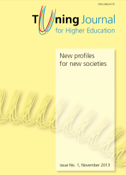
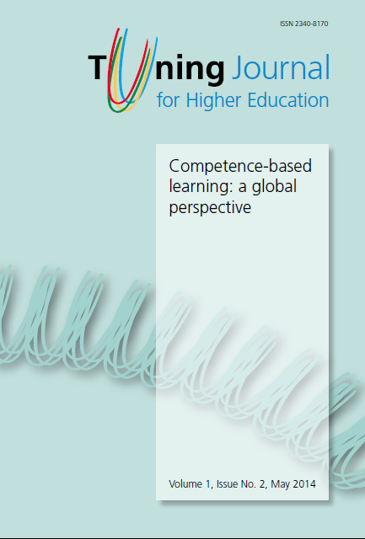
The Tuning Experience
A selection of publications

Slide 20
6. CALOHEE Initiative
New transnational initiative required ! To reach more consistency and therefore ‘consumable’ LO statements in Learner (Digital) Records
AIM:
Develop transnational Qualifications Reference Frameworks and Assessment Reference Frameworks: overarching and subject area based
Develop multi-dimensional instruments to measure and compare levels of learning doing justice to the different missions and profiles of HE institutions
Develop Assessment Reference Frameworks which include best strategies / examples of good practice for teaching, learning and assessment to meet the descriptors

Slide 21
Evidencing the level of learning
Intended level of learning requires international agreement
Need sophisticated reference frameworks based on internationally agreed descriptors
We can distinguish different types:
Overarching reference frameworks
Academic domain reference frameworks
Subject-area / disciplinary reference frameworks
Subject-area based assessment reference frameworks
These frameworks – together - offer the standards of learning, but also require specific approaches regarding learning, teaching and assessment

Slide 22
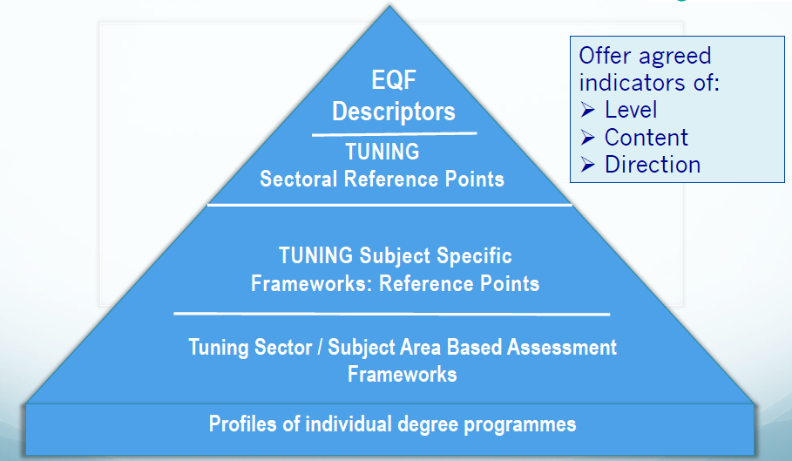
Tuning-CALOHEE model
Conditional for guaranteeing (minimum) quality of HE programmes:
Universal QA Standards and Guidelines
Qualifications Reference frameworks at overarching, national, sectoral and subject area level
Overarching
E/NQF

Slide 23

CALOHEE response
Four Tuning-CALOHEE instruments to define and test intended and achieved (level of) learning:
Tuning-CALOHEE General Qualifications Reference Frameworks for Higher Education cycles (EQF 5-8)
Tuning-CALOHEE Subject Specific Qualifications Reference Frameworks
Tuning-CALOHEE Subject Specific Assessment Reference Frameworks (including examples of Good Practice)
Tuning-CALOHEE Subject Specific Transnational Assessments for diagnostical identifycation of the level of learning / achievement
+ Revised edition of the Tuning Reference Points for the Design and Delivery of Degree Programmes in …..

Slide 24

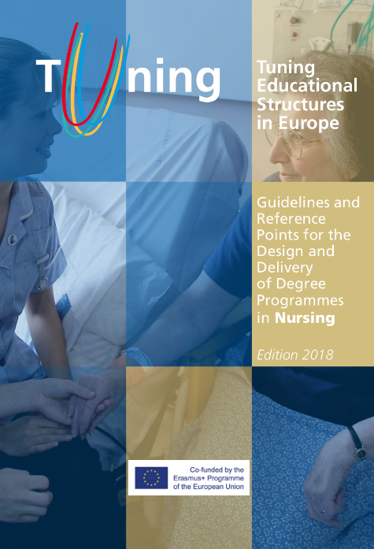
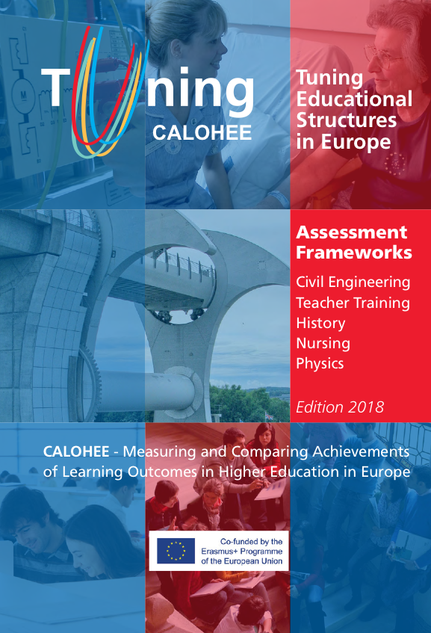
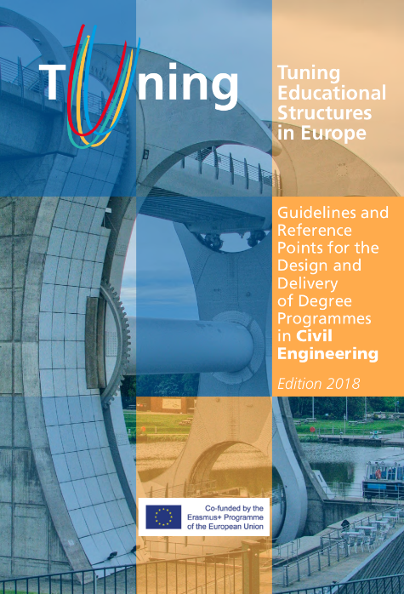
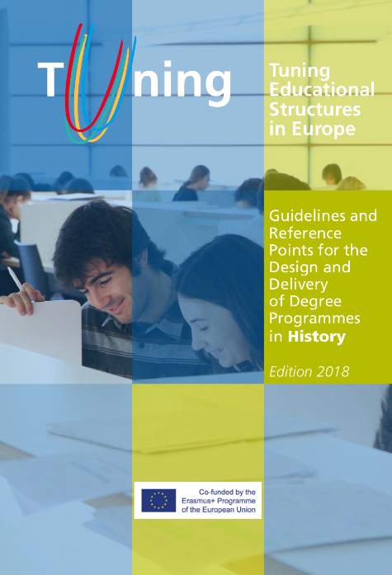
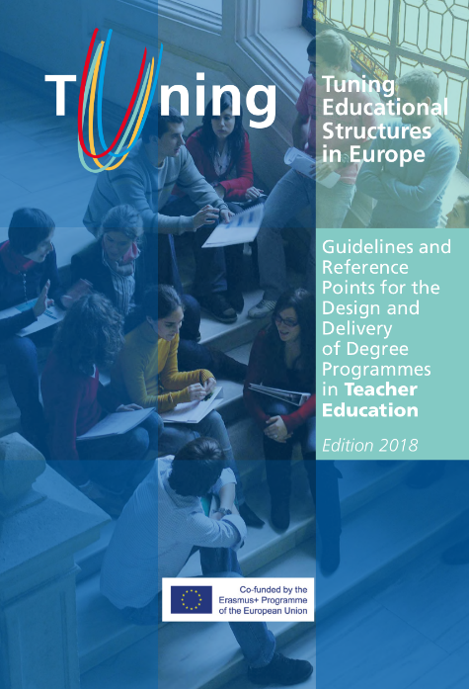
Tuning-CALOHEE Frameworks in publications
TUNING Guidelines and Reference Points for the Design and Delivery of Degree Programmes
Edition 2023
TUNING – CALOHEE Assessment Reference Frameworks

Slide 25
CALOHEE
Tuning-CALOHEE Qualifications Reference Frameworks
Need for revisiting existing frameworks / Need for full alignment
Rational
Existing two European frameworks + Tuning Subject Area frameworks were agreed more than 15 years ago: need to revaluate based on recent societal and educational developments and insights
In existing overarching frameworks digitalization, current modes of communication, job market disruption and flexibilization, gender equality, sustainability of societies, climate change have not been taken into account
Message: Existing frameworks require fine-tuning and updating
Response: Merger / combination of the two overarching European frameworks - EQF for LLL and the QF for the EHEA - in the Tuning-CALOHEE Qualifications Reference Frameworks: General and Subject Specific

Slide 26
Take into account: Civic, Social and cultural awareness
CALOHEE
Pressing Topical Societal Issues:
  Societies and Cultures: Interculturalism
  Processes of information and communication
  Processes of governance and decision making
  Ethics, norms, values and professional standards
  Sustainable development (climate change

Slide 27
CALOHEE
Tuning-CALOHEE General Qualifications Reference Frameworks
Rational
Merger / combination of the two overarching European frameworks at subject level is strongly supported by overarching General Qualifications Reference Frameworks (GQRF)
Tuning-CALOHEE GQRF model offers a way forward because it allows to integrate all mentioned elements in one model while at the same time is respecting the existing ones.
Easy to implement !

Slide 28
Based on merger EQF for LLL and QF for EHEA
CALOHEE Design: Merger of EQF and QF for EHEA
Three progressive levels of learning domains
1
2
3
Dimensions: constructive key elements
Knowledge Skills Autonomy and Responsibility

Slide 29
CALOHEE
Basic philosophy of the merger / combination of the two European qualifications frameworks:
Five /six dimensions implies five/six descriptors, which are split up in three parts
The dimensions for first and second cycle (EQF-levels 6 and 7) are:
  Knowledge and Understanding
  Field related and general / generic skills and competences
  Critical reflection, judgements, synthesizing and design (modelling)
  Communication and information sharing
  Lifelong learning
  Level 8 / third cycle has an additional descriptor: Research
  Each dimension involves a component of ‘knowledge’, of ‘skills’ (application) and of ‘autonomy and responsibility’ (operating with authority in work related and societal contexts)

Slide 30
CALOHEE Design
MULTI-DIMENSIONAL APPROACH
Frameworks based on parameters/dimensions
PARAMETERS / CATEGORIES
EQF: Knowledge Skills (Wider) Competences
Knowledge: theory and methodology
Application knowledge and skills
Civic, social and cultural engagement
Employability
1
2
Common body of knowledge, skills and wider competences
DIMENSIONS
Qualifications Reference and Assessment frameworks

Slide 31
CALOHEE Design
Tuning-CALOHEE Qualifications Reference Framework model
5 or 6 dimensions combined with three levels of achievement
Knowledge:
Foundation level of
achievement
Skills: (Application of knowledge): Mediate level of achievement
Autonomy and Responsibility (to be perceived as authority): Most advanced level of achievement
Model consistent with taxonomies of learning: no skills application without a body of knowledge; no authority without being knowledgeable and skilled

Slide 32
CALOHEE Design
MULTI-DIMENSIONAL APPROACH:
Flexible model allows for covering different missions and profiles
Example of a research university
(based on profile and mission)
Knowledge: theory and methodology
Application knowledge and skills
Civic, social and cultural engagement
Employability
Example of a university of applied sciences
(based on profile and mission)
Common body of knowledge, skills and wider competences
Shared body
Reference /Assessment framework

Slide 33
CALOHEE Model
Tuning-CALOHEE General Qualifications Reference Frameworks – GQRFs: Basic principles
Reference frameworks allow for flexibility
The model does not challenge the two existing Qualifications Frameworks
Progression of learning is expressed as activities in sub-levels: ‘knowledge acquisition’ (knowing and understanding), ‘knowledge and skills application’ and developing ‘authority’
Each of these categories has its own verb’, for the GQRF respectively: ‘demonstrate’, ‘evidence’ and ‘demonstrate’, reflecting the activities involved
Each sub-level requires its own (aligned) learning approaches, methods and strategies

Slide 34
Tuning-CALOHEE General Qualifications Reference Framework for Bachelor
TUNING-CALOHEE Qualifications Reference Framework for the First Cycle EHEA / Bachelor / EQF Level 6 (Based on a combination of the Bologna Process QF for the EHEA and the European Qualifications Framework for Lifelong Learning)
 | Knowledge | Domain-specific and generic technical and non-technical skill | Autonomy and responsibility in the field of study and as a member of society
Knowledge and understanding | Demonstrate current understanding of a domain of knowledge which defines the field of studies. | Evidence the ability to contextualize, integrate and compare knowledge which is fundamental for the field of study applying correctly the related terminology. | Demonstrate the ability to use, share, and contribute to field-related knowledge and understanding in professional and societal settings.
Field related and general skills and competences | Demonstrate current knowledge and understanding of the generic, subject specific, and digital skills required to operate successfully in the field of study and wider contexts. | Evidence the ability to apply field related and generic skills, including digital ones, which facilitate critical thinking and evidence-based arguments and solving subject related and societal problems. | Demonstrate an evidence-informed approach to managing technical / professional projects and activities, applying effectively field and societal related knowledge and skills, taking initiative, showing responsibility and leadership.
Critical reflection, judgements, synthesising and design | Demonstrate current knowledge and understanding of relevant theoretical frameworks, concepts, methodologies and/or practices to gather, evaluate and interpret field related and societal information. This includes ethical awareness, intercultural issues, political and governance awareness, decision making, and other societal and sustainable developments. | Apply appropriate theories, concepts, methodologies and/or practices and field related and generic skills and competences, including digital ones, to analyse, synthesise, and make informed judgments while taking into account relevant social, cultural, scientific and ethical issues and challenges. | Demonstrates the ability to evaluate and reflect on new knowledge and contribute to discourse to identify and implement individual and collaborative ways to either move forward and/or solve field and societal challenges and problems.
Communication and information sharing | Demonstrate current knowledge and understanding of the appropriate means, skills, attitudes, approaches and strategies to effectively communicate information, ideas, problems, challenges and solutions related to the field of studies and selected societal issues for a variety of audiences, including field specialists, using a variety of media. | Evidence effective communication of different types of information involving ideas, problems, challenges and possible solutions by applying technical and non-technical strategies, means and skills tailoring them to a variety of audiences including field specialists. | Demonstrate the ability to communicate effectively in predicable and unpredictable workplace and/or societal situations by listening to others and making convincing arguments in order to reach a common understanding of topics and activities involved.
Continuous learning and development | Demonstrate knowledge and understanding of learning approaches and methods required for self-directed continuous learning and development in a variety of formats and settings. | Evidence learning skills and appropriate strategies to advance the continuous learning and development of self and others in order to reflect on, update, and upgrade field knowledge, skill and competences, and societal developments | Demonstrate motivation and initiative to organise, manage, and evaluate learning and development activities for oneself and others in order to continually update and upgrade field related knowledge, skill, and competences, and societal developments.

Slide 35
Tuning-CALOHEE General Qualifications Reference Framework for Master
Activity | Knowledge acquisition: domain specific and generic competence | Knowledge and skills application: domain specific and generic technical and non-technical skill | Authority: autonomy and responsibility on the field of study and as a member of society
Knowledge and understanding | Demonstrate a depth and breadth of understanding of a domain of specialised knowledge which offers a foundation for developing original thinking and new ideas. | Evidence the ability to contextualise, compare, critique, and integrate specialised knowledge utilised to advance thinking and ideas relevant to the field of study. | Demonstrate the ability to use and share specialised knowledge and understanding which allow for the development new knowledge, policies and strategic decision making in complex and unpredictable field-related and societal settings.
Field related and general skills and competences | Demonstrate a depth and breadth of knowledge and understanding regarding higher-order generic and subject specific (digital) skills and competences required to operate successfully in a particular field of study at expert level, as well as in a wider societal context. | Evidence the ability to apply higher-order and evidence-informed subject specific and generic skills and competences using appropriate (digital) learning formats, which facilitate the development of high-level critical thinking, complex problem-solving and effective argumentation skills in multi-dimensional and differentiated work and societal settings. | Demonstrate the ability to effectively apply field and societal related knowledge, skills and competences, including innovation, entrepreneurship, responsibility and/or leadership, to manage complex technical and/or content related activities including projects and initiatives in familiar and unfamiliar work and societal contexts.
Critical reflection, judgements, synthesising and design | Demonstrate a depth and breadth of knowledge and understanding of complex theoretical frameworks, concepts, methodologies and practices at a level which allows for comparing and integrating these, to serve as a foundation for (applied) research and creative thinking related to the field of studies and societal challenges. | Evidence mastery of the ability to identify, analyse, synthesise and compare theories, concepts, methodologies and skills from field related and wider perspectives (including one’s social, ethical, cultural and political responsibilities) to organise often incomplete information, to make evidence-based judgements, and to solve complex problems in research related or innovative contexts. | Demonstrate the analytical ability to critically comprehend and reflect on new specialised knowledge and skills, and to use this critical capability to contribute in individual and /or team capacities to the identification of evidence-informed judgements and solutions to move forward and /or solve complex field and societal related challenges and problems.
Communication and information sharing | Demonstrate a depth and breadth of knowledge and understanding of the appropriate means, skills, strategies, attitudes and approaches to effectively communicate complex information and multidimensional problems, challenges, ideas and solutions in field related and societal contexts to a variety of audiences, including field specialists. | Evidence the effective application of a variety of sophisticated communication strategies, media, means, and skills to convey different types of information involving multi-dimensional problems, challenges, ideas, and possible solutions through messaging tailored to the target audience, including field specialists. | Demonstrate the ability to communicate clearly and unambiguously in complex work and/or professional, academic and societal situations, by making convincing and evidence-informed arguments and by listening to and appreciating the view of others.
Continuous learning and development | Demonstrate advanced knowledge and understanding of learning principles, skills and strategies required for largely self-directed autonomous continuing formal, non-formal and informal learning in face-to-face, hybrid and digital formats, in order to keep acquiring new knowledge and insights resulting from work related and societal and sustainable developments. | Evidence advanced learning skills and appropriate strategies to advance one’s own learning and that of others in a lifelong learning context, showing the motivation, metacognitive insight, initiative and leadership to continuously update and upgrade knowledge and field related and generic skills and competences. | Demonstrate continuous personal and professional development in individual, team-based and societal settings by initiating, organising, managing and evaluating lifelong learning activities for oneself providing good service in a professional context and to society at large.

Slide 36
Tuning-CALOHEE General Qualifications Reference Framework for Doctorate
Knowledge and understanding | Demonstrate state-of-the-art systematic understanding of a domain of specialised field of study and work which offers a robust foundation for developing original research, thinking and/or performance at the frontier of once own field of specialisation and associated ones. | Evidence the mastery of high-level skills and techniques and complex methods to contextualize, integrate, compare and critique state-of-the-art specialised knowledge, thinking and/or performance in formats as currently applied in once own field of specialisation and associated and/or related ones. | Demonstrate authority and leadership to use and share field-related understanding in complex and unpredictable professional and societal settings which allow for advancing (applied) research and/or developing new knowledge, ideas, policies, processes and strategic decision making.
Field related and general skills and competences | Demonstrate deep understanding of appropriate methods and/or theoretical frameworks for defining a substantial process of (applied) research or ideas development, respecting applicable ethical and scholarly standards and conservation of the environment. | Evidence the ability to conceive, design, implement and adapt a substantial process of (applied) research and/or ideas development by applying an effective combination of domain specific and high-level generic skills, including academic leadership, project and time management, creativity, innovation and entrepreneurship, social and civic responsibility and concern for sustainability, with scholarly and ethical integrity. | Demonstrate scholarly and professional integrity and sustained commitment in managing complex technical and/or content related activities including projects and initiatives in familiar and unfamiliar environments, e.g. work-based and societal contexts, applying effectively field and societal related knowledge, skills and competences by demonstrating creativity, initiative, innovation, entrepreneurship, responsibility and/or leadership.
Research | Demonstrate deep understanding of conditions and scholarly standards for developing and implementing a highly original and substantial body of research and/or creative work. | Evidence the ability of developing and implementing, autonomously, original research and/or ideas extending the frontier of knowledge and skills application by producing a substantial body of scholarly work as a written publication and/or a substantiated creative (set of) product(s) of which at least part merits national and/or international refereed publication and/or assessment. | Demonstrate the ability to developing new ideas and/or processes at the forefront of work or study contexts, including state-of-the art science, to address critical issues and complex problems and/or processes in professional and societal settings with integrity and sustained commitment.
Critical reflection, judgements, synthesising and design | Demonstrate deep understanding of complex theoretical frameworks, concepts, methodologies and/or practices at a level which allows for critically analysing, evaluating, comparing and synthesising these to serve as a foundation for (applied) research, creative thinking and developing of new insights and original ideas related to the field of studies and challenging societal topics. | Evidence the ability to identify and compare complex theories, concepts, methodologies and/or practices and high-level skills from one’s own academic field as well as related fields to critically analyse, evaluate, compare and synthesize their usefulness to develop original and creative thinking which results in new insights and original ideas, field of studies and/or societal related. | Demonstrate metacognitive insight and analytical ability to critically appraise and reflect on new specialised skills and knowledge and field and societal related complex challenges and issues and contribute in discourse and teams to arrive to new insights and ideas which offer ways forward and/or address challenges and problems in complex and multi-dimensional settings.
Communication and information sharing | Demonstrate deep understanding of the appropriate means, skills, strategies, attitudes and approaches to communicate effectively complex information, multi-facial ideas, and multidimensional problems, challenges and solutions related to once own and related fields of studies and selected societal issues for a variety of audiences, ranging from an informed general audience to field specialists and once peers. | Evidence effective communication of various types of information involving multi-facial ideas and multi-dimensional problems, challenges and solutions by applying sophisticated strategies, means and skills tailored to a variety of audiences covering an informed general audience, field specialists and once peers. | Demonstrate, in complex workplace and/or societal related situations, including academia, the ability to communicate clearly and unambiguously about complex issues, using a variety of strategies to make convincing and evidence-informed arguments and by listening to others with the purpose to develop support and possibly agreement by integrating a variety of viewpoints and opinions.
Continuous learning and development | Demonstrate deep understanding of best strategies to promote, share and discuss effectively new technical, social-economic and cultural insights in once work environment and related context(s), with the aim to contribute to the knowledge-based society, taking into account societal challenges, such as gender equality, intercultural issues, political and governance awareness, decision making, and sustainable development. | Evidence the use of strategic means to promote, share and discuss effectively science based technological and societal developments, which are at the forefront of knowledge, taking the welfare of the workplace and society at large as its reference. | Demonstrate continuous personal and professional development at the most advanced level of knowledge resulting from state-of-the-art knowledge and/or (creative) thinking, in individual, team-based and societal settings by initiating, organising, managing and evaluating activities to contribute to a knowledge-based society as well as welfare of society.

Slide 37
In conclusion
Tuning-CALOHEE Generic Qualifications Reference Frameworks in conjunction with the Subject Area Reference Qualifications Reference Frameworks offer a robust basis for:
Programme Learning Oucomes
Course unit Learning Outcomes
which should follow the same model to be entered in Diploma Supplement / Transcript / Digital Learning Records
GDN, Tuning-CALOHEE Networks deserve intertwining to assure the most appropriate data for recognition are become available: in the interest of all involved

Slide 38
Thank you for your attention!

