Slide 1
A Question of Interoperability: Proof of Concept Presentation Digital Credentials for Higher Education Institutions – DiBiHo
GDN Annual Meeting 2022 Alexander Mühle, Kathleen Clancy
Ref. No. M534800
Icons: Pixelmeetup, Good Ware
Notes:
Interoperability is one of the core problems in the current project landscape. In contrast to a closed system, the construction of an open system needs to consider a larger variety of requirements in order to design an interoperable infrastructure. The question of interoperability in credentialing systems presents itself as a chicken or egg dilemma: What comes first - working systems or technical and organisational standards? During the past year, the DiBiHo research project - comprising the Technical University of Munich (TUM), the Hasso-Plattner Institute for Digital Engineering (HPI) and the German Academic Exchange Service (DAAD) - has explored infrastructure standards for digital academic credentials for the German Higher Education landscape in an international setting. The research covers questions on trust anchoring through suitable technical solutions, the link between an issued credential and the natural identity of the learner, user consent, storage and revocation of credentials and lastly, their representation. The presented prototype relies on common technical components, based on open standards, to demonstrate the process of issuing, verifying and revoking digital credentials for the use cases final diploma, MOOC and scholarship.

Slide 2
DiBiHo Project Summary
Consortium
Project Goal
Exploration of a trusted, distributed, and internationally interoperable infrastructure standard for issuing, storing, presenting, and verifying digital academic credentials in a national and international context for German Higher Education Institutions.
Project Period
Funding
Contact
Website
Felix Hoops (Lead TUM Team)
Alexander Mühle (Lead HPI Team)
Kathleen Clancy (Lead DAAD Team)
www.dibiho.de
11/2020 – 12/2022
Ref. No.: M534800

Slide 3
The Chicken-or-Egg Dilemma of Interoperability
Notes:
Basic technical infrastructure​
User-centered data management is key​
Technical toolkit and standardised components are there (Open ID Connect, W3C VC Standard, PKI infrastructures) and being used already (e.g. Covid-Certificates)​
​
Digital and machine-readable student and credential data​
​
Secure and interoperable digital identity systems​
Variety of exisiting solutions already used – eIDAS, various national eID solutions, Apple Digital drivers licenses, Samsung eID​
Need to secure technical interoperability and build trust​
​
International conventions on the recognition of academic achievements​
Lisbon Recognition Convention since 1999, as of now ratified by 47 member states​
2019 Global Convention on the Recognition of Qualifications concerning Higher Education is achieved​
Need to make recognition policies digital-ready​
​
Structural and semantic standards for credential content​
​
Qualification frameworks, Quality Assurance and (world) reference levels

Slide 4
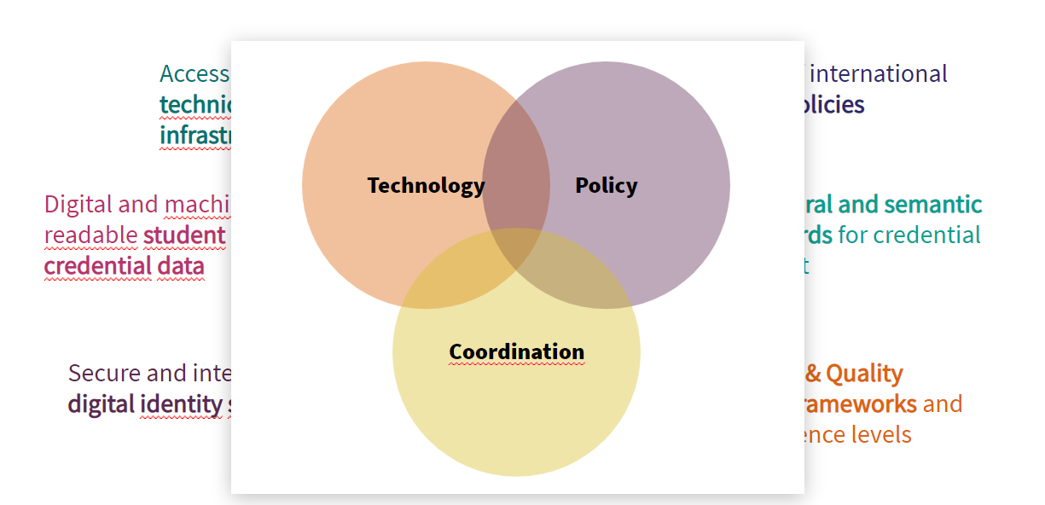

Slide 6
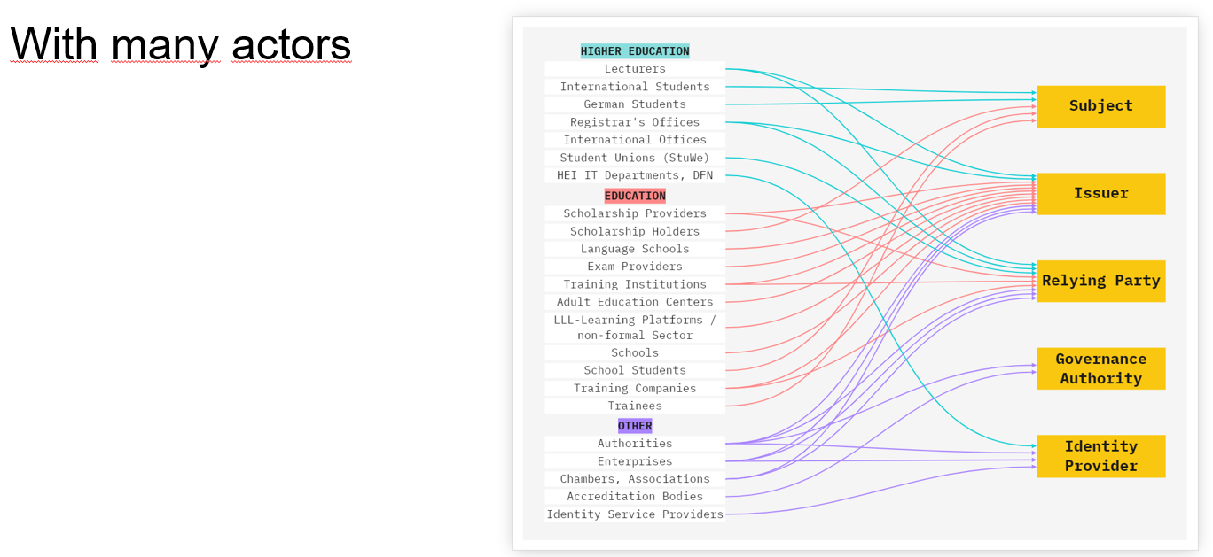

Slide 8
Notes:
· It is of vital importance that the learner be at the centre of the process, user-centred
data management is a must (DiBiHo 3 is a must for all: DiBiHo-3 As a learner, I want to manage (request, present, delete, recover, store) my credentials in a usable and secure way, so that I have full control over my data, can access it at all times, can use the system and have trust in the system.)
· The system must be free of charge for learners (Must: DiBiHo-33 The DiBiHo system shall be free-of-charge for learners. Note: Primarily, this ensures that no learners will be unable to use the system because of monetary issues. Further, a free-of-charge system enhances anonymity of the user as there is no need to provide payment information. Enabling this brings a wide variety of users to increase the attractiveness of the system.)
· All information related to the learner must be available in their wallet to ensure full control. (Must: DiBiHo-50 As a learner, I want to have all information related to me available in my wallet, so that I have full control.
· Authentication of the learner (i.e. identity anchors) is key for issuers, whilst the authentication of issuers is key for relying parties (DiBiHo-12 As an issuer, I want to authenticate a learner, so that I can be sure that the subject of the presented digital credential is the same (or authorized) as the receiver of the digital credential.
· DiBiHo-14 As a relying party, I want to authenticate the issuer of a presented digital credential, so that I can be sure of the identity of the issuer, as well as their authorization to issue, and therefore the validity of the credential.
· Learner data must not be used for secondary purposes. Data minimisation is key (Won’t: DiBiHo-26 As a governance authority, I want to inspect the issuers and access key metrics, so that I can make informed decisions for governance.
These statements seem fairly obvious, but it is helpful to validate these. And there were also some surprises:

Slide 9
Notes:
And some surprises
· Verification of credentials could directly involve the issuer (from the perspective of the relying party). The DiBIHO team felt that the requirement “As a relying party I want to verify a credential without the direct involvement of the issuer” was a must, the participants didn’t rate as highly as a “should” requirement, perhaps this is a nod to the double role university administrators have both issuing and verifying. DiBiHo-55 As a relying party, I want to verify a credential without the direct involvement of the issuer, so that I am not dependent on the issuer’s infrastructure especially when the issuing party does not exist anymore. Note: We presume that it is not possible to support revocation functionality without the issuers involvement.
· Storage Location was seen to be of less importance by workshop participants. The Dibiho team felt the choice of storage location was a must, participants felt it was a “could” – however, we were not asking learners directly as mentioned at the beginning. DiBiHo-8 As a learner, I want to choose my storage location, so that I can switch to the storage best suiting my needs of accessibility, privacy, security. was seen as a must requirement by the DiBiHo-Team, for workshop participants it “could” be a requirement
· A human-readable version of a VC was important to us, but ranked low for workshop participants. As a learner, I want to generate a human-readable version from a verifiable credential, so that I can add it to an application or print it to hang it on my office wall was a “must” requirement for the DiBiHo team, as it is a legal requirement in Germany (Textform/Schriftform). The participants ranked this requirement as “should/could”, indicating a growing understanding of VCs for personal use
· Selective Disclosure or minimal disclosure is needed due to a growing awareness of data privacy. We ranked this as a could requirement, while the participants felt this was a “must”. DiBiHo-18 As a learner, I want to disclose only the minimal set of credentials to an RP, so that I keep full control over my data was a “could” requirement for the team, but was seen as a “must” for the participants
· Multiple identifiers were seen as a minor issue for data control, though user-centred data management is a must. The team ranked multiple identifiers as a must, while participants said “could”. DiBiHo-100 As a learner, I want to be able to own multiple identifiers, so that I can have full control over how my data is connected.
· Delegation of Credential Management is needed, authorisation concepts must be
implementable. DiBiHo-22 As an issuer, I want to administer who is allowed to manage credentials in my organisation, so that I can delegate credential management. This requirement was seen as less important (should) by the team. The participants (mostly representing future issuers/relying parties) found this requirement to be of major relevance (“must”)

Slide 10
Join us at Moving Target Digitalisation 2022

Slide 11
Requirements
Spanning 3 Use Cases
46
Functional Requirements
10 Non-Functional Requirements
Dive into the full report here
MOOC
Diploma
Based on user stories informed by expert interviews. Enriched with comments and origin tracing.
Scholarship

Slide 12
Credential Lifecycle
issue
Learner
present
Relying Party
Issuer
verify
register/revoke
Trusted Data Registry

Slide 13
What do we issue?
„Digital Identity as a set of claims made by one digital subject about itself or another digital subject“
- Kim Cameron
Different claims can be issued by different institutions
Primary goal for our institutions
Diploma, records of achievements and scholarships
Secondary goal to enable the primary goal
Identity attributes of the learner

Slide 14
What do we issue?
Verifiable Credential (VC) standardised by W3C
Different contexts definable
I.e. credential attesting to learning achievements
VC
VC identifying the learner
Needs to be linked to other VCs if real life identity is required by relying party
VC_{ident}

Slide 15
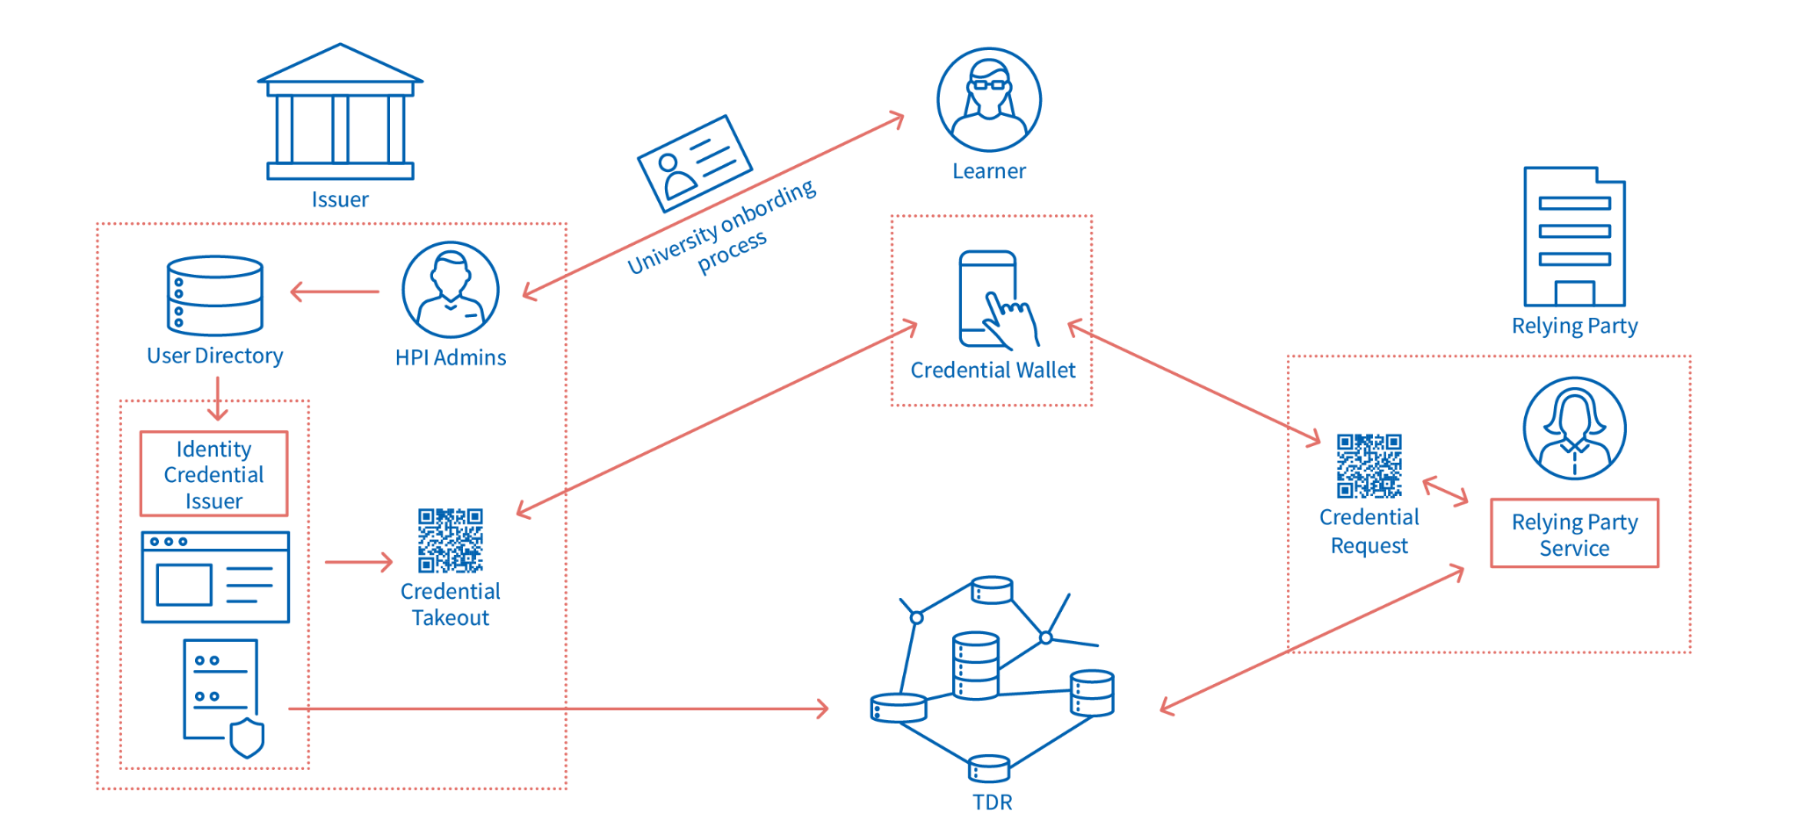
Where do we get (trusted) data from?

Slide 16
Where do we get (trusted) data from?
Use established Single-Sign On
SSO-to-VC Middleware

Slide 17
Where do we get (trusted) data from?

Slide 18
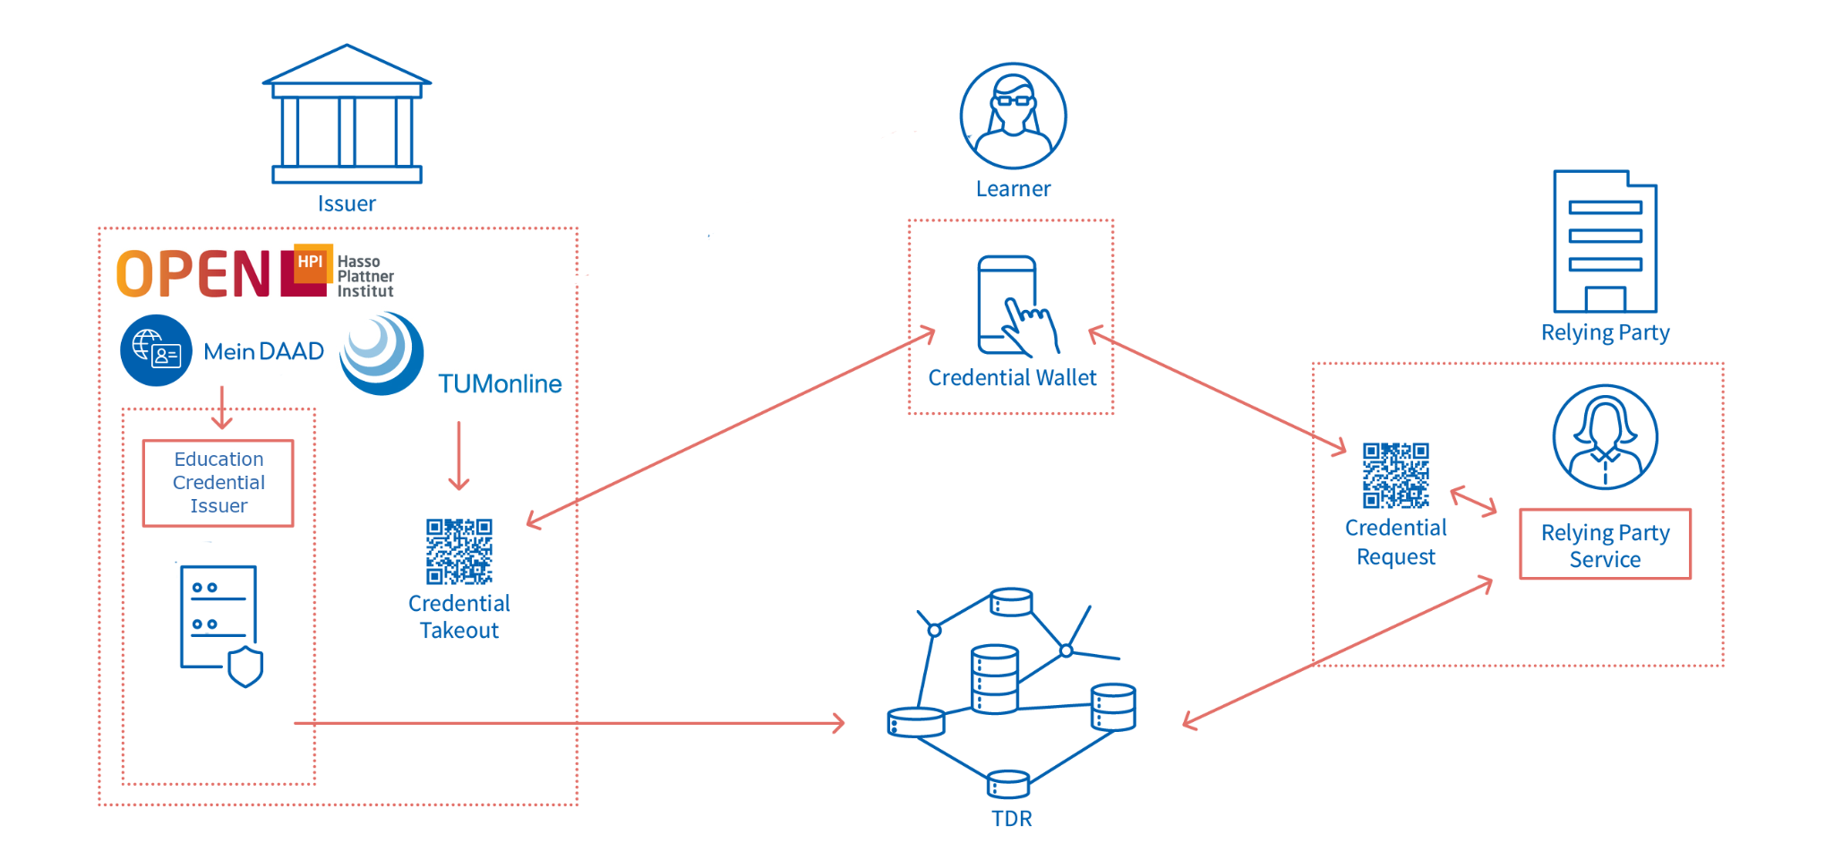
Where do we get (trusted) data from?

Slide 19
Where do we get (trusted) data from?
Use established standards?
x-to-VC Middleware?
Most systems do not expose this information easily
Generalised API for VC Issuance (VC-API)
Integration on a per system basis
openHPI
TUMOnline
{ xAPI }

Slide 20
Where do we get (trusted) data from?
DiBiHo
openHPI
Request a valid authentication token for a user authenticated via OIDC
post /authenticate with uid
Request all enrolled courses for the user
get /my_courses
Request achievements for each course
get /my_courses/{id}/achievements

Slide 21
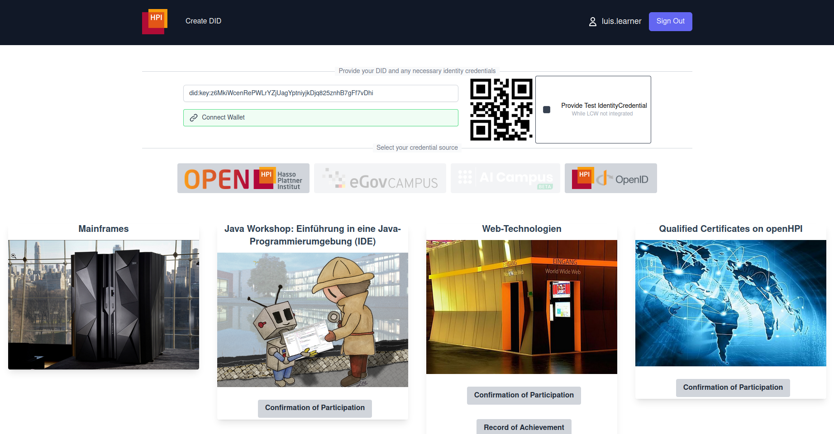
Where do we get (trusted) data from?

Slide 22
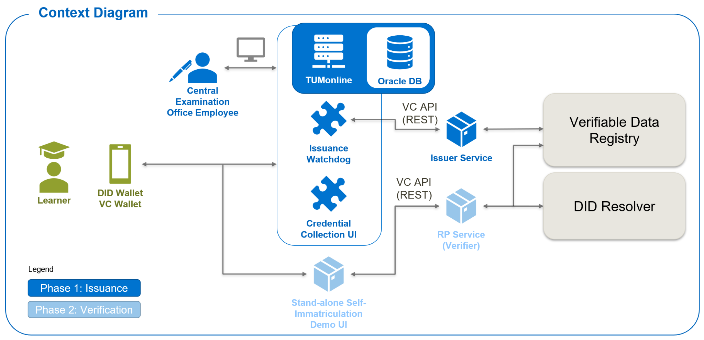
Where do we get (trusted) data from?
Watchdog automatically issues credentials for new degrees every night
Students & Staff use the TUMonline website like they are accustomed to

Slide 23
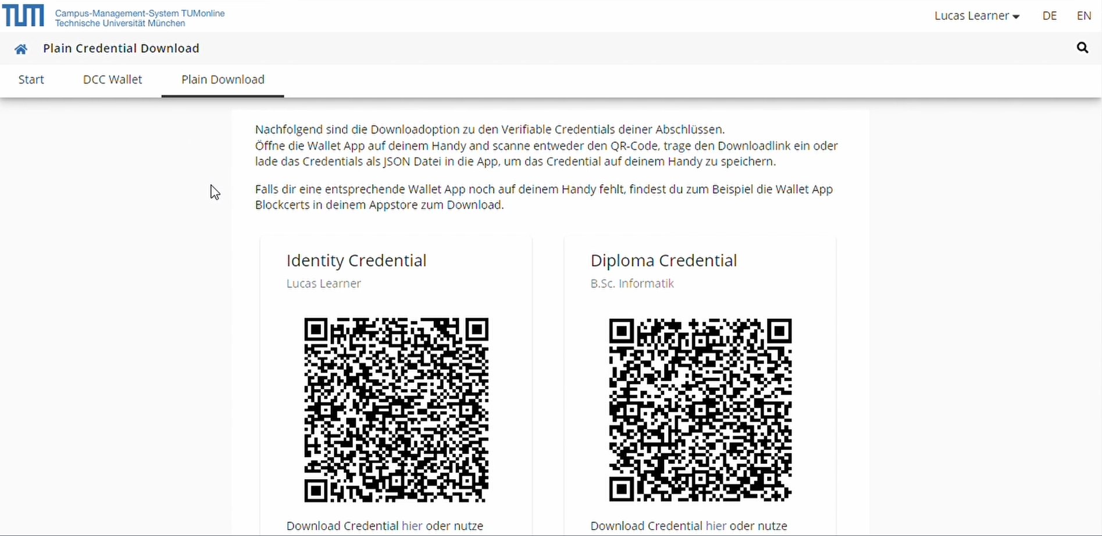
Where do we get (trusted) data from?

Slide 24
What is presented?
Verifiable Presentation (VP) standardised by W3C
Combination of different VCs (i.e. VC_{ident} + VC_{diploma)}
Signed by user to proof control and freshness
Relying Party requests specific set of attributes
Relying Party operates specific trust boundaries
VP

Slide 25
How does the learner interact?
Relying Party Service
DID Wallet
Credential Wallet

Slide 26
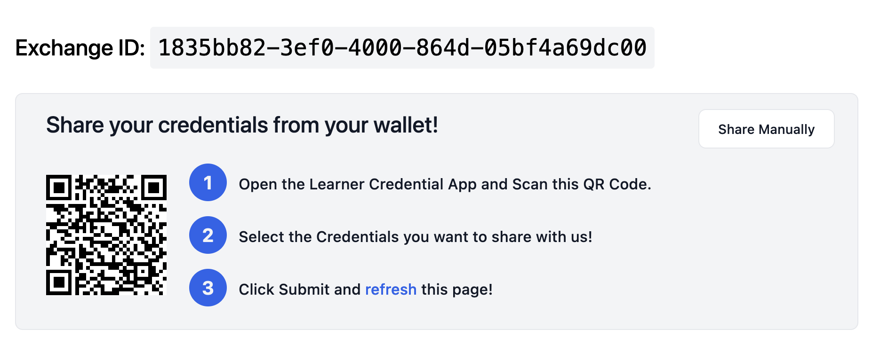
How does the learner interact?
Relying Party Service
DID + Credential Wallet

Slide 27
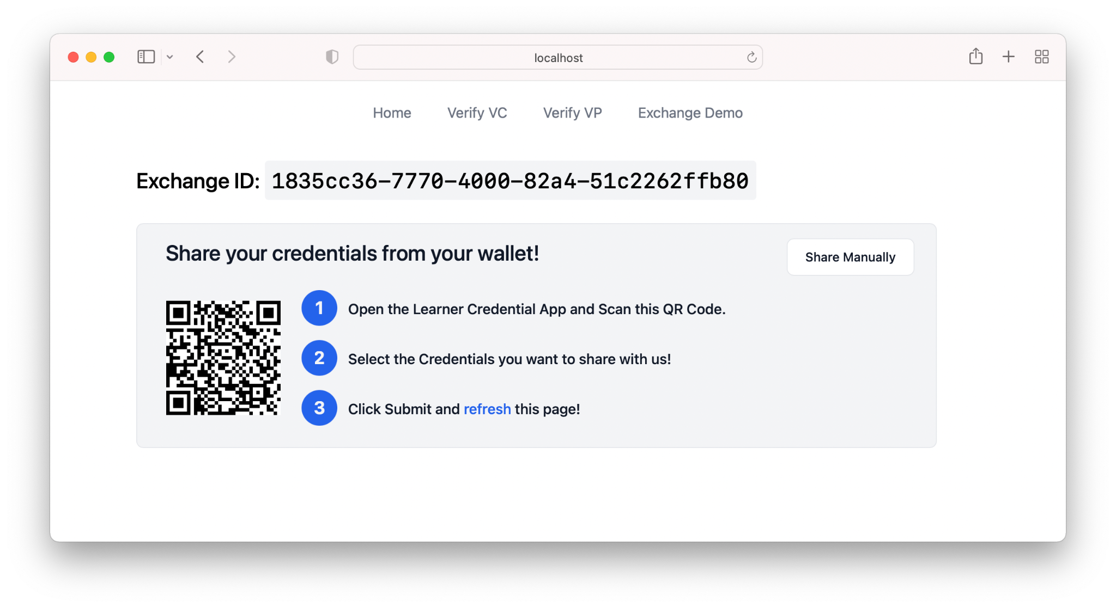
1. Relying Party Application generates QR Code
contains endpoint to Initiate-Exchange-API-Endpoint
includes Exchange ID to associate browser session to wallet
user-specific generated challenge parameter
expected credential types, query description, etc.
submission-endpoint
2. User scans QR Code
3. Wallet calls Initiate-Exchange-API -- Server responds with Presentation Request
4. Wallet guides user through VC selection; creates a VP; sends to submission endpoint
5. Server verifies VP and notifies querying application

Slide 29
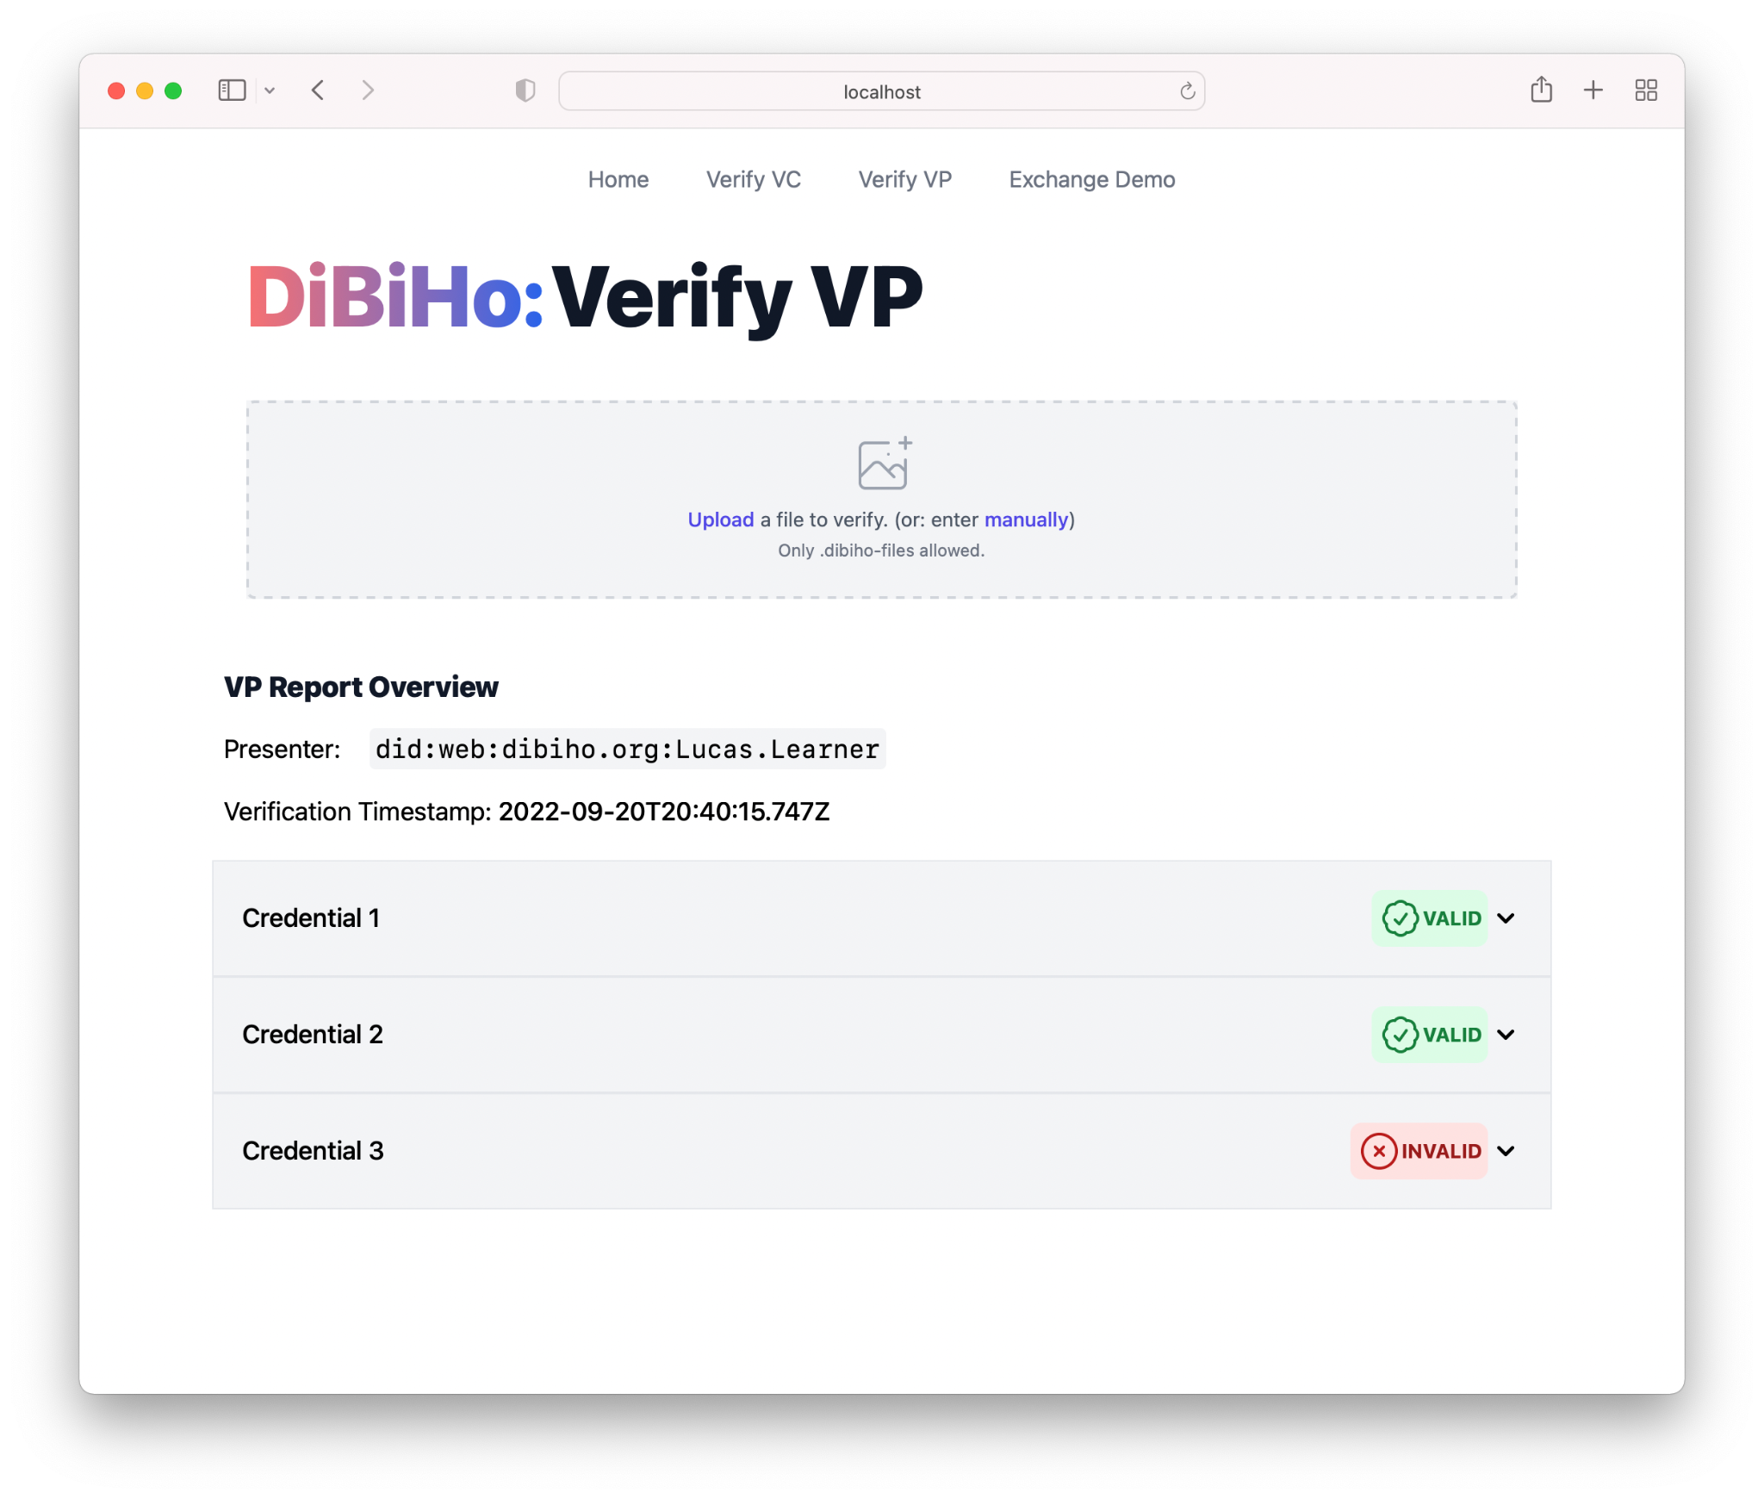
Verification Result Overview
VP Metadata
Credential Verification Results
For all VCs included in the VP.
(can be expanded for more details)

Slide 30
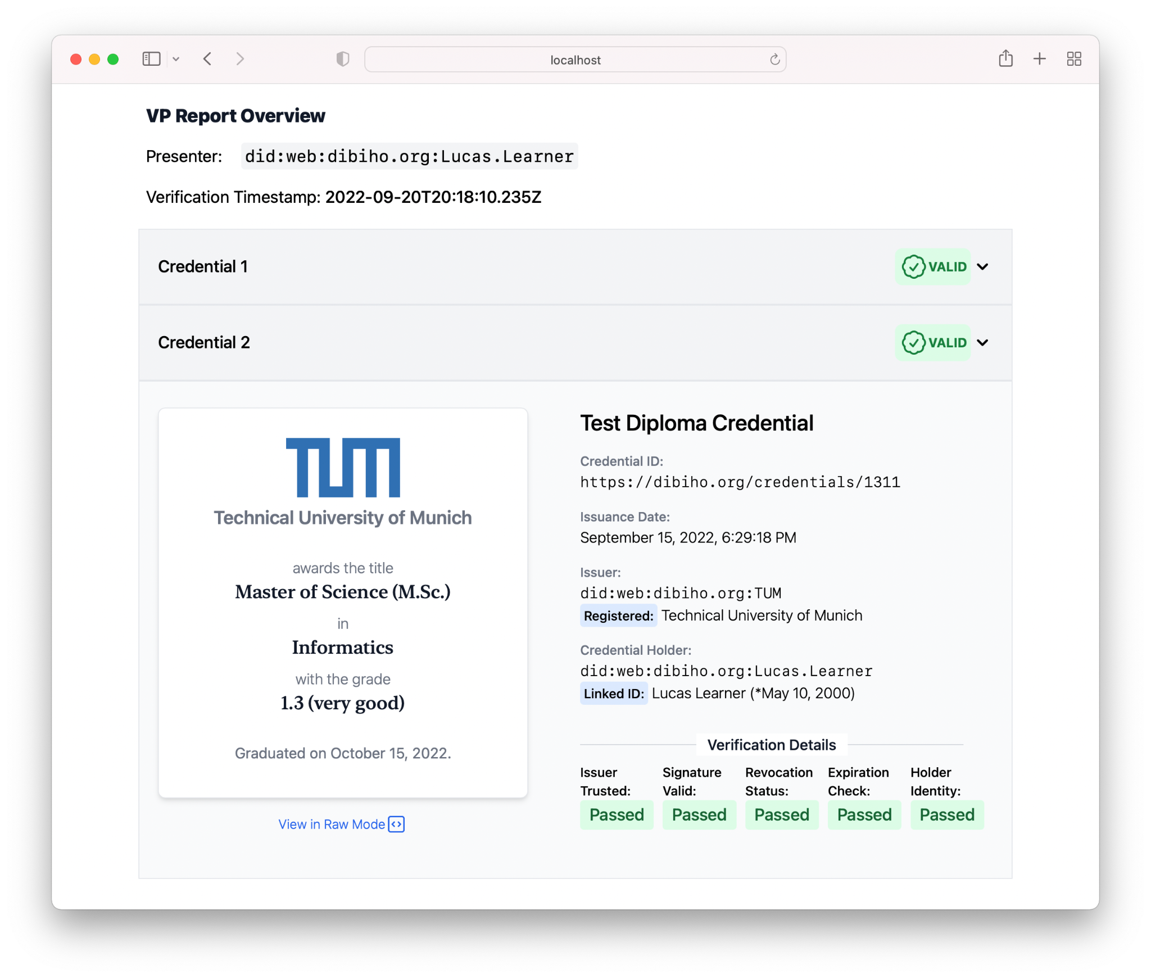
VC Detail View
Verified Issuer Identity
Based on Trusted Issuer Registry
Verified Holder Identity
Based on Identity Credential Check
Verification Results
Narrowed down to credential and check type
Credential Preview Rendering
Dynamic Rendering based on Credential Type

Slide 31
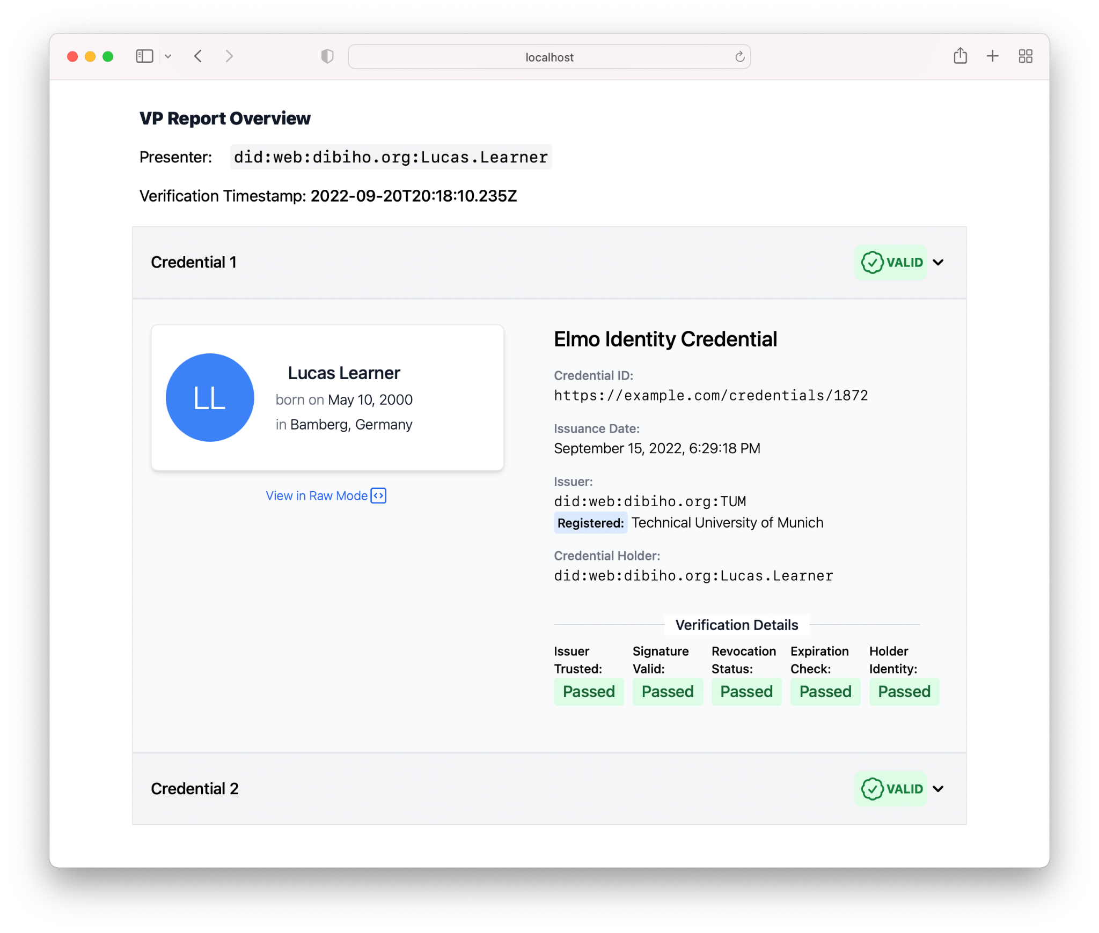
Identity Credential

Slide 32
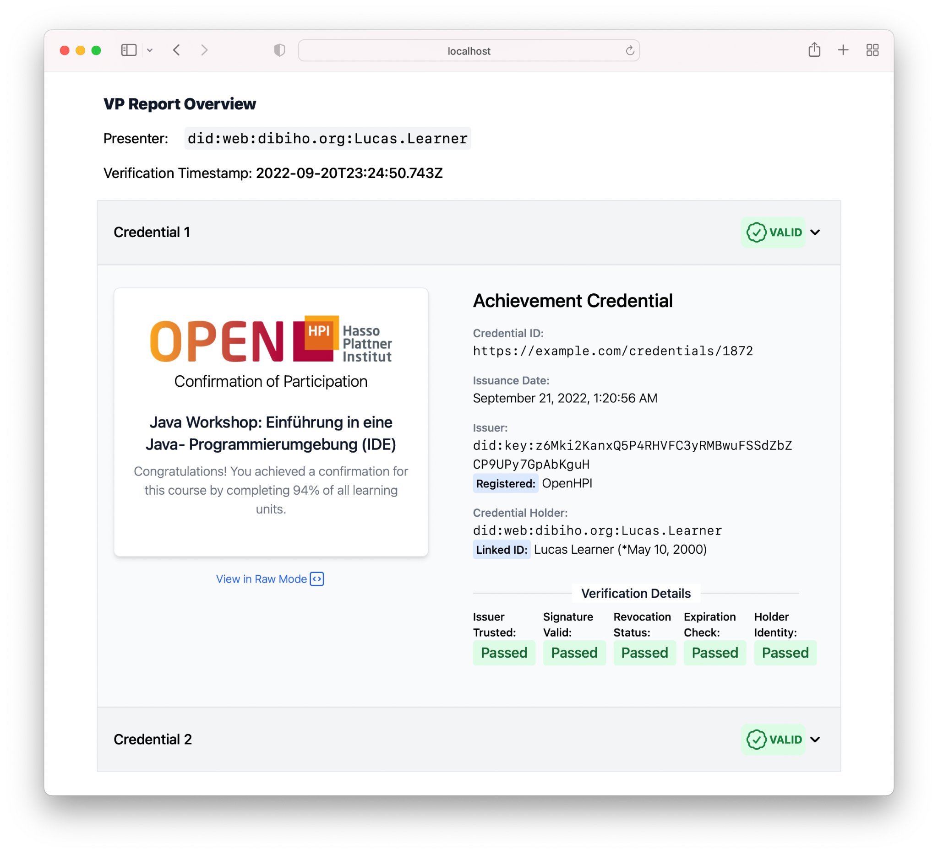
Achievement Credential

Slide 33
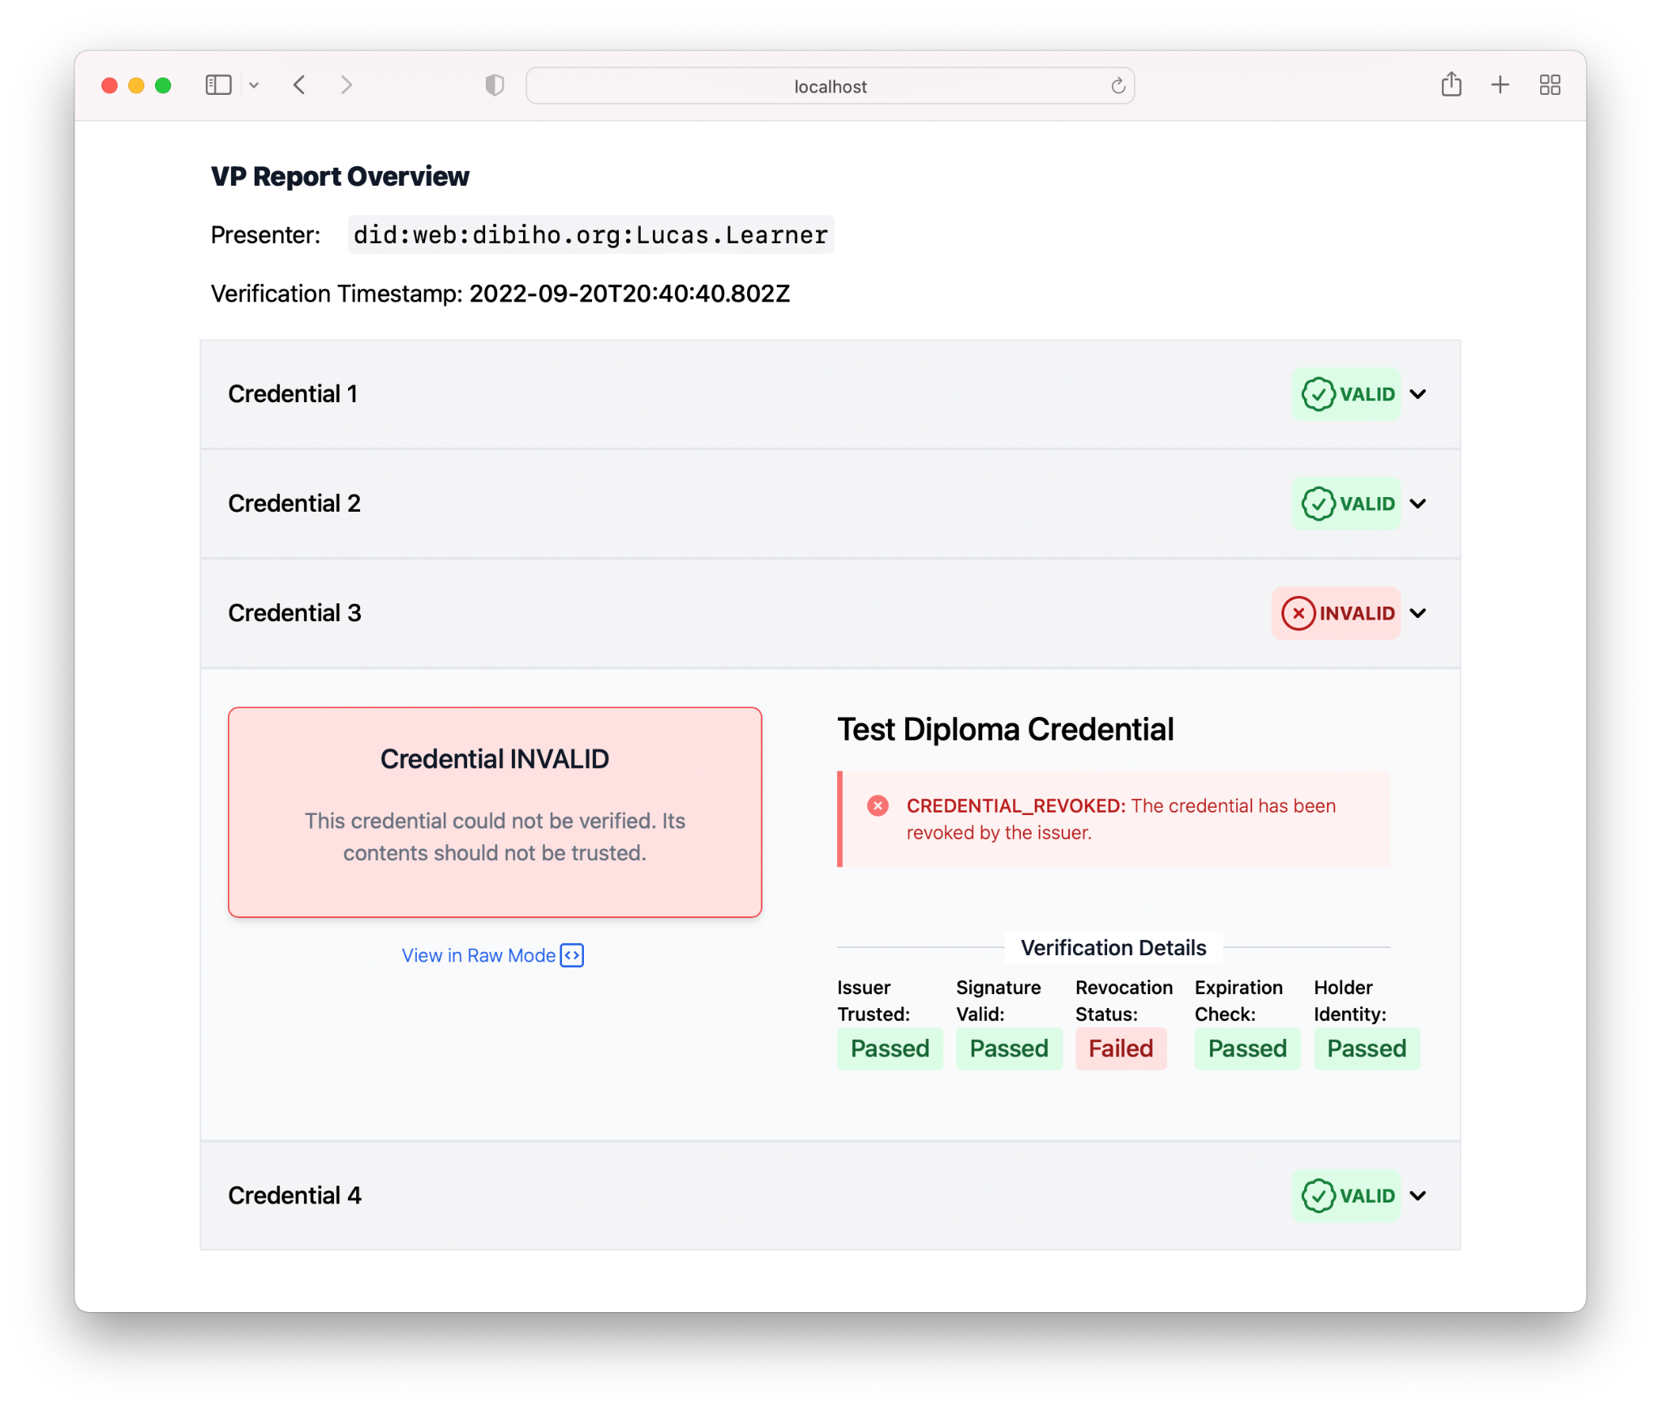
Invalid Credential

Slide 34
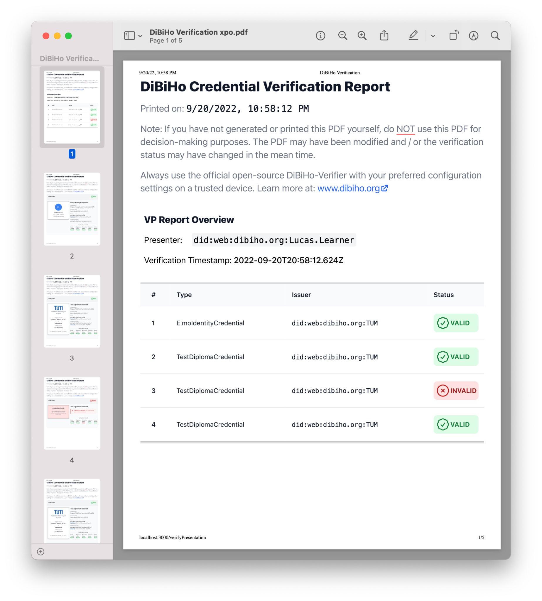
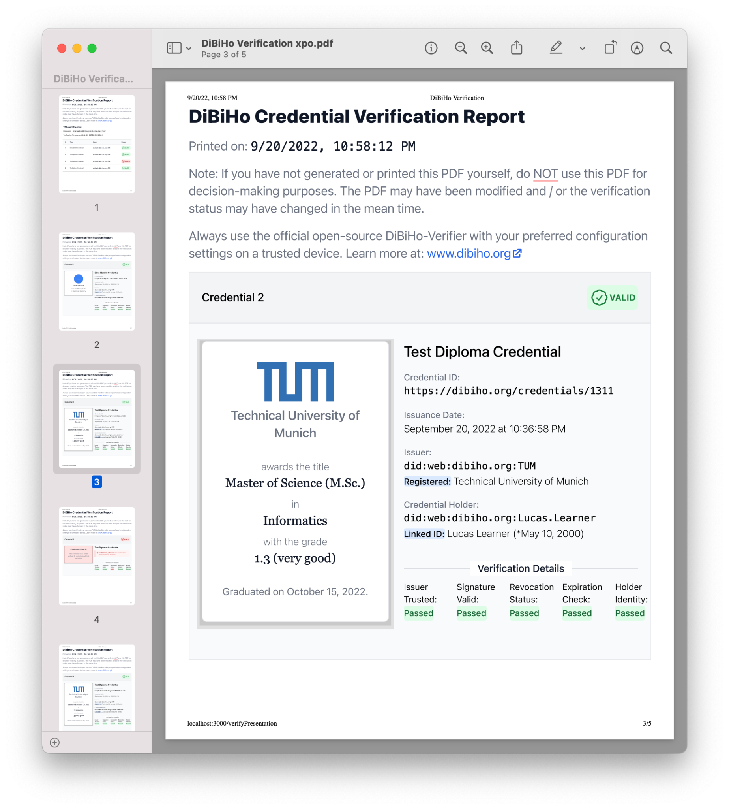
Print / Export - Mode

Slide 35
Thank you for listening
Join our mailing list!
See you in Berlin?

Slide 36
Diploma Credential

Slide 37
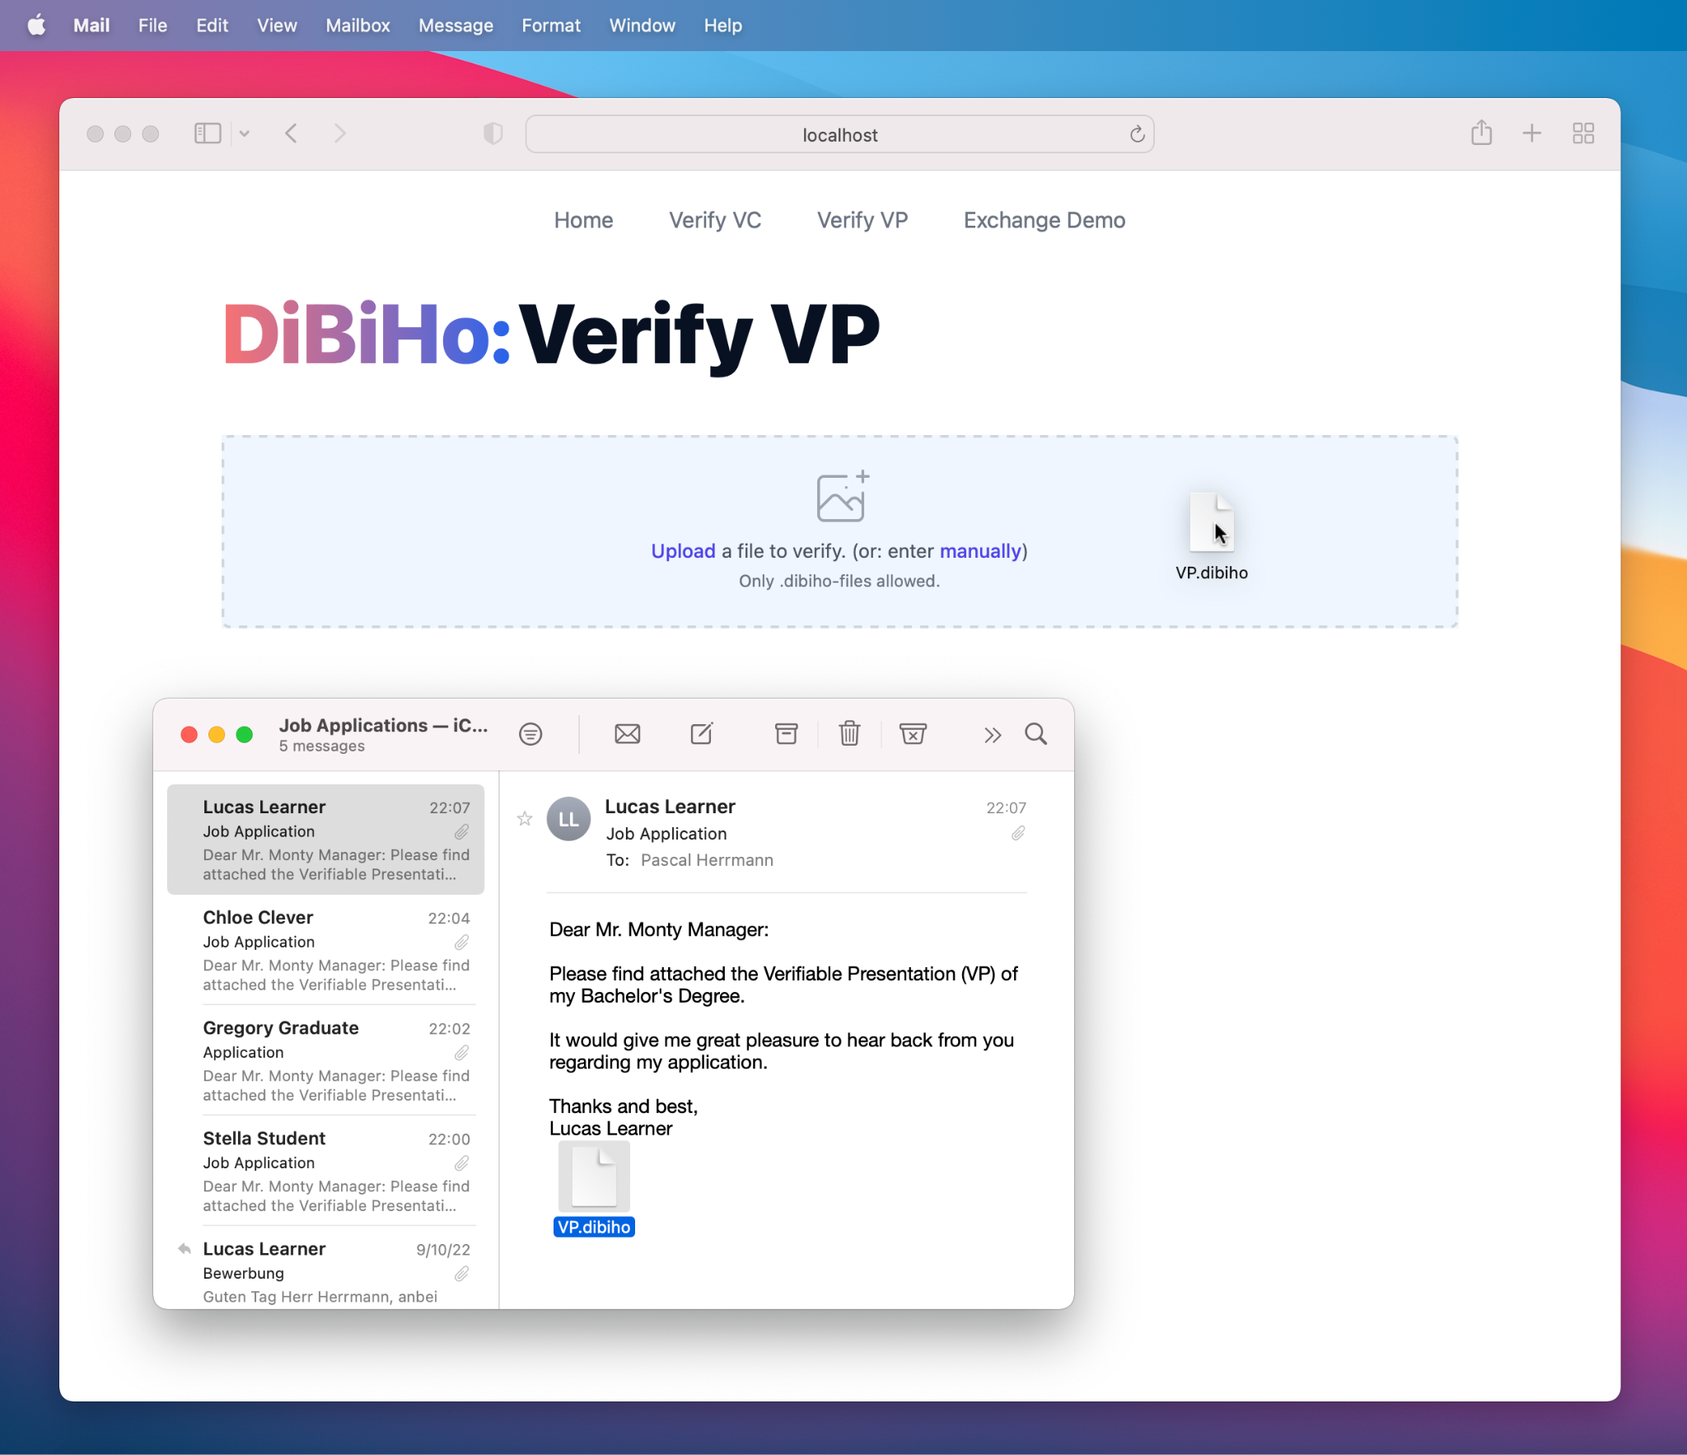
DiBiHo Verifier
VP Input can happen via:
Drag & Drop
Copy & Paste
Exchange API (directly from Wallet)

Slide 38
Project Timeline
Project Kickoff
Dissemination and Stakeholder Concept
User Workshop
Proof of Concept Development
2021
Now
1st International Stakeholder Dialogue
Requirements Engineering
State-of-the-Art Analysis

Slide 41
How are the credentials verified?
The verifier has access to the following data sources:
DID Registries
provide cryptographic keys & metadata
depends on DID-method - currently supported: did:key, did:web, did:ethr, did:iota
Verifiable Credential(s)
credential(s) to be verified
wrapped inside of a VP
provided by presenter
(e.g. per email or via API)
Verifiable Presentation
contains metadata
and proof signed by presenter
Presentation
resolved (e.g. web or distributed ledger)
Verifiable Data Registry
provides revocation information
Proof
Verifier
Relying Party’s DB
contains exchange transactions and challenge parameters
DB
on Relying Party’s side
Trusted Issuer Registry
servers as Trust Anchor to identify issuer

Slide 42
What checks are evaluated?
Checks on Credential Level
Are evaluated for every credential in a VP to determine whether the individual VC is valid.
Checks on Presentation Level
Are evaluated on the VP metadata to determine if the presentation of the credentials is valid.
DID Registry
Credential Signature Check
VP Signature Check
Trusted Issuer
Registry
Trusted Issuer Check
Presentation
Challenge Check
Submitted VC(s)
Challenge
DB
Credential Status Check
Verifiable Data Registry
Expiration Check
Holder Identity Check

Slide 43
Credential Status - Implementation
The issuer can configure which database they use to store credential status information.
StatusListCredential is resolved via DID Service Endpoint
Signed StatusListCredential
different issuers and infrastructure have different requirements
currently based on StatusList2021
ethereum: → data held in an Ethereum Smart Contract
web: → signed credential directly accessible
others: flexible like did:methods

Slide 44
Trusted Issuer Registry - Implementation
The relying party can configure which Trusted Issuer Registries they use as trust anchor.
Multiple registry resolution methods are supported
ethereum: → registry is based on an Ethereum Smart Contract
web: → registry is wrapped into a signed VC to prevent man-in-the-middle attacks
a registry can link to sub-endorsed registries, allowing for hierarchical structuring & administration
different relying parties might require different trust levels
the HEI landscape is complex - different registries can exist for different regions, HIE types, etc.
contract needs to implement an interface, implementation up to registry. e.g., can implement voting mechanism to register new entries - or simple onlyOwner modifier
Top Level Registry
e.g. DCC maintained
Sub-Endorsed Registry
e.g. National Association
…
Sub-Endorsed Registry
e.g. Germany TU9

Slide 45
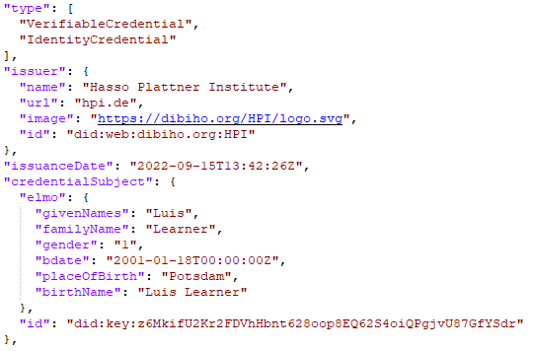
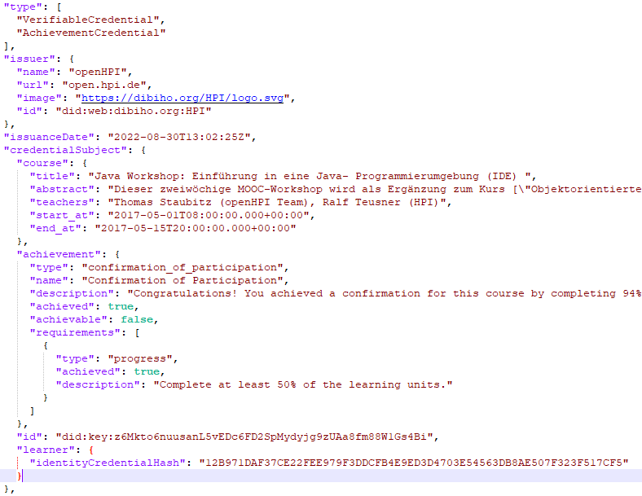
What do we issue?

